Slide 1
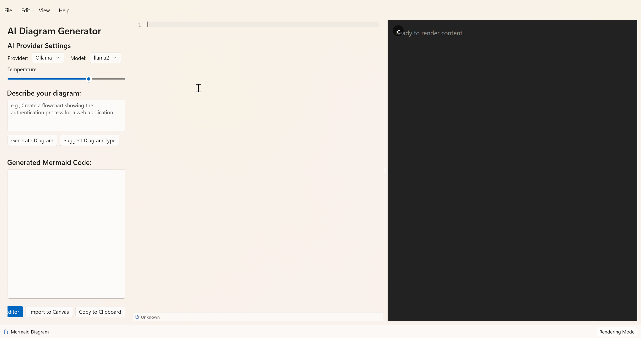
Move this into the floating text box. Add a button that allows me to spawn a dialog that allows me to specify the relevant configuration for the different providers. Save the config into a config file.
Change this to become a floating text box
This entire left panel is not required. Use the floating box
I don’t need this panel, we can use back the panel that is already exist, which is behind this text box.
Floating text box

