Slide 1
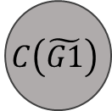
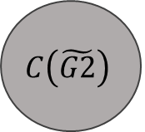
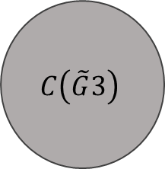
$$C\left(\tilde{G1}\right)$$
$$C\left(\tilde{G2}\right)$$
$$C\left(\tilde{G}3\right)$$
2
2
1

