Slide 1
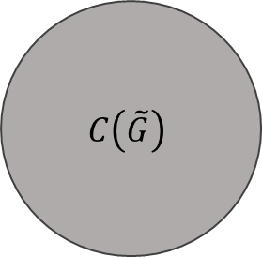
$$C\left(\tilde{G}\right)$$
1
1
2

