Slide 1
碩一睡眠判讀報告
2022/02/10

Slide 2
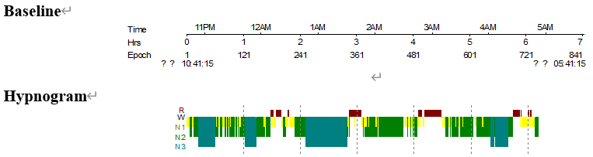
選用的睡眠資料
I016 20191018_徐O文

Slide 3
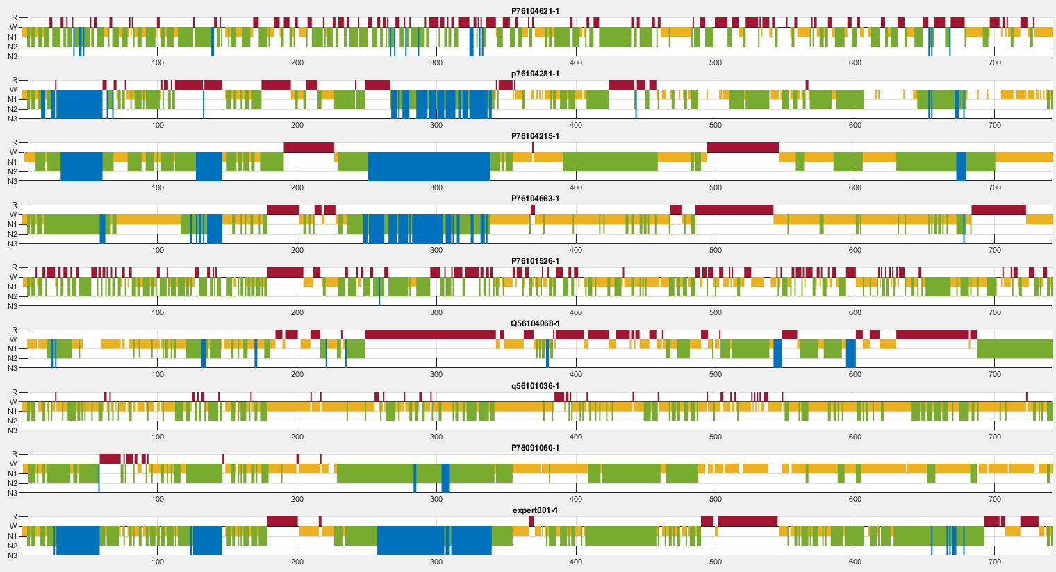
Hypnogram總覽

Slide 4
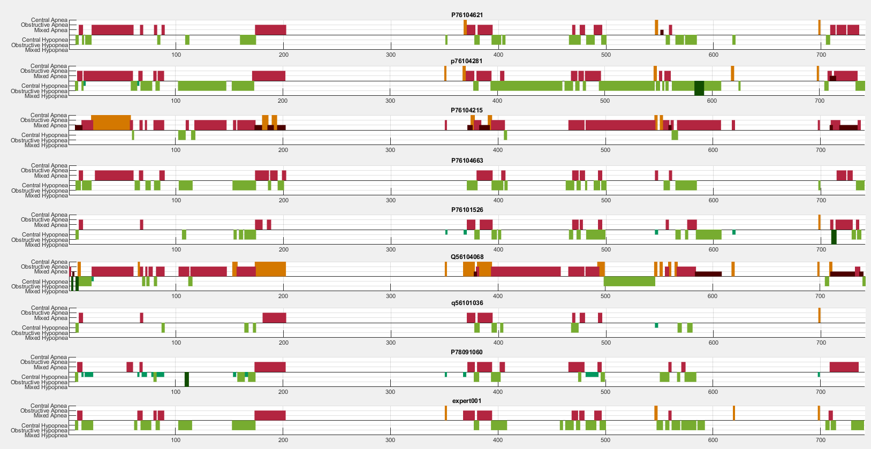

Slide 5
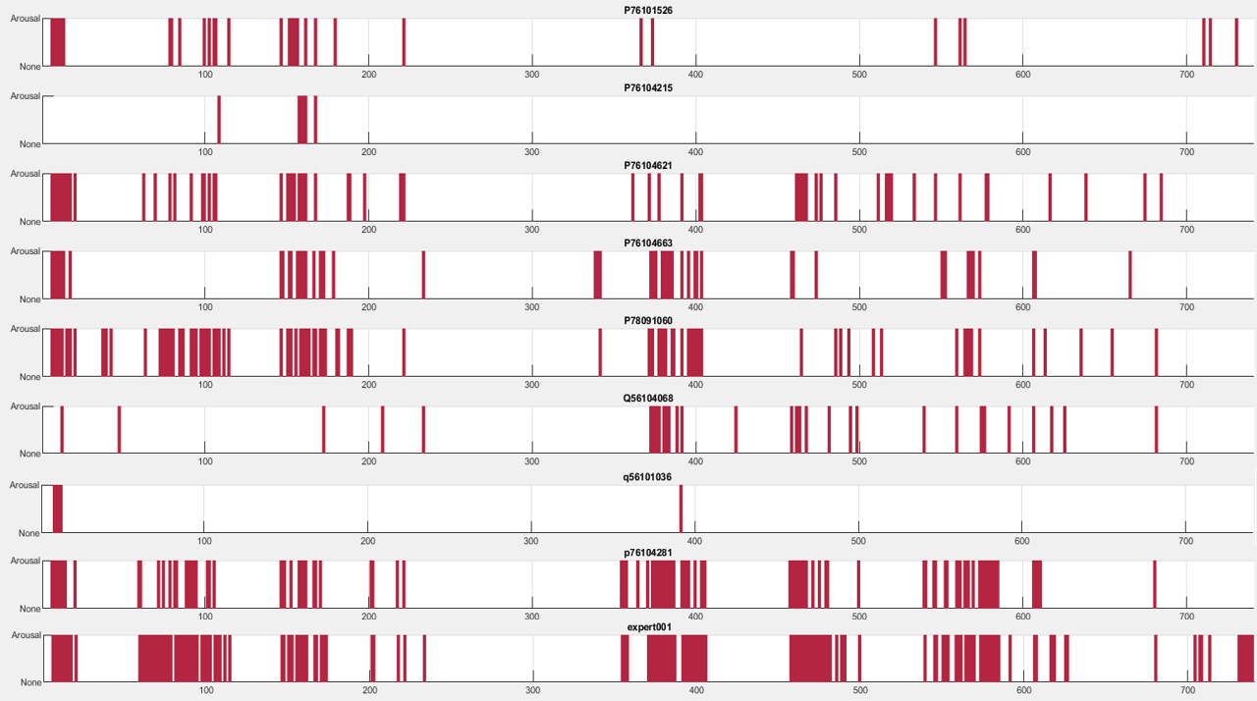

Slide 6
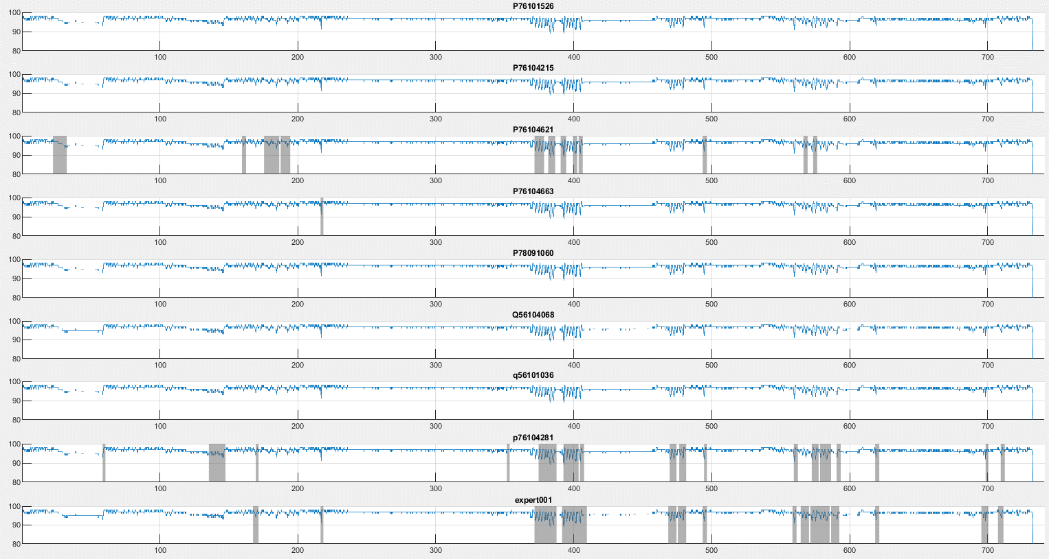

Slide 7
Stage Agreement P76104621
 | 專家答案
您的判讀 |  | WAKE | N1 | N2 | N3 | REM
 | WAKE | 55.6% | 3.5% | 0.6% | 0% | 0%
 | N1 | 33.3% | 50% | 18% | 0% | 17.9%
 | N2 | 7.4% | 33.3% | 56.3% | 48.9% | 27.4%
 | N3 | 0% | 0% | 0.3% | 12.1% | 0%
 | REM | 3.7% | 13.2% | 24.8% | 39% | 54.7%
整體一致性：46.4%

Slide 8
Event Agreement P76104621
 | 專家答案
您的判讀 | % | None | CA | OA | MA | CH | OH | MH
 | None | 89.2 | 0 | 3.1 | Null | Null | 31.6 | Null
 | CA | 0 | 55.6 | 3.1 | Null | Null | 0.6 | Null
 | OA | 10.4 | 0 | 86.7 | Null | Null | 17.5 | Null
 | MA | 0 | 0 | 0 | Null | Null | 1.7 | Null
 | CH | 0 | 0 | 0 | Null | Null | 0 | Null
 | OH | 0.4 | 44.4 | 19.4 | Null | Null | 55.4 | Null
 | MH | 0 | 0 | 0 | Null | Null | 0 | Null
CA：Central Apnea
OA：Obstructive Apnea
MA：Mixed Apnea
CH：Central Hypopnea
OH：Obstructive Hypopnea
MH：Mixed Hypopnea
整體一致性：80.7%

Slide 9
Arousal、SpO2 Agreement P76104621
Arousal一致性
SpO2 Desat一致性
 | 專家答案
您的判讀 | % | None | Arousal
 | None | 95 | 65.5
 | Arousal | 5 | 34.5
 | 專家答案
您的判讀 | % | None | Desat
 | None | 95 | 68.8
 | Desat | 5 | 31.3
Arousal整體一致性：75.6%
SpO2 Desat整體一致性：86.8%

Slide 10
Stage Agreement P76104281
 | 專家答案
您的判讀 |  | WAKE | N1 | N2 | N3 | REM
 | WAKE | 77.8% | 15.3% | 12.1% | 0% | 22.6%
 | N1 | 18.5% | 50.7% | 9% | 0% | 31.1%
 | N2 | 0% | 25.7% | 51.1% | 14.2% | 30.2%
 | N3 | 0% | 0% | 4.3% | 64.5% | 0%
 | REM | 3.7% | 8.3% | 23.5% | 21.3% | 16%
整體一致性：49.5%

Slide 11
Event Agreement P76104281
 | 專家答案
您的判讀 | % | None | CA | OA | MA | CH | OH | MH
 | None | 57.8 | 0 | 0 | Null | Null | 0.6 | Null
 | CA | 0.2 | 100 | 3.1 | Null | Null | 0.6 | Null
 | OA | 10.6 | 0 | 95.9 | Null | Null | 35 | Null
 | MA | 0.2 | 0 | 2 | Null | Null | 2.8 | Null
 | CH | 0 | 0 | 3.1 | Null | Null | 3.4 | Null
 | OH | 31.7 | 22.2 | 21.4 | Null | Null | 78.5 | Null
 | MH | 0.2 | 0 | 0 | Null | Null | 4.5 | Null
CA：Central Apnea
OA：Obstructive Apnea
MA：Mixed Apnea
CH：Central Hypopnea
OH：Obstructive Hypopnea
MH：Mixed Hypopnea
整體一致性：67.9%

Slide 12
Arousal、SpO2 Agreement P76104281
Arousal一致性
SpO2 Desat一致性
 | 專家答案
您的判讀 | % | None | Arousal
 | None | 98.6 | 36.6
 | Arousal | 1.4 | 63.4
 | 專家答案
您的判讀 | % | None | Desat
 | None | 96.9 | 33.3
 | Desat | 3.1 | 66.7
Arousal整體一致性：87.3%
SpO2 Desat整體一致性：93%

Slide 13
Stage Agreement P76104215
 | 專家答案
您的判讀 |  | WAKE | N1 | N2 | N3 | REM
 | WAKE | 7.4% | 1.4% | 0% | 0% | 0%
 | N1 | 77.8% | 61.1% | 22% | 0% | 23.6%
 | N2 | 3.7% | 20.1% | 72.8% | 9.9% | 18.9%
 | N3 | 0% | 0% | 5.3% | 90.1% | 0%
 | REM | 11.1% | 17.4% | 0% | 0% | 57.5%
整體一致性：69.2%

Slide 14
Event Agreement P76104215
 | 專家答案
您的判讀 | % | None | CA | OA | MA | CH | OH | MH
 | None | 69.2 | 0 | 7.1 | Null | Null | 15.8 | Null
 | CA | 7.2 | 33.3 | 19.4 | Null | Null | 4.5 | Null
 | OA | 21.1 | 77.8 | 42.9 | Null | Null | 69.5 | Null
 | MA | 2.3 | 0 | 48 | Null | Null | 7.9 | Null
 | CH | 0 | 0 | 0 | Null | Null | 0 | Null
 | OH | 1 | 0 | 0 | Null | Null | 9.6 | Null
 | MH | 0 | 0 | 0 | Null | Null | 0 | Null
CA：Central Apnea
OA：Obstructive Apnea
MA：Mixed Apnea
CH：Central Hypopnea
OH：Obstructive Hypopnea
MH：Mixed Hypopnea
整體一致性：51.6%

Slide 15
Arousal、SpO2 Agreement P76104215
Arousal一致性
SpO2 Desat一致性
 | 專家答案
您的判讀 | % | None | Arousal
 | None | 100 | 95.8
 | Arousal | 0 | 4.2
 | 專家答案
您的判讀 | % | None | Desat
 | None | 100 | 100
 | Desat | 0 | 0
Arousal整體一致性：69.2%
SpO2 Desat整體一致性：87%

Slide 16
Stage Agreement P76104663
 | 專家答案
您的判讀 |  | WAKE | N1 | N2 | N3 | REM
 | WAKE | 7.4% | 0% | 0% | 0% | 0%
 | N1 | 70.4% | 72.9% | 62.2% | 3.5% | 11.3%
 | N2 | 3.7% | 8.3% | 28.2% | 46.8% | 0.9%
 | N3 | 0% | 0% | 4.3% | 49.6% | 0%
 | REM | 18.5% | 18.8% | 5.3% | 0% | 87.7%
整體一致性：48.7%

Slide 17
Event Agreement P76104663
 | 專家答案
您的判讀 | % | None | CA | OA | MA | CH | OH | MH
 | None | 89 | 44.4 | 7.1 | Null | Null | 23.2 | Null
 | CA | 0 | 0 | 0 | Null | Null | 0 | Null
 | OA | 10.1 | 33.3 | 70.4 | Null | Null | 13 | Null
 | MA | 0 | 0 | 0 | Null | Null | 0 | Null
 | CH | 0 | 0 | 0 | Null | Null | 0 | Null
 | OH | 0.8 | 22.2 | 42.9 | Null | Null | 72.3 | Null
 | MH | 0 | 0 | 0 | Null | Null | 0 | Null
CA：Central Apnea
OA：Obstructive Apnea
MA：Mixed Apnea
CH：Central Hypopnea
OH：Obstructive Hypopnea
MH：Mixed Hypopnea
整體一致性：81.7%

Slide 18
Arousal、SpO2 Agreement P76104663
Arousal一致性
SpO2 Desat一致性
 | 專家答案
您的判讀 | % | None | Arousal
 | None | 98.2 | 69.3
 | Arousal | 1.8 | 30.7
 | 專家答案
您的判讀 | % | None | Desat
 | None | 100 | 97.9
 | Desat | 0 | 2.1
Arousal整體一致性：76.5%
SpO2 Desat整體一致性：87.3%

Slide 19
Stage Agreement P76104526
 | 專家答案
您的判讀 |  | WAKE | N1 | N2 | N3 | REM
 | WAKE | 37% | 4.2% | 1.5% | 0.7% | 7.5%
 | N1 | 40.7% | 38.2% | 31.9% | 6.4% | 34%
 | N2 | 14.8% | 27.1% | 47.1% | 54.6% | 15.1%
 | N3 | 0% | 0% | 0% | 0.7% | 0%
 | REM | 7.4% | 30.6% | 19.5% | 37.6% | 43.4%
整體一致性：35.6%

Slide 20
Event Agreement P76104526
 | 專家答案
您的判讀 | % | None | CA | OA | MA | CH | OH | MH
 | None | 93.6 | 0 | 35.7 | Null | Null | 40.1 | Null
 | CA | 0 | 22.2 | 0 | Null | Null | 0 | Null
 | OA | 2.9 | 0 | 55.1 | Null | Null | 18.1 | Null
 | MA | 0 | 0 | 0 | Null | Null | 0 | Null
 | CH | 0.2 | 77.8 | 3.1 | Null | Null | 0.6 | Null
 | OH | 3.3 | 0 | 17.3 | Null | Null | 48 | Null
 | MH | 0 | 0 | 2 | Null | Null | 2.8 | Null
CA：Central Apnea
OA：Obstructive Apnea
MA：Mixed Apnea
CH：Central Hypopnea
OH：Obstructive Hypopnea
MH：Mixed Hypopnea
整體一致性：77.3%

Slide 21
Arousal、SpO2 Agreement P76104526
Arousal一致性
SpO2 Desat一致性
 | 專家答案
您的判讀 | % | None | Arousal
 | None | 98 | 80.7
 | Arousal | 2 | 19.3
 | 專家答案
您的判讀 | % | None | Desat
 | None | 100 | 100
 | Desat | 0 | 0
Arousal整體一致性：72.7%
SpO2 Desat整體一致性：87%

Slide 22
Stage Agreement Q56104068
 | 專家答案
您的判讀 |  | WAKE | N1 | N2 | N3 | REM
 | WAKE | 33.3% | 4.9% | 0.3% | 8.5% | 0%
 | N1 | 37% | 45.8% | 34.1% | 6.4% | 13.2%
 | N2 | 18.5% | 27.1% | 21.7% | 21.3% | 61.3%
 | N3 | 3.7% | 2.8% | 4.3% | 2.1% | 2.8%
 | REM | 7.4% | 19.4% | 39.6% | 61.7% | 22.6%
整體一致性：23.3%

Slide 23
Event Agreement Q56104068
 | 專家答案
您的判讀 | % | None | CA | OA | MA | CH | OH | MH
 | None | 58 | 0 | 0 | Null | Null | 7.3 | Null
 | CA | 0.2 | 100 | 70.4 | Null | Null | 14.7 | Null
 | OA | 25.3 | 0 | 31.6 | Null | Null | 60.5 | Null
 | MA | 6.8 | 0 | 3.1 | Null | Null | 13.6 | Null
 | CH | 0 | 0 | 0 | Null | Null | 1.7 | Null
 | OH | 9.5 | 11.1 | 9.2 | Null | Null | 15.3 | Null
 | MH | 0.4 | 0 | 1 | Null | Null | 1.7 | Null
CA：Central Apnea
OA：Obstructive Apnea
MA：Mixed Apnea
CH：Central Hypopnea
OH：Obstructive Hypopnea
MH：Mixed Hypopnea
整體一致性：45.2%

Slide 24
Arousal、SpO2 Agreement Q56104068
Arousal一致性
SpO2 Desat一致性
 | 專家答案
您的判讀 | % | None | Arousal
 | None | 97.6 | 79.8
 | Arousal | 2.4 | 20.2
 | 專家答案
您的判讀 | % | None | Desat
 | None | 100 | 100
 | Desat | 0 | 0
Arousal整體一致性：72.7%
SpO2 Desat整體一致性：87%

Slide 25
Stage Agreement Q56101036
 | 專家答案
您的判讀 |  | WAKE | N1 | N2 | N3 | REM
 | WAKE | 22.2% | 5.6% | 1.2% | 0% | 0%
 | N1 | 51.9% | 76.4% | 57.9% | 43.3% | 84%
 | N2 | 25.9% | 11.8% | 36.5% | 48.9% | 2.8%
 | N3 | 0% | 0% | 0% | 0% | 0%
 | REM | 0% | 6.3% | 4.3% | 7.8% | 13.2%
整體一致性：33.5%

Slide 26
Event Agreement Q56101036
 | 專家答案
您的判讀 |  | None | CA | OA | MA | CH | OH | MH
 | None | 99.8 | 44.4 | 27.6 | Null | Null | 75.7 | Null
 | CA | 0 | 22.2 | 0 | Null | Null | 0 | Null
 | OA | 0 | 0 | 64.3 | Null | Null | 6.8 | Null
 | MA | 0 | 0 | 0 | Null | Null | 0 | Null
 | CH | 0 | 33.3 | 0 | Null | Null | 0.6 | Null
 | OH | 0.2 | 0 | 15.3 | Null | Null | 20.3 | Null
 | MH | 0 | 0 | 0 | Null | Null | 0 | Null
CA：Central Apnea
OA：Obstructive Apnea
MA：Mixed Apnea
CH：Central Hypopnea
OH：Obstructive Hypopnea
MH：Mixed Hypopnea
整體一致性：76%

Slide 27
Arousal、SpO2 Agreement Q56101036
Arousal一致性
SpO2 Desat一致性
 | 專家答案
您的判讀 | % | None | Arousal
 | None | 100 | 96.6
 | Arousal | 0 | 3.4
 | 專家答案
您的判讀 | % | None | Desat
 | None | 100 | 100
 | Desat | 0 | 0
Arousal整體一致性：69%
SpO2 Desat整體一致性：87%

Slide 28
Stage Agreement P78091060
 | 專家答案
您的判讀 |  | WAKE | N1 | N2 | N3 | REM
 | WAKE | 25.9% | 6.9% | 0.6% | 0% | 16%
 | N1 | 40.7% | 73.6% | 43% | 6.4% | 80.2%
 | N2 | 18.5% | 13.9% | 50.8% | 87.9% | 1.9%
 | N3 | 0% | 0% | 0.3% | 5.7% | 0%
 | REM | 14.8% | 5.6% | 5.3% | 0% | 1.9%
整體一致性：38.7%

Slide 29
Event Agreement P78091060
 | 專家答案
您的判讀 |  | None | CA | OA | MA | CH | OH | MH
 | None | 95 | 55.6 | 2 | Null | Null | 29.4 | Null
 | CA | 0 | 0 | 0 | Null | Null | 0 | Null
 | OA | 4.1 | 0 | 80.6 | Null | Null | 23.7 | Null
 | MA | 0 | 0 | 0 | Null | Null | 0 | Null
 | CH | 0.4 | 44.4 | 17.3 | Null | Null | 19.8 | Null
 | OH | 0.4 | 0 | 13.3 | Null | Null | 33.3 | Null
 | MH | 0 | 0 | 0 | Null | Null | 2.3 | Null
CA：Central Apnea
OA：Obstructive Apnea
MA：Mixed Apnea
CH：Central Hypopnea
OH：Obstructive Hypopnea
MH：Mixed Hypopnea
整體一致性：77.8%

Slide 30
Arousal、SpO2 Agreement P78091060
Arousal一致性
SpO2 Desat一致性
 | 專家答案
您的判讀 | % | None | Arousal
 | None | 93.8 | 50.8
 | Arousal | 6.2 | 49.2
 | 專家答案
您的判讀 | % | None | Desat
 | None | 100 | 100
 | Desat | 0 | 0
Arousal整體一致性：79.5%
SpO2 Desat整體一致性：87%

