Slide 1
碩一睡眠判讀報告
2022/02/10

Slide 2
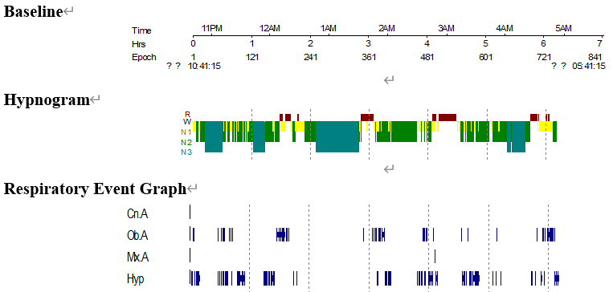
睡眠資料
I016 20191018_徐O文

Slide 3
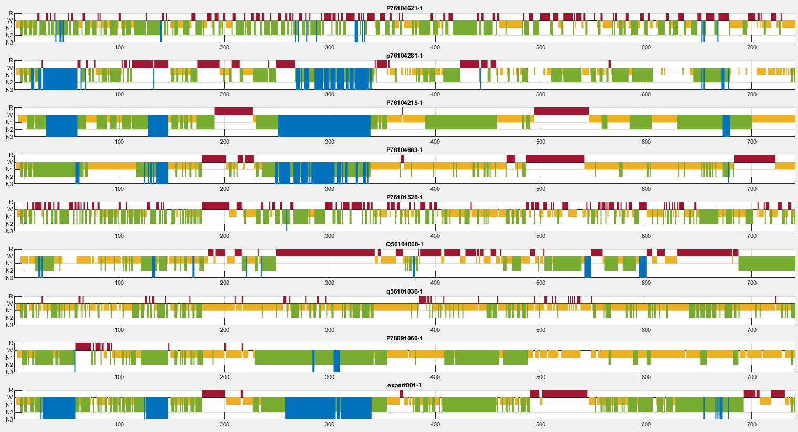
Hypnogram總覽

Slide 4
Stage Agreement P76104621
 | 專家答案
您的判讀 |  | WAKE | N1 | N2 | N3 | REM
 | WAKE | 55.6% | 3.5% | 0.6% | 0% | 0%
 | N1 | 33.3% | 50% | 18% | 0% | 17.9%
 | N2 | 7.4% | 33.3% | 56.3% | 48.9% | 27.4%
 | N3 | 0% | 0% | 0.3% | 12.1% | 0%
 | REM | 3.7% | 13.2% | 24.8% | 39% | 54.7%
整體一致性：46.4%

Slide 5
Event Agreement P76104621

Slide 6
Arousal、SpO2 Agreement P76104621

Slide 7
Stage Agreement P76104281
 | 專家答案
您的判讀 |  | WAKE | N1 | N2 | N3 | REM
 | WAKE | 77.8% | 15.3% | 12.1% | 0% | 22.6%
 | N1 | 18.5% | 50.7% | 9% | 0% | 31.1%
 | N2 | 0% | 25.7% | 51.1% | 14.2% | 30.2%
 | N3 | 0% | 0% | 4.3% | 64.5% | 0%
 | REM | 3.7% | 8.3% | 23.5% | 21.3% | 16%
整體一致性：49.5%

Slide 8
Stage Agreement P76104215
 | 專家答案
您的判讀 |  | WAKE | N1 | N2 | N3 | REM
 | WAKE | 7.4% | 1.4% | 0% | 0% | 0%
 | N1 | 77.8% | 61.1% | 22% | 0% | 23.6%
 | N2 | 3.7% | 20.1% | 72.8% | 9.9% | 18.9%
 | N3 | 0% | 0% | 5.3% | 90.1% | 0%
 | REM | 11.1% | 17.4% | 0% | 0% | 57.5%
整體一致性：69.2%

Slide 9
Stage Agreement P76104663
 | 專家答案
您的判讀 |  | WAKE | N1 | N2 | N3 | REM
 | WAKE | 7.4% | 0% | 0% | 0% | 0%
 | N1 | 70.4% | 72.9% | 62.2% | 3.5% | 11.3%
 | N2 | 3.7% | 8.3% | 28.2% | 46.8% | 0.9%
 | N3 | 0% | 0% | 4.3% | 49.6% | 0%
 | REM | 18.5% | 18.8% | 5.3% | 0% | 87.7%
整體一致性：48.7%

Slide 10
Stage Agreement P76104526
 | 專家答案
您的判讀 |  | WAKE | N1 | N2 | N3 | REM
 | WAKE | 37% | 4.2% | 1.5% | 0.7% | 7.5%
 | N1 | 40.7% | 38.2% | 31.9% | 6.4% | 34%
 | N2 | 14.8% | 27.1% | 47.1% | 54.6% | 15.1%
 | N3 | 0% | 0% | 0% | 0.7% | 0%
 | REM | 7.4% | 30.6% | 19.5% | 37.6% | 43.4%
整體一致性：35.6%

Slide 11
Stage Agreement Q56104068
 | 專家答案
您的判讀 |  | WAKE | N1 | N2 | N3 | REM
 | WAKE | 33.3% | 4.9% | 0.3% | 8.5% | 0%
 | N1 | 37% | 45.8% | 34.1% | 6.4% | 13.2%
 | N2 | 18.5% | 27.1% | 21.7% | 21.3% | 61.3%
 | N3 | 3.7% | 2.8% | 4.3% | 2.1% | 2.8%
 | REM | 7.4% | 19.4% | 39.6% | 61.7% | 22.6%
整體一致性：23.3%

Slide 12
Stage Agreement Q56101036
 | 專家答案
您的判讀 |  | WAKE | N1 | N2 | N3 | REM
 | WAKE | 22.2% | 5.6% | 1.2% | 0% | 0%
 | N1 | 51.9% | 76.4% | 57.9% | 43.3% | 84%
 | N2 | 25.9% | 11.8% | 36.5% | 48.9% | 2.8%
 | N3 | 0% | 0% | 0% | 0% | 0%
 | REM | 0% | 6.3% | 4.3% | 7.8% | 13.2%
整體一致性：33.5%

Slide 13
Stage Agreement P78091060
 | 專家答案
您的判讀 |  | WAKE | N1 | N2 | N3 | REM
 | WAKE | 25.9% | 6.9% | 0.6% | 0% | 16%
 | N1 | 40.7% | 73.6% | 43% | 6.4% | 80.2%
 | N2 | 18.5% | 13.9% | 50.8% | 87.9% | 1.9%
 | N3 | 0% | 0% | 0.3% | 5.7% | 0%
 | REM | 14.8% | 5.6% | 5.3% | 0% | 1.9%
整體一致性：38.7%

