Slide 1
sys clk
ad clk
lcd
跨时钟域
sys_rstn
Ad_data
volt
volt
Adc
异步FIFO
sdram

Slide 2
176mm
8mm
2mm
125.1mm
100mm
18.15mm
JLU GAS SENSOR LA
96.26mm
3.34mm
80mm
63.7mm
85.3mm
48.48mm
10mm
15mm
18.15mm
180mm

Slide 3
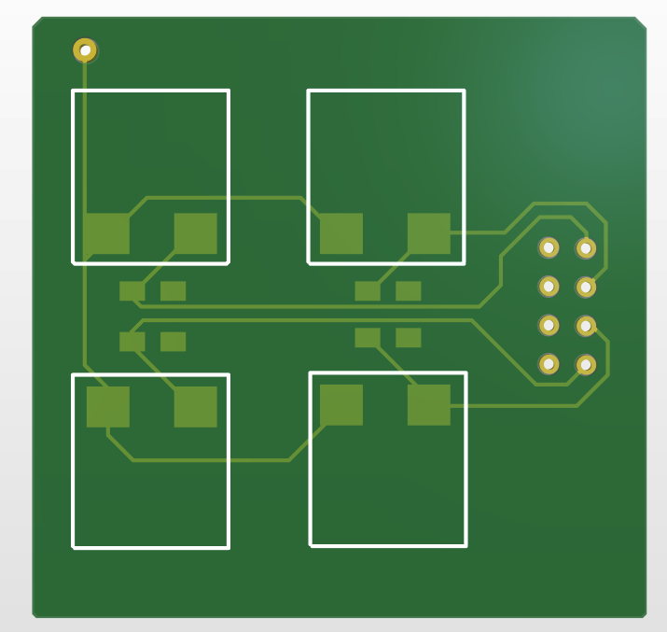
5V
8mm
5mm
50mm
3.22mm
3.17mm
0.64mm
33mm
Vin=(5*ad_data)/2¹⁵
R=50(2¹⁵/data-1)
Ppm=R

Slide 4
Adc
sys clk
sys_rstn
ad clk
Ad_data
volt

Slide 5
sensor_top
sys clk
Tft_clk
pll_gen
Tft_ctrl
hsync
sys_rstn
Vsync
Rgb_tft
Tft_clk
Pix_data
Tft_clk
Tft_de
ad7606
Tft_pic
ch1
BCD
Tft_bl
Ad_data
Pix_x
ch2
BCD
ch3
Pix_y
BCD
ch4
BCD

Slide 6
288
512
752
800
JLU GAS SENSOR
40
360欧姆
CH :
360
0,400
cnt,400-data
799,400
0欧姆
400
CH1:
xxx Ω
CH2:
Xxx Ω
CH3:
Xxx Ω
CH4:
Xxx Ω
NH3:
xxx ppm
NH3:
Xxx ppm
NH3:
Xxx ppm
NH3:
Xxx ppm
480
400
600
64
200

Slide 7
288
512
752
800
40
360欧姆
300
200
360
100
0
5 min
10 min
0欧姆
400
CH1:
xxx Ω
CH2:
Xxx Ω
CH3:
Xxx Ω
CH4:
Xxx Ω
NH3:
xxx ppm
480
400
600
64
200

Slide 8
CH1:
xxx Ω
CH2:
Xxx Ω
CH3:
Xxx Ω
CH4:
Xxx Ω
NH3:
xxx ppm

