Slide 1
PBL 1 Contents
Short intro to topic 2 Energy Generation and science (which we will cover in the second lecture on weds)
Revision on thermodynamics (Carnot cycle)
A note on units
PBL questions on heat pumps (from 2021 Exam paper)

Slide 2
Energy Science & Generation
PHAS0050 : Climate & Energy
Prof. Cham Ghag & Prof. Chris Howard
Units
Energy Consumption
Examples of Fossil Fuel Combustion
Basic Heat & Thermodynamics
The Carnot Cycle
The Rankine Cycle
The Brayton (Joule) Cycle
Combined Cycle Gas Turbine (CCGT)
Conclusions

Slide 3
Basic Heat & Thermodynamics (Revision I)
The heat required to raise the temperature of a substance :
Note the difference between specific & molar heat capacity at constant volume and pressure :
Thermal energy carried by each degree of freedom :
For n moles of an ideal gas :

Slide 4
Basic Heat & Thermodynamics (Revision II)
system
heat input
change in internal energy
work done by system
First law of thermodynamics :

Slide 5
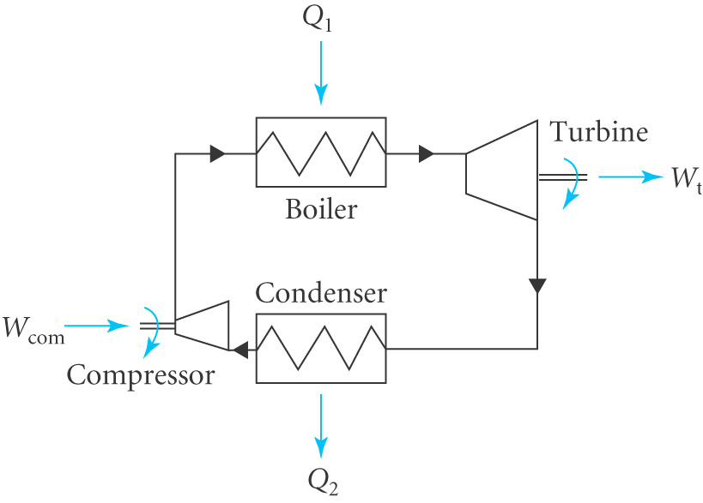
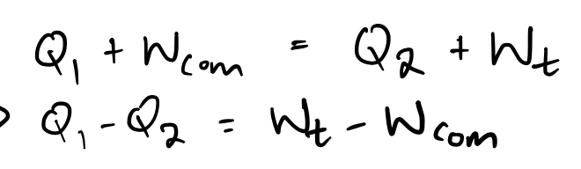
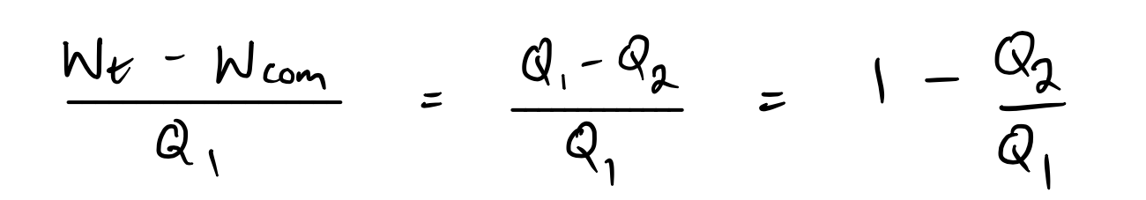
Efficiency of a Steam Power Plant
For a closed cycle :
n.b 100% efficiency is impossible - 2nd law thermodynamics

Slide 6
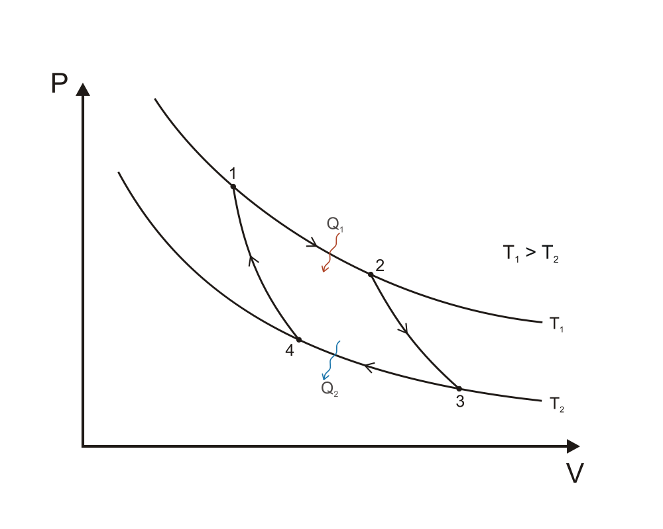
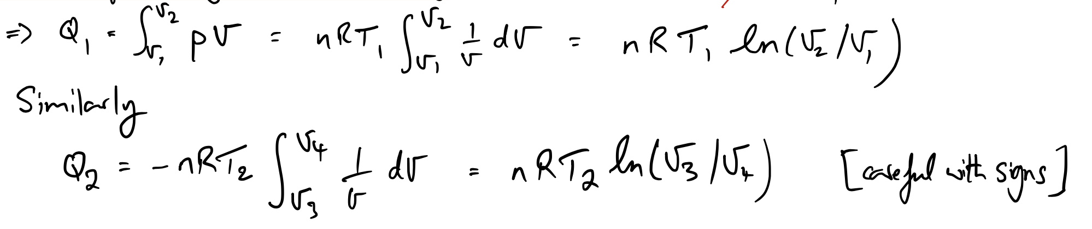
Carnot Cycle & Efficiency
Carnot cycle on a (T,V) diagram :
Calculate Q₁ and Q₂ for an ideal gas :
= 0 (for isothermal)
pV = nRT

Slide 7
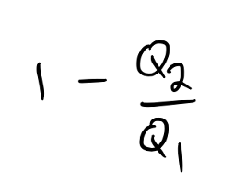
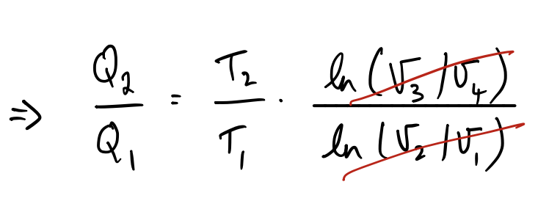
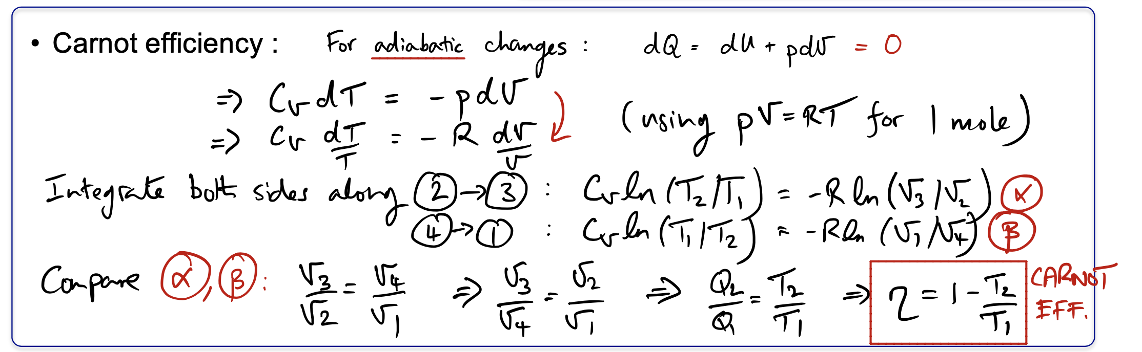
Carnot Cycle & Efficiency
From the previous page :
Carnot efficiency :

Slide 8
Units
Energy : kilowatt-hour (kWh)
Thermal and electric units : kWh and kWh_{e}
In a power station, the two are related by the efficiency of electrical energy generation.
Power : kilowatt-hour per day (kWh d⁻¹)

Slide 9
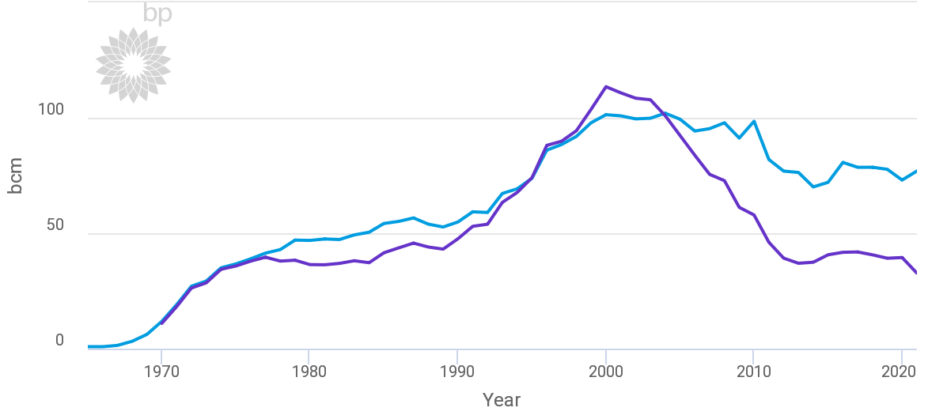
Problem Based Learning Session 1
PHAS0050 : Climate & Energy
UK natural gas production and consumption (billion cubic metres) :
consumption
(domestic & power/industrial)
production

Slide 10
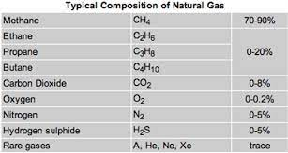
Composition of ‘natural gas’

Slide 11
Problem Based Learning Session 1
2021 Q2

Slide 12
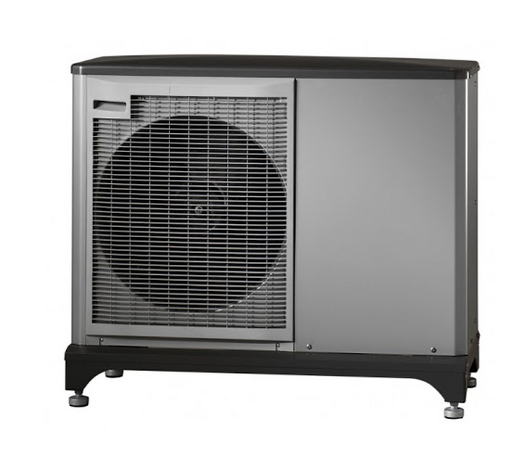
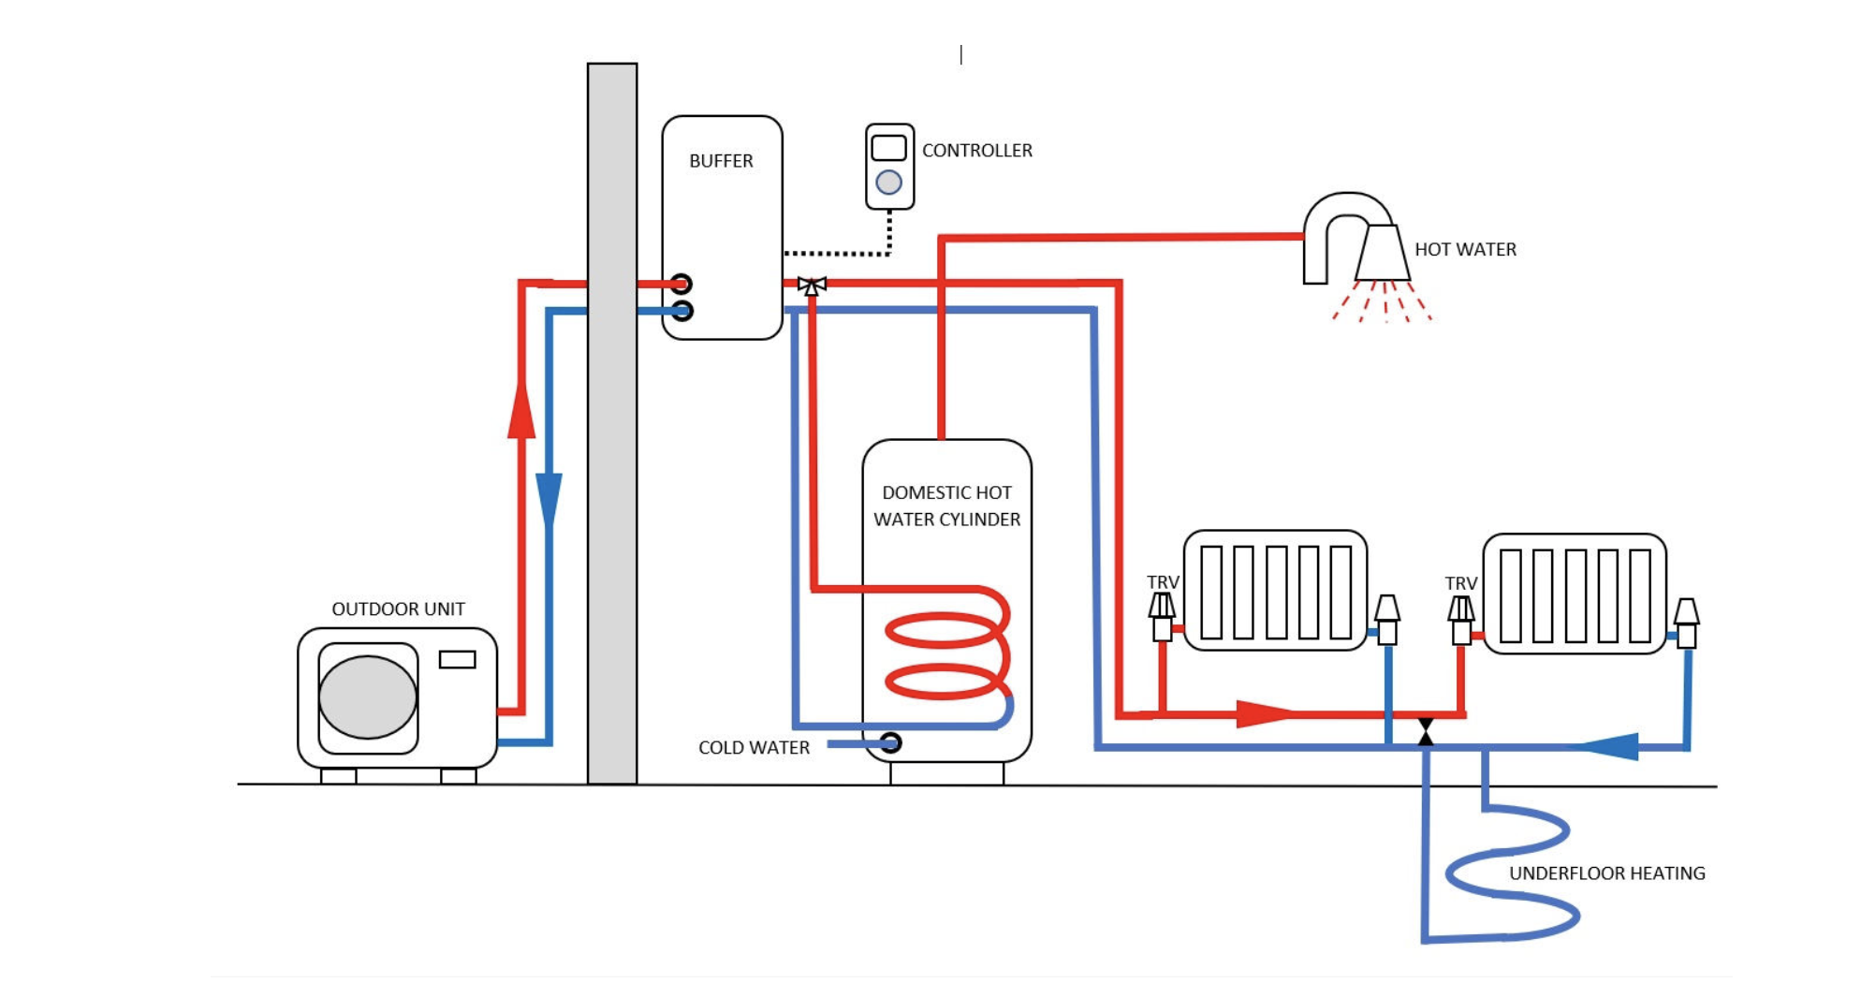
Problem Based Learning Session 1
Heat Pump (air source)

Slide 13
Problem Based Learning Session 1

Slide 14
Problem Based Learning Session 1

Slide 15
Problem Based Learning Session 1

