Slide 1
Team B UX Design Cohort 2
Thea Partin, John Locken, Leo Osborne, Jordan Staten, Brian Littrell

Slide 2
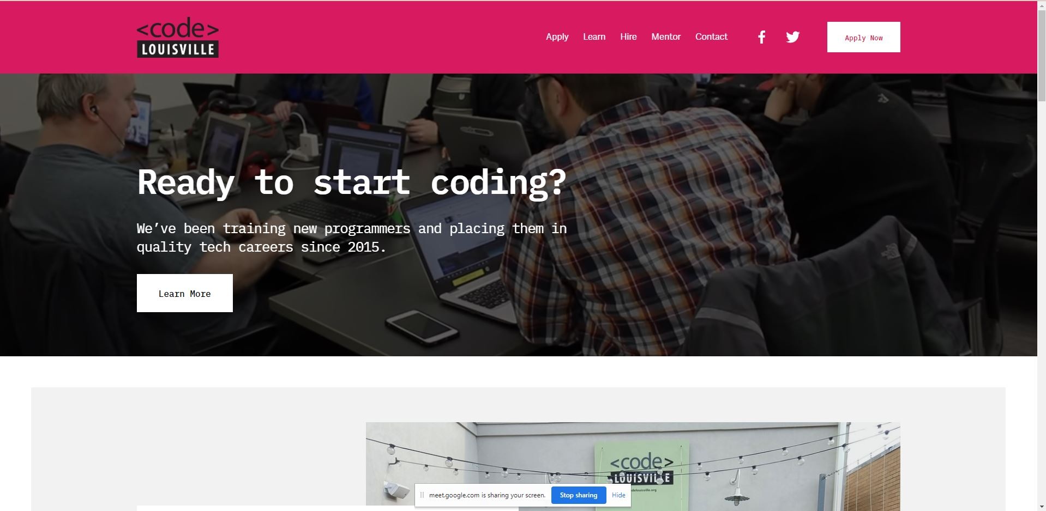
Project overview
The goal:
Improving the Code Louisville experience.

Slide 3
Project overview
Our role:
We did both UX low-fidelity design and UX research
Responsibilities:
user research, wireframing, prototyping

Slide 4
Surveys
Student
Employer
Interviews
Student
Employer
Mentors
Stakeholders
Personas
Empathy Map
Understanding
the user

Slide 5
User research: pain points
1
2
3
4
Resources
Communication
Login
Connection
Being a government funded, fully free program, Code Louisville struggles with coming up with the resources to affect significant change quickly
Notifications, slack channel too crowded
Students and mentors struggle with finding all the information involved in a course over multiple sites and communication platforms
Students struggle with connecting to employers in the area looking to hire people in their field

Slide 6
User research: potential gains
1
2
3
4
Diversity of Experience
Experience
Access
Success
Students can now have different opportunities in how they are able to connect with employers or mentors
Code Louisville students could potentially gain more experience in their desired career fields
Potential to ease the difficulty of finding employment opportunities in their desired fields
All users will be able to connect with each other to help obtain the results they are looking for

Slide 7
Digital wireframes
Low-fidelity prototype
Starting
the design

Slide 8
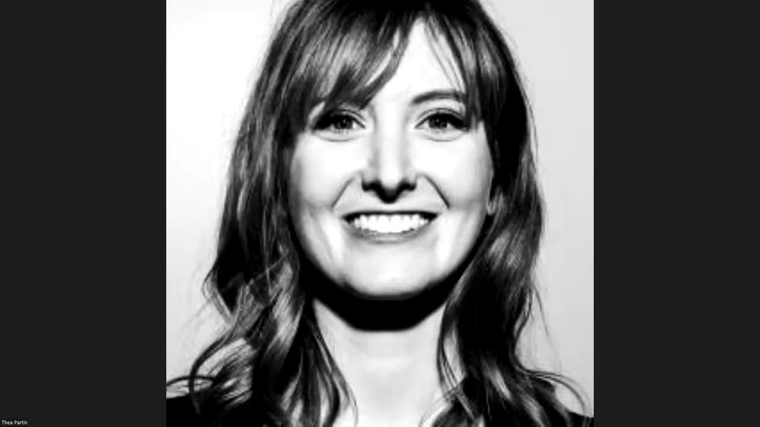
Thea’s Wireframe

Slide 9
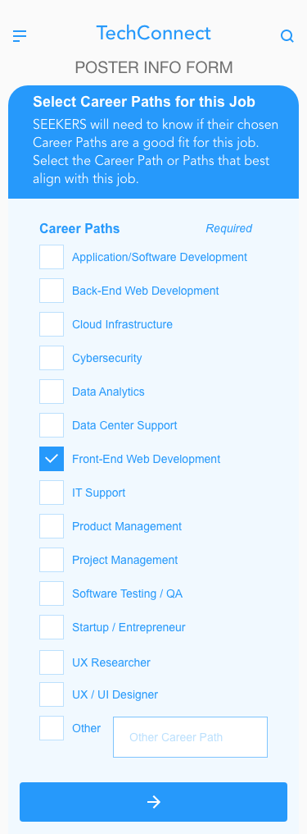
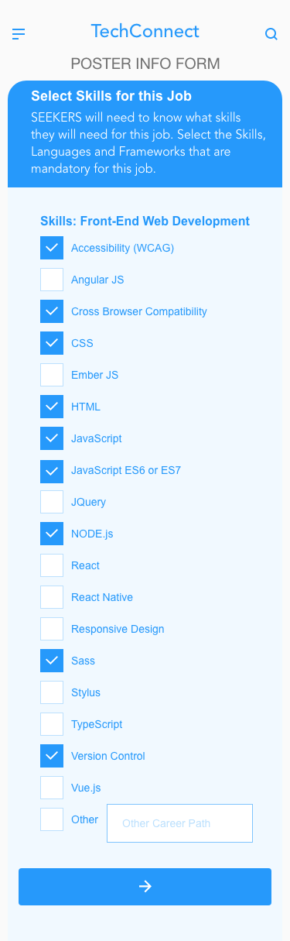
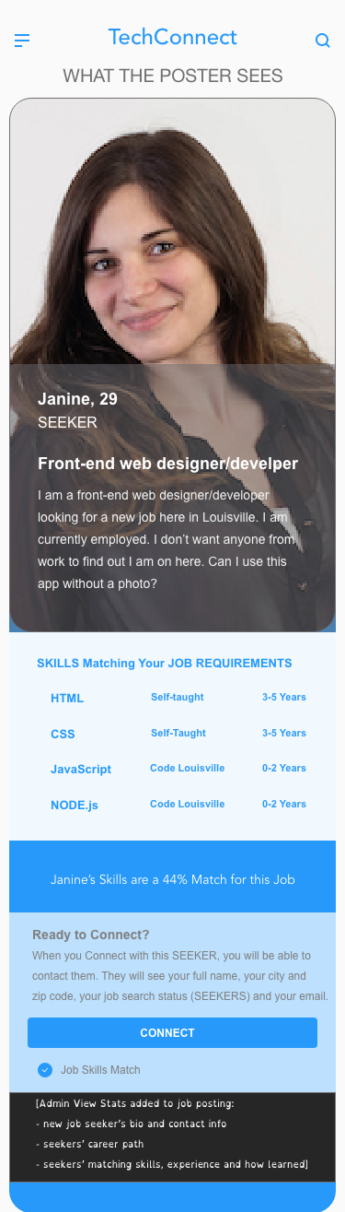
Leo’s Wireframe
[Link to full wireframe]

Slide 10
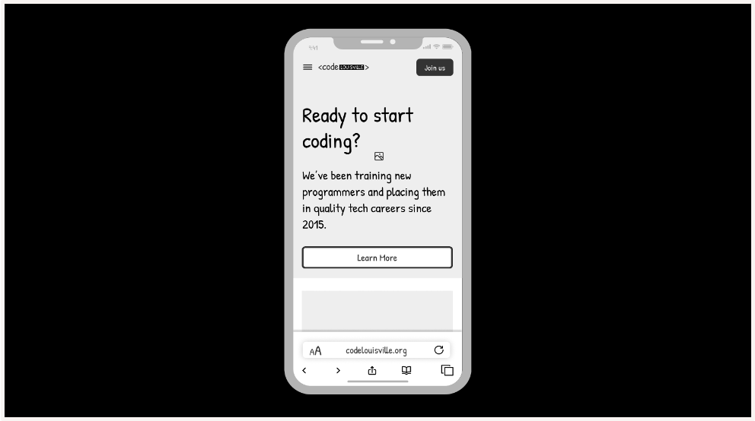
Brian wireframes

Slide 11
Going forward
Takeaways
Next steps

Slide 12
Takeaways
Impact:
What We learned:
That Code Louisville has been working on these same issues for years.
That they appreciate ux-team-b focusing our efforts on these issues. That our solutions our pretty similar to the solutions they have been working on secretly.
“There is a website in progress for students. This will motivate us to complete it!”
“A dashboard would be perfect for what we are doing.”
“Having this kind of data on the hiring process is the holy grail for Code Louisville"

Slide 13
Next steps
1
2
3
Write a bulleted list of the main points we learned so the developer (Don) can use it as a quick reference as he builds the project.
Re-testing of prototypes to create a high fidelity prototype.
Brian is working on a roadmap for his prototype.

Slide 14
Insert a few sentences summarizing the next steps you would take with this project and why. Feel free to organize next steps in a bullet point list.
Thank you!
Presentation by: Brian Littrell, Thea Partin, Jordan Staten, John Locken, Leo Osborne
Presentation slides, images, icons by: Google

Slide 15
Q&A

