Slide 1
UX Team B Case Study

Slide 2
Thea Partin
Brian Littrell
Jordan Staten
John Locken
Leo Osborne

Slide 3
Discover

Slide 4
Problem Definition
“Improve the candidate experience for Code Louisville graduates.”

Slide 5

Research

Slide 6
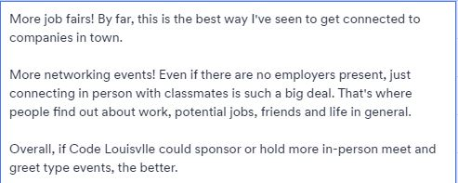
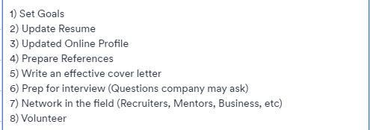

Student User Surveys

Slide 7
Employer User Surveys

Slide 8
“Code Louisville needs to come in from a mentor side of things.”
–Code Louisville Mentor

Slide 9
“ I would love to find a person who you can just talk to, especially about the hard things. An individual that I can refer to.” –UX Design Student

Slide 10
“We want to connect on someone’s personality types and we need to know that the individual is easy to work with not only has hard skills but, also has soft skills.”
–Employer for Mediaura

Slide 11
“It is hard to organize job offers as they primarily come from many small and medium-sized local businesses in ones and twos.” –Code Louisville Admin

Slide 12
“We would like to have metrics on how participants are connecting with local businesses during the job application process.”
–Code Louisville Admin

Slide 13
Lean UX Canvas
Key Insights:
Began to have more communication and distribution of information.
The process narrowed our focus.
We began forming many potential solutions.
We identified our target audience.

Slide 14
Competitive Analysis
Key Insights:
There are many paid bootcamps.
CL is the only local government funded program we found.
Other courses offer a more gradual learning environment than just watching videos.
Code Louisville is the only fully-free program for all participants.

Slide 15
Personas
Key Insights:
Large variety of people and roles in Code Louisville.
We approached our project from many different perspectives or pain points.

Slide 16
Market Trends
Key Insights:
Many more education options now than just university.
Coding-bootcamp graduates tend to be deficient in data structures and algorithms as compared with computer science grads.
Ability to operate within a team environment (meetings, GitHub) is important.
Big push towards gamification of learning.

Slide 17
User Interviews

Slide 18
Empathy Map
Key Insights:
1. Fear of job readiness
2. Tech can become overwhelming
3.Mentors are key to success in Code Louisville
4.Life-long learning because tech field is ever changing

Slide 19
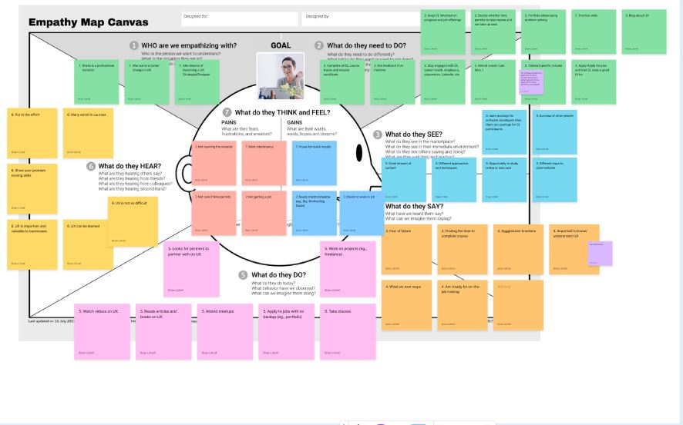

Slide 20
Define

Slide 21
Hypothesis
Constraints
Features Overview
Users want fast and easy ways to connect with employers.
Users would like more access to mentors and mentors would like to lessen their workload.
Users want more information on the program.
Code Louisville wants to keep track of the application process while connecting students with employers.
Large group we are catering to.
Time (users).
Funding (stakeholders).
UX Design first cohort (uncertainty of project requirements)
Organizing data
Connecting

Slide 22
Design

Slide 23
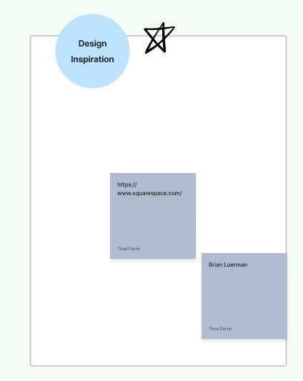
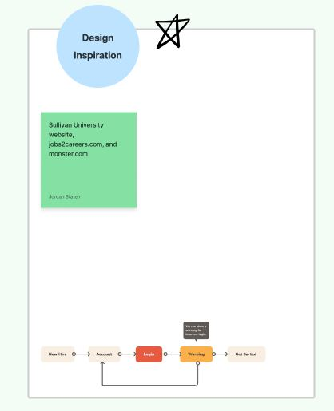
Code Louisville Connect Moodboard
Before:
After:

Slide 24
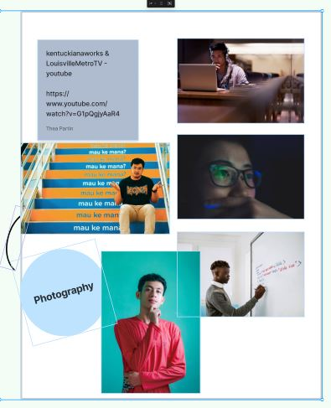
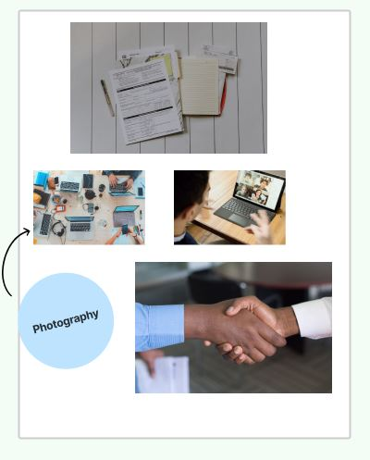
Code Louisville Connect
Moodboard
Before:
After:

Slide 25
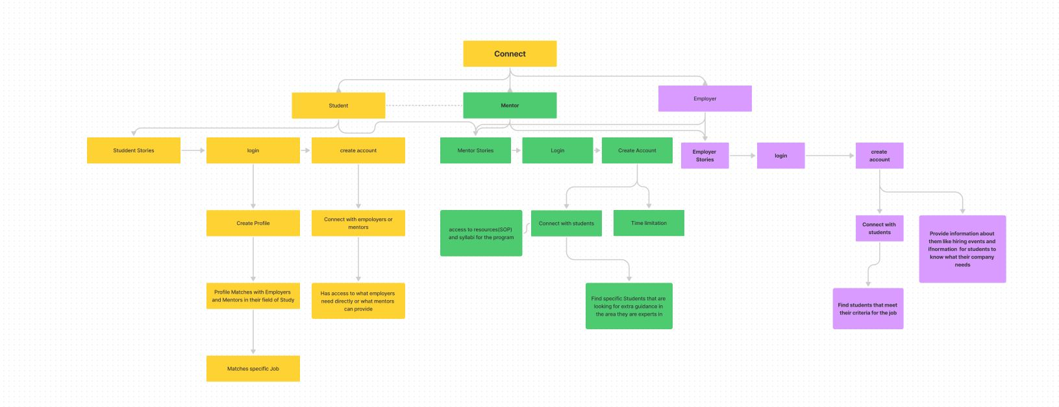

Slide 26
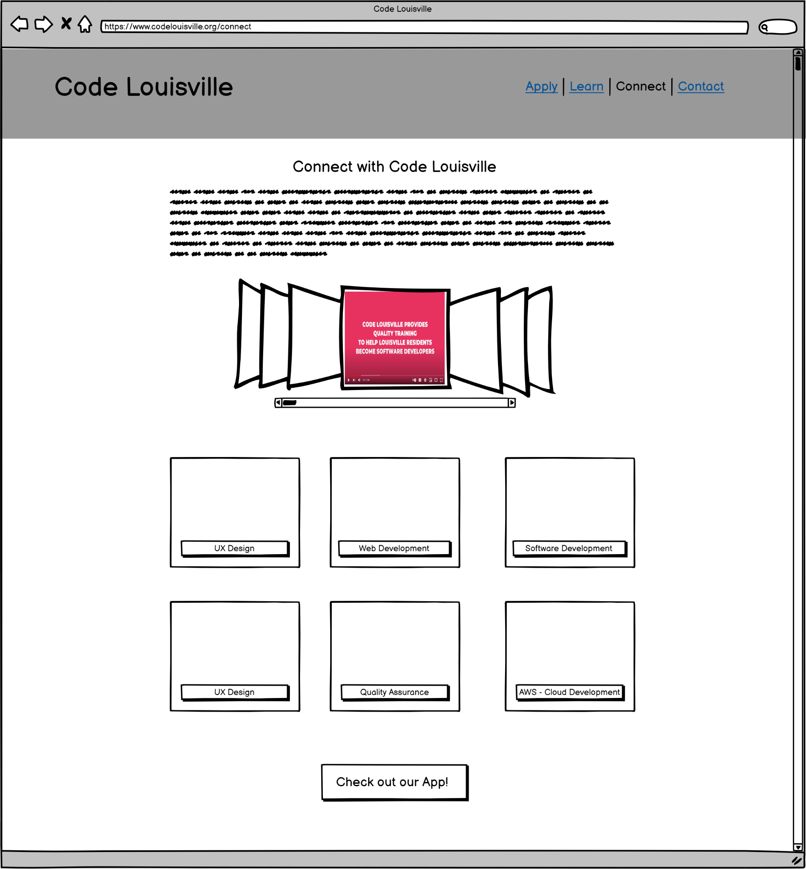
Code Louisville Connect

Slide 27
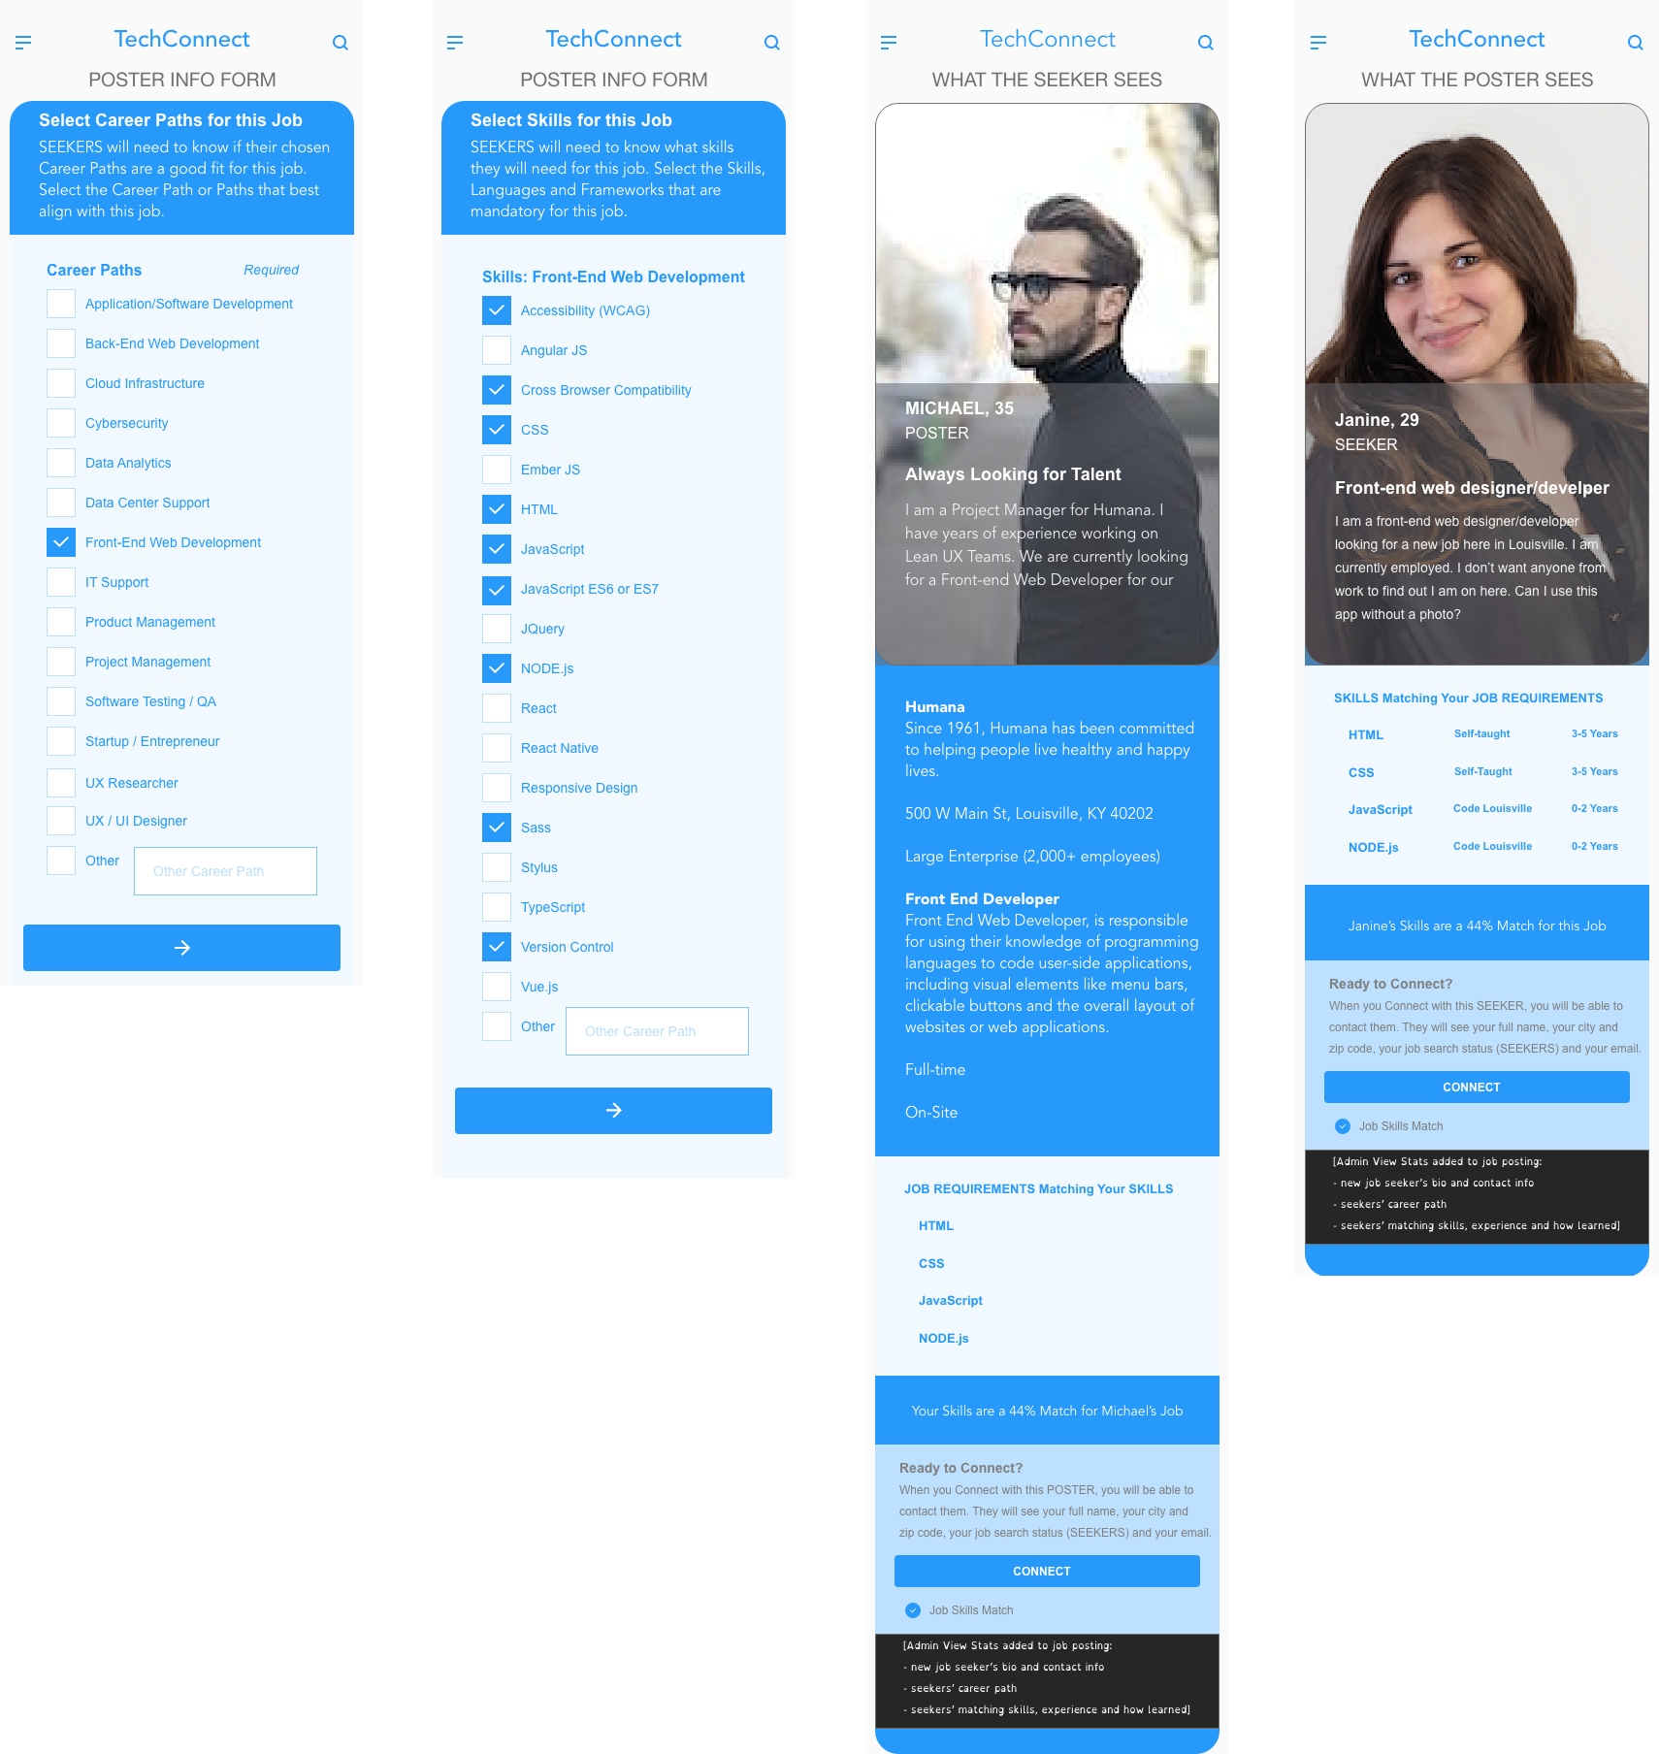
TechConnect
[link to clickable wireframe]
Key Insights:
Connects using format of dating app.
Uses Career Path and Skills to connect: easily measurable!
Can be used to connect students, graduates, mentors businesses and Code Louisville Admin.
Keeps stats on the connections.

Slide 28
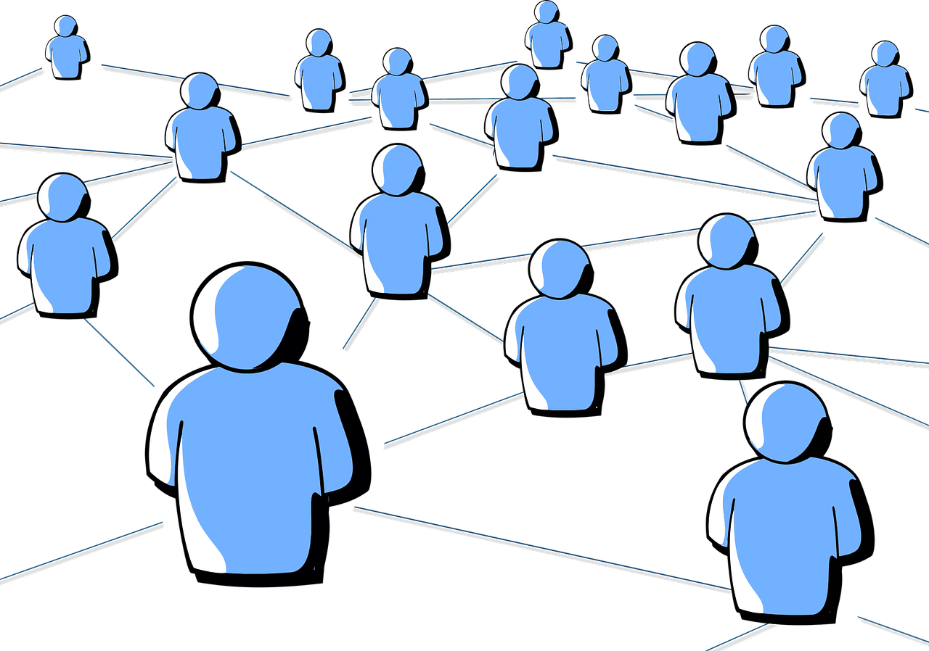
Conclusion: Connection is Key to Code Louisville’s future success.

Slide 29
Deliver
We presented to the Code Louisville Team and they want us to provide a word document with our findings and action items that they see need to happen based on our research and prototypes.

Slide 30
Outcomes
Lessons Learned
Imposter syndrome with all Code Louisville students is very real and students need that personal connections that one on one discussion available to them.
Slack is not being used enough because students are not comfortable posting on a large channel.
Biggest challenge is incentives to have students use the resources designed.
Next Steps
Code Louisville is creating a new student portal so, our designs will help them with their expansion of that project.

Slide 31
Questions

Slide 32

Thank you for your time!

Slide 33
Appendix

Slide 34
Links to Research
https://www.jotform.com/myforms/
https://www.figma.com/file/T0GDkONDxyAmdVOxoIZwSo/UX-2-Project-Files
https://docs.google.com/spreadsheets/d/16f82uUrM_jVO-9k9sBSZx-I_Q9MjiRzzZAm353OLIuY/edit#gid=2069237634

Slide 35
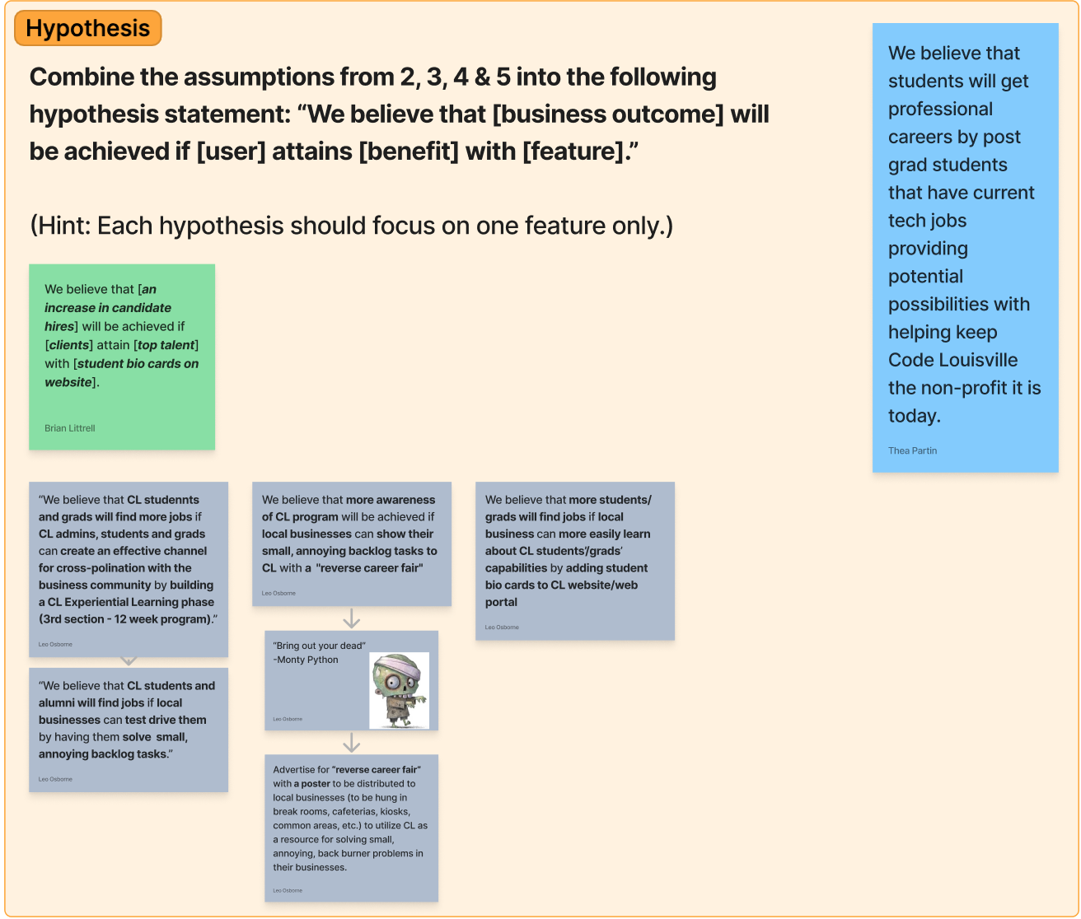

Slide 36
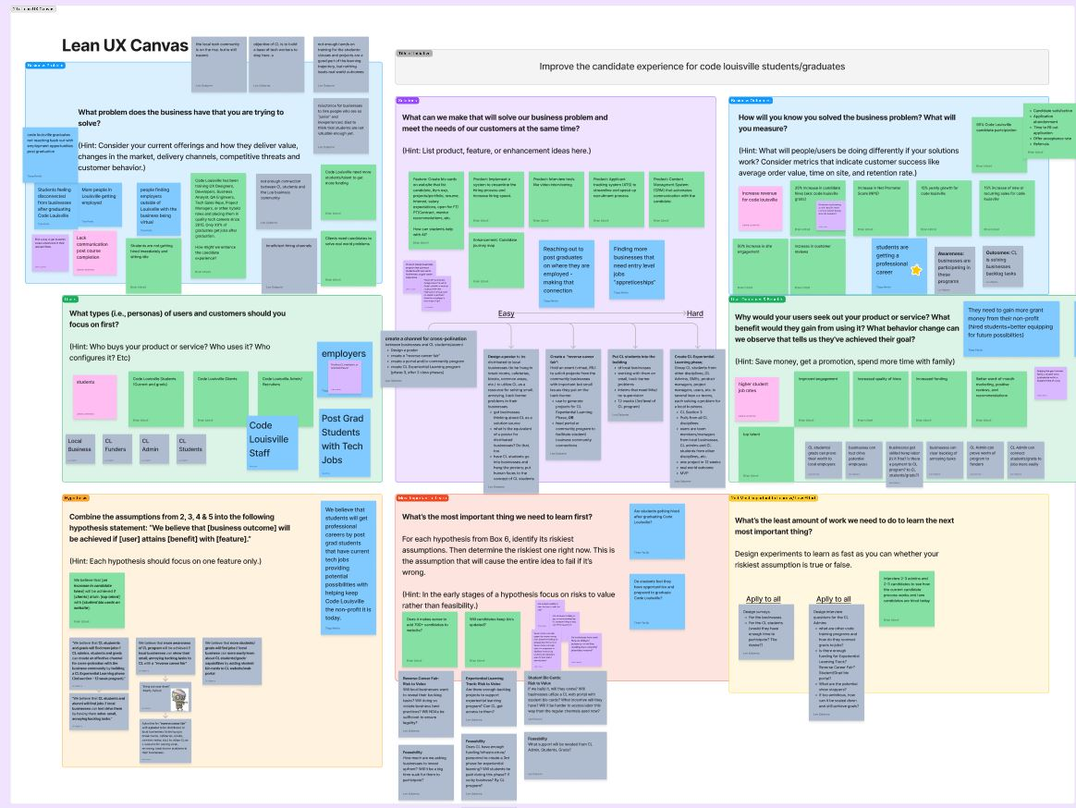

Slide 37
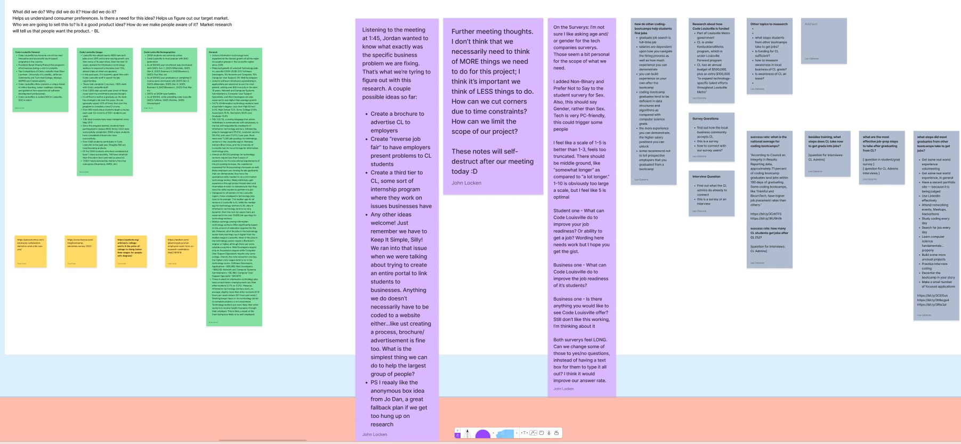

Slide 38
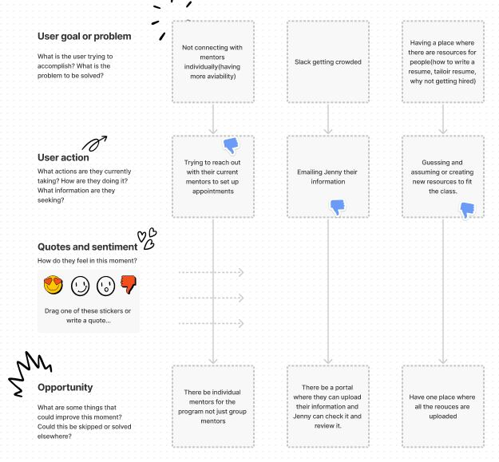
Code Louisville Connect
Brainstorm

Slide 39
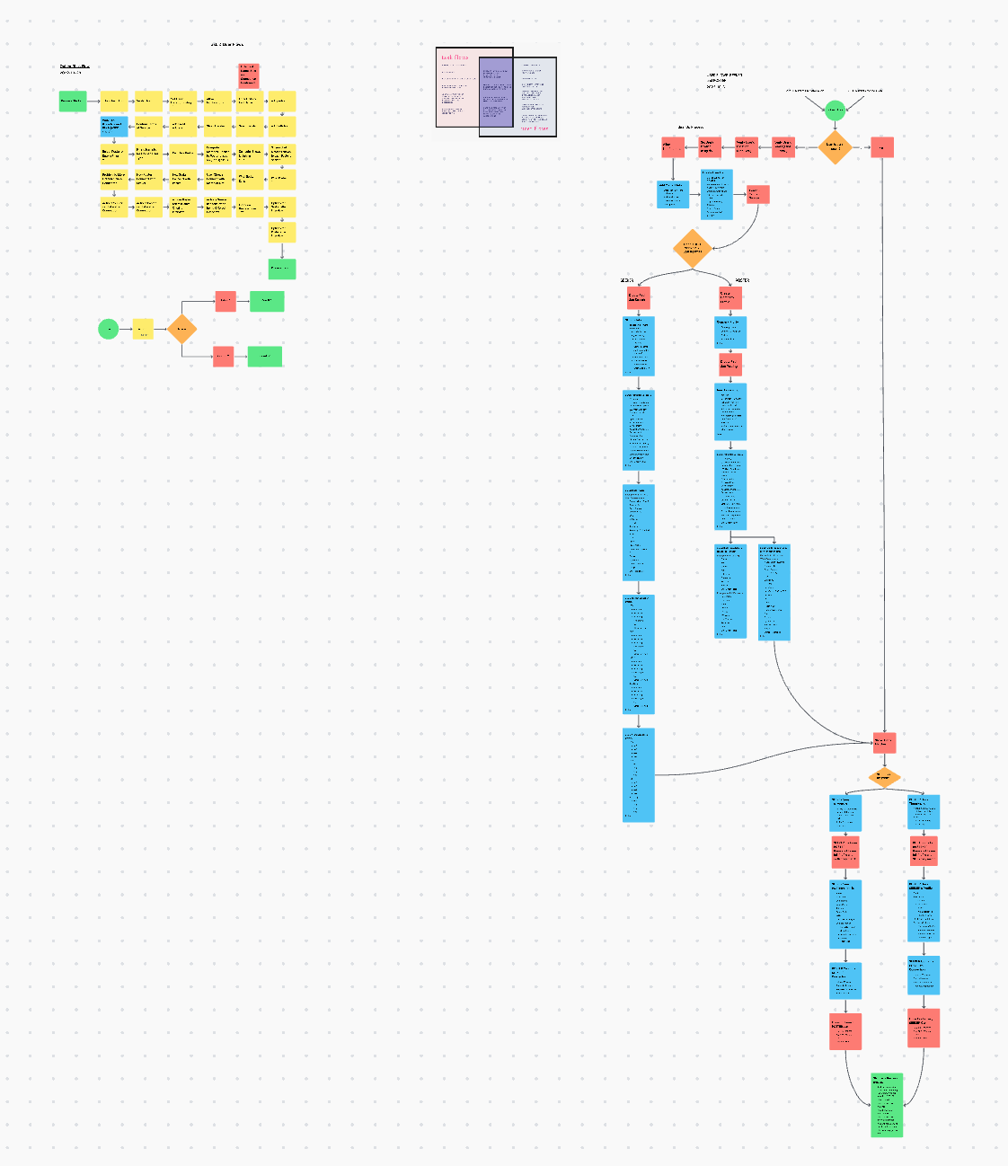
Task Flow and User Flows for TechConnect App

Slide 40
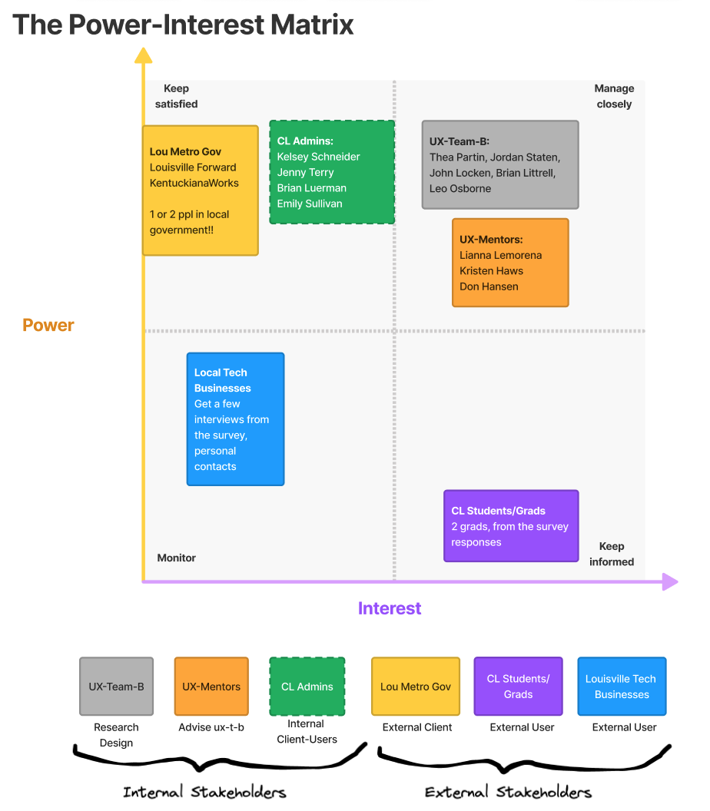
Power / Interest Matrix
Key Insights:
Internal and External Stakeholders
Interviewed people from all 6 groups
Presenting three solutions to Code Lou Admin (Client and User) and one to UX Class
UX-Mentors grew to All Mentors

