Slide 1

DATA STRUCTURES AND ITS APPLICATIONS
UE21CS252A
Shylaja S S & Kusuma K V
Department of Computer Science
& Engineering

Slide 2

DATA STRUCTURES AND ITS APPLICATIONS
n-ary Tree Traversal
Shylaja S S
Department of Computer Science & Engineering

Slide 3
DATA STRUCTURES AND ITS APPLICATIONS
Tree Traversal
Structure of a treenode revisited
struct treenode{
int info;
struct treenode *child;
struct treenode *sibling;
};

Slide 4
DATA STRUCTURES AND ITS APPLICATIONS
Tree Traversal
With the treenode implemented as having pointers to first child and immediate sibling, the traversal preorder, inorder and postorder for a tree are defined as follows:
Preorder:
1. Visit the root of the first tree in the forest
2. Traverse in preorder the forest formed by the subtrees of the first tree, if any
3. Traverse in preorder the forest formed by the remaining trees in the forest, if any

Slide 5

DATA STRUCTURES AND ITS APPLICATIONS
Tree Traversal
Preorder Tree Traversal
A
B
C
D
A
B
E
F
C
G
H
D
E
F
G
H

Slide 6
DATA STRUCTURES AND ITS APPLICATIONS
Tree Traversal
void preorder(TREE *root)
{
if(root!=NULL)
{
printf(" %d ",root->info);
preorder(root->child);
preorder(root->sibling);
}
}

Slide 7
DATA STRUCTURES AND ITS APPLICATIONS
Tree Traversal
Inorder
1. Traverse in inorder the forest formed by the subtrees of the first tree, if any
2. Visit the root of the first tree in the forest
3. Traverse in inorder the forest formed by the remaining trees in the forest, if any

Slide 8
DATA STRUCTURES AND ITS APPLICATIONS
Tree Traversal
Inorder Tree Traversal
A
B
C
D
E
F
B
H
G
C
D
A
E
F
G
H

Slide 9
DATA STRUCTURES AND ITS APPLICATIONS
Tree Traversal
void inorder(TREE *root)
{
if(root!=NULL)
{
inorder(root->child);
printf(" %d ",root->info);
inorder(root->sibling);
}
}

Slide 10
DATA STRUCTURES AND ITS APPLICATIONS
Tree Traversal
Postorder
Traverse in postorder the forest formed by the subtrees of the first tree, if any
Traverse in postorder the forest formed by the remaining trees in the forest, if any
Visit the root of the first tree in the forest

Slide 11
DATA STRUCTURES AND ITS APPLICATIONS
Tree Traversal
Postorder Tree Traversal
A
B
C
D
F
E
H
G
D
C
B
A
E
F
G
H

Slide 12
DATA STRUCTURES AND ITS APPLICATIONS
Tree Traversal
void postorder(TREE *root)
{
if(root!=NULL)
{
postorder(root->child);
postorder(root->sibling);
printf(" %d ", root->info);
}
}

Slide 13
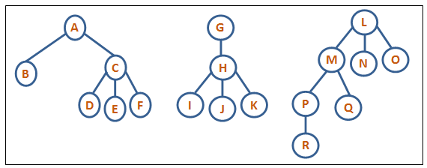
DATA STRUCTURES AND ITS APPLICATIONS
Forest traversal
Preorder: ABCDEFGHIJKLMPRQNO
Inorder: BDEFCAIJKHGRPQMNOL
Postorder: FEDCBKJIHRQPONMLGA

Slide 14
THANK YOU
Shylaja S S
Department of Computer Science
& Engineering
shylaja.sharath@pes.edu

