Slide 1



WEB TECHNOLOGIES
React JS –
Styling the Components and Complex Components
Prof. Vinay Joshi and Prof. Sindhu R Pai
Department of Computer Science and Engineering

Slide 2

React.JS – Styling the Components
Agenda
Introduction
Inline CSS
Usage of props.children
Demo code

Slide 3

React.JS – Styling the Components
Introduction
Different ways to style React Components
  Inline CSS - using style attribute
  CSS in JS - Using Libraries JSS and Styled Components
  CSS modules – css loader and Sass & SCSS
  Stylable

Slide 4
React.JS – Styling the Components
Inline CSS
In inline styling we create objects of style and render it inside the components in style attribute using the React technique.
In JSX, JavaScript expressions and objects are written inside curly braces the styling is written inside two sets of curly braces {{}}.
Example:
  class MyHeader extends React.Component {
  render() { return (
  <h1 style={{color: "red"}}>Hello Style!</h1>
  <p>Add a little style!</p> ); }}
camelCased Property Names
  <h1 style={{backgroundColor: "lightblue"}}>Hello Style!</h1>

Slide 5
React.JS – Styling the Components
Inline CSS continued..
Creation of JavaScript object which contains the css properties and values in the form of key value pair.
Passing this as a value to style attribute
Example:
class Letter extends React.Component {
  render() {var letterStyle = { padding: 10,
  margin: 10, backgroundColor:"#ffde00",
  color: "#333“,
  display: "inline-block“,
  fontFamily: "monospace",
  fontSize: 32,
  textAlign: "center“
  };
return(
<div style={letterStyle}>
{this.props.children}
</div> ); }

Slide 6
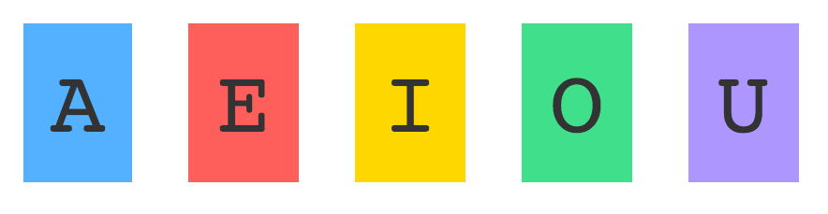
React.JS – Styling the Components
Demo
Create the following letters using react components
Additionally, apply styles to them differently by passing styling properties

Slide 7
React.JS – Complex Components
Agenda
Introduction
Approach followed
Complex Component creation
Sub component creation
Properties from parent to sub component
Modified parent and sub components
Transferring properties

Slide 8
React.JS – Complex Components
Introduction
Combining components to create the complex one
Advantage is composability
Approach
  Identify the major visual elements
  Breaking them into individual components

Slide 9


React.JS – Complex Components
Approach followed
The complex component consists of Image rendering, caption rendering and link rendering on the web page

Slide 10
React.JS – Complex Components
Creation of complex component
class SrchResult extends React.Component {
render() {
return (
<div>
<ResImage/>
<ResCaption/>
<ResLink/>
</div>
);
}
}

Slide 11
React.JS – Complex Components
Creation of sub components
class ResImage extends React.Component {
render() {
return (
<div> <img src=“tiger.jpg”>
</img> </div> );
}
}
class ResLink extends React.Component {
render() {
return (
<div> <a href=“https://www.britannica.com/animal/tiger”> britannica.com </a> </div> );
}
}
class ResCaption extends React.Component {
render() {
return (
<div> <p>tiger | Facts, Information and Habitat…</p> </div> );
}
}

Slide 12
React.JS – Complex Components
Properties from parent to sub component
To avoid hard coding, properties have to be passed from parent Components to it’s sub components
src
href
linktext
caption
<SrchResult src=“tiger.jpg” href=“https://www.britannica.com/animal/tiger” linktext=“britannica.com” caption=“tiger | Facts, Information and Habitat… ” />

Slide 13
React.JS – Complex Components
Modified Parent and sub components
class SrchResult extends React.Component {
render() {return ( <div> <ResImage {...this.props}/> <ResCaption {...this.props}/> <ResLink {...this.props}/>
</div> ); }
}
class ResImage extends React.Component {
render() {
return (
<div> <img src={this.props.src}>
</img> </div>
); } }
class ResLink extends React.Component {
render() {
return (
<div> <a href={this.props.href}> {this.props.linktext} </a> </div> );
} }
class ResCaption extends React.Component {
render() {
return (
<div> <p>{this.props.caption}</p> </div>
); } }

Slide 14
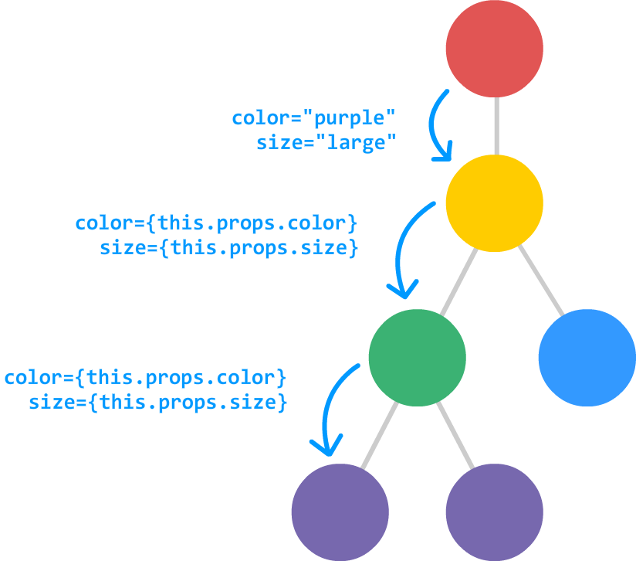
React.JS – Complex Components
Transferring Properties
Transferring properties was not a tedious as there was only one level of hierarchy
If there are multiple levels of components, transferring properties will be very cumbersome
To overcome that, we use the spread operator (…)
<Display {...this.props}/>

Slide 15
THANK YOU
Vinay Joshi and Sindhu R Pai
Department of Computer Science and Engineering
vinayj@pes.edu
+91 80 2672 6622
sindhurpai@pes.edu
+91 8277606459

