Slide 1



WEB TECHNOLOGIES
React JS –
refs and keys
Prof. Vinay Joshi and Prof. Sindhu R Pai
Department of Computer Science and Engineering

Slide 2

refs and keys
Agenda
Introduction to refs
Create and use refs
Callback refs
Introduction to keys
Keys - Sample code
Map function
Using map with key property

Slide 3

Lists
Introduction to lists
Lists are used to display data in an ordered format and mainly used to display menus on websites.
In React, Lists can be created in a similar way as we create lists in JavaScript.
The map() function is used for traversing the lists.
In the below example, the map() function takes an array of numbers and multiply their values with 5.
We assign the new array returned by map() to the variable multiplyNums and log it.

Slide 4
refs and keys
Introduction to refs
There are many JavaScript array methods.
One of the most useful in React is the .map() array method.
The .map() method allows you to run a function on each item in the array, returning a new array as the result.
In React, map() can be used to generate lists.
var numbers = [1, 2, 3, 4, 5];
const multiplyNums = numbers.map((number)=>{
return (number * 5);
});
console.log(multiplyNums);

Slide 5
refs and keys
Map function
Map is a data collection type where data is stored in the form of key-value pairs
The value stored in the map must be mapped to the key
The map is a JavaScript function that can be called on any array
With the map function, we map every element of the array to the custom components in a single line of code
Sample code:
  const numbers = [1, 2, 3, 4, 5];
  const doubled = numbers.map((number) => number * 2);
  console.log(doubled);

Slide 6
refs and keys
Introduction to refs
const myArray = ['apple', 'banana', 'orange'];
const myList = myArray.map((item) => <p>{item}</p>)
ReactDOM.render(myList, document.getElementById('root’));

Slide 7
refs and keys
Introduction to refs
Lists are used to display data in an ordered format and mainly used to display menus on websites.
In React, Lists can be created in a similar way as we create lists in JavaScript.
let us see how we create a list in React.
To do this, we will use the map() function for traversing the list element, and for updates, we enclosed them between curly braces {}.
Finally, we assign the array elements to listItems.
Now, include this new list inside <ul> </ul> elements and render it to the DOM.

Slide 8
refs and keys
Introduction to refs
function NameList(props) {
const myLists = props.myLists;
const listItems = myLists.map((myList) =>
<li>{myList}</li>
);
return (
<div>
<h2>Rendering Lists inside component</h2>
<ul>{listItems}</ul>
</div>
);
}
const myLists = ['Peter', 'Sachin', 'Kevin', 'Dhoni', 'Alisa'];
ReactDOM.render(
<NameList myLists={myLists} />,
document.getElementById('app')
);

Slide 9
refs and keys
Using map with key property
The code will result in error, as the list of items does not have the key property
const numbers = [1, 2, 3, 4, 5];
const listItems = numbers.map((number) => <li>{number}</li>);
ReactDOM.render(
<ul>{listItems}</ul>,
document.getElementById('root') );
Modified by adding key property
function NumberList(props) {
const numbers = props.numbers;
const listItems = numbers.map((number) =>
    <li key={number.toString()}> {number} </li> );
    return ( <ul>{listItems}</ul> );
    }
    const numbers = [1, 2, 3, 4, 5];
ReactDOM.render(
<NumberList numbers={numbers} />
document.getElementById('root') );

Slide 10
refs and keys
Introduction to refs
A key is a unique identifier.
In React, it is used to identify which items have changed, updated, or deleted from the Lists.
It is useful when we dynamically created components or when the users alter the lists.
It also helps to determine which components in a collection needs to be re-rendered instead of re-rendering the entire set of components every time.
Keys should be given inside the array to give the elements a stable identity.
The best way to pick a key as a string that uniquely identifies the items in the list. It can be understood with the below example.

Slide 11
refs and keys
Introduction to keys
Utilized to identify specific virtual DOM elements that have changed, added, or removed.
Keys should be given to the elements inside the array to give the elements a stable identity
Keys only make sense in the context of the surrounding array
Not specifying the key property will display a warning on the console:
Warning: Each child in an array or iterator should have a unique "key" prop.

Slide 12
refs and keys
Keys - Sample codes
When returning a list of elements
  function Stuff () {
  return (
  [
  <p>Batman</p>,
  <p>Ironman</p>,
  <p>Spiderman</p>
  ]
  );
  };
  Specify key property as follows
  function Stuff () {
  return (
  [
  <p key=“1”>Batman</p>,
  <p key=“2”>Ironman</p>,
  <p key=“3”>Spiderman</p>
  ]
  );
  };

Slide 13
refs and keys
Introduction to refs
Provides a way to access DOM nodes or React elements created in the render method
Used to return a reference to the element
Good use cases for refs to be used:
  Managing focus, text selection, or media playback
  Triggering imperative animations
  Integrating with third-party DOM libraries

Slide 14
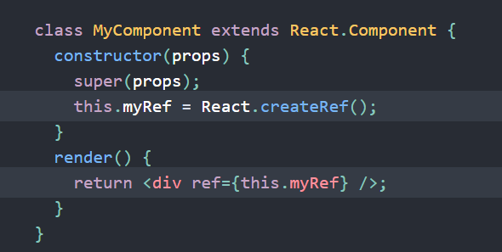

refs and keys
How to create and use refs?
Creating refs:
  React.createRef() method is used to attach React elements via the ref attribute.
  Refs are assigned to an instance property when a component is constructed so they can be referenced throughout the component.
Accessing refs:
  When a ref is passed to an element in render, a reference to the node becomes accessible at the current attribute of the ref.

Slide 15
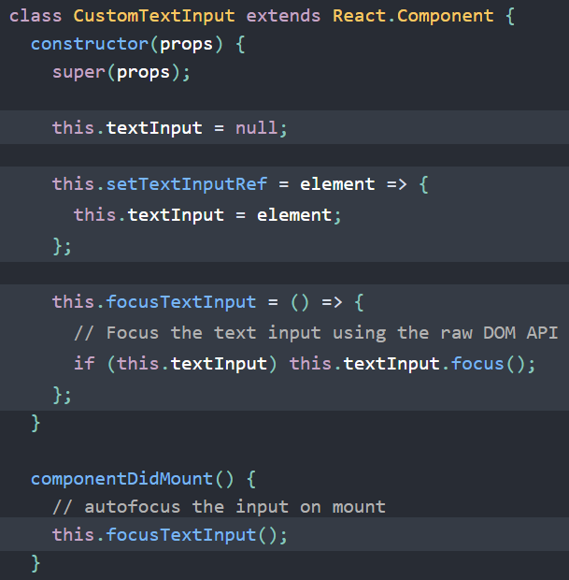
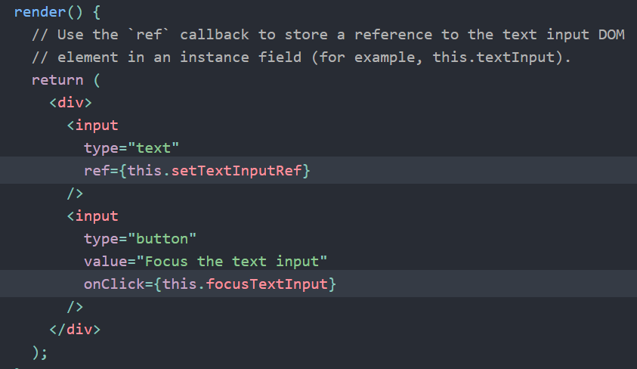
refs and keys
Callback refs
Gives more fine-grain control over when refs are set and unset
The function receives the React component instance or HTML DOM element as its argument, which can be stored and accessed elsewhere.
Coding example

Slide 16
THANK YOU
Vinay Joshi and Sindhu R Pai
Department of Computer Science and Engineering
vinayj@pes.edu
+91 9886703973
sindhurpai@pes.edu
+91 8277606459

