Slide 1



WEB TECHNOLOGIES
React JS –
Event Handling
Prof. Sindhu R Pai
Department of Computer Science and Engineering

Slide 2

ReactJS - Event Handling
Agenda
Introduction
Synthetic Event objects
Requirement
Event Registration
Demo
Programming assignments

Slide 3

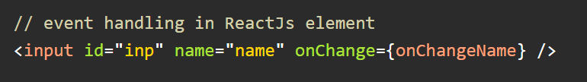

ReactJS - Event Handling
Introduction
Events make the web app interactive and responsive to the user.
React event handling system is known as Synthetic Events.
Almost same as the DOM events. A few differences in the syntax
With JSX in ReactJs, you pass a function as event handler and in DOM element we pass function as string
In DOM elements the event name is in lowercase while in ReactJs it is in camelCase.
In ReactJs, you cannot prevent default behavior by returning false from the event, need to explicitly call preventDefault of the event.

Slide 4
ReactJS - Event Handling
Introduction
Handling events with react have some syntactic differences from handling events on DOM. These are:
React events are named as camelCase instead of lowercase.
With JSX, a function is passed as the event handler instead of a string. For example:

Slide 5
ReactJS - Event Handling
Introduction
<button onclick="showMessage()">
Hello PES
</button>
Event declaration in React:
<button onClick={showMessage}>
Hello JavaTpoint
</button>

Slide 6
ReactJS - Event Handling
Introduction

Slide 7
ReactJS - Event Handling
Introduction

Slide 8
ReactJS - Event Handling
Synthetic Event objects
The event object passed to the event handlers are SyntheticEvent object
A wrapper around the DOMEvent object
The event handlers are registered at the time of rendering
Returning false does not prevent the default browser, use e.preventDefault() or e.stopPropogation() accordingly
Properties
boolean bubbles boolean cancelable
DOMEventTarget currentTarget boolean defaultPrevented
number eventPhase boolean isTrusted
DOMEvent nativeEvent string type

Slide 9
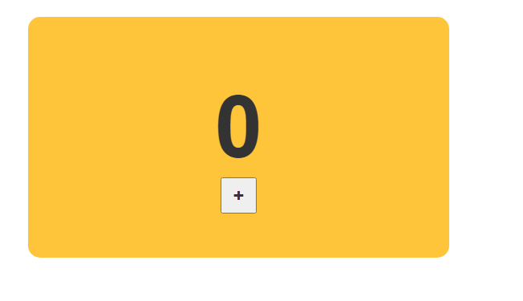
ReactJS - Event Handling
Requirement
Clicking on the + button, the value of our counter must be incremented by one
Involves:
Listen for the click event on the button
Implement the event handler where we react to the click and increase the value of this.state.count that counter relies on

Slide 10
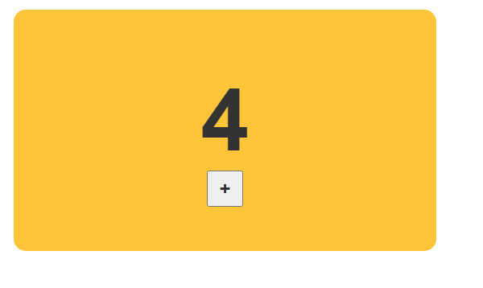
ReactJS - Event Handling
Event Registration
In React, you listen to an event by specifying everything inline in your JSX itself
Specify both the event you are listening for and the event handler that will get called inside the markup

Slide 11
ReactJS - Event Handling
Demo
Demo of event handling

Slide 12
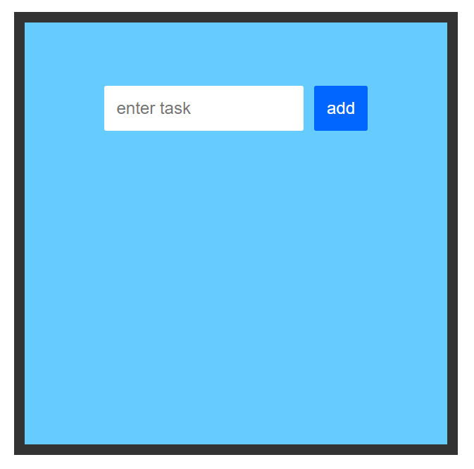
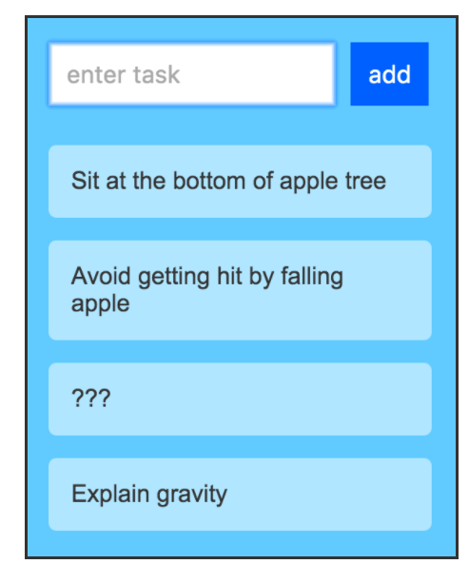
ReactJS - Event Handling
Programming assignment
Build an awesome todo list as shown.

Slide 13
THANK YOU
Sindhu R Pai
Department of Computer Science and Engineering
sindhurpai@pes.edu
+91 8277606459
www.kirupa.com

