Slide 1

WEB TECHNOLOGIES
Single Page Applications &
Asynchronous Communication
Vinay Joshi
Department of
Computer Science and Engineering

Slide 2

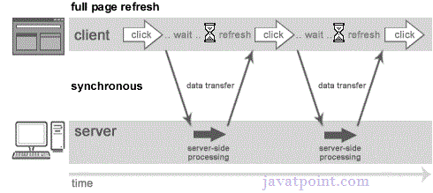
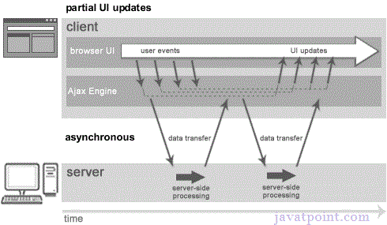
AJAX
A synchronous request blocks the client until operation completes i.e. browser is unresponsive. In such case, javascript engine of the browser is blocked.
An asynchronous request doesn’t block the client i.e. browser is responsive. At that time, user can perform another operations also. In such case, javascript engine of the browser is not blocked.

Slide 3
Single Page Applications
Introduction
Instead of the default method of the browser loading entire new pages, a single-page application (SPA) interacts with the web browser by dynamically rewriting the current web page with new data from the web server
Resources are dynamically loaded and added to the page as necessary, usually in response to user actions
The page does not reload at any point in the process, nor does it transfer control to another page
Can be built using
AJAX
Frameworks like ReactJS, AngularJS

Slide 4
Asynchronous Communication
AJAX(Asynchronous JavaScript And XML)
Traditional web applications, upon request from user like clicking a link or submitting a form, a new page is loaded with requested resources
Asynchronous applications, upon user action, updates a part of the page without reloading the entire page
Approaches include
Setting src property of iFrame or img element
A more elegant and complete approach is use of XHR or XMLHttpRequest object
First create an XHR object using
var xhr = new XMLHttpRequest();

Slide 5
jQuery
AJAX- XHR
An object of XMLHttpRequest is used for asynchronous communication between client and server.
XMLHttpRequest object plays a important role.
User sends a request from the UI and a javascript call goes to XMLHttpRequest object.
HTTP Request is sent to the server by XMLHttpRequest object.
Server interacts with the database using JSP, PHP, Servlet, ASP.net etc.
Data is retrieved.
Server sends XML data or JSON data to the XMLHttpRequest callback function.
HTML and CSS data is displayed on the browser.

Slide 6
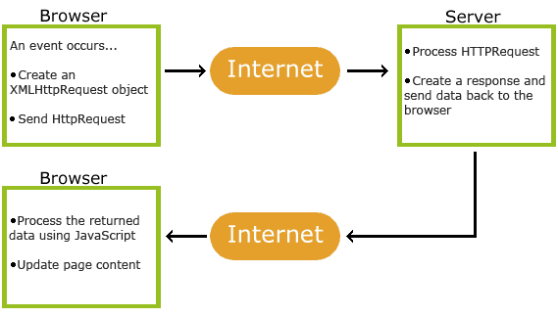
jQuery
AJAX- XHR

Slide 7
Asynchronous Communication
XHR object properties and methods
Properties / Methods | Description
open(method, url [, asynchronous]) | Initializes the request in preparation for sending to the server. The method parameter is the HTTP method to use, for example “GET” or “POST”. The url is the relative or absolute URL the request will be sent to. The optional asynchronous parameter indicates whether send() returns immediately or after the request is complete (default is true, meaning it does not wait for response to come back)
onreadystatechange | Function to call whenever the readyState changes
send([body]) | Initiates the request to the server. The body parameter should contain the body of the request, i.e., a string containing fieldname=value&fieldname2=value2… for POSTs or a null value for GET request

Slide 8
Asynchronous Communication
XHR object properties and methods
Properties / Methods | Description
readyState | Integer indicating the state of the request, either: 0 (uninitialized) 1 (loading) 2 (response headers received) 3 (some response body received) 4 (request complete)
status | HTTP status code returned by the server (e.g., 200, 404, etc.)
responseText | Full response from the server as a string (responseType property is set to “text” – default)
responseXML | A Document object representing the server’s response parsed as an XML document (responseType property is set to “document”)
response | Any other type of response received ((responseType property is set to “blob” or “json”)

Slide 9
AJAX - Asynchronous Javascript And XML
XMLHttpRequest – Code Example
let xmlhttp = new XMLHttpRequest();
xmlhttp.open("GET", filepath, true);
xmlhttp.onreadystatechange=handler;
[xmlhttp.responseType=“json”|“document” |“blob”] // default text
xmlhttp.send(null);
function handler() {
if(this.readyState == 4 && this.status == 200) {
// use this.response (json/blob) or this.responseText (text) or
// this.responseXML (document) to update a part of the page
}
}

Slide 10
THANK YOU
Vinay Joshi
Department of Computer Science and Engineering
vinayj@pes.edu
+91 80 2672 6622

