Slide 1

WEB TECHNOLOGIES
XML vs. JSON
Vinay Joshi
Compiled by Dr.Sarasvathi V
Associate Professor
Department of Computer Science and Engineering

Slide 2

XML vs. JSON
XML
XML stands for “extensible markup language”.
XML was designed in 1996 and officially became a W3C standard in 1998.
It was created to better represent data formats with a hierarchical structure.
HTML
Display data and focus on how the data looks.
XML
Structures, stores, and transfers information and describes what the data is.

Slide 3
XML Vs JSON HTML5
XML PROS
This data format fully supports hierarchical data structures and is very appropriate when receiving complex data as a response.
It is also very human readable. Most browsers have built in XML readers that allow you to inspect XML files.
Since XML was the first standard hierarchical data format, most APIs have built in functionality to automatically convert XML data streams into native data structures like objects.

Slide 4
XML Vs JSON HTML5
XML CONS
This data format is about three times as large as CSV. This is because each data element has an associated open and close parameter tag.

Slide 5
XML vs. JSON
JSON
JSON stands for (Javascript Object Notation).
It was invented in 2001 and became popularized by Yahoo and Google in 2005 and 2006.
It was created as an alternative to XML. Like XML, however, it represents hierarchical data with the use of commas, curly braces and brackets.

Slide 6
XML Vs JSON HTML5
JSON PROS
This data format supports hierarchical data while being smaller in size than XML.
As its name implies, it was also created to more easily parse data into native Javascript objects, making it very useful for web applications.
JSON is the best of both worlds with respect to CSV and XML. It’s simple and compact like CSV, but supports hierarchical data like XML. Unlike XML, JSON formats are only about twice as large as CSV formats.

Slide 7
XML Vs JSON HTML5
JSON CONS
This data format has a little bit less support than XML.
Since JSON is relatively newer than XML, fewer APIs exist to automatically convert JSON to native data structures.
However, this is rapidly changing because newer APIs and plugins are supporting both XML and JSON.

Slide 8
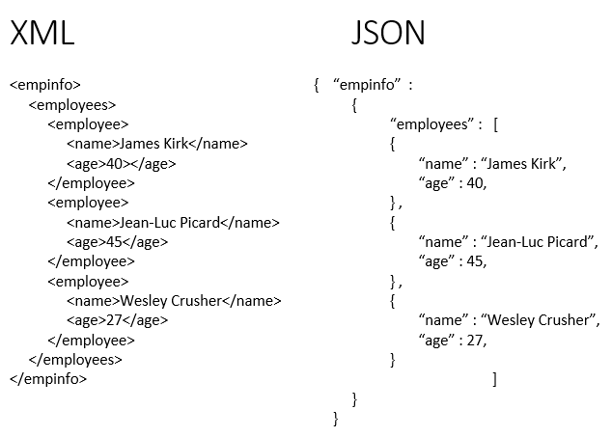
XML vs. JSON
Format

Slide 9
XML vs. JSON
Differences
JSON | XML
Based on JavaScript language | Derived from SGML
Way of representing objects | Markup language to represent data items
No support for namespaces | Supports namespaces
Support arrays | Doesn’t support arrays
Files are very easy to read as compared to XML | Documents are comparatively difficult to read and interpret
Doesn’t use end tag | Has start and end tags
Less secure | More secured than JSON
Doesn’t supports comments | Supports comments
Supports only UTF-8 encoding | Supports various encoding

Slide 10
XML Vs JSON HTML5
JSON
JSON String
'{"name":"John", "age":30, "car":null}’

Slide 11
XML Vs JSON HTML5
JSON
JavaScript has a built in function for converting JSON strings into JavaScript objects:
JSON.parse()
JavaScript also has a built in function for converting an object into a JSON string:
JSON.stringify()
You can receive pure text from a server and use it as a JavaScript object.
You can send a JavaScript object to a server in pure text format.
You can work with data as JavaScript objects, with no complicated parsing and translations.

Slide 12
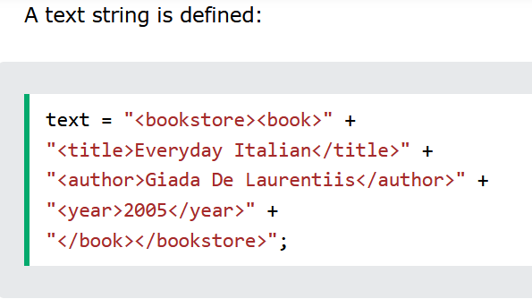
XML Vs JSON HTML5
XML Parser

Slide 13
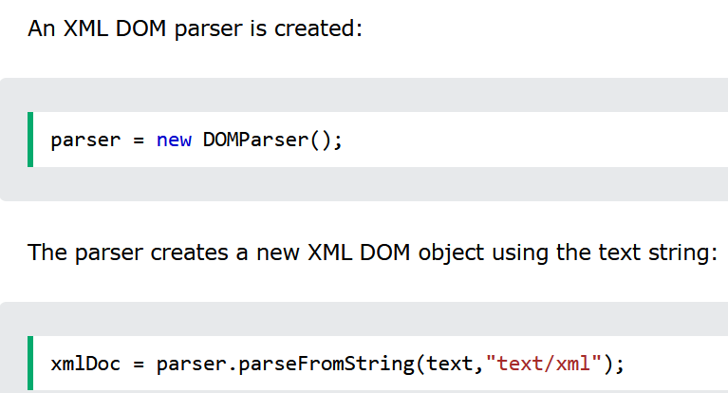
XML Vs JSON HTML5
XML Parser
Parses a text string into an XML DOM object, and extracts the info from it with JavaScript:

Slide 14
XML Vs JSON HTML5
JSON
When storing data, the data has to be a certain format, and regardless of where you choose to store it, text is always one of the legal formats.
JSON makes it possible to store JavaScript objects as text.
A common use of JSON is to exchange data to/from a web server.
When receiving data from a web server, the data is always a string.
Parse the data with JSON.parse(), and the data becomes a JavaScript object.
use the JavaScript function JSON.parse() to convert text into a JavaScript object:
Convert a JavaScript object into a string with JSON.stringify()

Slide 15
THANK YOU
Vinay Joshi
Compiled by Dr.Sarasvathi V
Department of Computer Science and Engineering

