Slide 1

WEB TECHNOLOGIES
Document Object Model
Prof.Vinay Joshi and Dr.Sarasvathi V
Department of
Computer Science and Engineering

Slide 2

HTML5,Jquery and Ajax
DOM – Document Object Model
When a web page is loaded, the browser creates a Document Object Model of the page.
The HTML DOM model is constructed as a tree of Objects.
The HTML DOM is a standard object model and programming interface for HTML. It defines:
The HTML elements as objects
The properties of all HTML elements
The methods to access all HTML elements
The events for all HTML elements

Slide 3
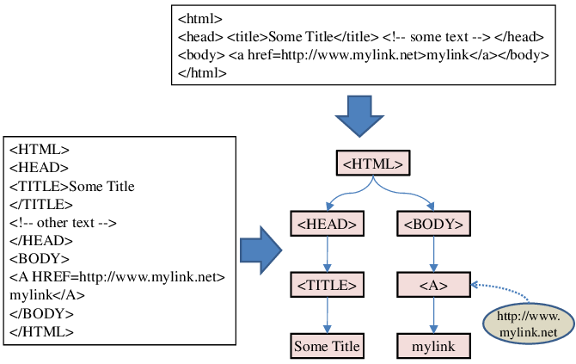
HTML5,Jquery and Ajax
DOM – Document Object Model

Slide 4
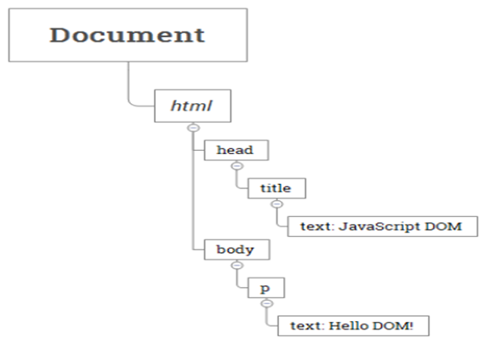
HTML5,Jquery and Ajax
DOM – Tree Representation
<html>
<head>
<title>JavaScript DOM</title>
</head>
<body>
<p>Hello DOM!</p>
</body>
</html>

Slide 5
Document Object Model
Drawbacks of using document.write()
"The W3C Document Object Model (DOM) is a platform and language-neutral interface that allows programs and scripts to dynamically access and update the content, structure, and style of a document.“
Document.write executed after the page has finished loading will overwrite the page, or write a new page, or not work
Document.write practically only appending to the page

Slide 6
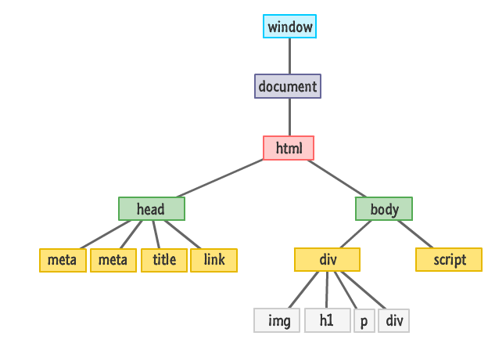
Document Object Model
Introduction to DOM
A Web page is a document. This document can be either displayed in the browser window or as the HTML source. But it is the same document in both cases.
The DOM is an object-oriented representation of the web page, which can be modified with a scripting language such as JavaScript.

Slide 7
DOM
Objects have properties and methods, and respond to events.
Properties – specify attributes or characteristic of object .
Methods – specify functions object can perform.
Events – methods corresponding to user actions.

Slide 8
Document Object Model
The document Object
The document object is the gateway to all the HTML elements and their styling properties that make up what gets shown.
We can dynamically add elements, remove them, move them around, modify attributes on them.
Any text, graphics or any information displayed on a web page is part of the document object.

Slide 9
DOM
DOM Elements Are Objects
Every HTML tag, style rule, and other things that go into your page has some sort of a representation in the DOM.
An image element defined in markup:
<img src="images/lol_panda.png" alt="Sneezing Panda!" width="250" height="100"/>

Slide 10
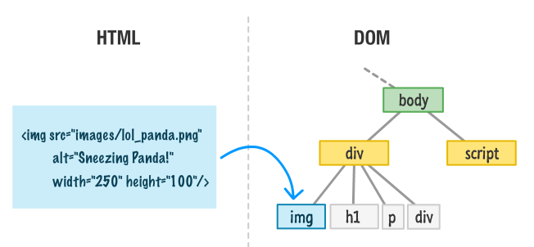
Document Object Model
DOM Elements are Objects

Slide 11
DOM
Accessing DOM
write(“string”): writes the given string on the document.
getElementById(): returns the element having the given id value.
getElementsByName(): returns all the elements having the given name value.
getElementsByTagName(): returns all the elements having the given tag name.

Slide 12
Document Object Model
Accessing Elements in DOM
Access Element By | Equivalent Selector | Method
ID | #demo | getElementByID(“demo”)
Class | .demo | getElementsByClassName(“demo”)
Tag | <tag name> like p | getElementsByTagName(“p”)
Selector (single) | Any CSS Selector | querySelector(“selector”)
Selector (all) |  | querySelectorAll(“selector”)

Slide 13
getElementById()
The document.getElementById() method returns the element of specified id.
The parameter of getElementById can be any expression that evaluates to a string.
syntax-
document.getElementById(“#id");

Slide 14
getElementsByTagName ()
getElementsByTagName is used to access elements and attributes using tag name.
This method will return an array of all the items with the same tag name as a NodeList object.
syntax-
document.getElementsByTagName(tagname)

Slide 15
getElementsByName()
The getElementsByName() method returns a collection of all elements in the document with the specified name (the value of the name attribute), as a NodeList object.
Syntax-
document.getElementsByName(name);

Slide 16
Document.querySelector()
The Document method querySelector() returns the first Element within the document that matches the specified selector, or group of selectors.
If no matches are found, null is returned.
Syntax-
element = document.querySelector(selectors);

Slide 17
Document.querySelectorAll()
The Document method querySelectorAll() returns a static (not live) NodeList representing a list of the document's elements that match the specified group of selectors.
If no matches are found, null is returned.
Syntax-
elementList= parentNode.querySelectorAll(selectors);

Slide 18
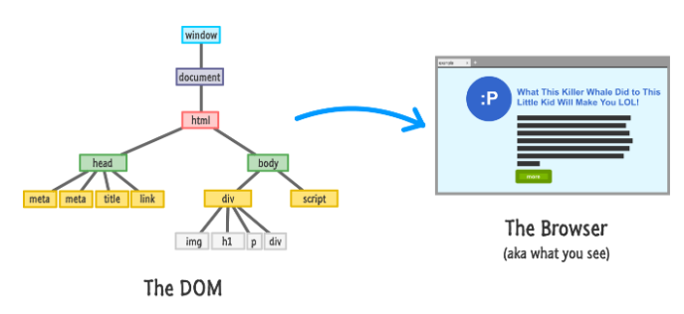
Traversing the DOM

Slide 19
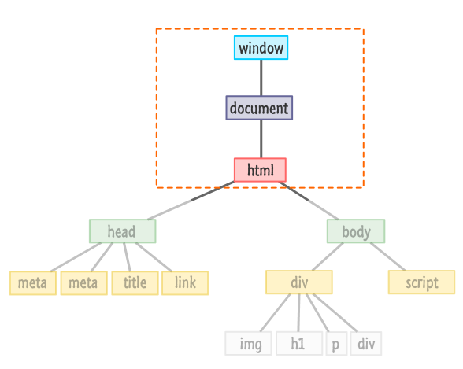
Traversing the DOM

Slide 20
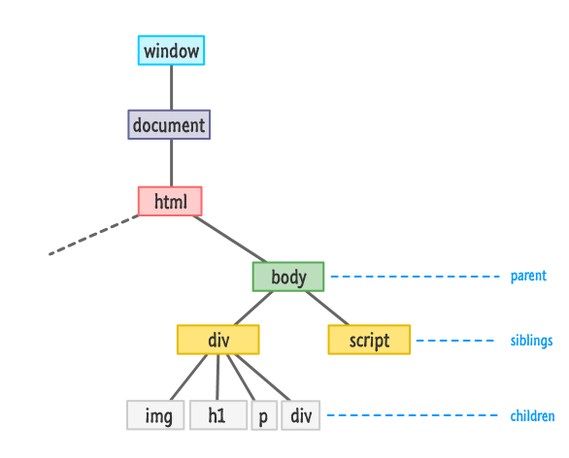
Traversing the DOM

Slide 21
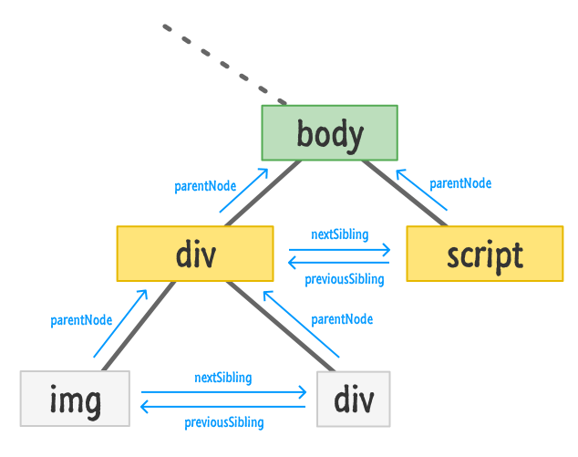
Document Object Model
Traversing the DOM

Slide 22
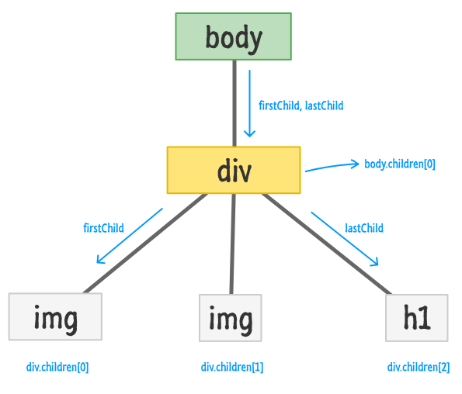
Document Object Model
Traversing the DOM

Slide 23
Document Object Model
Creating Element Objects
Method | Description
document.createElement() | Create a new element node using tag
document.createTextNode() | Create a new text node
Property | Description
node.textContent or node.innerText | Get or set the text content of an element node (without HTML tags)
node.innerHTML | Get or set the HTML content enclosed in the element tag

Slide 24
Document Object Model
Manipulating Nodes in the DOM
Method | Description
node.appendChild() | Add a node as the last child of the parent element.
node.insertBefore() | Insert a node into the parentbefore a specific sibling node
node.replaceChild() | Replace an existing node with a new node
node.removeChild() | Removes child node
node.remove() | Removes a node
* node here can be document.body or any existing element in the DOM

Slide 25
THANK YOU
Vinay Joshi
Department of Computer Science and Engineering
vinayj@pes.edu
+91 80 2672 6622

