Slide 1

WEB TECHNOLOGIES
Events
Vinay Joshi
Department of
Computer Science and Engineering

Slide 2

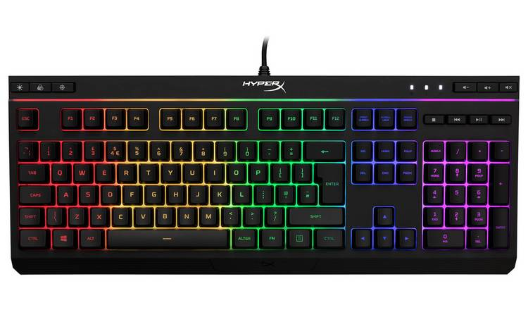
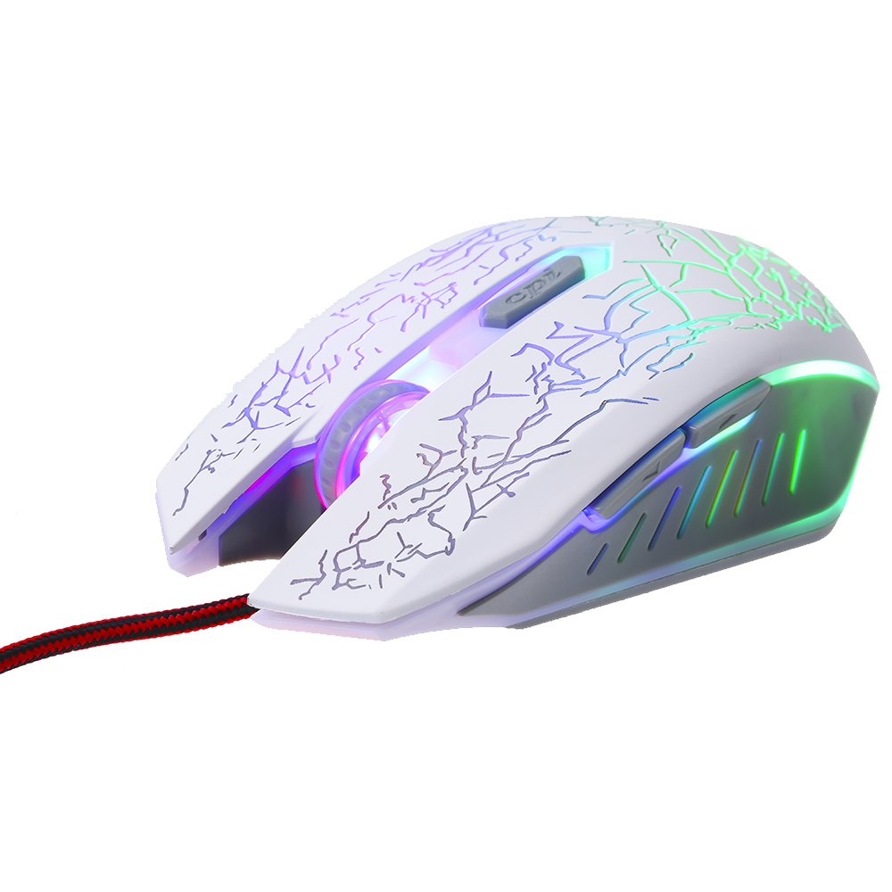
EVENT
What are Events?

Slide 3
EVENT
Events
Examples of HTML events:
When a user clicks the mouse
When a web page has loaded
When an image has been loaded
When the mouse moves over an element
When an input field is changed
When an HTML form is submitted
When a user strokes a key

Slide 4
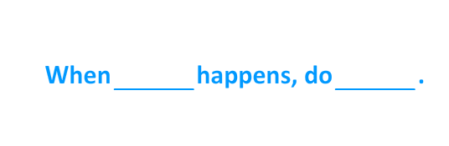
EVENT
What are Events?

Slide 5
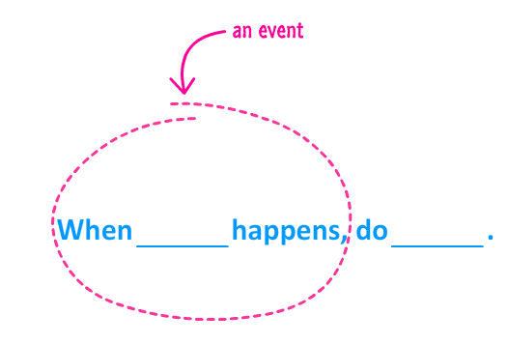
EVENT
What are Events?

Slide 6
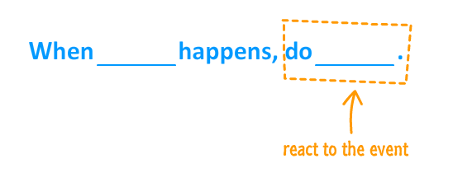
EVENT
What are Events?

Slide 7
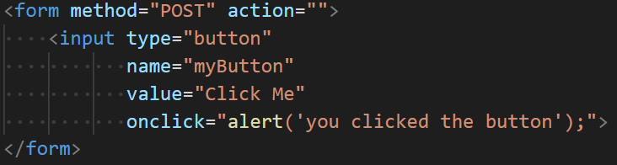
EVENT
A simple event handler Example

Slide 8
EVENT
Event Handlers and Event Listeners
Events are created by activities associated with specific HTML elements.
The process of connecting an event handler to an event is called registration.
There are two distinct approaches to event handler registration,
Assign element attributes
Inline event handlers
Assign handler addresses to object properties
Event handler properties and Event listeners

Slide 9
EVENT
Event Handlers and Event Listeners
Events are created by activities associated with specific HTML elements.
For example, the click event can be caused by the browser user clicking a radio button or the link of an anchor tag.
The process of connecting an event handler to an event is called registration.
There are two distinct approaches to event handler registration,
one that assigns tag attributes
one that assigns handler addresses to object properties.

Slide 10
EVENT
Assigning events to elements
There are three ways to assign events to elements:
Inline event handlers
Event handler properties
Add Event listeners

Slide 11
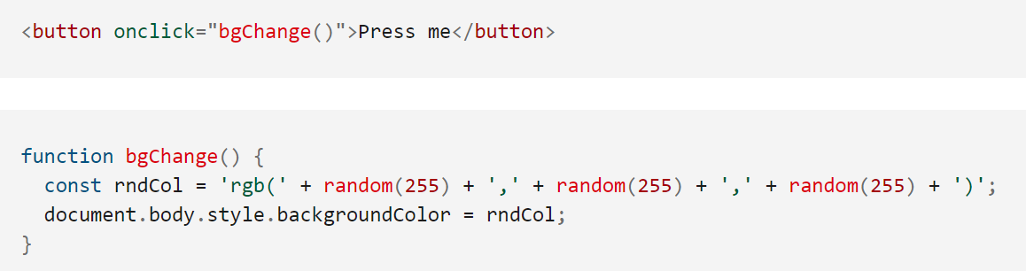
EVENT
Assigning events to elements
Inline event handlers
<button onclick="this.innerHTML = Date()">The time is?</button>

Slide 12
Event
Event Handler Properties
An element can be assigned the event handler property
element.on<event> = handler;
It involves two parts
the correct event name it is to be listening for
the handler callback function.
For example:
div.onclick = change; or
div.onmouseover = function(){ … };

Slide 13
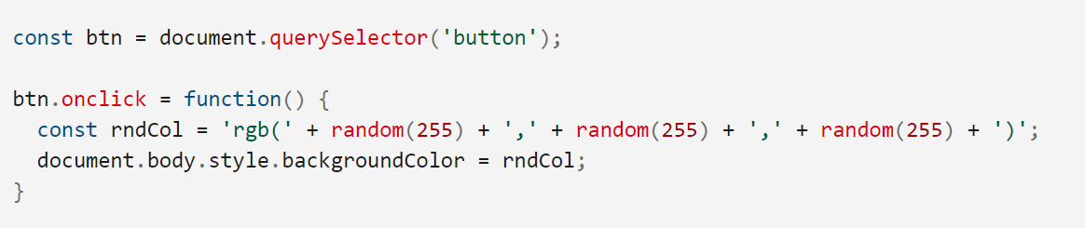
EVENT
Assigning events to elements
Event handler properties

Slide 14
Event
Event Listeners
An event listener watches for an event on an element.
element.addEventListener(event, handler)
It takes two mandatory parameters
the event it is to be listening for.
the handler callback function.
For Example:
div.addEventListener(“click”, change);
div.addEventListener(“keypress”, function(){ … });

Slide 15
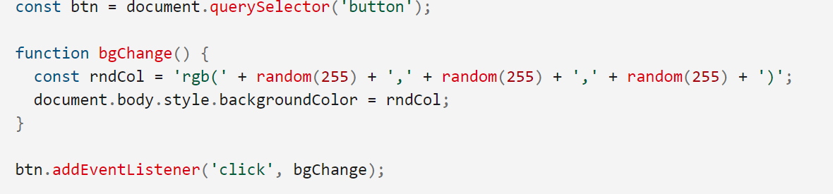
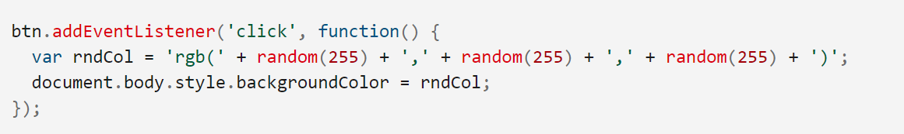
EVENT
Assigning events to elements
Event listeners

Slide 16
Events
Event Sources and example events
Source | Event | Fires When…
Mouse | click | the mouse is clicked and released on an element
 | dblclick | an element is clicked twice
 | mousemove | every time a mouse pointer moves inside an element
 | mouseover | every time a mouse pointer is placed over an element
Keyboard | keydown | when a key is pressed down
 | keyup | when a key pressed is released
 | keypress | when a key is pressed and released
Form | submit | a form is submitted
 | reset | a form reset button is clicked
 | focus | an input element is clicked and receives focus
 | blur | an input element loses focus

Slide 17
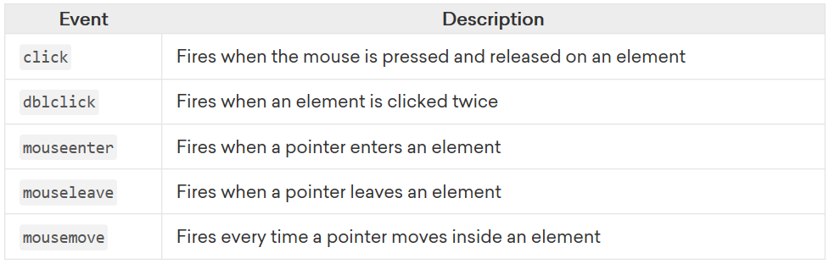
Mouse Events

Slide 18
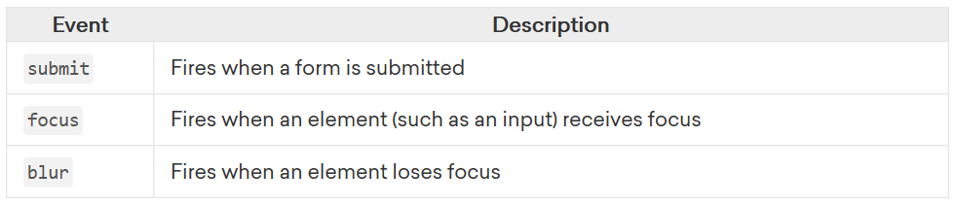
Form Events

Slide 19
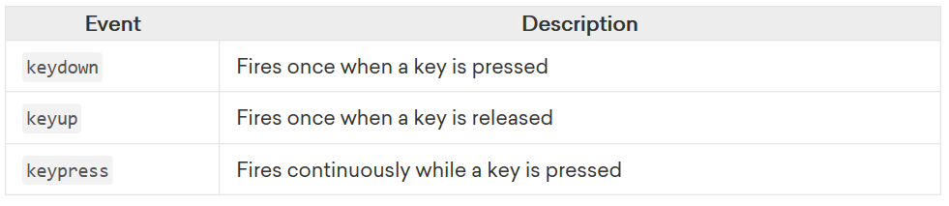
Keyboard Events

Slide 20
Event Concepts
Event Object
Objects have properties and methods, and respond to events.
Properties – specify attributes or characteristic of object .
Methods – specify functions object can perform.
Events – methods corresponding to user actions.
These nodes can be elements, attributes, text content, comments.

Slide 21
Event
Event Object Properties
Event object holds the context or details of the event
Property | IE5-8 Equivalent | Specifies
target | srcElement | the target of the event (most specific element).
type | - | the name of event fired (without the on prefix)
altKey / shiftKey / ctrlKey / metaKey | - | true/false to signify if Alt Key or Shift Key or Ctrl Key or Meta Key was pressed
charCode | keyCode | Unicode character code of the pressed key
key | - | Key Character Name (‘a’ or ‘F1’ or ‘CAPS LOCK’)
button | - | Returns which mouse button was pressed
clientX, clientY / offsetX, offsetY / screenX, screenY | - | the coordinates of the mouse pointer when the event triggered, relative to, the current window / target element / screen

Slide 22
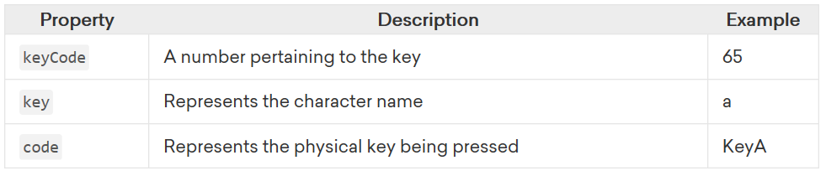
Events
Event Object Properties (contd.)

Slide 23
Event Concept
Event Object Method
Method | IE5-8 Equivalent Property | Purpose
preventDefault() | returnValue | It cancels the default behavior of the event (if possible).
stopPropogation() | cancelBubble | It stops any further bubbling/ capturing of the event.

Slide 24
Event Concepts
Event Delegation
When an event occurs in an element inside another element, and both elements have registered a handle for that event.
Propagation is the process of calling all the listeners for the given event type, attached to the nodes on the branch.
Each listener will be called with an event object that gathers information relevant to the event.
Several listeners can be registered on a node for the same event type.
When the propagation reaches one such node, listeners are invoked in the order of their registration.

Slide 25
Event
Event Object Properties
Event object holds the context or details of the event
Property/ Method | IE5-8 Equivalent | Purpose
target | srcElement | It specifies the target of the event (most specific element).
type | type | It specifies the type of event fired.
cancelable | Not supported | It specifies whether you can cancel the default behaviour of an element.
preventDefault() | returnValue | It cancels the default behavior of the event (if possible).
stopPropogation() | cancelBubble | It stops any further bubbling/ capturing of the event.

Slide 26
Event Flow
There are two ways in which an event can function:
Event Bubbling
Event Capturing
Why the event flow matters?
The flow of events only really matters when the code has event handlers on both an element and one of its ancestor/descendant elements. If the Boolean value is true, it sets the capturing phase but if false, it is the bubbling phase.

Slide 27
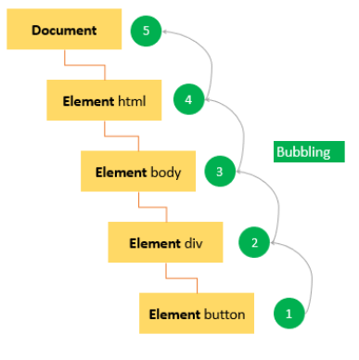
Event Flow
Event Bubbling

Slide 28
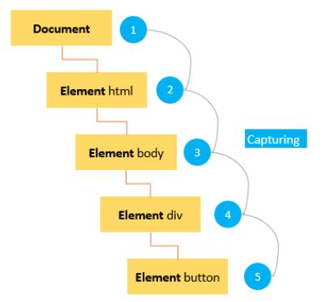
Event Flow
Event Capturing

Slide 29
THANK YOU
Vinay Joshi
Department of Computer Science and Engineering
vinayj@pes.edu
+91 80 2672 6622

