Slide 1

WEB TECHNOLOGIES
Event Handling
Vinay Joshi
Department of
Computer Science and Engineering

Slide 2

Event Handling
Event Propagation
Ways of event propagation in the HTML DOM,
Event bubbling
Event capturing.
Target Phase
Event propagation is a way of defining the element order when an event occurs.
<div>
<p> /<p>
</div>
If both <p> and <div> elements registered Click event, which element's "click" event should be handled first?

Slide 3
Event Handling
Event Propagation
bubbling
inner most element's event is handled first and then the outer: the <p> element's click event is handled first, then the <div> element's click event.
capturing
outer most element's event is handled first and then the inner: the <div> element's click event will be handled first, then the <p> element's click event.

Slide 4
Event Handling
Event Delegation
When an event occurs in an element inside another element, and both elements have registered a handle for that event.
Propagation is the process of calling all the listeners for the given event type, attached to the nodes on the branch.
Each listener will be called with an event object that gathers information relevant to the event.
Several listeners can be registered on a node for the same event type.
When the propagation reaches one such node, listeners are invoked in the order of their registration.

Slide 5
Event Handling
Event Delegation
When an event occurs in an element inside another element, and both elements have registered a handle for that event.
Propagation is the process of calling all the listeners for the given event type, attached to the nodes on the branch.
Each listener will be called with an event object that gathers information relevant to the event.
Several listeners can be registered on a node for the same event type.
When the propagation reaches one such node, listeners are invoked in the order of their registration.

Slide 6
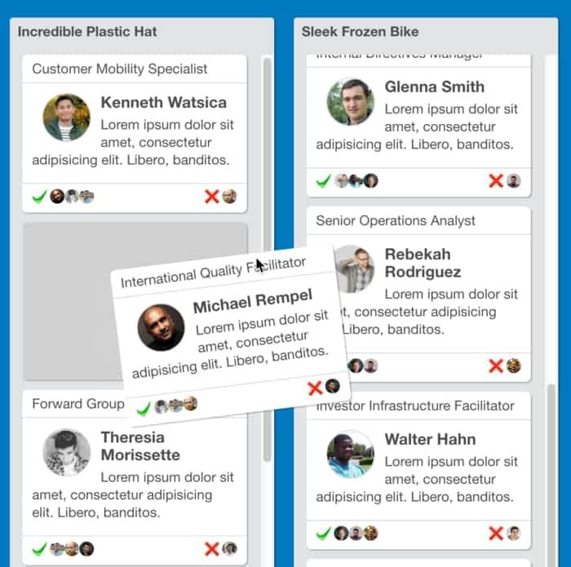
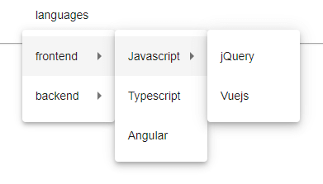
Event Handling
Event Propagation

Slide 7
Event Handling
Event Flow
There are three phases in which an event can propagate to handlers defined in parent elements:
Capturing phase
Target phase
Bubbling phase
elem.addEventListener(“event”, func_ref, flag);
flag = true :=> Handler registered for Capturing phase
flag = false:=> Handler registered for Bubbling phase (default)

Slide 8
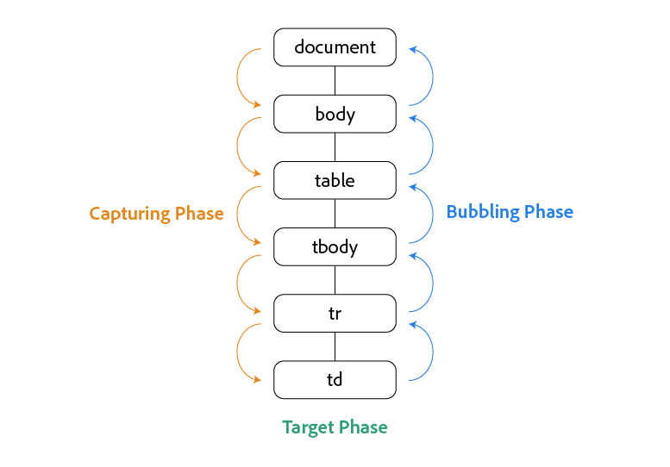
Event Flow
Event Capturing

Slide 9
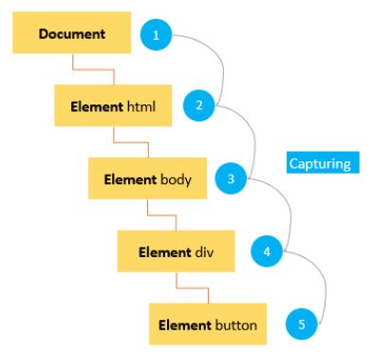
Event Flow
Event Capturing

Slide 10
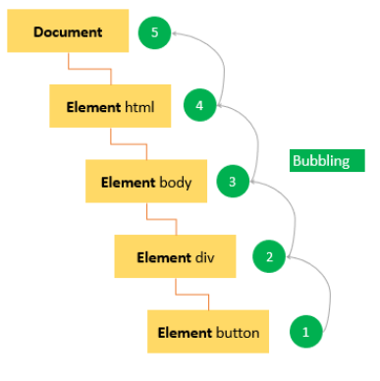
Event Flow
Event Bubbling

Slide 11
Event Flow
Event Capturing
The eventPhase event property returns a number that indicates which phase of the event flow is currently being evaluated.
The number is represented by 4 constants:
0 | NONE
1 | CAPTURING_PHASE | The event flow is in capturing phase
2 | AT_TARGET | The event flow is in target phase, i.e. it is being evaluated at the event target
3 | BUBBLING_PHASE | The event flow is in bubbling phase

Slide 12
Event Handling
Event Object Properties
Event object has properties and methods related to Bubbling and Capturing
Property/ Method | IE5-8 Equivalent | Purpose
cancelBubble | - | A historical alias to stopPropagation(). Setting its value to true before returning prevents propagation
eventPhase | - | Specifies which phase of the event flow is being processed
cancelable | Not supported | Indicates whether you can cancel the default behaviour of an element
preventDefault() | returnValue | It cancels the default behavior of the event (if possible)
stopPropogation() | cancelBubble | It stops any further bubbling/ capturing of the event.

Slide 13
THANK YOU
Vinay Joshi
Department of Computer Science and Engineering
vinayj@pes.edu
+91 80 2672 6622

