Slide 1

WEB TECHNOLOGIES
HTML 5 – Audio, Video and
Progress elements
Prof.Vinay Joshi and Dr.Sarasvathi V
Department of Computer Science and Engineering

Slide 2

HTML5 - Audio
Audio elements
A standard approach for browser to play audio without the use of plug-in.
Mp3, Wav and ogg formats supported by HTML5
Syntax
<audio controls="c1">
<source src="song.ogg" type="audio/ogg" />
<source src="song.mp3" type="audio/mp3" />
Your browser does not support the audio element.
</audio>

Slide 3
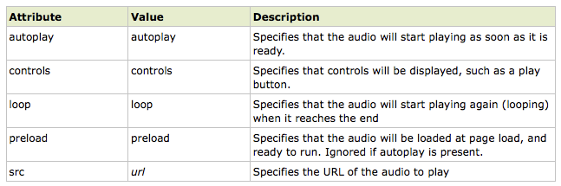
HTML5 - Audio
Audio element properties

Slide 4
HTML5 - Video
Video elements
A standard approach for browser to play video without the use of plug-in
Syntax
<video width="320" height="240" controls="controls">
<source src="movie.ogg" type="video/ogg" />
<source src="movie.mp4" type="video/mp4" />
<source src="movie.webm" type="video/webm" />
Your browser does not support the video tag.
</video>

Slide 5
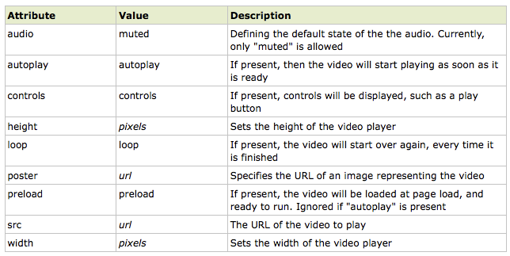
HTML5 - Video
Video element properties

Slide 6
HTML5 - Video
Progress elements
The <progress> tag represents the completion progress of a task.
Always add the <label> tag for describing the task!
Use JavaScript to manipulate the value of the progress bar
Syntax:
<label for="file">Downloading progress:</label>
<progress id="file" value="32" max="100"> 32% </progress>
Attribute | Value | Description
max | number | Specifies how much work the task requires in total. Default value is 1
value | number | Specifies how much of the task has been completed

Slide 7
THANK YOU
Vinay Joshi and Dr.Sarasvathi V
Department of Computer Science and Engineering

