Slide 1

WEB TECHNOLOGIES
HTML 5 – Geo Location &
Web Workers
Prof.Vinay Joshi and Dr.Sarasvathi V
Department of
Computer Science and Engineering

Slide 2

HTML5 – Geo Location
Introduction
Enables your web application to obtain the geographical position of your website visitors
The user has to accept to share their location,
The Geolocation API is work with the navigator.geolocation object.
Accessed via JavaScript, through the navigator.geolocation object.

Slide 3
HTML5 – Geo Location
Methods
navigator.geolocation object allows you to access geo location through two primary functions:
getCurrentPosition()
Returns the location of the visitor as a one-time snapshot
watchPosition()
returns the location of the visitor every time the location changes
Both functions take the following parameters:
Success callback function
Error callback function (optional)
Geo location options object (optional)

Slide 4
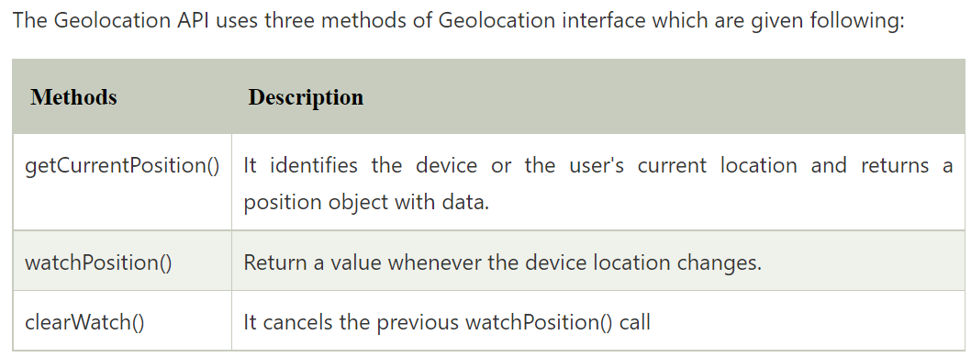
HTML5 – Geo Location
Introduction

Slide 5
HTML5 – Geo Location
Code Example
navigator.geolocation.getCurrentPosition(showPosition);
function showPosition(position) { x.innerHTML = "Latitude: " + position.coords.latitude + "<br>Longitude: " + position.coords.longitude; }
navigator.geolocation.getCurrentPosition( function(position) {
console.log("your position is: " + position.coords.latitude + ", " +
position.coords.longitude);
} );
* getCurrentPosition can be replaced with watchPosition if you need to receive updates to location

Slide 6
HTML5 – Geo Location
Associated Objects
Success callback function receives position object with these read only properties
double latitude
double longitude
double accuracy
double altitude
double altitudeAccuracy
double heading (direction)
double speed
Error callback function receives error object with these two properties
short code
1, meaning PERMISSION_DENIED
2, meaning POSITION_UNAVAILABLE
3, meaning TIMEOUT
DOMString message
Options object (third parameter to getCurrentPosition or watchPosition)
enableHighAccuracy // true or false
timeout // milliseconds
maximumAge // milliseconds

Slide 7
HTML5 – Web Worker
Introduction
A web worker is essentially a thread executing a JavaScript file
Makes it possible to execute a JavaScript file asynchronously and autonomously
Helps achieve multi threading in your web applications
To create a web worker:
var worker = new Worker(“myasync.js");
Parameter is the URL of the JavaScript file to execute

Slide 8
HTML5 – Web Worker
Restrictions
A web worker does not have access to the DOM of the page that creates the web worker.
Here is a list of what a web worker can do:
Listen for messages, using the onmessage event listener function.
Send messages via the postMessage() function.
Send AJAX requests using the XMLHttpRequest.
Create timers using the setTimeout() and sendInterval() functions.

Slide 9
HTML5 – Web Worker
Code Example
Main Page:
var worker = new Worker("worker.js");
// on receiving message from web worker
worker.onmessage = function(event) {
console.log("Reply: " + event.data);
}
// send message to web worker
worker.postMessage("Hello worker!");
Web Worker:
this.onmessage = function(event) {
postMessage("Reply from web worker for “ + event.data);
}
//Implementation of web worker thread code
setInterval(runEvery5Seconds, 5000);
function runEvery5Seconds() {
postMessage("Calling back at : " + new
Date().getTime());
}

Slide 10
THANK YOU
Vinay Joshi and Dr.Sarasvathi V
Department of Computer Science and Engineering

