Slide 1

WEB TECHNOLOGIES
jQuery – Callback and
Promises
Vinay Joshi
Department of
Computer Science and Engineering

Slide 2

jQuery – Callbacks
Introduction
As seen in setInterval, setTimeout and addEventListener, a function accepts a function reference as an argument
They will be called asynchronously based on timer or other events
These function references are called Callback functions
Example:
div.addEventListener(“keypress”, function(){ … });

Slide 3
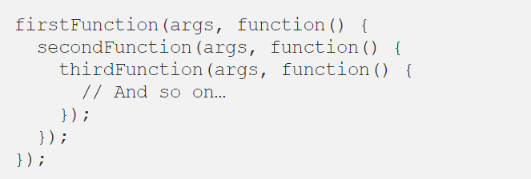
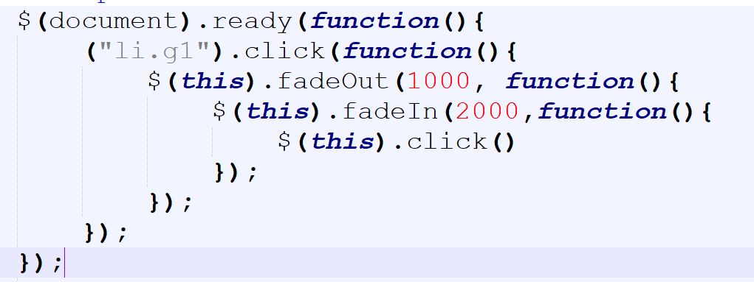
jQuery – Promises
Introduction
Callback Hell
Difficulties to read and maintain.
If there is an error in one function, all the other functions would also get affected, making error handling more complicated.

Slide 4
jQuery – Promises
Introduction
I Promise a Result!“
"Producing code" is code that can take some time
"Consuming code" is code that must wait for the result
A Promise is a JavaScript object that links producing code and consuming code
A JavaScript Promise object contains both the producing code and calls to the consuming code:

Slide 5
jQuery – Promises
Introduction
Promise is a JavaScript object with a value that may not be available at the moment when the code line executes.
These values are resolved at some point in the future.
It allows you to write asynchronous code more synchronously.

Slide 6
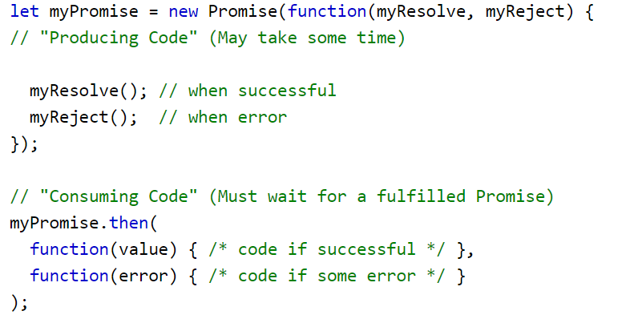
jQuery – Promises
Introduction

Slide 7
jQuery – Promises
Introduction
A Promise Object Properties
JavaScript Promise object can be:
Pending
Fulfilled
Rejected
The Promise object supports two properties: state and result.
While a Promise object is "pending" (working), the result is undefined.
When a Promise object is "fulfilled", the result is a value.
When a Promise object is "rejected", the result is an error object.

Slide 8
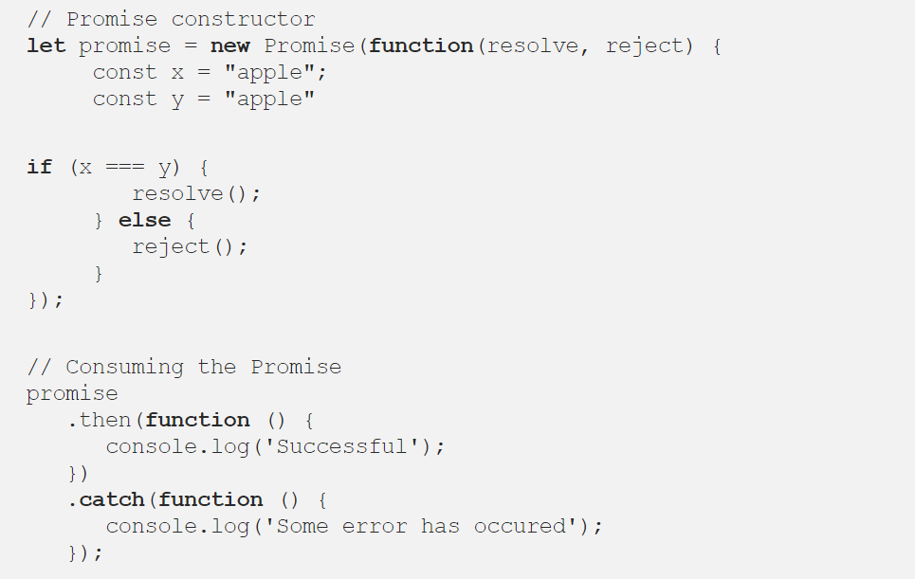
jQuery – Promises
Introduction
The promise constructor takes one argument where we need to pass a callback function.
The callback function takes arguments, resolve() and reject()

Slide 9
jQuery – Promises
Introduction
A promise is used to handle the asynchronous result of an operation.
With Promises, we can defer execution of a code block until an async request is completed.
The Promise object is created using the new keyword and contains the promise; this is an executor function which has a resolve and a reject callback
Essentially, a promise is a returned object to which you attach callbacks, instead of passing callbacks into a function.
const promise = new Promise(function(resolve, reject) {
// promise description
});

Slide 10
jQuery – Promises
Example
var weather;
const date = new Promise(
function(resolve, reject) {
weather = true; //usually a API call
if (weather) {
const dateDetails = {
name: 'Cubana Restaurant',
location: '55th Street',
table: 5
};
resolve(dateDetails)
} else {
reject(new Error('Bad weather'))
}
}
);
date
.then(function(done) {
console.log('We are going on a date!')
console.log(done)
})
.catch(function(error) {
console.log(error.message)
})

Slide 11
jQuery – Callback and Promises
Comparison
Callbacks and Promises are not the same
Callbacks are function passed to another function as a reference
Chaining of Callbacks can be clumsy and lead to Callback Hell
Promises use Callbacks and more elegant than Callbacks
Chaining of Promises is supported

Slide 12
THANK YOU
Vinay Joshi
Department of Computer Science and Engineering
vinayj@pes.edu
+91 80 2672 6622

