Slide 1

WEB TECHNOLOGIES
HTML 5
Vinay Joshi
Department of
Computer Science and Engineering

Slide 2


HTML5
Features
Notes:
Bottom three features are covered in Unit 2.

Slide 3
HTML 5
Forms – New Input Widgets
HTML5 specifications introduced new Input types and properties
New Input Types
email: email address
number: spinbox
range: slider
url: web addresses
color: color pickers
search: search boxes
date: date
time: time
file: input file selection
New Input properties
placeholder
required
pattern
autofocus

Slide 4
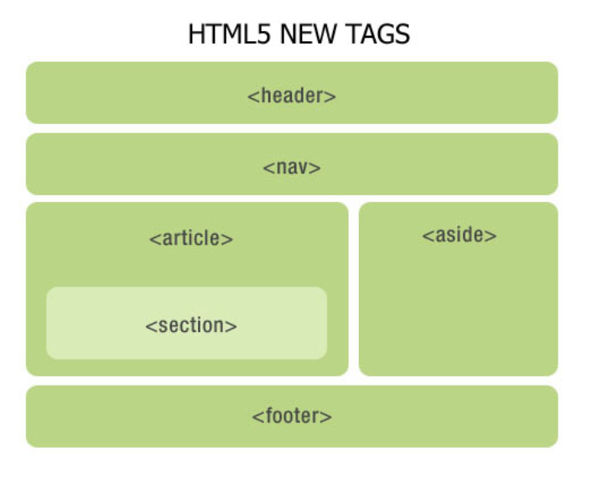
HTML 5
Semantic Elements

Slide 5
HTML 5
Semantic Elements
In earlier versions of HTML, there were no globally accepted names for structural elements, and each developer used their own. That made it very hard for search engines to index web page content correctly.
When a browser communicates with the code, it looks for some specific information to help with the display.
Hence, HTML5 introduced a consistent list of semantic elements to help search engines and developers.

Slide 6
XML Vs JSON HTML5
What are HTML5 semantic elements ?
Creating semantic elements in HTML5 is to give meaning to its traditional design layout.
It helps browsers quickly and efficiently understand the structure of the layout, and two, it helps web developers to systematically arrange or design web pages and give meaning to each section of the layout.
The elements are easy to remember, and fits where it needs.

Slide 7
HTML5: Input - e-mail
The email type is used for input fields that should contain an e-mail address.
The value of the email field is automatically validated when the form is submitted.
E-mail: <input type="email" name="user_email" />

Slide 8
HTML5: Input - url
The url type is used for input fields that should contain a URL address.
The value of the url field is automatically validated when the form is submitted.
Homepage: <input type="url" name="user_url" />

Slide 9
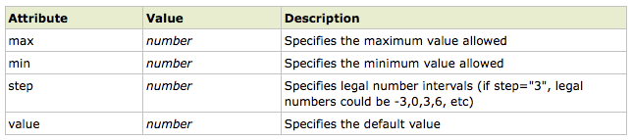
HTML5: Input - number
The number type is used for input fields that should contain a numeric value.
Set restrictions on what numbers are accepted:
Points: <input type="number" name="points" min="1" max="10" />

Slide 10
HTML5: Input - range
The range type is used for input fields that should contain a value from a range of numbers.
The range type is displayed as a slider bar.
You can also set restrictions on what numbers are accepted:
<input type="range" name="points" min="1" max="10" />

Slide 11
HTML5: Input – date pickers
HTML5 has several new input types for selecting date and time:
> date - Selects date, month and year
> month - Selects month and year
> week - Selects week and year
> time - Selects time (hour and minute)‏
> datetime - Selects time, date, month and year. This is now obsolete
> datetime-local - Selects time, date, month and year (local time)‏

Slide 12
HTML5: Input - search
The search type is used for search fields like a site search or Google search.
The search field behaves like a regular text field.

Slide 13
HTML5: Input – color picker
HTML5: Input – color picker
The color type is used for input fields that should contain a color.
This input type will allow you to select a color from a color picker:
Color: <input type="color" name="user_color" />

Slide 14
THANK YOU
Vinay Joshi
Department of Computer Science and Engineering
vinayj@pes.edu
+91 80 2672 6622

