Slide 1

WEB TECHNOLOGIES
Web Development Stack
Prof. Vinay Joshi and Prof. Sindhu R Pai
Department of Computer Science and Engineering

Slide 2

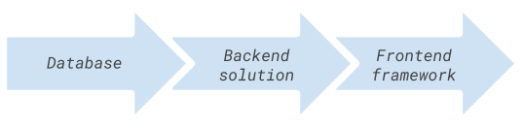
Web Development Stack
Introduction
A set of tools typically used in tandem to develop web apps.
Refers to the technologies that that individual developer specializes in and use together to develop new pieces of software.
Front End web development stack
Back End web development stack
Full web development stack
Web technology sets that include all the essential parts of a modern app: the frontend framework, the backend solution and the database (relational or document-orinted)

Slide 3
Web Development Stack
Full web development Stack
As the web development world is continually changing, its technology stacks too changing
Top web development stacks
MEAN
MERN
Meteor.js
Flutter
The serverless Technology stack
The LAMP technology stack
Ruby on Rails Tech Stack

Slide 4
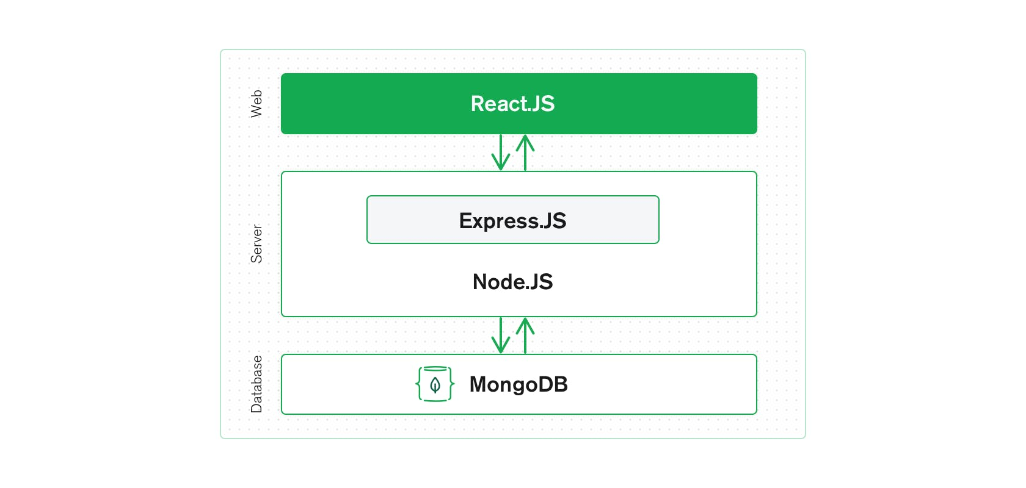
Web Development Stack
MERN - Introduction
Stands for MongoDB, Express, React, Node
MongoDB - document database
Express(.js) - Node.js web framework
React(.js) - a client-side JavaScript library
Node(.js) - the premier JavaScript web server
Allows you to easily construct a 3-tier architecture (frontend, backend, database) entirely using JavaScript and JSON MERN

Slide 5

Web Development Stack
React.JS
Front End Library (The top tier of MERN Stack)
The declarative JavaScript Library for creating dynamic client-side applications
Build up complex interfaces through
simple Components,
connect them to data on your backend server, and
render them as HTML
Strengths:
Handling stateful, data-driven interfaces
Great support for forms, error handling, events, lists, etc.

Slide 6
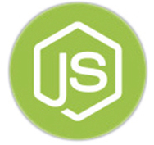

Web Development Stack
Node.JS and Express.JS
Server side Framework (The middle tier of MERN Stack)
Express.js server-side framework, running inside a Node.js server
Has powerful models for URL routing (matching an incoming URL with a server function), and handling HTTP requests and responses
In turn use Node.js MongoDB drivers, either via callbacks for using Promises, to access and update data in your MongoDB database

Slide 7

Web Development Stack
MongoDB
Database Server (The bottom tier of MERN Stack)
Application data store(user profiles, content, comments, uploads, events, etc.)
JSON documents created in the front end can be stored directly in MongoDB for later retrieval through Node.JS and Express.JS

Slide 8
THANK YOU
Vinay Joshi and Sindhu R Pai
Department of Computer Science and Engineering
vinayj@pes.edu
+91 8026726622
sindhurpai@pes.edu
+91 8277606459

