Slide 1



WEB TECHNOLOGIES
React JS –
Component States and LifeCycle Methods
Prof. Vinay Joshi and Prof. Sindhu R Pai
Department of Computer Science and Engineering

Slide 2

Component States and LifeCycle Methods
Agenda
Introduction to states
Conventions of using states
Demo of differences between props and states
Introduction to Life cycle
Pictorial Representation of methods
Life cycle methods in brief
Demo

Slide 3
Component States and LifeCycle Methods
States - Introduction
Can only be accessed and modified inside the component and directly by the component
An instance of React Component class can be defined as an object of a set of observable properties that control the behavior of the component
An object that holds some information that may change over the lifetime as a result of some user actions or system events
Used to track component’s internal state which may change over time

Slide 4
Component States and LifeCycle Methods
Conventions of using states
Must first have some initial state, should define the state in the constructor of the component’s class.
class MyClass extends React.Component {
constructor(props) {
super(props); this.state = { attribute : "value" }; }
}
The state object can contain as many properties as you like
State should never be updated explicitly. Use setstate()
  Takes a single parameter and expects an object which should contain the set of values to be updated.
  Once the update is done the method implicitly calls the render() method to repaint the page.

Slide 5
Component States and LifeCycle Methods
Demo of differences : props and state
Generate the Digital clock using reactJS

Slide 6

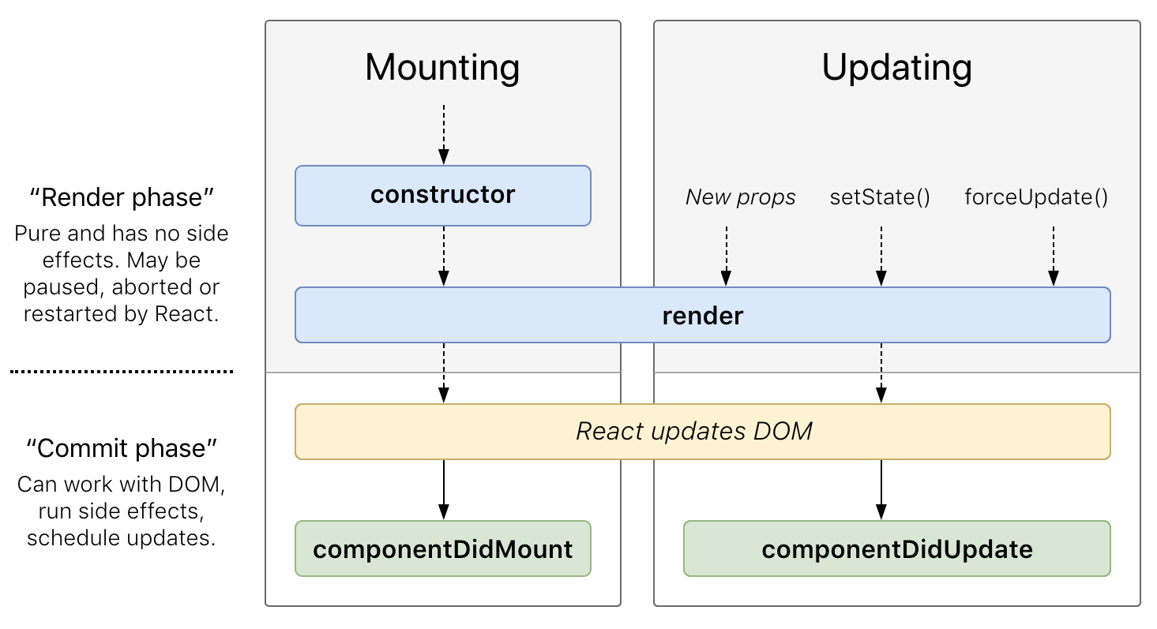
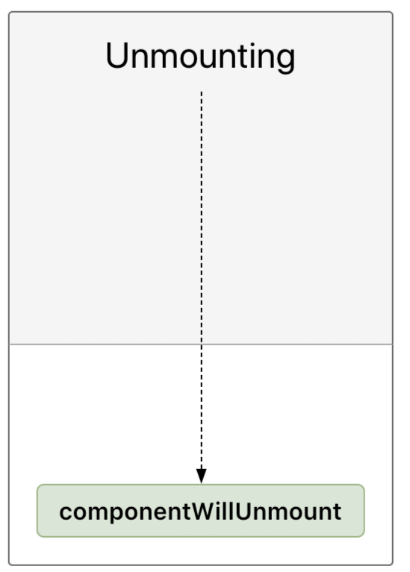
Component States and LifeCycle methods
Introduction to Life Cycle
The series of events that happen from the starting of a React component to its ending.
Every component in React should go through the following lifecycle of events.
  Mounting - Birth of the Component
  Updating- Growing of component
  Unmounting- End of the component

Slide 7
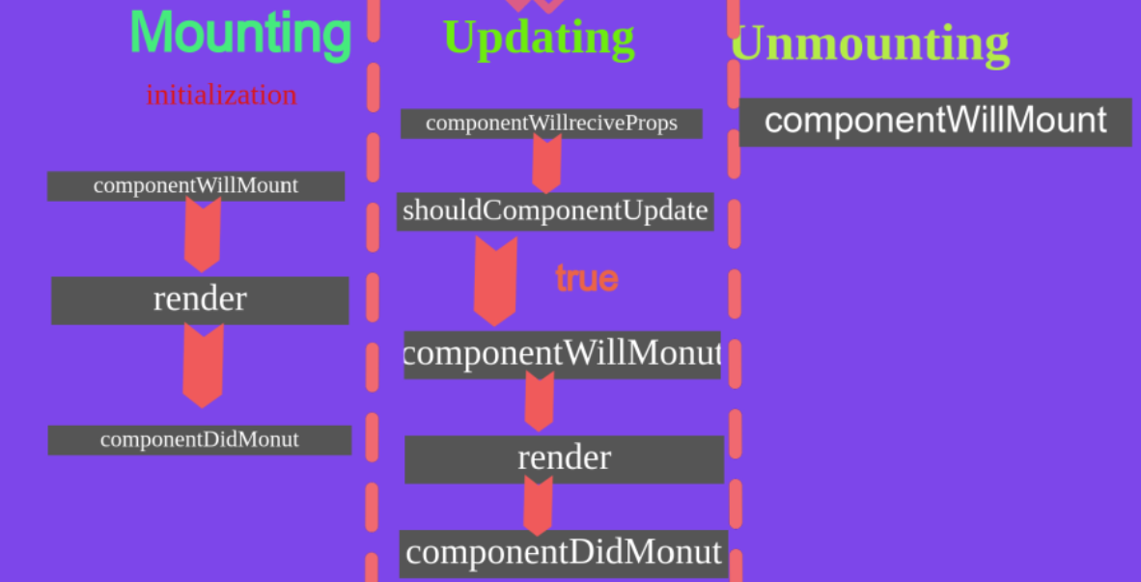
Component States and LifeCycle methods
Pictorial Representation of methods

Slide 8
Component States and LifeCycle methods
Methods
constructor()
  Called before the component is mounted.
  Implementation requires calling of super(props) before further moving. Otherwise, this.props it will be undefined in the constructor, which can lead to a major error in the application.
  Supports Initializing the state and Binding our component
componentWillMount()
  Executed before rendering, on both the server and the client side
render()
  Most useful life cycle method as it is the only method that is required
  Handles the rendering of component while accessing this.state and this.props

Slide 9
Component States and LifeCycle methods
Methods continued..
componentDidMount()
  The best place to initiate API calls in order to fetch data from remote servers
  Use setState which will cause another rendering but It will happen before the browser updates the UI. This is to ensure that the user won’t see the intermediate state
  AJAX requests and DOM or state updates should occur here
  Also used for integration with other JavaScript frameworks like Node.js and any functions with late execution such as setTimeout or setInterval
componentWillReceiveProps()
  Allows us to match the incoming props against our current props and make logical
  We get our current props by calling this.props and the new value is the nextProps argument passed to the method
  It is invoked as soon as the props are updated before another render method is called

Slide 10
Component States and LifeCycle methods
Methods continued..
shouldComponentUpdate()
  Allows a component to exit the Update life cycle if there’s no reason to use a replacement render.
  It may be a no-op that returns true. Means while updating the component, we’ll re-render.
componentWillUpdate()
  Called just before the rendering
componentDidUpdate()
  Is invoked immediately after updating occurs. Not called for the initial render.
  Will not be invoked if shouldcomponentUpdate() returns false.
componentWillUnmount()
  Called when a component is being removed from the DOM

Slide 11
Component States and LifeCycle methods
Demo of diff lifecycle methods

Slide 12
THANK YOU
Vinay Joshi and Sindhu R Pai
Department of Computer Science and Engineering
vinayj@pes.edu
+91 80 2672 6622
sindhurpai@pes.edu
+91 8277606459

