Slide 1



WEB TECHNOLOGIES
React JS –
refs and keys
Prof. Vinay Joshi and Prof. Sindhu R Pai
Department of Computer Science and Engineering

Slide 2

refs and keys
Agenda
Introduction to refs
Create and use refs
Callback refs
Introduction to keys
Keys - Sample code
Map function
Using map with key property

Slide 3

refs and keys
Introduction to refs
Provides a way to access DOM nodes or React elements created in the render method
Used to return a reference to the element
Good use cases for refs to be used:
  Managing focus, text selection, or media playback
  Triggering imperative animations
  Integrating with third-party DOM libraries

Slide 4
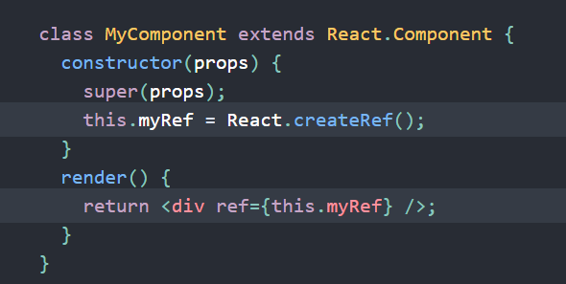

refs and keys
How to create and use refs?
Creating refs:
  Using React.createRef() and attached to React elements via the ref attribute. Refs are commonly assigned to an instance property when a component is constructed so they can be referenced throughout the component.
Accessing refs:
  When a ref is passed to an element in render, a reference to the node becomes accessible at the current attribute of the ref.

Slide 5
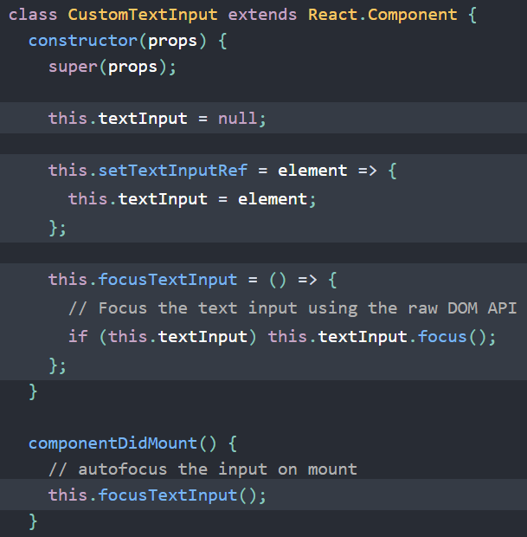
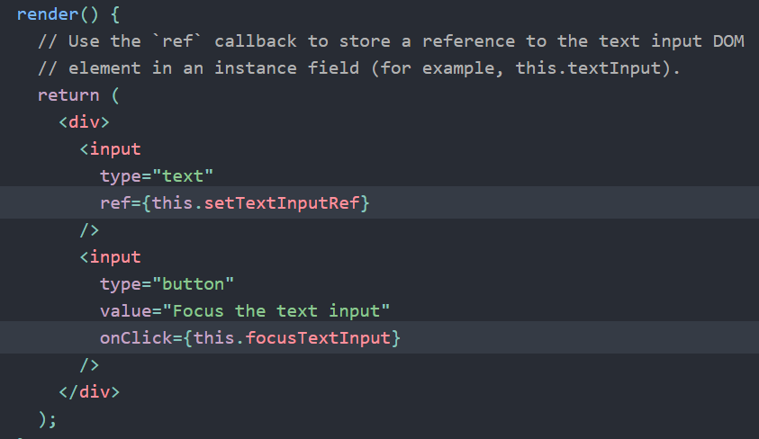
refs and keys
Callback refs
Gives more fine-grain control over when refs are set and unset
The function receives the React component instance or HTML DOM element as its argument, which can be stored and accessed elsewhere.
Coding example

Slide 6
refs and keys
Introduction to keys
Special string attribute while creating list of elements in React
Utilized to identify specific virtual DOM elements that have changed, added, or removed
Keys should be given to the elements inside the array to give the elements a stable identity
Keys only make sense in the context of the surrounding array
Not specifying the key property will display a warning on the console:
Warning: Each child in an array or iterator should have a unique "key" prop.

Slide 7
refs and keys
Keys - Sample codes
When returning a list of elements
  function Stuff () {
  return (
  [
  <p>Batman</p>,
  <p>Ironman</p>,
  <p>Spiderman</p>
  ]
  );
  };
  Specify key property as follows
  function Stuff () {
  return (
  [
  <p key=“1”>Batman</p>,
  <p key=“2”>Ironman</p>,
  <p key=“3”>Spiderman</p>
  ]
  );
  };

Slide 8
refs and keys
Map function
Map is a data collection type where data is stored in the form of key-value pairs
The value stored in the map must be mapped to the key
The map is a JavaScript function that can be called on any array
With the map function, we map every element of the array to the custom components in a single line of code
Sample code:
  const numbers = [1, 2, 3, 4, 5];
  const doubled = numbers.map((number) => number * 2);
  console.log(doubled);

Slide 9
refs and keys
Using map with key property
The code will result in warning, as the list of items does not have the key property
const numbers = [1, 2, 3, 4, 5];
const listItems = numbers.map((number) => <li>{number}</li>);
ReactDOM.render(
<ul>{listItems}</ul>,
document.getElementById('root') );
Modified by adding key property
function NumberList(props) {
const numbers = props.numbers;
const listItems = numbers.map((number) =>
    <li key={number.toString()}> {number} </li> );
    return ( <ul>{listItems}</ul> );
    }
    const numbers = [1, 2, 3, 4, 5];
ReactDOM.render(
<NumberList numbers={numbers} />
document.getElementById('root') );

Slide 10
THANK YOU
Vinay Joshi and Sindhu R Pai
Department of Computer Science and Engineering
vinayj@pes.edu
+91 9886703973
sindhurpai@pes.edu
+91 8277606459

