Slide 1



WEB TECHNOLOGIES
React JS –
Form Handling
Prof. Vinay Joshi and Prof. Sindhu R Pai
Department of Computer Science and Engineering

Slide 2

ReactJS - Form Handling
Agenda
Introduction
Uncontrolled Components
Controlled components
Sample codes
Handling multiple inputs
Practice Program Demo

Slide 3

ReactJS - Form Handling
Introduction
Deals with how to handle the data when the input values are changed or when the form is submitted
Control these changes by adding event handlers to onChange and onSubmit respectively
Two different ways
  Uncontrolled components : Data handled by DOM.
  Controlled components: Data handled by Components
    When the data is handled by the components, all the data is stored in the component state
    Form data is usually handled by the components.

Slide 4
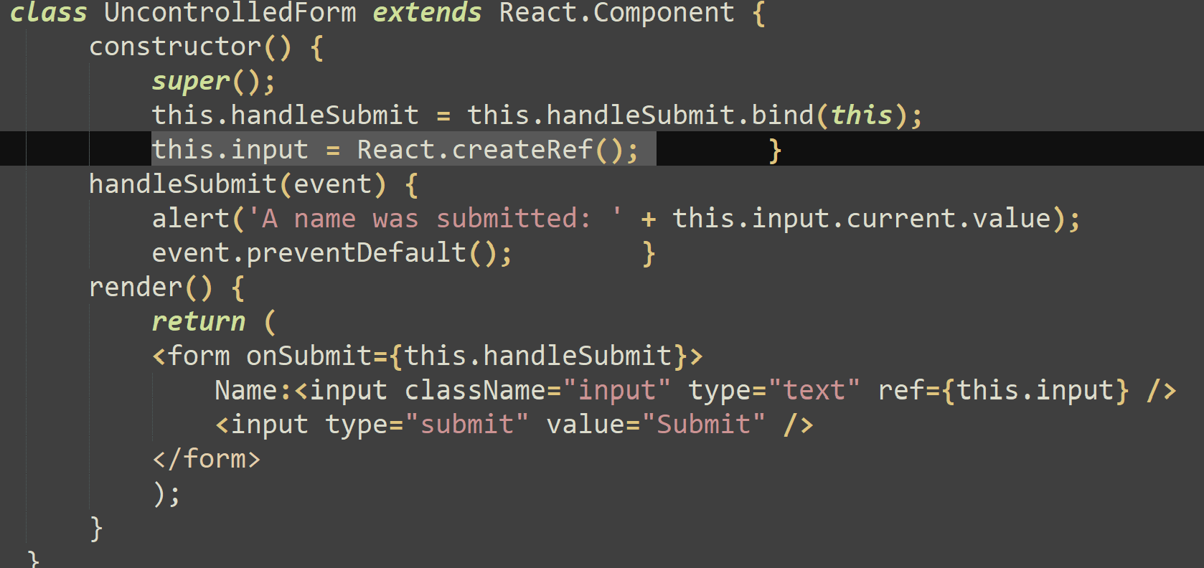
ReactJS - Form Handling
Uncontrolled components
Use a ref to get form values from the DOM
Use the defaultValue property to specify initial value in React
<input defaultValue="Bob" type="text" ref={this.input} />

Slide 5
ReactJS - Form Handling
Controlled components
Has two aspects:
  Have functions to govern the data going into them on every onChange event, rather than grabbing the data only once
    Examples: When a user clicks a submit button. This 'governed' data is then saved to state
  Data displayed by a controlled component is received through props passed down from it's parent/container component.
Value attribute is set on our form element, the displayed value will always be this.state.value, making the React state the source of truth. Since handleChange runs on every keystroke to update the React state, the displayed value will update as the user types

Slide 6
ReactJS - Form Handling
Sample codes related to Controlled components
text inputs, number inputs, radio inputs, checkbox inputs, textareas, selects
Sample codes:
  <textarea> Default Value </textarea> can be changed to
      <textarea value={this.state.value} />
  <select>
    <option select value = “optionselected”> Default Value </option>
    </select> can be changed to
    <select value = {this.state.value}>
    <option value = “optionselected”>Default Value</option>
    </select>

Slide 7
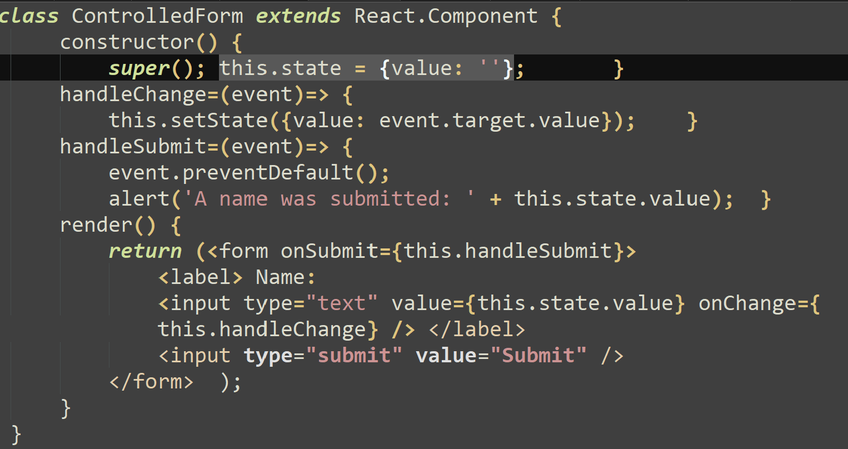
ReactJS - Form Handling
Handling Multiple inputs
First case: Single input

Slide 8
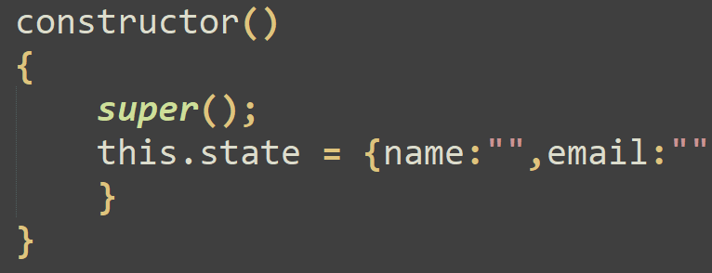
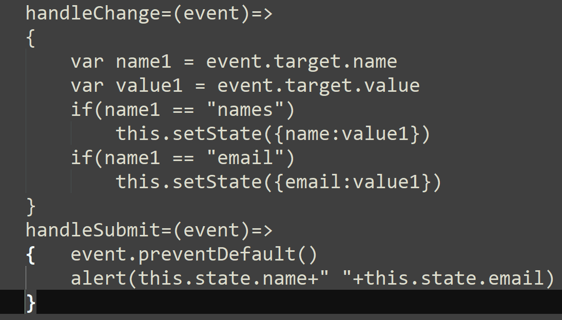
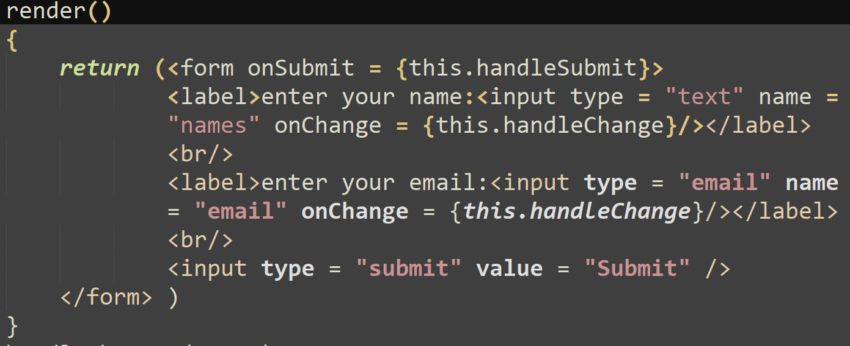
ReactJS - Form Handling
Handling Multiple inputs contd
Second case: Multiple input
Note: If the form contains many fields, this code might not be ideal to use. Reason being event handler contains the code to check the event.target.name on every field before updating the state

Slide 9
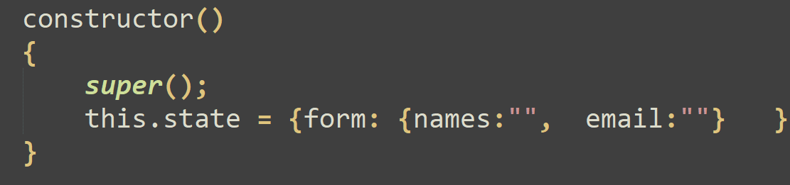
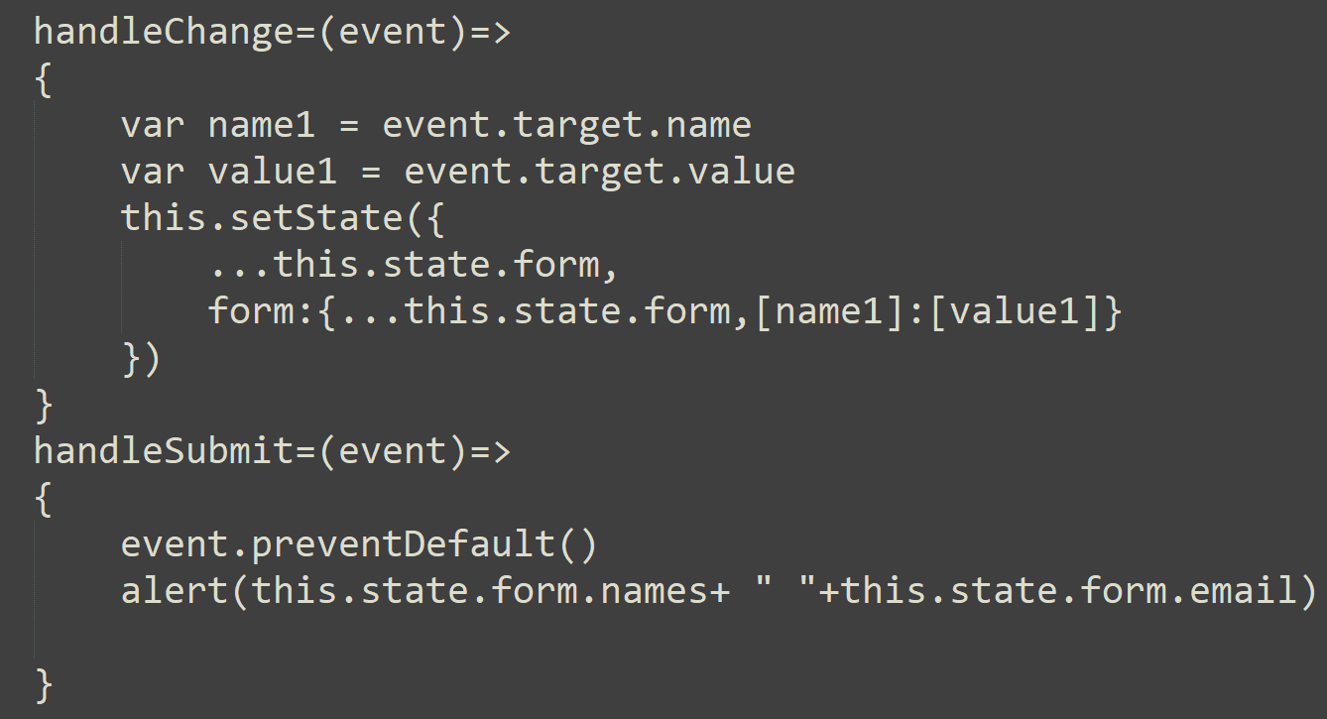
ReactJS - Form Handling
Handling Multiple inputs contd
Solution code to previous Problem

Slide 10
ReactJS - Form Handling
Practice Program Demo
Calculate the Body Mass Index of a person, given the height in meters and weight in kilograms. Also display appropriate message.
  bmi = weight/(height*height)
    If bmi < 19, display “underweight”
    If bmi is between 20 and 24, display “Normal”
    Else display “overweight”

Slide 11
THANK YOU
Vinay Joshi and Sindhu R Pai
Department of Computer Science and Engineering
vinayj@pes.edu
+91 80 2672 6622
sindhurpai@pes.edu
+91 8277606459

