Slide 1

Harry
https://netty.io
PPT模板下载：www.1ppt.com/moban/ 行业PPT模板：www.1ppt.com/hangye/
节日PPT模板：www.1ppt.com/jieri/ PPT素材下载：www.1ppt.com/sucai/
PPT背景图片：www.1ppt.com/beijing/ PPT图表下载：www.1ppt.com/tubiao/
优秀PPT下载：www.1ppt.com/xiazai/ PPT教程： www.1ppt.com/powerpoint/
Word教程： www.1ppt.com/word/ Excel教程：www.1ppt.com/excel/
资料下载：www.1ppt.com/ziliao/ PPT课件下载：www.1ppt.com/kejian/
范文下载：www.1ppt.com/fanwen/ 试卷下载：www.1ppt.com/shiti/
教案下载：www.1ppt.com/jiaoan/ PPT论坛：www.1ppt.cn

Slide 2

What Is Multithreading?
Netty is an asynchronous event-driven network application framework
for rapid development of maintainable high performance protocol servers & clients.
Netty is a NIO client server framework which enables quick and easy development of network applications such as protocol servers and clients. It greatly simplifies and streamlines network programming such as TCP and UDP socket server.
'Quick and easy' doesn't mean that a resulting application will suffer from a maintainability or a performance issue. Netty has been designed carefully with the experiences earned from the implementation of a lot of protocols such as FTP, SMTP, HTTP, and various binary and text-based legacy protocols. As a result, Netty has succeeded to find a way to achieve ease of development, performance, stability, and flexibility without a compromise.
PPT模板下载：www.1ppt.com/moban/ 行业PPT模板：www.1ppt.com/hangye/
节日PPT模板：www.1ppt.com/jieri/ PPT素材下载：www.1ppt.com/sucai/
PPT背景图片：www.1ppt.com/beijing/ PPT图表下载：www.1ppt.com/tubiao/
优秀PPT下载：www.1ppt.com/xiazai/ PPT教程： www.1ppt.com/powerpoint/
Word教程： www.1ppt.com/word/ Excel教程：www.1ppt.com/excel/
资料下载：www.1ppt.com/ziliao/ PPT课件下载：www.1ppt.com/kejian/
范文下载：www.1ppt.com/fanwen/ 试卷下载：www.1ppt.com/shiti/
教案下载：www.1ppt.com/jiaoan/ PPT论坛：www.1ppt.cn

Slide 3
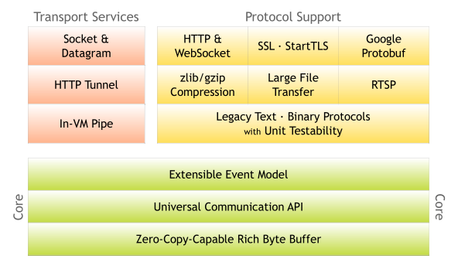
Netty Architecture
PPT模板下载：www.1ppt.com/moban/ 行业PPT模板：www.1ppt.com/hangye/
节日PPT模板：www.1ppt.com/jieri/ PPT素材下载：www.1ppt.com/sucai/
PPT背景图片：www.1ppt.com/beijing/ PPT图表下载：www.1ppt.com/tubiao/
优秀PPT下载：www.1ppt.com/xiazai/ PPT教程： www.1ppt.com/powerpoint/
Word教程： www.1ppt.com/word/ Excel教程：www.1ppt.com/excel/
资料下载：www.1ppt.com/ziliao/ PPT课件下载：www.1ppt.com/kejian/
范文下载：www.1ppt.com/fanwen/ 试卷下载：www.1ppt.com/shiti/
教案下载：www.1ppt.com/jiaoan/ PPT论坛：www.1ppt.cn

Slide 4


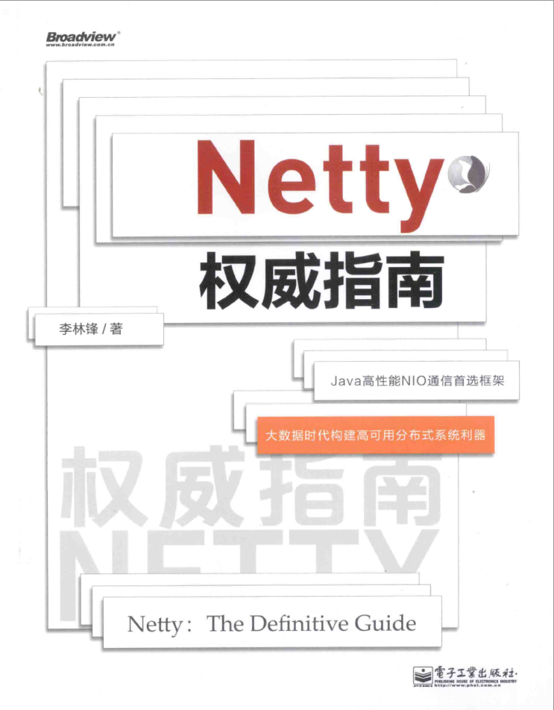
推荐书籍
PPT模板下载：www.1ppt.com/moban/ 行业PPT模板：www.1ppt.com/hangye/
节日PPT模板：www.1ppt.com/jieri/ PPT素材下载：www.1ppt.com/sucai/
PPT背景图片：www.1ppt.com/beijing/ PPT图表下载：www.1ppt.com/tubiao/
优秀PPT下载：www.1ppt.com/xiazai/ PPT教程： www.1ppt.com/powerpoint/
Word教程： www.1ppt.com/word/ Excel教程：www.1ppt.com/excel/
资料下载：www.1ppt.com/ziliao/ PPT课件下载：www.1ppt.com/kejian/
范文下载：www.1ppt.com/fanwen/ 试卷下载：www.1ppt.com/shiti/
教案下载：www.1ppt.com/jiaoan/ PPT论坛：www.1ppt.cn

Slide 5

PPT模板下载：www.1ppt.com/moban/ 行业PPT模板：www.1ppt.com/hangye/
节日PPT模板：www.1ppt.com/jieri/ PPT素材下载：www.1ppt.com/sucai/
PPT背景图片：www.1ppt.com/beijing/ PPT图表下载：www.1ppt.com/tubiao/
优秀PPT下载：www.1ppt.com/xiazai/ PPT教程： www.1ppt.com/powerpoint/
Word教程： www.1ppt.com/word/ Excel教程：www.1ppt.com/excel/
资料下载：www.1ppt.com/ziliao/ PPT课件下载：www.1ppt.com/kejian/
范文下载：www.1ppt.com/fanwen/ 试卷下载：www.1ppt.com/shiti/
教案下载：www.1ppt.com/jiaoan/ PPT论坛：www.1ppt.cn

Slide 6

PPT模板下载：www.1ppt.com/moban/ 行业PPT模板：www.1ppt.com/hangye/
节日PPT模板：www.1ppt.com/jieri/ PPT素材下载：www.1ppt.com/sucai/
PPT背景图片：www.1ppt.com/beijing/ PPT图表下载：www.1ppt.com/tubiao/
优秀PPT下载：www.1ppt.com/xiazai/ PPT教程： www.1ppt.com/powerpoint/
Word教程： www.1ppt.com/word/ Excel教程：www.1ppt.com/excel/
资料下载：www.1ppt.com/ziliao/ PPT课件下载：www.1ppt.com/kejian/
范文下载：www.1ppt.com/fanwen/ 试卷下载：www.1ppt.com/shiti/
教案下载：www.1ppt.com/jiaoan/ PPT论坛：www.1ppt.cn

