Slide 1


Harry
https://netty.io
PPT模板下载：www.1ppt.com/moban/ 行业PPT模板：www.1ppt.com/hangye/
节日PPT模板：www.1ppt.com/jieri/ PPT素材下载：www.1ppt.com/sucai/
PPT背景图片：www.1ppt.com/beijing/ PPT图表下载：www.1ppt.com/tubiao/
优秀PPT下载：www.1ppt.com/xiazai/ PPT教程： www.1ppt.com/powerpoint/
Word教程： www.1ppt.com/word/ Excel教程：www.1ppt.com/excel/
资料下载：www.1ppt.com/ziliao/ PPT课件下载：www.1ppt.com/kejian/
范文下载：www.1ppt.com/fanwen/ 试卷下载：www.1ppt.com/shiti/
教案下载：www.1ppt.com/jiaoan/ PPT论坛：www.1ppt.cn

Slide 2

What Is a Netty?
Netty is an asynchronous event-driven network application framework
for rapid development of maintainable high performance protocol servers & clients.
Netty is a NIO client server framework which enables quick and easy development of network applications such as protocol servers and clients. It greatly simplifies and streamlines network programming such as TCP and UDP socket server.
'Quick and easy' doesn't mean that a resulting application will suffer from a maintainability or a performance issue. Netty has been designed carefully with the experiences earned from the implementation of a lot of protocols such as FTP, SMTP, HTTP, and various binary and text-based legacy protocols. As a result, Netty has succeeded to find a way to achieve ease of development, performance, stability, and flexibility without a compromise.
PPT模板下载：www.1ppt.com/moban/ 行业PPT模板：www.1ppt.com/hangye/
节日PPT模板：www.1ppt.com/jieri/ PPT素材下载：www.1ppt.com/sucai/
PPT背景图片：www.1ppt.com/beijing/ PPT图表下载：www.1ppt.com/tubiao/
优秀PPT下载：www.1ppt.com/xiazai/ PPT教程： www.1ppt.com/powerpoint/
Word教程： www.1ppt.com/word/ Excel教程：www.1ppt.com/excel/
资料下载：www.1ppt.com/ziliao/ PPT课件下载：www.1ppt.com/kejian/
范文下载：www.1ppt.com/fanwen/ 试卷下载：www.1ppt.com/shiti/
教案下载：www.1ppt.com/jiaoan/ PPT论坛：www.1ppt.cn

Slide 3
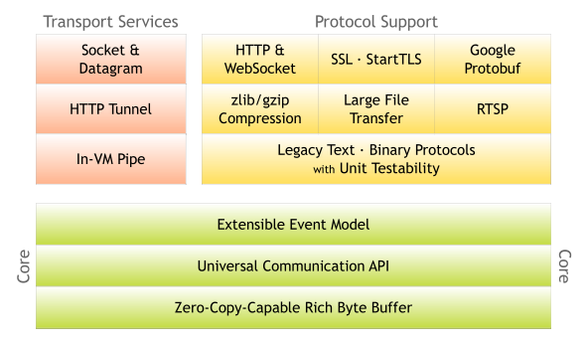
Netty Architecture
PPT模板下载：www.1ppt.com/moban/ 行业PPT模板：www.1ppt.com/hangye/
节日PPT模板：www.1ppt.com/jieri/ PPT素材下载：www.1ppt.com/sucai/
PPT背景图片：www.1ppt.com/beijing/ PPT图表下载：www.1ppt.com/tubiao/
优秀PPT下载：www.1ppt.com/xiazai/ PPT教程： www.1ppt.com/powerpoint/
Word教程： www.1ppt.com/word/ Excel教程：www.1ppt.com/excel/
资料下载：www.1ppt.com/ziliao/ PPT课件下载：www.1ppt.com/kejian/
范文下载：www.1ppt.com/fanwen/ 试卷下载：www.1ppt.com/shiti/
教案下载：www.1ppt.com/jiaoan/ PPT论坛：www.1ppt.cn

Slide 4
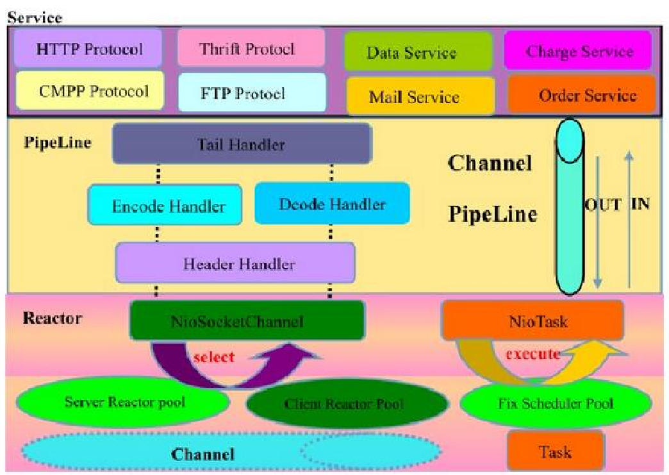
Netty Logic Architecture
PPT模板下载：www.1ppt.com/moban/ 行业PPT模板：www.1ppt.com/hangye/
节日PPT模板：www.1ppt.com/jieri/ PPT素材下载：www.1ppt.com/sucai/
PPT背景图片：www.1ppt.com/beijing/ PPT图表下载：www.1ppt.com/tubiao/
优秀PPT下载：www.1ppt.com/xiazai/ PPT教程： www.1ppt.com/powerpoint/
Word教程： www.1ppt.com/word/ Excel教程：www.1ppt.com/excel/
资料下载：www.1ppt.com/ziliao/ PPT课件下载：www.1ppt.com/kejian/
范文下载：www.1ppt.com/fanwen/ 试卷下载：www.1ppt.com/shiti/
教案下载：www.1ppt.com/jiaoan/ PPT论坛：www.1ppt.cn

Slide 5
Netty Features
Design
Unified API for various transport types - blocking and non-blocking socket
Based on a flexible and extensible event model which allows clear separation of concerns
Highly customizable thread model - single thread, one or more thread pools such as SEDA
True connectionless datagram socket support (since 3.1)
Ease of use
Well-documented Javadoc, user guide and examples
No additional dependencies, JDK 5 (Netty 3.x) or 6 (Netty 4.x) is enough
Note: Some components such as HTTP/2 might have more requirements. Please refer to the Requirements page for more information.
PPT模板下载：www.1ppt.com/moban/ 行业PPT模板：www.1ppt.com/hangye/
节日PPT模板：www.1ppt.com/jieri/ PPT素材下载：www.1ppt.com/sucai/
PPT背景图片：www.1ppt.com/beijing/ PPT图表下载：www.1ppt.com/tubiao/
优秀PPT下载：www.1ppt.com/xiazai/ PPT教程： www.1ppt.com/powerpoint/
Word教程： www.1ppt.com/word/ Excel教程：www.1ppt.com/excel/
资料下载：www.1ppt.com/ziliao/ PPT课件下载：www.1ppt.com/kejian/
范文下载：www.1ppt.com/fanwen/ 试卷下载：www.1ppt.com/shiti/
教案下载：www.1ppt.com/jiaoan/ PPT论坛：www.1ppt.cn

Slide 6
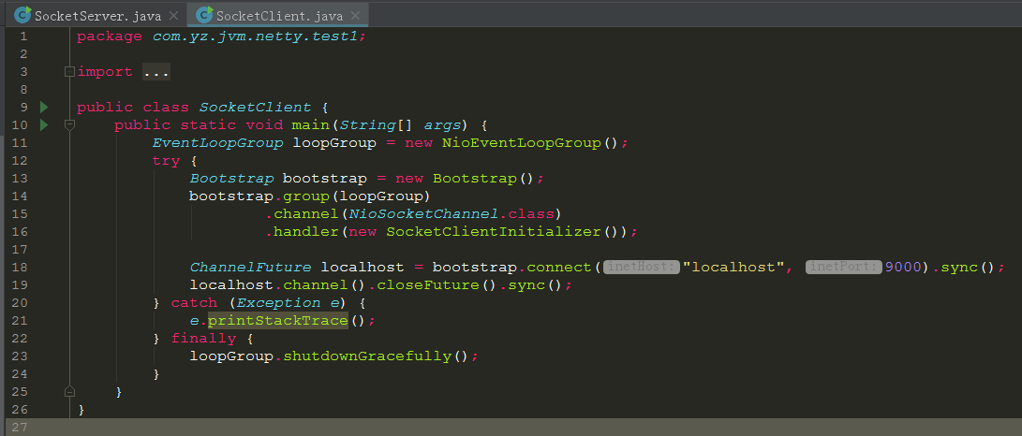
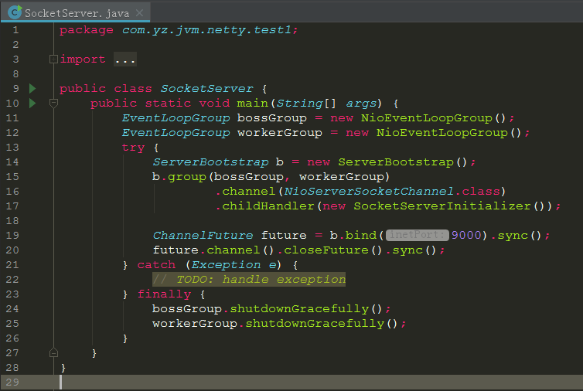
Code Example
PPT模板下载：www.1ppt.com/moban/ 行业PPT模板：www.1ppt.com/hangye/
节日PPT模板：www.1ppt.com/jieri/ PPT素材下载：www.1ppt.com/sucai/
PPT背景图片：www.1ppt.com/beijing/ PPT图表下载：www.1ppt.com/tubiao/
优秀PPT下载：www.1ppt.com/xiazai/ PPT教程： www.1ppt.com/powerpoint/
Word教程： www.1ppt.com/word/ Excel教程：www.1ppt.com/excel/
资料下载：www.1ppt.com/ziliao/ PPT课件下载：www.1ppt.com/kejian/
范文下载：www.1ppt.com/fanwen/ 试卷下载：www.1ppt.com/shiti/
教案下载：www.1ppt.com/jiaoan/ PPT论坛：www.1ppt.cn

Slide 7

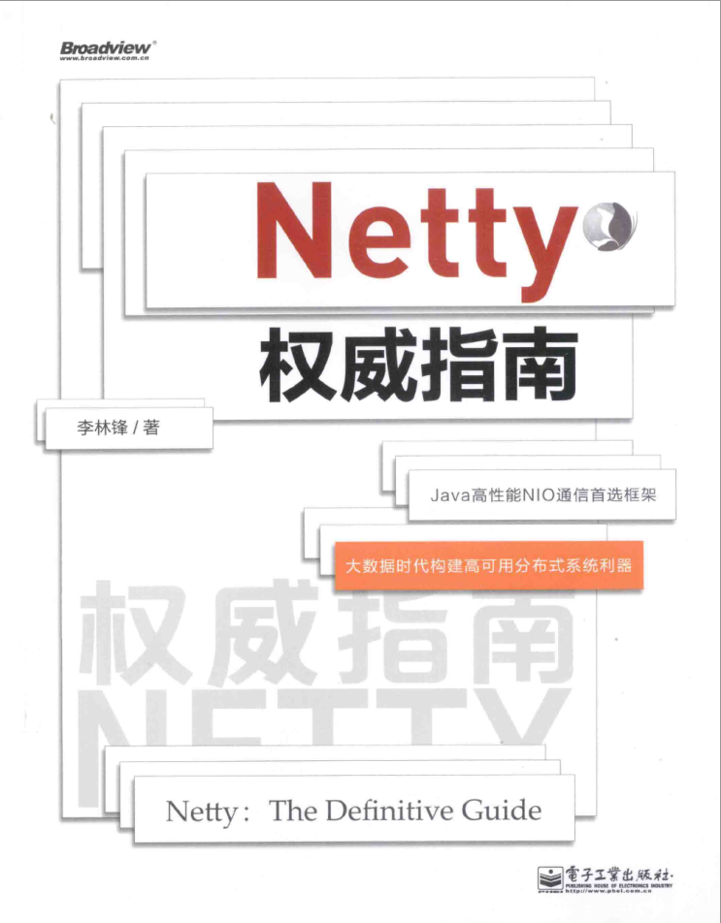
推荐书籍
PPT模板下载：www.1ppt.com/moban/ 行业PPT模板：www.1ppt.com/hangye/
节日PPT模板：www.1ppt.com/jieri/ PPT素材下载：www.1ppt.com/sucai/
PPT背景图片：www.1ppt.com/beijing/ PPT图表下载：www.1ppt.com/tubiao/
优秀PPT下载：www.1ppt.com/xiazai/ PPT教程： www.1ppt.com/powerpoint/
Word教程： www.1ppt.com/word/ Excel教程：www.1ppt.com/excel/
资料下载：www.1ppt.com/ziliao/ PPT课件下载：www.1ppt.com/kejian/
范文下载：www.1ppt.com/fanwen/ 试卷下载：www.1ppt.com/shiti/
教案下载：www.1ppt.com/jiaoan/ PPT论坛：www.1ppt.cn

Slide 8
推荐网站
http://www.oodesign.com/
https://sourcemaking.com/design_patterns/
http://www.java2s.com/Code/Java/Design-Pattern/CatalogDesign-Pattern.htm
http://www.tutorialspoint.com/design_pattern/index.htm
PPT模板下载：www.1ppt.com/moban/ 行业PPT模板：www.1ppt.com/hangye/
节日PPT模板：www.1ppt.com/jieri/ PPT素材下载：www.1ppt.com/sucai/
PPT背景图片：www.1ppt.com/beijing/ PPT图表下载：www.1ppt.com/tubiao/
优秀PPT下载：www.1ppt.com/xiazai/ PPT教程： www.1ppt.com/powerpoint/
Word教程： www.1ppt.com/word/ Excel教程：www.1ppt.com/excel/
资料下载：www.1ppt.com/ziliao/ PPT课件下载：www.1ppt.com/kejian/
范文下载：www.1ppt.com/fanwen/ 试卷下载：www.1ppt.com/shiti/
教案下载：www.1ppt.com/jiaoan/ PPT论坛：www.1ppt.cn

Slide 9

PPT模板下载：www.1ppt.com/moban/ 行业PPT模板：www.1ppt.com/hangye/
节日PPT模板：www.1ppt.com/jieri/ PPT素材下载：www.1ppt.com/sucai/
PPT背景图片：www.1ppt.com/beijing/ PPT图表下载：www.1ppt.com/tubiao/
优秀PPT下载：www.1ppt.com/xiazai/ PPT教程： www.1ppt.com/powerpoint/
Word教程： www.1ppt.com/word/ Excel教程：www.1ppt.com/excel/
资料下载：www.1ppt.com/ziliao/ PPT课件下载：www.1ppt.com/kejian/
范文下载：www.1ppt.com/fanwen/ 试卷下载：www.1ppt.com/shiti/
教案下载：www.1ppt.com/jiaoan/ PPT论坛：www.1ppt.cn

Slide 10

PPT模板下载：www.1ppt.com/moban/ 行业PPT模板：www.1ppt.com/hangye/
节日PPT模板：www.1ppt.com/jieri/ PPT素材下载：www.1ppt.com/sucai/
PPT背景图片：www.1ppt.com/beijing/ PPT图表下载：www.1ppt.com/tubiao/
优秀PPT下载：www.1ppt.com/xiazai/ PPT教程： www.1ppt.com/powerpoint/
Word教程： www.1ppt.com/word/ Excel教程：www.1ppt.com/excel/
资料下载：www.1ppt.com/ziliao/ PPT课件下载：www.1ppt.com/kejian/
范文下载：www.1ppt.com/fanwen/ 试卷下载：www.1ppt.com/shiti/
教案下载：www.1ppt.com/jiaoan/ PPT论坛：www.1ppt.cn

