Slide 1


Harry
https://netty.io
PPT模板下载：www.1ppt.com/moban/ 行业PPT模板：www.1ppt.com/hangye/
节日PPT模板：www.1ppt.com/jieri/ PPT素材下载：www.1ppt.com/sucai/
PPT背景图片：www.1ppt.com/beijing/ PPT图表下载：www.1ppt.com/tubiao/
优秀PPT下载：www.1ppt.com/xiazai/ PPT教程： www.1ppt.com/powerpoint/
Word教程： www.1ppt.com/word/ Excel教程：www.1ppt.com/excel/
资料下载：www.1ppt.com/ziliao/ PPT课件下载：www.1ppt.com/kejian/
范文下载：www.1ppt.com/fanwen/ 试卷下载：www.1ppt.com/shiti/
教案下载：www.1ppt.com/jiaoan/ PPT论坛：www.1ppt.cn

Slide 2

What Is a Netty?
Netty is an asynchronous event-driven network application framework
for rapid development of maintainable high performance protocol servers & clients.
Netty is a NIO client server framework which enables quick and easy development of network applications such as protocol servers and clients. It greatly simplifies and streamlines network programming such as TCP and UDP socket server.
'Quick and easy' doesn't mean that a resulting application will suffer from a maintainability or a performance issue. Netty has been designed carefully with the experiences earned from the implementation of a lot of protocols such as FTP, SMTP, HTTP, and various binary and text-based legacy protocols. As a result, Netty has succeeded to find a way to achieve ease of development, performance, stability, and flexibility without a compromise.
PPT模板下载：www.1ppt.com/moban/ 行业PPT模板：www.1ppt.com/hangye/
节日PPT模板：www.1ppt.com/jieri/ PPT素材下载：www.1ppt.com/sucai/
PPT背景图片：www.1ppt.com/beijing/ PPT图表下载：www.1ppt.com/tubiao/
优秀PPT下载：www.1ppt.com/xiazai/ PPT教程： www.1ppt.com/powerpoint/
Word教程： www.1ppt.com/word/ Excel教程：www.1ppt.com/excel/
资料下载：www.1ppt.com/ziliao/ PPT课件下载：www.1ppt.com/kejian/
范文下载：www.1ppt.com/fanwen/ 试卷下载：www.1ppt.com/shiti/
教案下载：www.1ppt.com/jiaoan/ PPT论坛：www.1ppt.cn

Slide 3
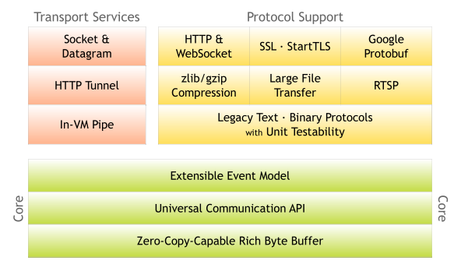
Netty Architecture
PPT模板下载：www.1ppt.com/moban/ 行业PPT模板：www.1ppt.com/hangye/
节日PPT模板：www.1ppt.com/jieri/ PPT素材下载：www.1ppt.com/sucai/
PPT背景图片：www.1ppt.com/beijing/ PPT图表下载：www.1ppt.com/tubiao/
优秀PPT下载：www.1ppt.com/xiazai/ PPT教程： www.1ppt.com/powerpoint/
Word教程： www.1ppt.com/word/ Excel教程：www.1ppt.com/excel/
资料下载：www.1ppt.com/ziliao/ PPT课件下载：www.1ppt.com/kejian/
范文下载：www.1ppt.com/fanwen/ 试卷下载：www.1ppt.com/shiti/
教案下载：www.1ppt.com/jiaoan/ PPT论坛：www.1ppt.cn

Slide 4
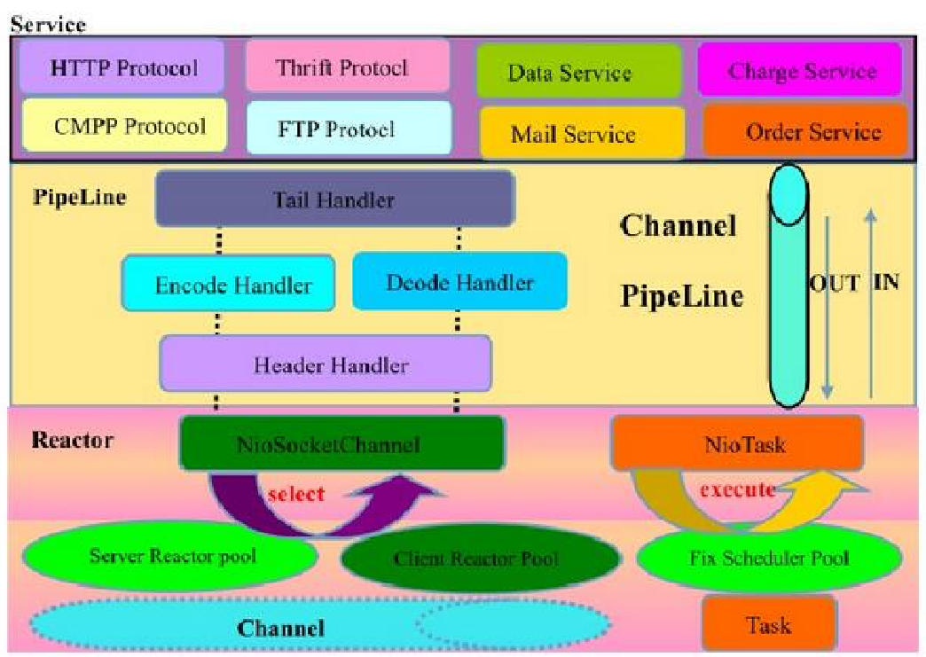
Netty Logic Architecture
PPT模板下载：www.1ppt.com/moban/ 行业PPT模板：www.1ppt.com/hangye/
节日PPT模板：www.1ppt.com/jieri/ PPT素材下载：www.1ppt.com/sucai/
PPT背景图片：www.1ppt.com/beijing/ PPT图表下载：www.1ppt.com/tubiao/
优秀PPT下载：www.1ppt.com/xiazai/ PPT教程： www.1ppt.com/powerpoint/
Word教程： www.1ppt.com/word/ Excel教程：www.1ppt.com/excel/
资料下载：www.1ppt.com/ziliao/ PPT课件下载：www.1ppt.com/kejian/
范文下载：www.1ppt.com/fanwen/ 试卷下载：www.1ppt.com/shiti/
教案下载：www.1ppt.com/jiaoan/ PPT论坛：www.1ppt.cn

Slide 5
Netty Features
Design
Unified API for various transport types - blocking and non-blocking socket
Based on a flexible and extensible event model which allows clear separation of concerns
Highly customizable thread model - single thread, one or more thread pools such as SEDA
True connectionless datagram socket support (since 3.1)
Ease of use
Well-documented Javadoc, user guide and examples
No additional dependencies, JDK 5 (Netty 3.x) or 6 (Netty 4.x) is enough
Note: Some components such as HTTP/2 might have more requirements. Please refer to the Requirements page for more information.
PPT模板下载：www.1ppt.com/moban/ 行业PPT模板：www.1ppt.com/hangye/
节日PPT模板：www.1ppt.com/jieri/ PPT素材下载：www.1ppt.com/sucai/
PPT背景图片：www.1ppt.com/beijing/ PPT图表下载：www.1ppt.com/tubiao/
优秀PPT下载：www.1ppt.com/xiazai/ PPT教程： www.1ppt.com/powerpoint/
Word教程： www.1ppt.com/word/ Excel教程：www.1ppt.com/excel/
资料下载：www.1ppt.com/ziliao/ PPT课件下载：www.1ppt.com/kejian/
范文下载：www.1ppt.com/fanwen/ 试卷下载：www.1ppt.com/shiti/
教案下载：www.1ppt.com/jiaoan/ PPT论坛：www.1ppt.cn

Slide 6
Netty History
2004年6月Netty2发布
2004年6月Netty2的1.0版本发布，这是在java社区中第一个基于事件驱动的应用网络框架。
2005年5月Mina发布
2005年5月官方发布了第一个版本mina 0.7.1，并在ApacheDS 项目中使用。
2006年10月Mina发布1.0.0版本。
2010年9月Mina发布2.0.0版本。
2008年Netty3发布
2008年10月jboss发布Netty3.0.0版本。
2013年Netty4发布
2013年7月Netty（netty.io）发布4.0.0版本。
2015年Netty4.1发布
2018年5月（netty.io）发布最新的Netty 4.1.25版本。
PPT模板下载：www.1ppt.com/moban/ 行业PPT模板：www.1ppt.com/hangye/
节日PPT模板：www.1ppt.com/jieri/ PPT素材下载：www.1ppt.com/sucai/
PPT背景图片：www.1ppt.com/beijing/ PPT图表下载：www.1ppt.com/tubiao/
优秀PPT下载：www.1ppt.com/xiazai/ PPT教程： www.1ppt.com/powerpoint/
Word教程： www.1ppt.com/word/ Excel教程：www.1ppt.com/excel/
资料下载：www.1ppt.com/ziliao/ PPT课件下载：www.1ppt.com/kejian/
范文下载：www.1ppt.com/fanwen/ 试卷下载：www.1ppt.com/shiti/
教案下载：www.1ppt.com/jiaoan/ PPT论坛：www.1ppt.cn

Slide 7
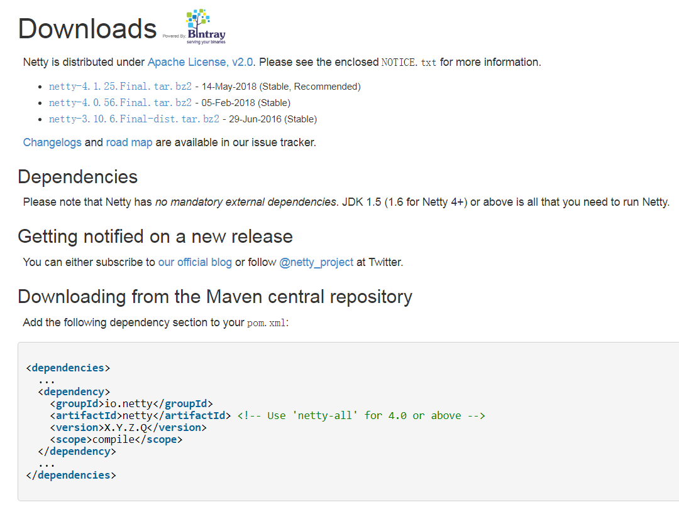
Netty Downloads
http://netty.io/downloads.html
PPT模板下载：www.1ppt.com/moban/ 行业PPT模板：www.1ppt.com/hangye/
节日PPT模板：www.1ppt.com/jieri/ PPT素材下载：www.1ppt.com/sucai/
PPT背景图片：www.1ppt.com/beijing/ PPT图表下载：www.1ppt.com/tubiao/
优秀PPT下载：www.1ppt.com/xiazai/ PPT教程： www.1ppt.com/powerpoint/
Word教程： www.1ppt.com/word/ Excel教程：www.1ppt.com/excel/
资料下载：www.1ppt.com/ziliao/ PPT课件下载：www.1ppt.com/kejian/
范文下载：www.1ppt.com/fanwen/ 试卷下载：www.1ppt.com/shiti/
教案下载：www.1ppt.com/jiaoan/ PPT论坛：www.1ppt.cn

Slide 8






Netty Related projects
http://netty.io/wiki/related-projects.html
PPT模板下载：www.1ppt.com/moban/ 行业PPT模板：www.1ppt.com/hangye/
节日PPT模板：www.1ppt.com/jieri/ PPT素材下载：www.1ppt.com/sucai/
PPT背景图片：www.1ppt.com/beijing/ PPT图表下载：www.1ppt.com/tubiao/
优秀PPT下载：www.1ppt.com/xiazai/ PPT教程： www.1ppt.com/powerpoint/
Word教程： www.1ppt.com/word/ Excel教程：www.1ppt.com/excel/
资料下载：www.1ppt.com/ziliao/ PPT课件下载：www.1ppt.com/kejian/
范文下载：www.1ppt.com/fanwen/ 试卷下载：www.1ppt.com/shiti/
教案下载：www.1ppt.com/jiaoan/ PPT论坛：www.1ppt.cn

Slide 9
Scalable IO in Java
Blocking
Nonblocking
Synchronous
Asynchronous
PPT模板下载：www.1ppt.com/moban/ 行业PPT模板：www.1ppt.com/hangye/
节日PPT模板：www.1ppt.com/jieri/ PPT素材下载：www.1ppt.com/sucai/
PPT背景图片：www.1ppt.com/beijing/ PPT图表下载：www.1ppt.com/tubiao/
优秀PPT下载：www.1ppt.com/xiazai/ PPT教程： www.1ppt.com/powerpoint/
Word教程： www.1ppt.com/word/ Excel教程：www.1ppt.com/excel/
资料下载：www.1ppt.com/ziliao/ PPT课件下载：www.1ppt.com/kejian/
范文下载：www.1ppt.com/fanwen/ 试卷下载：www.1ppt.com/shiti/
教案下载：www.1ppt.com/jiaoan/ PPT论坛：www.1ppt.cn

Slide 10
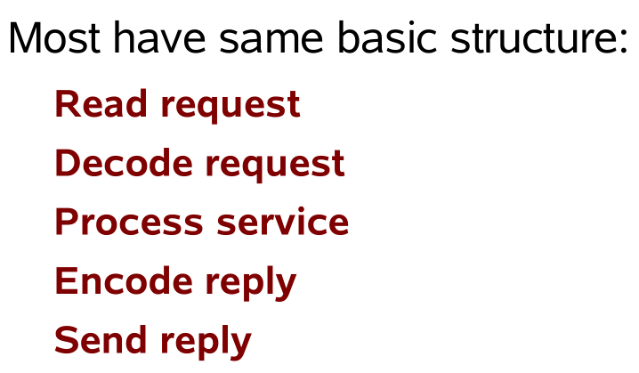
Network Services
PPT模板下载：www.1ppt.com/moban/ 行业PPT模板：www.1ppt.com/hangye/
节日PPT模板：www.1ppt.com/jieri/ PPT素材下载：www.1ppt.com/sucai/
PPT背景图片：www.1ppt.com/beijing/ PPT图表下载：www.1ppt.com/tubiao/
优秀PPT下载：www.1ppt.com/xiazai/ PPT教程： www.1ppt.com/powerpoint/
Word教程： www.1ppt.com/word/ Excel教程：www.1ppt.com/excel/
资料下载：www.1ppt.com/ziliao/ PPT课件下载：www.1ppt.com/kejian/
范文下载：www.1ppt.com/fanwen/ 试卷下载：www.1ppt.com/shiti/
教案下载：www.1ppt.com/jiaoan/ PPT论坛：www.1ppt.cn

Slide 11
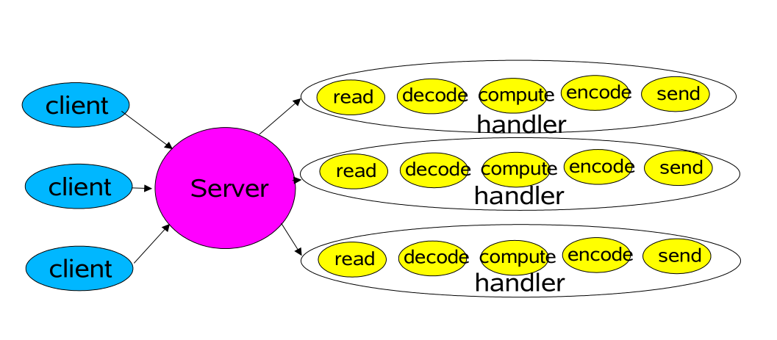
Classic Service Designs
Each handler may be started in its own thread
PPT模板下载：www.1ppt.com/moban/ 行业PPT模板：www.1ppt.com/hangye/
节日PPT模板：www.1ppt.com/jieri/ PPT素材下载：www.1ppt.com/sucai/
PPT背景图片：www.1ppt.com/beijing/ PPT图表下载：www.1ppt.com/tubiao/
优秀PPT下载：www.1ppt.com/xiazai/ PPT教程： www.1ppt.com/powerpoint/
Word教程： www.1ppt.com/word/ Excel教程：www.1ppt.com/excel/
资料下载：www.1ppt.com/ziliao/ PPT课件下载：www.1ppt.com/kejian/
范文下载：www.1ppt.com/fanwen/ 试卷下载：www.1ppt.com/shiti/
教案下载：www.1ppt.com/jiaoan/ PPT论坛：www.1ppt.cn

Slide 12
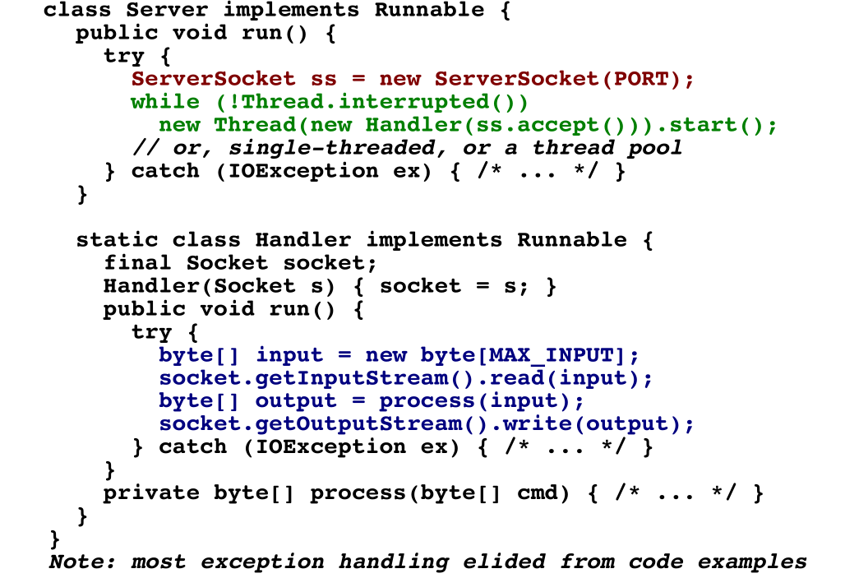
Classic ServerSocket Loop
PPT模板下载：www.1ppt.com/moban/ 行业PPT模板：www.1ppt.com/hangye/
节日PPT模板：www.1ppt.com/jieri/ PPT素材下载：www.1ppt.com/sucai/
PPT背景图片：www.1ppt.com/beijing/ PPT图表下载：www.1ppt.com/tubiao/
优秀PPT下载：www.1ppt.com/xiazai/ PPT教程： www.1ppt.com/powerpoint/
Word教程： www.1ppt.com/word/ Excel教程：www.1ppt.com/excel/
资料下载：www.1ppt.com/ziliao/ PPT课件下载：www.1ppt.com/kejian/
范文下载：www.1ppt.com/fanwen/ 试卷下载：www.1ppt.com/shiti/
教案下载：www.1ppt.com/jiaoan/ PPT论坛：www.1ppt.cn

Slide 13
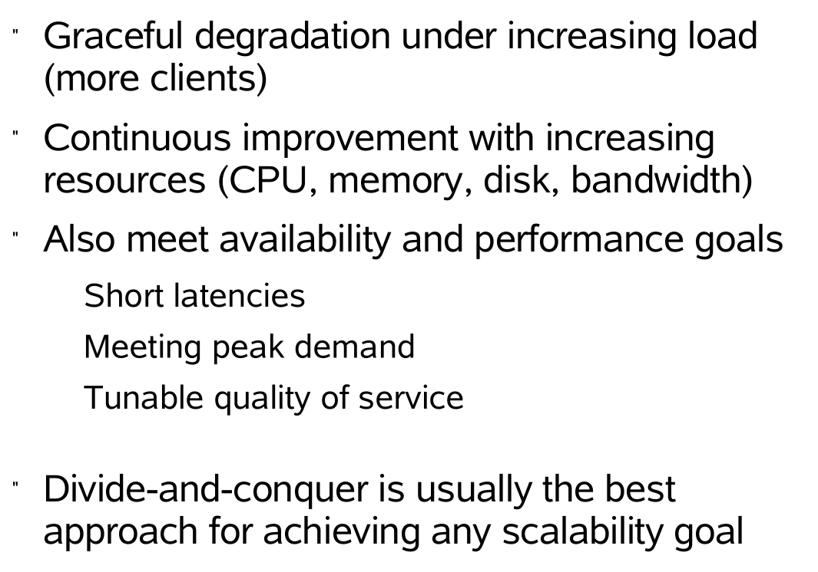
Scalability Goals
PPT模板下载：www.1ppt.com/moban/ 行业PPT模板：www.1ppt.com/hangye/
节日PPT模板：www.1ppt.com/jieri/ PPT素材下载：www.1ppt.com/sucai/
PPT背景图片：www.1ppt.com/beijing/ PPT图表下载：www.1ppt.com/tubiao/
优秀PPT下载：www.1ppt.com/xiazai/ PPT教程： www.1ppt.com/powerpoint/
Word教程： www.1ppt.com/word/ Excel教程：www.1ppt.com/excel/
资料下载：www.1ppt.com/ziliao/ PPT课件下载：www.1ppt.com/kejian/
范文下载：www.1ppt.com/fanwen/ 试卷下载：www.1ppt.com/shiti/
教案下载：www.1ppt.com/jiaoan/ PPT论坛：www.1ppt.cn

Slide 14
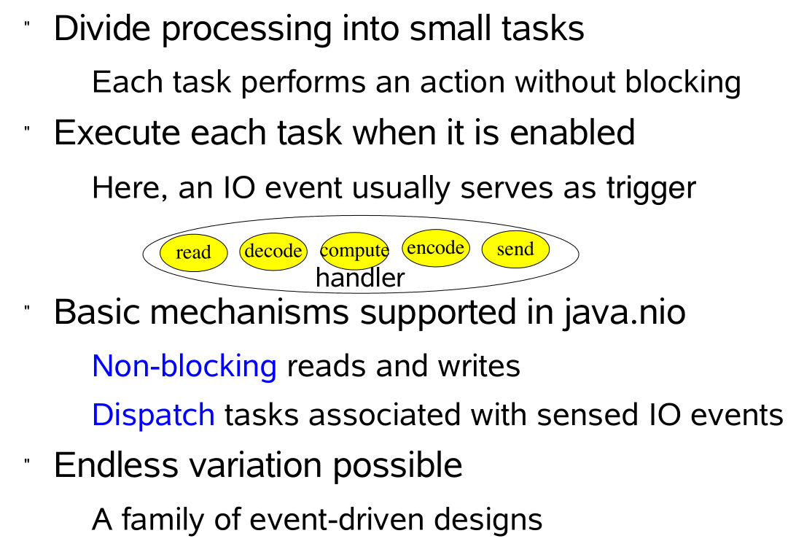
Divide and Conquer
PPT模板下载：www.1ppt.com/moban/ 行业PPT模板：www.1ppt.com/hangye/
节日PPT模板：www.1ppt.com/jieri/ PPT素材下载：www.1ppt.com/sucai/
PPT背景图片：www.1ppt.com/beijing/ PPT图表下载：www.1ppt.com/tubiao/
优秀PPT下载：www.1ppt.com/xiazai/ PPT教程： www.1ppt.com/powerpoint/
Word教程： www.1ppt.com/word/ Excel教程：www.1ppt.com/excel/
资料下载：www.1ppt.com/ziliao/ PPT课件下载：www.1ppt.com/kejian/
范文下载：www.1ppt.com/fanwen/ 试卷下载：www.1ppt.com/shiti/
教案下载：www.1ppt.com/jiaoan/ PPT论坛：www.1ppt.cn

Slide 15
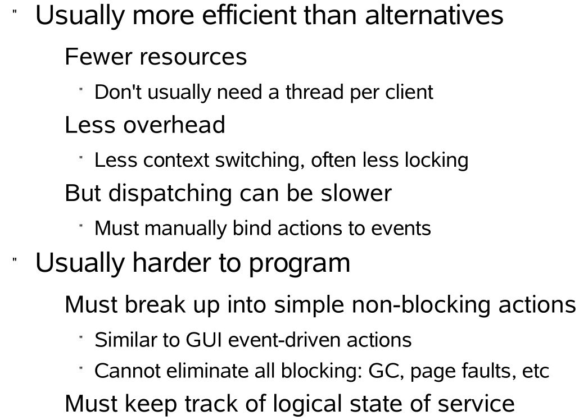
Event-driven Designs
PPT模板下载：www.1ppt.com/moban/ 行业PPT模板：www.1ppt.com/hangye/
节日PPT模板：www.1ppt.com/jieri/ PPT素材下载：www.1ppt.com/sucai/
PPT背景图片：www.1ppt.com/beijing/ PPT图表下载：www.1ppt.com/tubiao/
优秀PPT下载：www.1ppt.com/xiazai/ PPT教程： www.1ppt.com/powerpoint/
Word教程： www.1ppt.com/word/ Excel教程：www.1ppt.com/excel/
资料下载：www.1ppt.com/ziliao/ PPT课件下载：www.1ppt.com/kejian/
范文下载：www.1ppt.com/fanwen/ 试卷下载：www.1ppt.com/shiti/
教案下载：www.1ppt.com/jiaoan/ PPT论坛：www.1ppt.cn

Slide 16
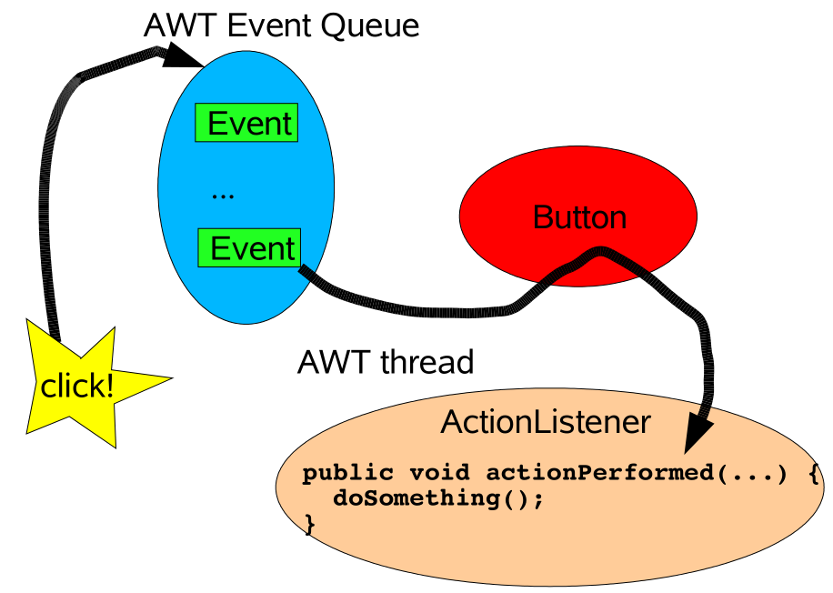
Background: Events in AWT
Event-driven IO uses similar ideas but in different designs
PPT模板下载：www.1ppt.com/moban/ 行业PPT模板：www.1ppt.com/hangye/
节日PPT模板：www.1ppt.com/jieri/ PPT素材下载：www.1ppt.com/sucai/
PPT背景图片：www.1ppt.com/beijing/ PPT图表下载：www.1ppt.com/tubiao/
优秀PPT下载：www.1ppt.com/xiazai/ PPT教程： www.1ppt.com/powerpoint/
Word教程： www.1ppt.com/word/ Excel教程：www.1ppt.com/excel/
资料下载：www.1ppt.com/ziliao/ PPT课件下载：www.1ppt.com/kejian/
范文下载：www.1ppt.com/fanwen/ 试卷下载：www.1ppt.com/shiti/
教案下载：www.1ppt.com/jiaoan/ PPT论坛：www.1ppt.cn

Slide 17
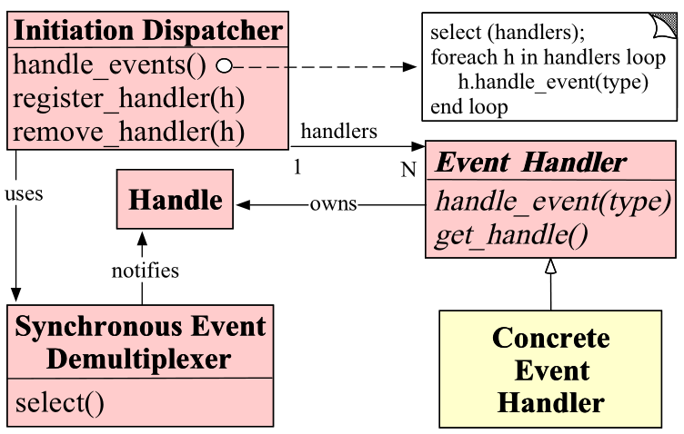
Reactor Pattern
PPT模板下载：www.1ppt.com/moban/ 行业PPT模板：www.1ppt.com/hangye/
节日PPT模板：www.1ppt.com/jieri/ PPT素材下载：www.1ppt.com/sucai/
PPT背景图片：www.1ppt.com/beijing/ PPT图表下载：www.1ppt.com/tubiao/
优秀PPT下载：www.1ppt.com/xiazai/ PPT教程： www.1ppt.com/powerpoint/
Word教程： www.1ppt.com/word/ Excel教程：www.1ppt.com/excel/
资料下载：www.1ppt.com/ziliao/ PPT课件下载：www.1ppt.com/kejian/
范文下载：www.1ppt.com/fanwen/ 试卷下载：www.1ppt.com/shiti/
教案下载：www.1ppt.com/jiaoan/ PPT论坛：www.1ppt.cn

Slide 18
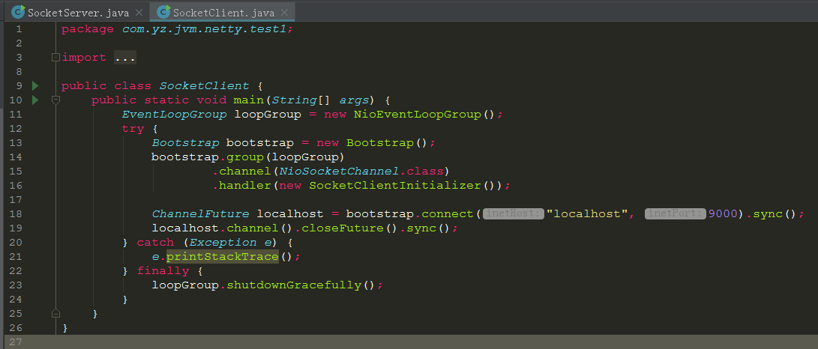
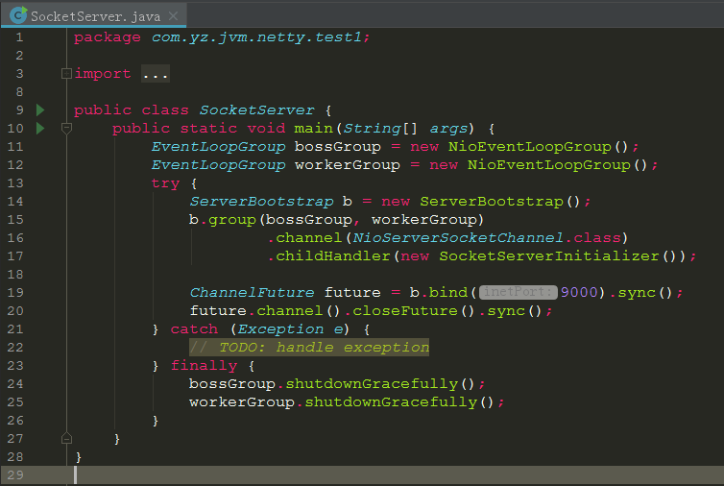
Code Example
PPT模板下载：www.1ppt.com/moban/ 行业PPT模板：www.1ppt.com/hangye/
节日PPT模板：www.1ppt.com/jieri/ PPT素材下载：www.1ppt.com/sucai/
PPT背景图片：www.1ppt.com/beijing/ PPT图表下载：www.1ppt.com/tubiao/
优秀PPT下载：www.1ppt.com/xiazai/ PPT教程： www.1ppt.com/powerpoint/
Word教程： www.1ppt.com/word/ Excel教程：www.1ppt.com/excel/
资料下载：www.1ppt.com/ziliao/ PPT课件下载：www.1ppt.com/kejian/
范文下载：www.1ppt.com/fanwen/ 试卷下载：www.1ppt.com/shiti/
教案下载：www.1ppt.com/jiaoan/ PPT论坛：www.1ppt.cn

Slide 19


推荐书籍
PPT模板下载：www.1ppt.com/moban/ 行业PPT模板：www.1ppt.com/hangye/
节日PPT模板：www.1ppt.com/jieri/ PPT素材下载：www.1ppt.com/sucai/
PPT背景图片：www.1ppt.com/beijing/ PPT图表下载：www.1ppt.com/tubiao/
优秀PPT下载：www.1ppt.com/xiazai/ PPT教程： www.1ppt.com/powerpoint/
Word教程： www.1ppt.com/word/ Excel教程：www.1ppt.com/excel/
资料下载：www.1ppt.com/ziliao/ PPT课件下载：www.1ppt.com/kejian/
范文下载：www.1ppt.com/fanwen/ 试卷下载：www.1ppt.com/shiti/
教案下载：www.1ppt.com/jiaoan/ PPT论坛：www.1ppt.cn

Slide 20
推荐网站
http://www.oodesign.com/
https://sourcemaking.com/design_patterns/
http://www.java2s.com/Code/Java/Design-Pattern/CatalogDesign-Pattern.htm
http://www.tutorialspoint.com/design_pattern/index.htm
PPT模板下载：www.1ppt.com/moban/ 行业PPT模板：www.1ppt.com/hangye/
节日PPT模板：www.1ppt.com/jieri/ PPT素材下载：www.1ppt.com/sucai/
PPT背景图片：www.1ppt.com/beijing/ PPT图表下载：www.1ppt.com/tubiao/
优秀PPT下载：www.1ppt.com/xiazai/ PPT教程： www.1ppt.com/powerpoint/
Word教程： www.1ppt.com/word/ Excel教程：www.1ppt.com/excel/
资料下载：www.1ppt.com/ziliao/ PPT课件下载：www.1ppt.com/kejian/
范文下载：www.1ppt.com/fanwen/ 试卷下载：www.1ppt.com/shiti/
教案下载：www.1ppt.com/jiaoan/ PPT论坛：www.1ppt.cn

Slide 21

PPT模板下载：www.1ppt.com/moban/ 行业PPT模板：www.1ppt.com/hangye/
节日PPT模板：www.1ppt.com/jieri/ PPT素材下载：www.1ppt.com/sucai/
PPT背景图片：www.1ppt.com/beijing/ PPT图表下载：www.1ppt.com/tubiao/
优秀PPT下载：www.1ppt.com/xiazai/ PPT教程： www.1ppt.com/powerpoint/
Word教程： www.1ppt.com/word/ Excel教程：www.1ppt.com/excel/
资料下载：www.1ppt.com/ziliao/ PPT课件下载：www.1ppt.com/kejian/
范文下载：www.1ppt.com/fanwen/ 试卷下载：www.1ppt.com/shiti/
教案下载：www.1ppt.com/jiaoan/ PPT论坛：www.1ppt.cn

Slide 22

PPT模板下载：www.1ppt.com/moban/ 行业PPT模板：www.1ppt.com/hangye/
节日PPT模板：www.1ppt.com/jieri/ PPT素材下载：www.1ppt.com/sucai/
PPT背景图片：www.1ppt.com/beijing/ PPT图表下载：www.1ppt.com/tubiao/
优秀PPT下载：www.1ppt.com/xiazai/ PPT教程： www.1ppt.com/powerpoint/
Word教程： www.1ppt.com/word/ Excel教程：www.1ppt.com/excel/
资料下载：www.1ppt.com/ziliao/ PPT课件下载：www.1ppt.com/kejian/
范文下载：www.1ppt.com/fanwen/ 试卷下载：www.1ppt.com/shiti/
教案下载：www.1ppt.com/jiaoan/ PPT论坛：www.1ppt.cn

