Slide 1
Network Coding Meets TCP
Michael Mitzenmacher
Joint work with
Jay-Kumar Sudararajan, Devavrat Shah,
Muriel Medard, Joao Barros

Slide 2
Network Coding
Packets can be encoded arbitrarily, not just by end nodes, but also by nodes within the network.
  End-to-end codes a special case.
Standard example : butterfly network.

Slide 3
Butterfly Example
Want both bits to get to both y and z as quick as possible.
  Delay, throughput.
Bottleneck at link from w to x.
s
b
b
1
2
t
b
b
u
1
2
w
b
b
1
2
x
y
z

Slide 4
Butterfly Example
Want both bits to get to both y and z as quick as possible.
  Delay, throughput.
Bottleneck at link from w to x.
Solution : encode by sending linear combination of bits.
s
b
b
1
2
t
b
b
u
1
2
w
b
b
1
b
+
b
2
1
2
x
y
b
+
b
b
+
b
z
1
2
1
2

Slide 5
Practice?
Will network coding achieve wide use in practice, or just a mathematical toy?
  Jury is still out… but lots of believers.
    Lots of theory, projects.
    Avalanche, COPE, MORE,…
Potential problem: incremental deployment / backward compatibility.
  Standard problem for anything new.

Slide 6
TCP and Coding
For incremental deployment, best to be compatible or friendly with TCP.
Not easy; TCP not designed for coding.
TCP combines reliability and congestion control; with coding, you don’t want reliability.
  But still the need for congestion control.

Slide 7
Comparison : Fountain Codes
Fountain codes use coding just at endpoints.
  Random XORs of packets.
Congestion control issues a big problem for usage. TCP-friendliness/TCP-compatibility.
Special schemes designed for:
  Multicast congestion control.
  Long-distance, high-bandwidth connections.

Slide 8
The Problem
Sender Buffer
Receiver Buffer
Network
P3
P2
P1
P1 + P2
P2 + P3
P1 + P2 + P3
Can’t acknowledge a packet until you can decode.
Usually, decoding requires a number of packets.
Code / acknowledge over small blocks to avoid
delay, manage complexity.

Slide 9
Compare to ARQ
Context: Reliable communication over a (wireless) network of packet erasure channels
ARQ
Network Coding
Retransmit lost packets
Low delay, queue size
Streaming, not blocks
Not efficient on broadcast links
Link-by-link ARQ does not achieve network multicast capacity.
Transmit linear combinations of packets
Achieves min-cut multicast capacity
Extends to broadcast links
Congestion control requires feedback
Decoding delay: block-based

Slide 10
Goals
Devise a system that behaves as close to TCP as possible, while masking non-congestion wireless losses from congestion control where possible.
  Standard TCP/wireless problem.
Stream-based, not block-based.
Low delay.
Focus on wireless setting.
  Where network coding can offer biggest benefits.
  Not necessarily a universal solution.

Slide 11
Main Idea : Coding ACKs
What does it mean to “see” a packet?
Standard notion: we have a copy of the packet.
  Doesn’t work well in coding setting.
  Implies must decode to see a packet.
New definition: we have a packet that will allow us to decode once enough useful packets arrive.
  Packet is useful if linearly independent.
  When enough useful packets arrive can decode.

Slide 12
Coding ACKs
For a message of size n, need n useful packets.
Each coded packet corresponds to a degree of freedom.
Instead of acknowledging individual packets, acknowledge newly arrived degrees of freedom.

Slide 13
Coding ACKs
Original message : p₁, p₂, p₃…
Coded
Packets
4p₁ + 2p₂ + 5p₃
c₁
4 2 5 0 0 0 0
4 2 5 0 0 0 0
c₂
3 1 2 5 0 0 0
3 1 2 5 0 0 0
c₃
1 2 3 4 1 0 0
1 2 3 4 1 0 0
c₄
3 3 1 2 1 0 0
3 3 1 2 1 0 0
c₅
1 2 5 4 5 0 0
1 2 5 4 5 0 0

Slide 14
Coding ACKs
Original message : p₁, p₂, p₃…
Coded
Packets
4p₁ + 2p₂ + 5p₃
c₁
4 2 5 0 0 0 0
4 2 5 0 0 0 0
c₂
3 1 2 5 0 0 0
3 1 2 5 0 0 0
c₃
1 2 3 4 1 0 0
1 2 3 4 1 0 0
c₄
3 3 1 2 1 0 0
3 3 1 2 1 0 0
c₅
1 2 5 4 5 0 0
1 2 5 4 5 0 0
When c₁ comes in, you’ve “seen” packet 1; eventually
you’ll be able to decode it. And so on…

Slide 15
Coding ACKs
Original message : p₁, p₂, p₃…
Coded
Packets
4p₁ + 2p₂ + 5p₃
c₁
4 2 5 0 0 0 0
1 4 5 3 0 0 0
c₂
3 1 2 5 0 0 0
0 1 3 2 6 0 0
c₃
1 2 3 4 1 0 0
0 0 1 6 2 0 0
c₄
3 3 1 2 1 0 0
0 0 0 1 5 0 0
c₅
1 2 5 4 5 0 0
0 0 0 0 1 0 0
Use Gaussian elimination as packets arrive to check for
a new seen packet.

Slide 16
Formal Definition
A node has seen a packet p_{k} if it can compute a linear combination p_{k}+q where q is a linear combination of packets with index larger than k.
When all packets have been seen, decoding is possible.

Slide 17



Layered Architecture
SOURCE SIDE
RECEIVER SIDE
Application
Application
Eg. HTTP, FTP
TCP
TCP
Transport layer: Reliability,
flow and congestion control
IP
IP
Network layer (Routing)
MAC / PHY
MAC / PHY
Medium access, channel coding
Physical medium
Data
ACK

Slide 18




TCP using Network Coding
SOURCE SIDE
RECEIVER SIDE
Application
Application
TCP
TCP
Network coding layer
Network coding layer
IP
IP
Lower layers
Data
ACK

Slide 19
The Sender Module
Buffers packets in the current window from the TCP source, sends linear combinations.
Need for redundancy factor R.
  Sending rate should account for loss rate.
  Send a constant factor more packets.
  Open issue : determine R dynamically?

Slide 20
Redundancy
Too low R
  TCP times out and backs off drastically.
Too high R
  Losses recovered – TCP window advances smoothly.
  Throughput reduced due to low code rate.
  Congestion increases.
Right R is 1/(1-p), where p is the loss rate.

Slide 21
Which TCP to Use?
Use redundancy to match sending rate to desired data rate.
  Masking wireless losses not due to congestion.
  TCP Reno reacts to losses; does not seem suitable here.
    Continuing work – make this approach TCP Reno compatible.
Instead use TCP Vegas.
  Sets window based on Round Trip Times.
  We use RTTs not of packets, but of degrees of freedom.

Slide 22






Measurement of RTTs
t=0
TX_SERIAL_NUM=1
TX_SERIAL_NUM=2
TX_SERIAL_NUM=3
Lost
RTT₁
TX_SERIAL_NUM=4
Lost
ACK=2
RTT₂
ACK=3

Slide 23
The Receiver Module
Acknowledgment: ACK a packet upon seeing it (even before it is decoded).
With high probability (if field size is large), every random linear combination will cause next unseen packet to be seen.
Buffer incoming linear combinations until they can be decoded.
  Possibly can decode early.
  Interesting design tradeoff for future work.
Upon decoding, deliver the packets to the TCP sink.

Slide 24
Decoding Early
4 2 5 0 0 0 0
3 1 2 5 0 0 0
1 2 3 4 1 0 0
3 3 1 2 1 0 0
1 2 5 4 5 0 0

Slide 25
Some Simulations
SRC
1
1 Mbps ,
100 ms
SINK
1
1
2
3
4
5
SRC
2
SINK
2

Slide 26
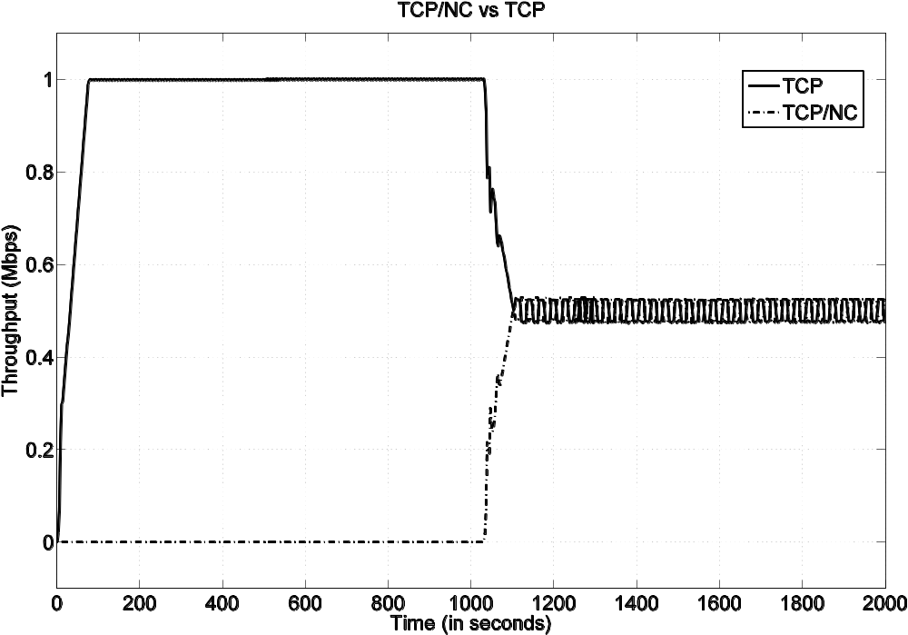
Fairness
0% Loss Rate, Redundancy 1

Slide 27
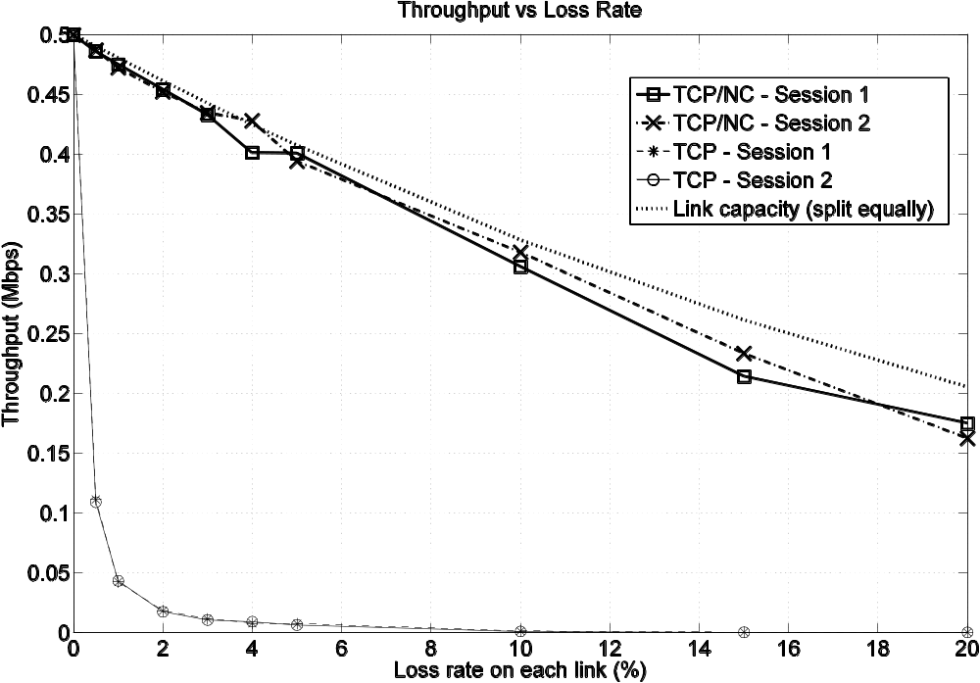
Resilience to Losses

Slide 28
Caveats
Does not use link layer retransmission.
  Would help TCP under high loss rates!
Network coding headers.
  Need to give coefficients for linear combination!
  Shared pseudorandom generators help.
Assumes large field size.
  Small field size might lead to non-useful packets.
  In practice, field size of 256 (8 bits) very effective.
Decoding time.

Slide 29
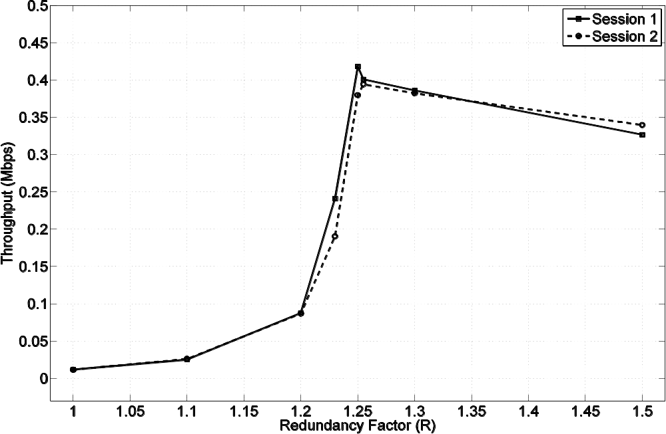
Redundancy factor
Overall loss rate is roughly 20%

Slide 30
Redundancy Behavior
Overshooting optimal redundancy : graceful slowdown of throughput.
Undershooting : less graceful.
  TCP timeouts.
But even R = 1 is better (by approx. factor of 2) over unmodified TCP.

Slide 31
Re-encoding Experiment
To see if true network coding (not just end-to-end) is helpful.
4 node network, losses along all link.
  But biggest losses on last link.
Re-encode along last link.
  Node has a buffer, sends linear combinations of buffered packets.
  R for sender is 1.8, for node 3 is 1.5.

Slide 32
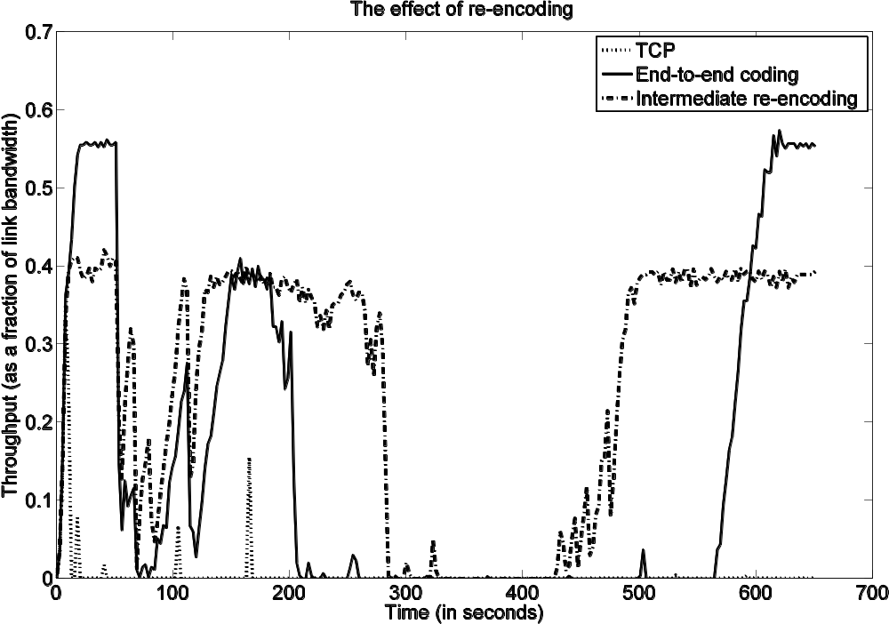
Re-encoding
TCP : 0.0042 Mbps ; Coding E-to-E : 0.1420 Mbps ;
Re-encoding : 0.2448 Mbps

Slide 33
Conclusions
New coding layer proposed between TCP and IP.
Novel ACK mechanism provides clean interface between network coding and existing congestion control protocols.
Ideas also work with intermediate node coding.
Possible extensions to multipath TCP and to multicast sessions.
Not a final solution, but a step towards realizing the potential of network coding in practice.
  Proof of concept ; theory.
  Next stage: deployments underway.

Slide 34
Other Recent Work of Interest
Hash-Based Techniques for High-Speed Packet Processing
  A. Kirsch, M. Mitzenmacher, and G. Varghese
  Survey article
Why Simple Hash Functions Work: Exploiting the Entropy in a Data Stream
  M. Mitzenmacher and S. Vadhan
  Explains why simple hash functions work so well for hash tables, Bloom filters, etc.
  Randomness in data “combines” with randomness in choice of hash function.

Slide 35

More About Me
Website: www .eecs.harvard.edu/~michaelm
  Links to papers
  Link to book
  Link to blog : mybiasedcoin
    mybiasedcoin.blogspot.com

