Slide 1

Fake Job Posting Predictions
ISDS 7070 | Group 2
Summer 2020
Youssuf Elnoamany
Arielle Laurent
Leopold Marx
Christopher O’Brien
Luke Willson
Presented to:
Dr. James Davis

Slide 2
Table of Contents
Overview
The Dataset & Assumptions
Wrangling the Data
Modeling
Findings, Lessongs, & Recommendations
References
Questions?

Slide 3
Overview
Understanding the employment scam problem and how to avoid it
Purpose of Model
Using text data and meta-features, create a classification model to predict which job postings are real or fake
Success Overview - How success will be measured
Most accurately identify and classify fraudulent postings
Achieve high sensitivity (correctly generate a positive result - true positive)

Slide 4
The Dataset & Assumptions

Slide 5
The Data
Obtained through Kaggle from the University of the Aegean, Laboratory of Information & Communication Systems Security
Employment Scam Aegean Dataset (EMSCAD) is a publicly available dataset
Consists of 17,880 real-life job postings (17,014 legitimate and 866 fraudulent)
Published between 2012 to 2014
Both textual and meta-information about the jobs posted
18 Total Features

Slide 6
Project Assumptions & Observations
Random samples
Independence
Measurements system is accurate and precise
Imbalanced sample with less than 5% of job postings being fraudulent
Over/under sampling methods will be tested
Missing data & distribution against fraudulent feature
Fake postings may have more missing features than real job posts

Slide 7
The 18 Original Features
job_id*
title
location
department
salary_range
company_profile
description
requirements
benefits
telecommuting
has_company_logo
has_questions
employment_type
required_experience
required_education
industry
function
Fraudulent (Target)

Slide 8
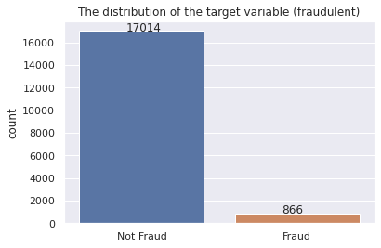
Naive Rule
0.9516

Slide 9
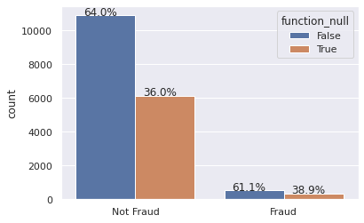
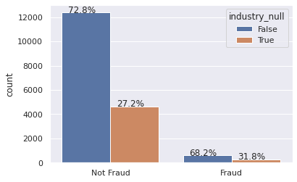
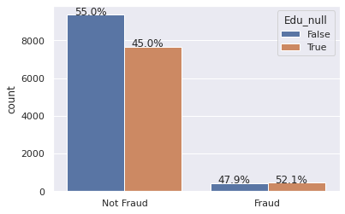
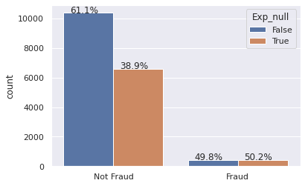
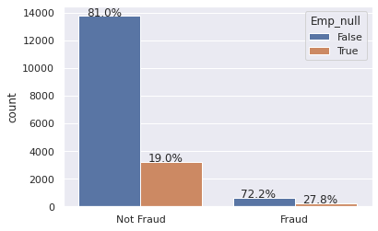
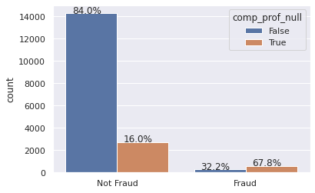
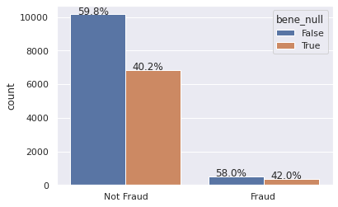
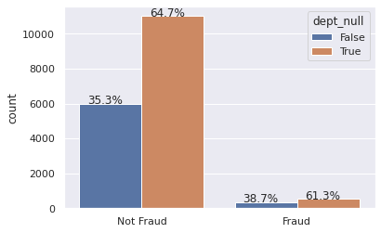
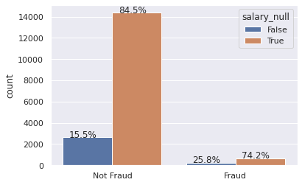

Slide 10
Wrangling the Data

Slide 11
Inspection & Wrangling of Data
Data Cleanliness
The data had some missing values and the text itself had some issues with htmls, numbers, and punctuations
Data Wrangling
We made a text column with all the text in the dataset
Partitioned text into a sequence of words and removed HTML tags, punctuation, and numbers (Tokenizing)
Chopped off the ends of words (Stemming)
Removed stopwords
Over/Under sample the data to reduce imbalance.

Slide 12

Creating Text Feature
title
location
department
company_profile
description
requirements
benefits
employment_type
required_experience
required_education
industry
function

Slide 13
Cleaning Text Feature
text_clean
text_clean_nostem
Remove HTML tags
Remove punctuation
Remove numbers
Removed stemming of words
Removing stop words
Remove HTML tags
Remove punctuation
Remove numbers
Removing stop words

Slide 14
Modeling

Slide 15
Splitting Data Train/Validation
70/30 split
We split the data using a random sample to create a training dataset with 70% of the original data and a validation dataset with 30% to test against the training model.
We did this to prevent overfitting the model.
We wanted to have as much data to train our model so we could make a better prediction.
We had 17,880 observations
Training dataset had 12,516 observations
Validation dataset had 5,364 observations
In our code we used the Sklearn train_test_split function first with Consistent Random State=9

Slide 16
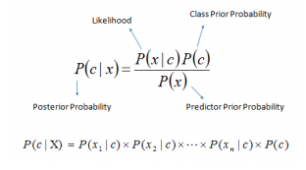
Naive Bayes Algorithm
Used in text classification
Higher success rate as compared to other algorithms
Commonly used in:
Spam filtering (identify spam e-mails)
Sentiment Analysis (in social media analysis, to identify positive and negative customer sentiments)
P(c|x) is the posterior probability of class (c, target) given predictor (x, attributes).
P(c) is the prior probability of class.
P(x|c) is the likelihood which is the probability of predictor given class.
P(x) is the prior probability of predictor.
(Analytics Vidyha)

Slide 17
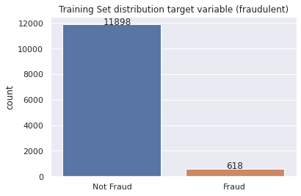
Original training dataset Fraudulent distribution

Slide 18
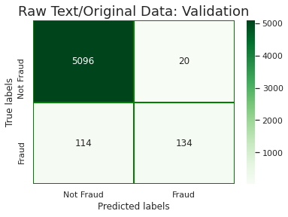
Validation Hitrate
0.9750
Hitrate - Considered “good”
Sensitivity - Poor
Further model adjustment and hyperparameter manipulation
Sensitivity = 0.54

Slide 19
Data Sampling Imbalance
Oversampling
Undersampling
Increase the number of minority observations
Fraudulent job postings from the training data set,
X10 - still imbalanced (65.8% real listings)
Increasing above this level to a near balanced split did not improve model performance
Validation set is held constant
Integrity of a proper test on the original sample
Decrease the number of majority observations
Legitimate job postings from the training data set
Randomly sampled at a quantity equal to the minority
Similar effect to oversampling, many of the observations from the original data set remain unused
Validation set is held constant

Slide 20
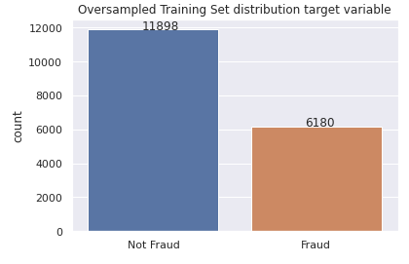
Oversampled training dataset Fraudulent distribution

Slide 21
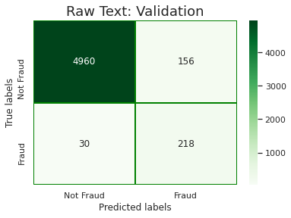
Oversample Validation Hitrate
0.9653
Hitrate - Slightly less than the original model
Sensitivity - Increased
(to identify fake postings has dramatically)
Oversampling → Better able to train itself to identify fraud
Untouched validation set - Reliable improvements
Sensitivity = 0.88

Slide 22
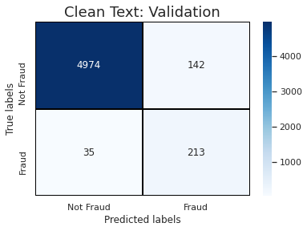
Oversample Validation Hitrate
0.9670
This model and the ones that follow involve cleaning the text with various methods
Stemming, Stopwords, Punctuation, HTML code etc.
Sensitivity = 0.859

Slide 23
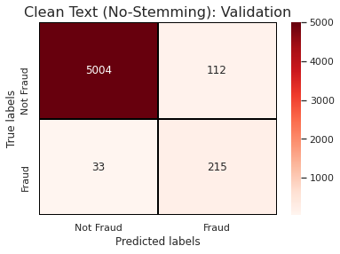
Oversample Validation Hitrate
0.9730
Text classification does not involve stemming (words are not reduced to origin/stem)
Yield the highest hit rate, sensitivity and specificity values
May be ineffective in some texts
Sensitivity = 0.867

Slide 24
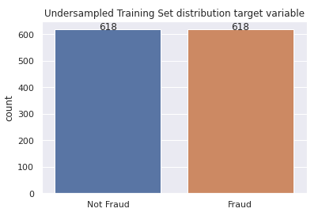
Undersampled training dataset Fraudulent distribution

Slide 25

Undersample Validation Hitrate
0.8978
Hitrate - Significantly less than the naive rule and the original model,
Sensitivity - Dramatically decreased
(to identify fake postings)
Undersampling → discards potentially useful data
Model does not improve on the naive rule but has high sensitivity at the cost of low specificity
Sensitivity = 0.903

Slide 26

Undersample Validation Hitrate
0.8976
More or less the same as without cleaning the texts
Hiitrate - Significantly less than naive rule and slightly less than the undersampled model w/o cleaning
Sensitivity & Specificity - No increase
Sensitivity = 0.899

Slide 27
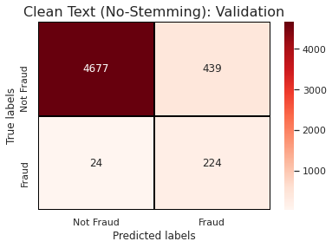
Undersample Validation Hitrate
0.9137
Hiitrate - Significantly less than the naive rule and slightly higher than the undersampled model regardless of cleaning
Sensitivity - Higher than earlier undersampled models
Specificity - Lower than earlier
Sensitivity = 0.903

Slide 28
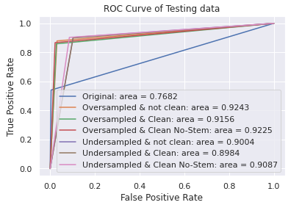
Oversampling & Undersampling Effects
Text cleaning methods vary in effectiveness -- Good for exploration, but should not be relied upon

Slide 29
Findings, Lessons, & Recommendations

Slide 30
Interesting Facts / Lessons Learned
Findings
Oversampled method has the best balance between sensitivity, specificity, and hit rate.
Undersampling discards potentially useful data that could be important for the induction process
Evident by significant drop in validation hit rate compared to training
Text cleaning methods vary in effectiveness (apply on a case by case basis)
Interesting facts
Oversampling worked, Undersampling has limitations
Limitation: Data sampling imbalance

Slide 31
Recommendations for Future Models
Look into identifying specific features within job postings to determine the validity of posts
Try to find phrases that discriminate fraudulent and non-fraudulent listings
Use ‘PyEnchant library’ to check for misspelled words
Implement high-level classification models and compare with Naive Bayes
Logistic Regression
Decision Trees
Random Forest
Support Vector Machine (SVM)

Slide 32
References
https://www.kaggle.com/shivamb/real-or-fake-fake-jobposting-prediction
The University of the Aegean | Laboratory of Information & Communication Systems Security http://emscad.samos.aegean.gr/
https://medium.com/biaslyai/beginners-guide-to-text-preprocessing-in-python-2cbeafbf5f44
Analytics Vidyha https://www.analyticsvidhya.com/

Slide 33

Thank You!
Questions?

Slide 34
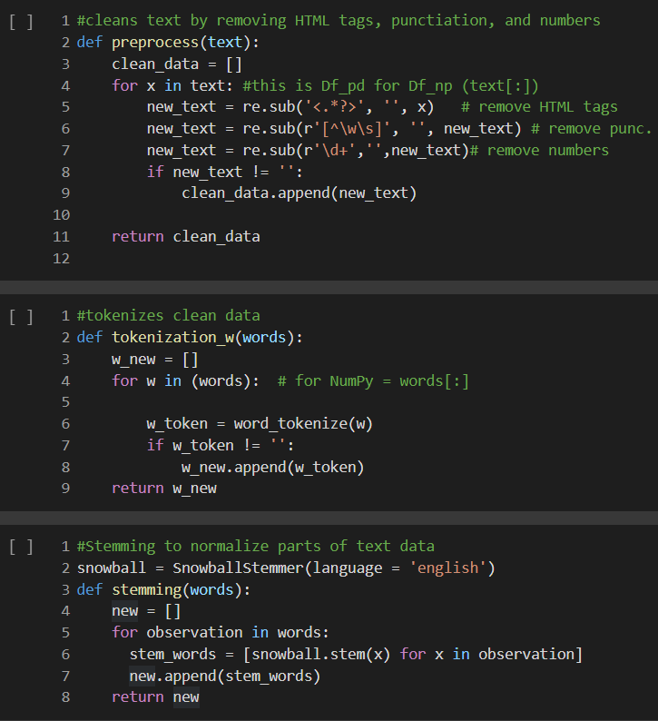
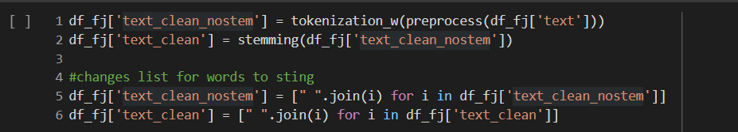
Back up slides

Slide 35
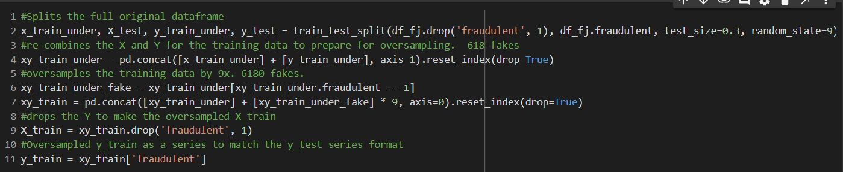
Back up slides

Slide 36
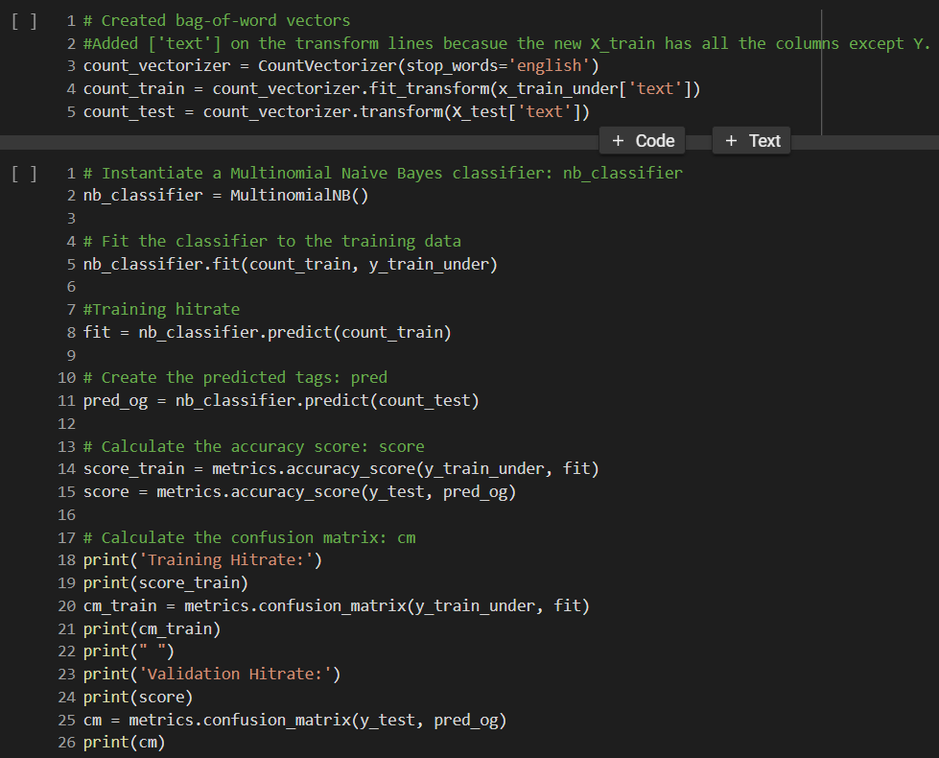
Back up slides

Slide 37
Back up slides

Slide 38
Back up slides

