Slide 1
Graph Neural Networks
Qingyao Li, Xi’an Jiaotong University
ly890306@stu.xjtu.edu.cn

Slide 2
DL trend
CNN and deep NNs
Word embeddings, LSTM and GRUs
Attention, pre-trained language models
Graph neural networks
Few-shot learning and contrastive learning

Slide 3
Table of Contents
Deep Learning on Graphs Framework
GCN(Graph Convolutional Network)
GraphSAGE
GAT(Graph Attention Network)
Summary
Exploration

Slide 4
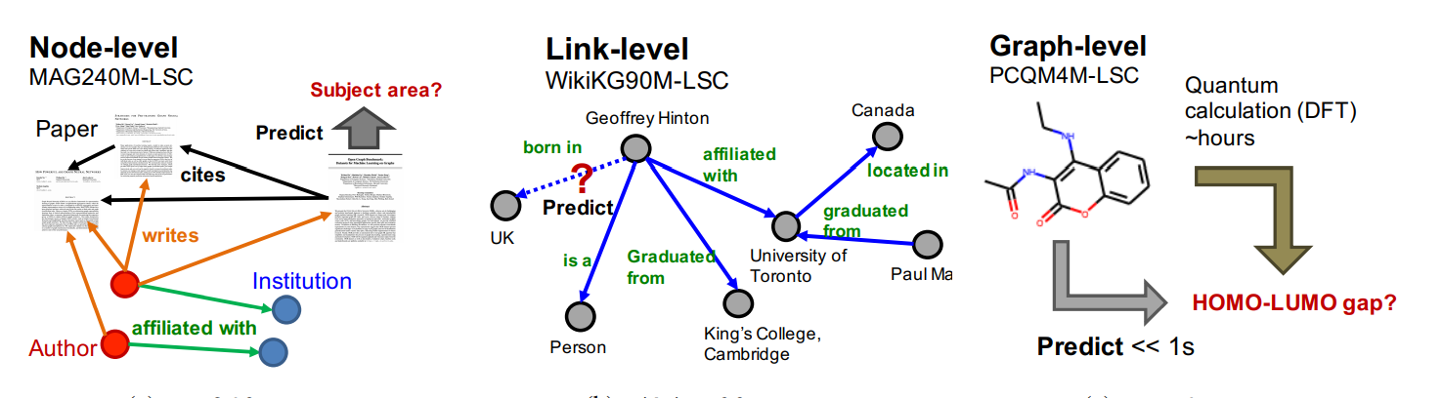
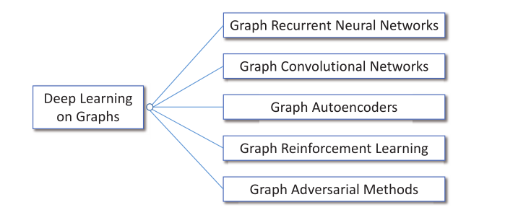
Deep Learning on Graphs Intro

Slide 5
Node Encoding
Shallow Encoding
One vector for each node, as learned parameters
Drawback: O(|V|), transductive, no node features
Deep Encoding
A series of NN to produce node embedding
Param # independent of |V|, inductive, incorporate node features

Slide 6
Table of Contents
Deep Learning on Graphs Framework
GCN(Graph Convolutional Network)
GraphSAGE
GAT(Graph Attention Network)
Summary
Exploration

Slide 7
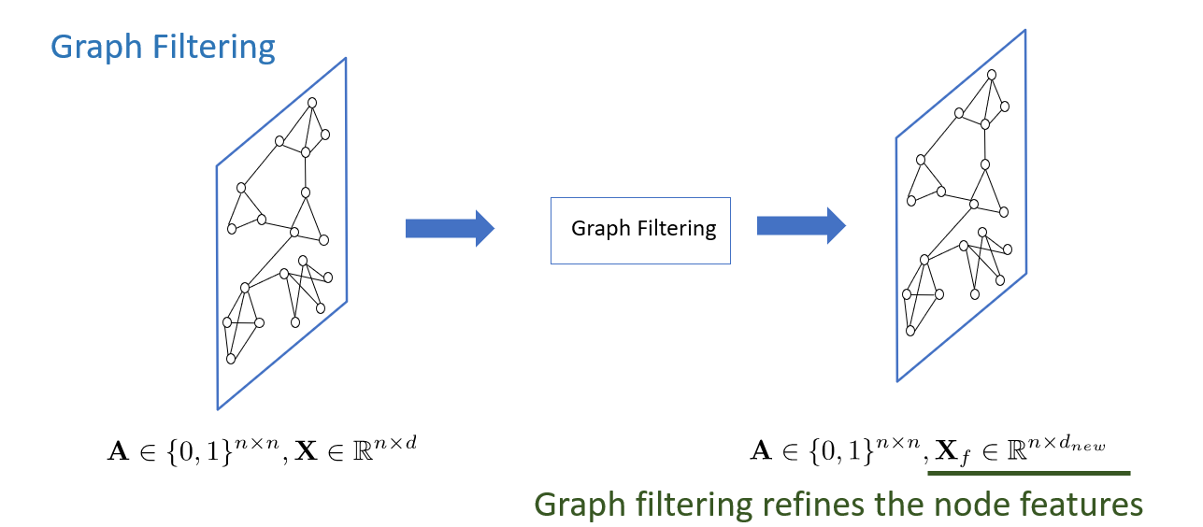
Convolution

Slide 8
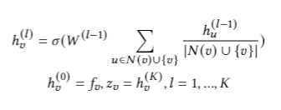
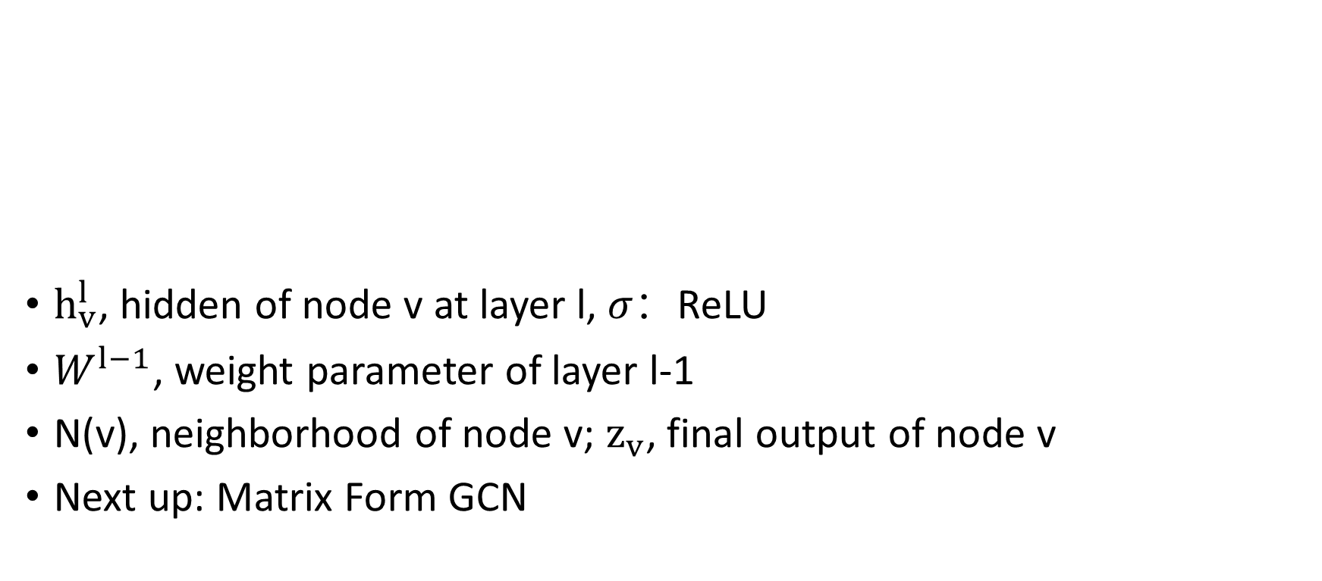
Single Node Standpoint Convolution
$h_{v}^{l}$, hidden of node v at layer l, $σ：$ReLU
$W^{l−1}$, weight parameter of layer l-1
N(v), neighborhood of node v; $z_{v}$, final output of node v
Next up: Matrix Form GCN

Slide 9
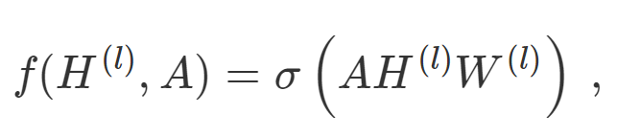
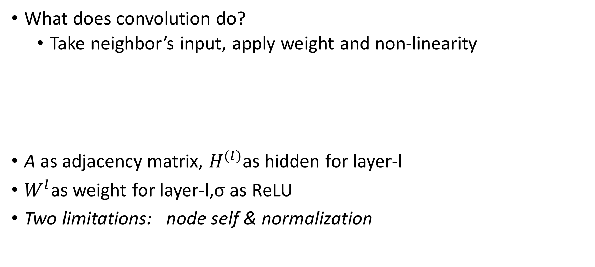
Simple Convolution on Graphs
What does convolution do?
Take neighbor’s input, apply weight and non-linearity
A as adjacency matrix, $H^{(l)}$as hidden for layer-l
$W^{l}$as weight for layer-l,$σ$as ReLU
Two limitations: node self & normalization

Slide 10



Solved: Convolution that Includes Itself
Where
What is now?
Imagine one node has 2 neighbors, one node has 2000
Does it make a difference?

Slide 11
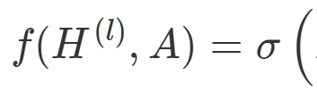



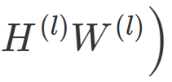


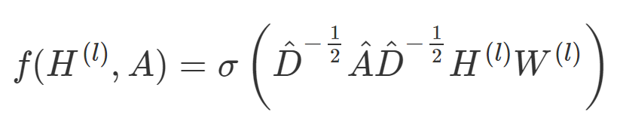
Solved: Averaging over Neighbor #
A
Where and is the diagonal node degree matrix with self-connect.
A renormalization trick (symmetric operation):

Slide 12
Summary: GCN
How is it a convolution?
How does GCN leverage node features?
Why GCN is deep encoder? How many trainable params?
Inductive vs. Transductive?

Slide 13
Table of Contents
Deep Learning on Graphs Framework
GCN(Graph Convolutional Network)
GraphSAGE
GAT(Graph Attention Network)
Summary
Exploration

Slide 14
GraphSAGE Motivation
Ego issues
My features are important when evaluating myself
Aggregation Methods
In GCN, average is taken on neighbors
Other aggregators? (addressed in GraphSAGE)
Different importance for different nodes? (addressed in GAT)

Slide 15
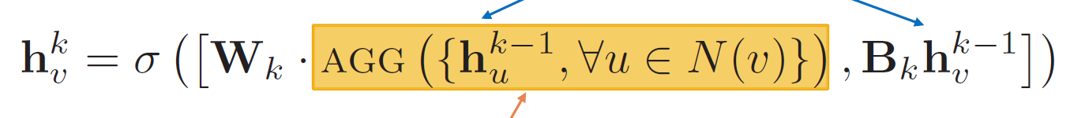
GraphSAGE
Generalized aggregator
Opens up to AGG() options
Concatenation rather than addition
‘ego’ issue

Slide 16
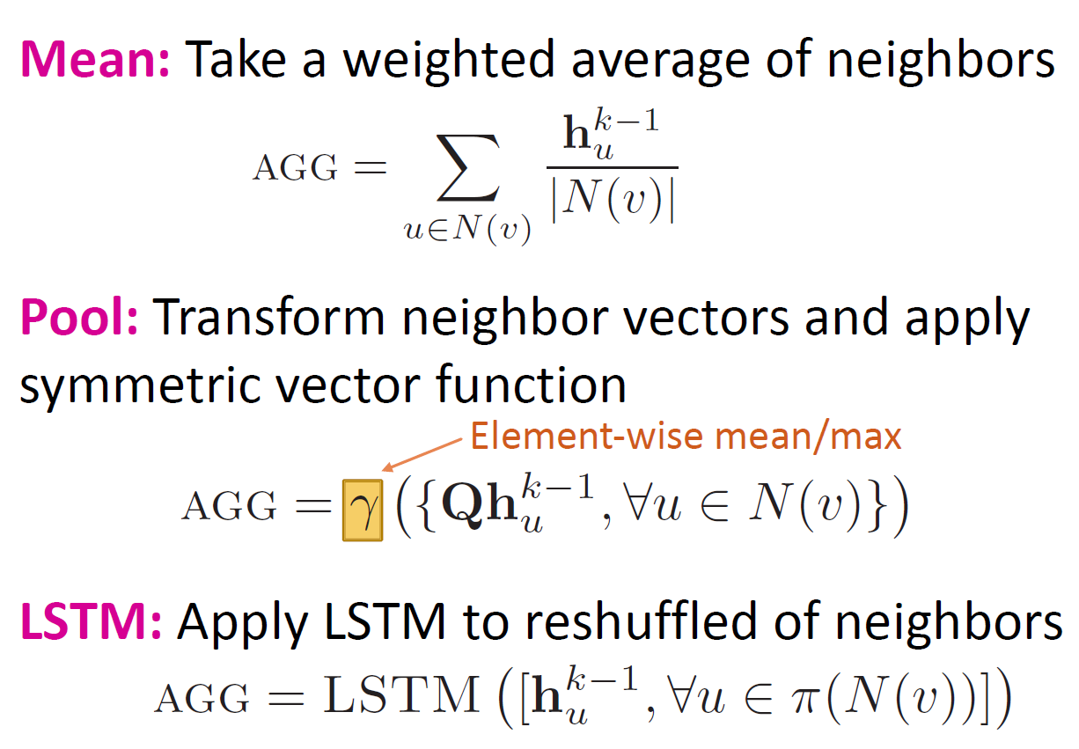
AGG(.) Choices
AGG(.) must be
Order invariant
LSTM?

Slide 17
Summary: GraphSAGE
AGG(.)
Mean, pool, LSTM
When is GraphSAGE similar to GCN?
Where is GraphSAGE different to GCN?
Hidden Representation Size Increase?

Slide 18
Table of Contents
Deep Learning on Graphs Framework
GCN(Graph Convolutional Network)
GraphSAGE
GAT(Graph Attention Network)
Summary
Exploration

Slide 19
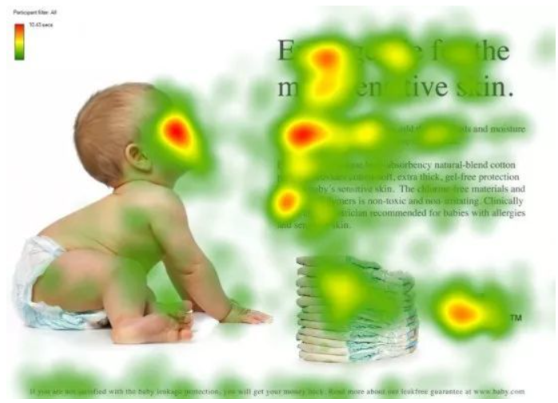
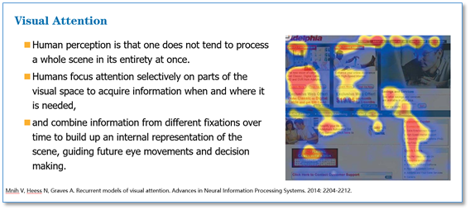
Attention
Even if the picture is partially obscured, you can understand the content of the picture.

Slide 20
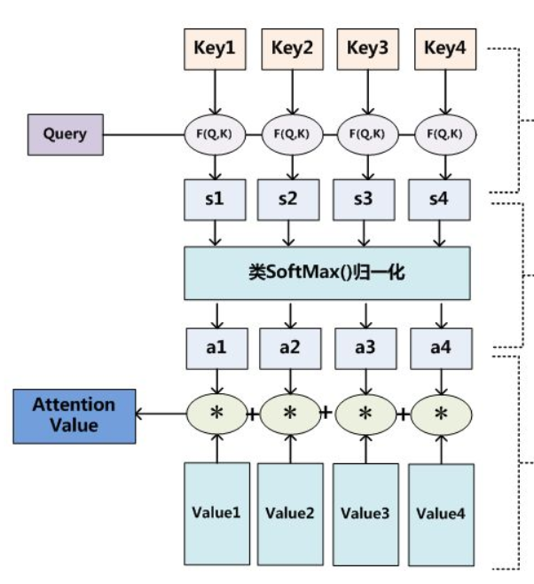
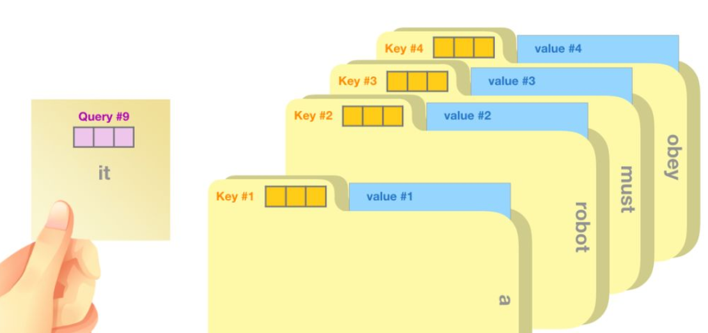
Attention

Slide 21
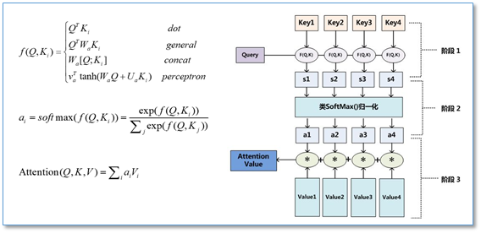
Self-attention
Q=K=V
One cell in the sequence & all cells in the sequence

Slide 22
Motivation
In NLP
Not all tokens are equally important!
In GNN
Not all nodes are equally important!
Naturally, the incorporation of attention comes to mind

Slide 23

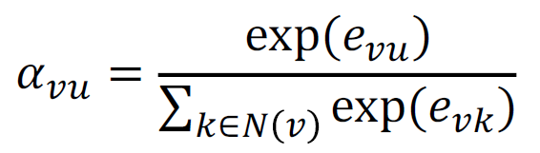
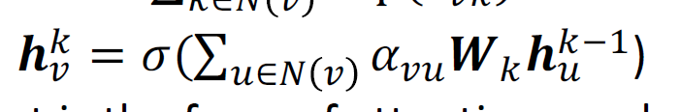
Q: How is it self-attention? (QKV?)
Generate Attention Weight
Average with Weights

Slide 24

Summary: GAT
is self-attention weight on W_k h^k-1

Slide 25
Table of Contents
Deep Learning on Graphs Framework
GCN(Graph Convolutional Network)
GraphSAGE
GAT(Graph Attention Network)
Summary
Exploration

Slide 26
Summary
GNN Framework
Node Encoder: Shallow vs Deep
GCN
Imitates authentic convolution, matrix form
GraphSAGE
Generalized aggregator, mean/pool/LSTM, ‘ego’ solution
GAT
Self-attention over transformed hidden

Slide 27
Table of Contents
Deep Learning on Graphs Framework
GCN(Graph Convolutional Network)
GraphSAGE
GAT(Graph Attention Network)
Summary
Exploration

Slide 28
torch_geometric
Pytorch implementation of graph neural networks

Slide 29
Thx for Attention
Qingyao Li, Xi’an Jiaotong University
ly890306@stu.xjtu.edu.cn

