Slide 1

Exploratory Data Analysis
G2M insight for Cab Investment firm
2022-04-26
Notes:
As a Go-To-Market (G2M) strategy on the Cab industry, the XYZ company needs an understanding of the cab market before taking a decision.

Slide 2
Agenda
Executive Summary
Problem Statement
Approach
EDA
EDA Summary
Recommendations

Slide 3
Executive Summary
Problem Statement
Two cab companies (Yellow Cab and Pink Cab) need to be analyzed and evaluated in order to indicate which one is the best cab company to invest in.
Approach
We are going to do an Exploratory Data Analysis (EDA) where we apply a descriptive analysis, a correlation analysis and a contextual analysis with numerical and categorical attributes.
EDA
EDA Summary
Recommendation

Slide 4
Problem Statement
Client: XYZ is a private firm in US planning an investment in the cab industry.
Objective: Provide insights to identify the best Cab company between Pink Cab and Yellow Cab for investments.
The analysis has been divided into two parts:
Exploratory Data Analysis (EDA)
Recommendations for investment

Slide 5
EDA - Dataset Statistics
Merged File: all_data.csv
Number of Attributes: 20
Number of Observations: 359392
Missing Cells: 0 (zero)
Timeframe: 01/31/2016 to 12/31/2018
Attributes types:
Numerical: 10
Categorical: 10
Actions:
cab_data dataset: Convert the excel serial date of Date of Travel column into datetime object and add the columns: Weekday, Month, Day and Year.
City_data dataset: Convert strings to integers on Population and Users attributes.
Merge all datasets excluding rows that are not filled in all columns.
Create the new attribute Profit as the difference between Price Charged and Cost of Trip.
Delete eastern holidays and fill the cells NaN as Not a holiday.
.
Cab_Data.csv
Customer_ID.csv
Transaction_ID.csv
City.csv
USholiday.csv
all_data

Slide 6
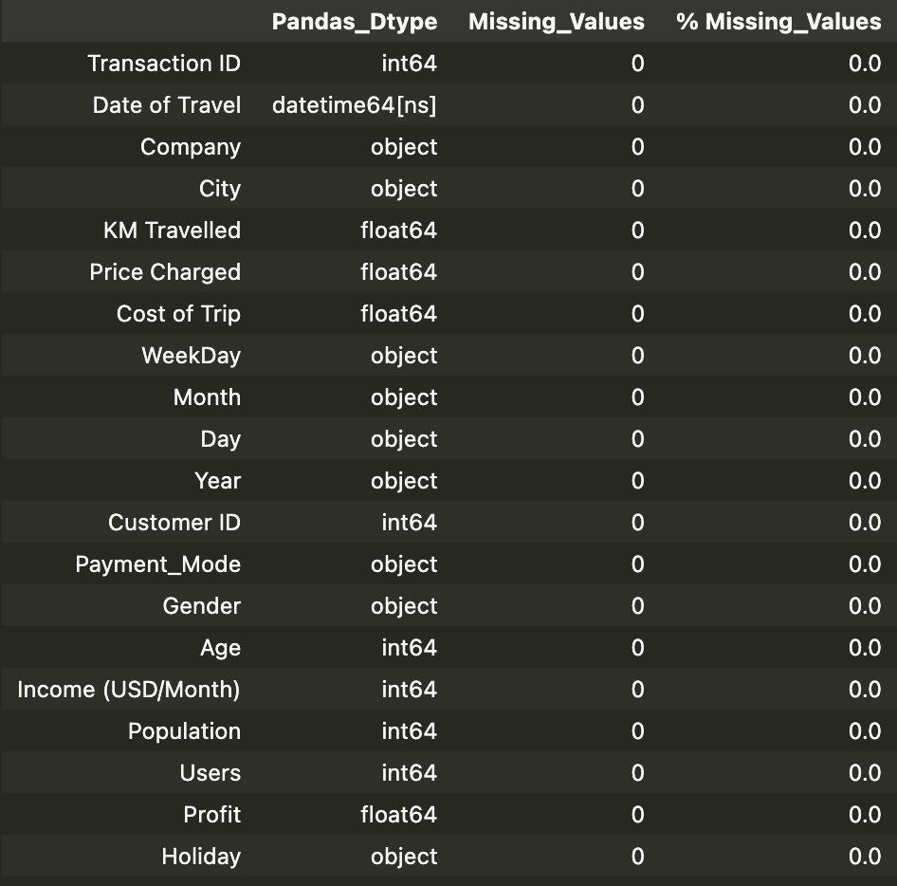
EDA - Dataset Statistics
Dataset: all_data:
After the merging there're no missing values and the data types are according to the attributes.

Slide 7
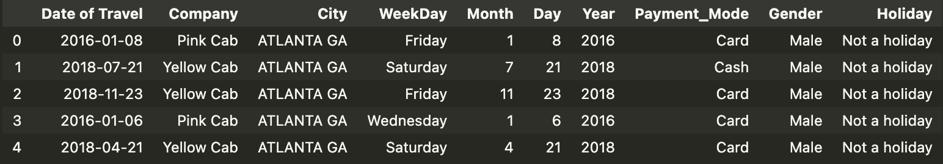
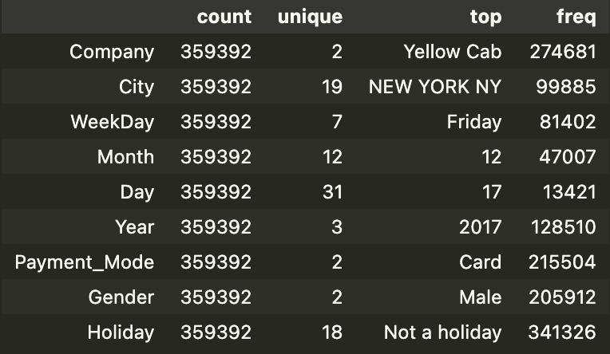
EDA - Dataset Statistics
Categorical Attribute
Assumptions:
The extreme values in Price_Charged attribute will not be treated as outliers. It shows that there are fewer trips with high prices charged (and so high mileage).
“Users” attribute is treated as number of cab users (Yellow Cab, Pink Cab and others) per city.

Slide 8
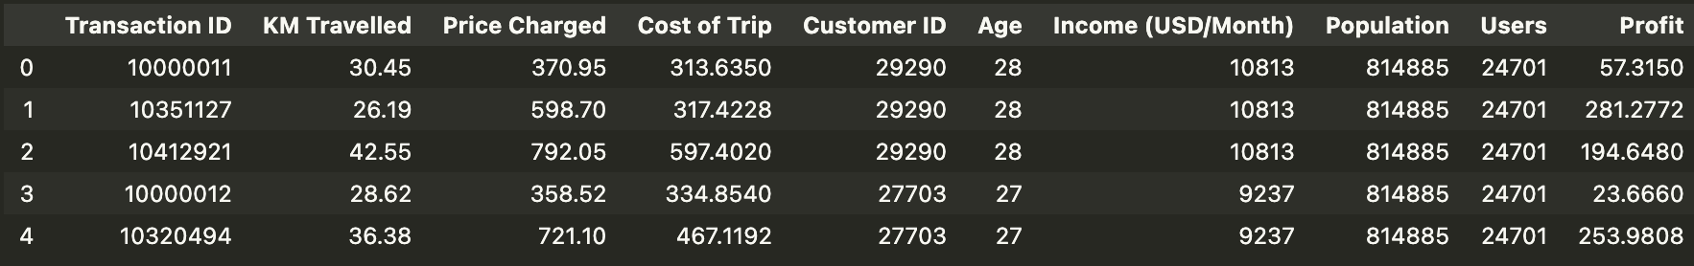
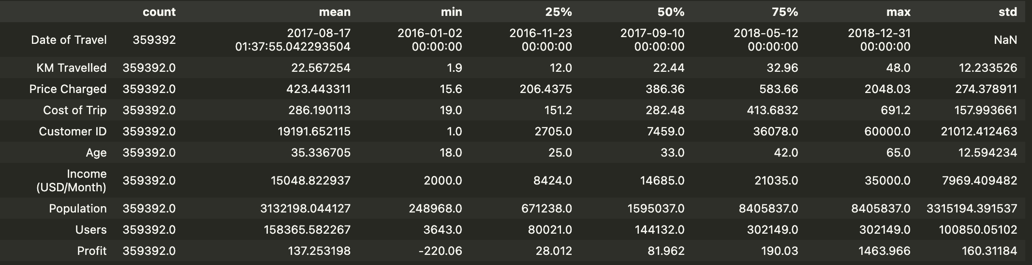
EDA - Dataset Statistics
Numerical Attribute

Slide 9
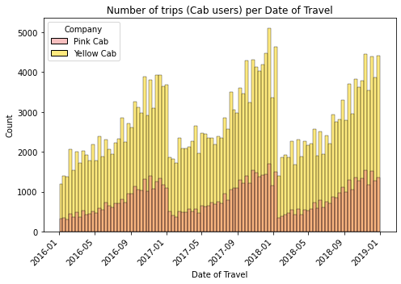
Profit Analysis
EDA - Cab trips vs Date of travel (Numerical)
There is a pattern showing that the number of trips (cab users) increases from the beginning to the end of each year for both cab companies.

Slide 10
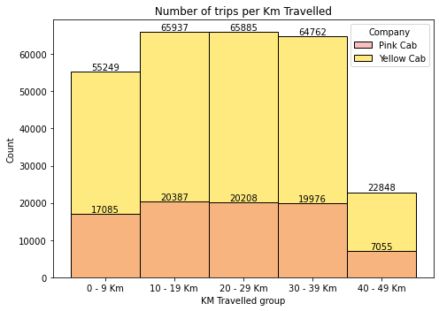
Profit Analysis
EDA - Cab trips vs Date of travel (Numerical)
Most cab trips were within 10 to 39 km with a few over 40 km, and the majority with the Yellow Cab.

Slide 11
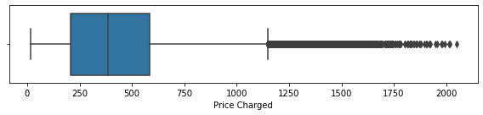
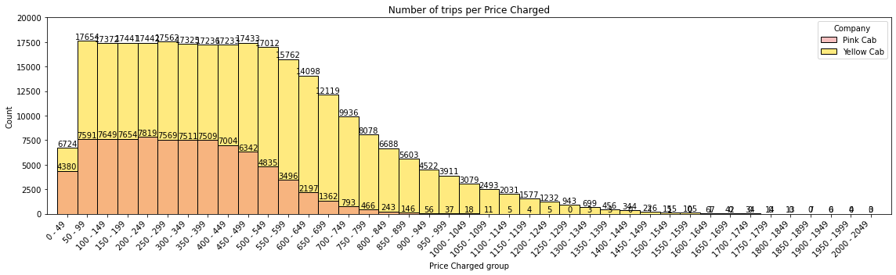
Profit Analysis
EDA - Cab trips vs Price/Cost (Numerical)
There is a decrease in the number of trips as we move towards higher prices being charged, which reflected in the cost range. This is because there are fewer long trips (higher prices) than short trips (lower prices).

Slide 12
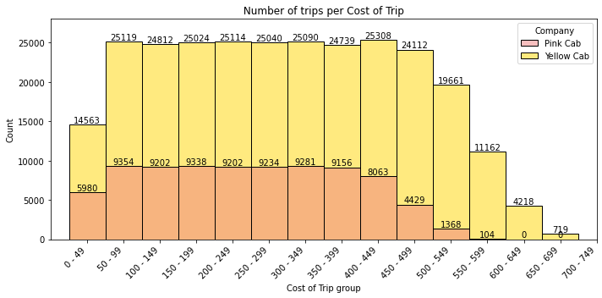
Profit Analysis
EDA - Cab trips vs Price/Cost (Numerical)
The extreme values in the `Price charged` histogram cannot be considered outliers. It shows that there are fewer trips with high prices charged (and high mileage). The prices charged and the cost of the trip increase with the increase in the mileage driven.

Slide 13
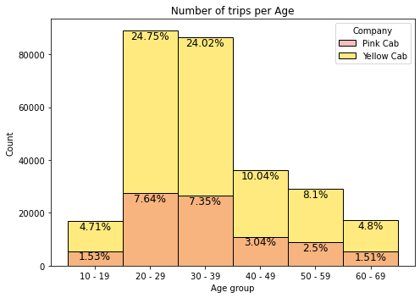
Profit Analysis
EDA - Cab trips vs Age (Numerical)
Most cab users are between 20 and 39 years old on both cab companies.

Slide 14
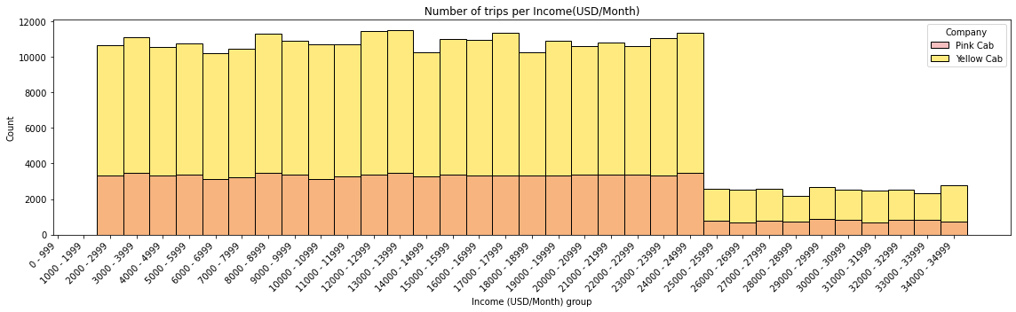
Profit Analysis
EDA - Cab trips vs User income USD/month (Numerical)
Most users has income ranging from US$2,000.00 to US$25,000.00 per month and the majority use Yellow cab.

Slide 15
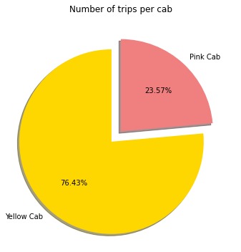
Profit Analysis
EDA - Cab trips vs Cabs (Categorical)
The Yellow Cab was the most used with 76.43% of all cab rides.

Slide 16
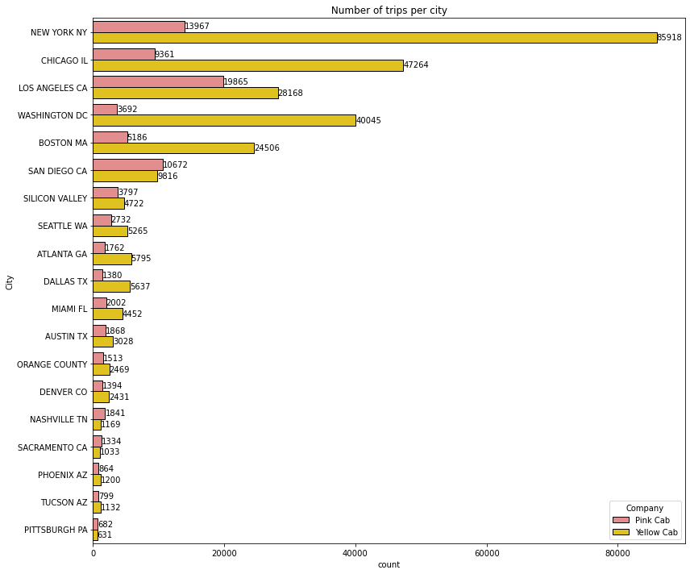
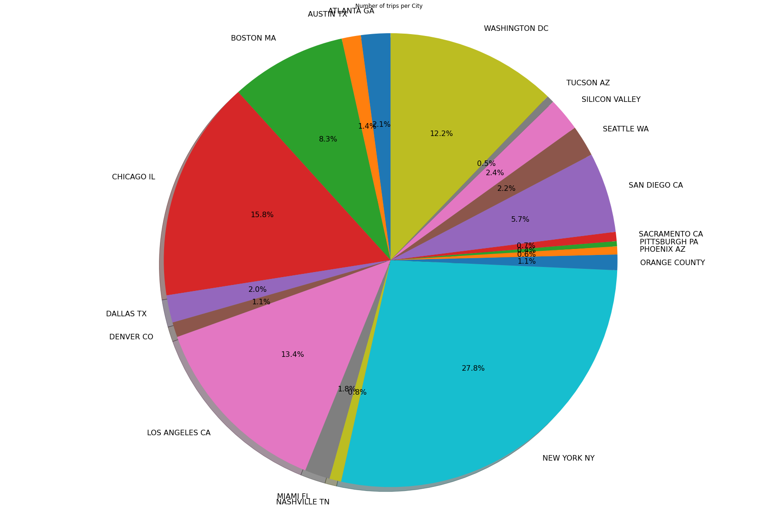
Profit Analysis
EDA - Cab trips vs City (Categorical)
NY, Chicago and LA are cities with the highest number of cab trips (from 2016 to 2018), concentrating 57% of all cab rides.

Slide 17
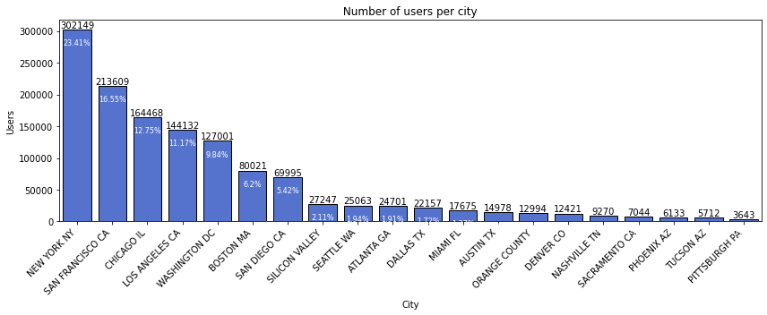
Profit Analysis
EDA - Cab trips vs City (Categorical)
The cities with the most cab users are NY, San Francisco, Chicago and LA, mainly due to their highest population. Apparently the cab_data dataset is missing the San Francisco data, which can mislead the analysis. We also see a high demand for Yellow Cabs rather than Pink Cabs in most cities.

Slide 18
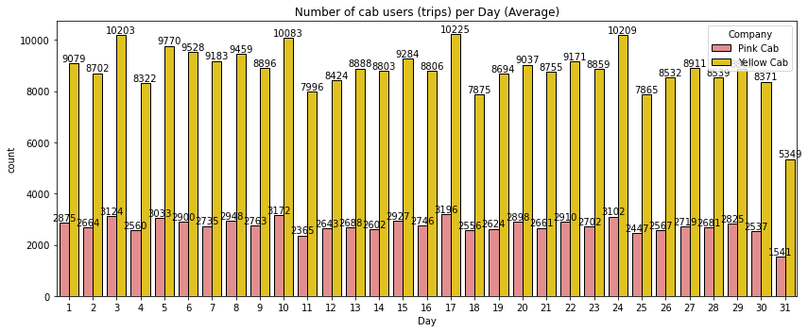
Profit Analysis
EDA - Cab users vs Day (Categorical)

Slide 19
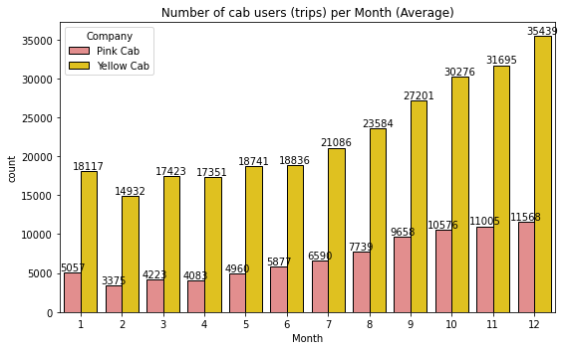
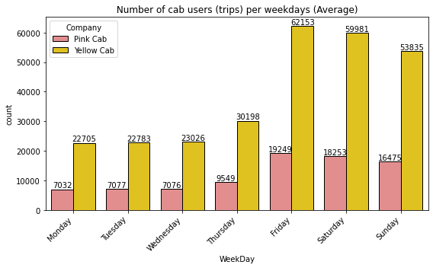
Profit Analysis
EDA - Cab users vs Month/Weekday (Categorical)

Slide 20
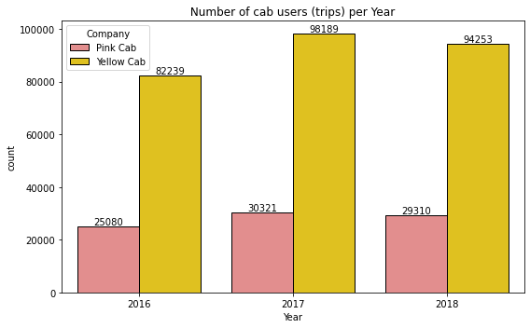
Profit Analysis
EDA - Cab users vs Year (Categorical)
1. Most trips take place on Fridays, Saturdays and Sundays.
2. There is an increase in the number of cab trips (users) as we approach the end of the year, with a peak in December.
3. The number of trips for each day over the years has highlighted decrease for the 31st.
4. The number of taxi cabs (users) in 2016, 2017 and 2018 are close, with a slightly higher number for 2017.
5. In all histograms we see a high demand for Yellow Cab.

Slide 21
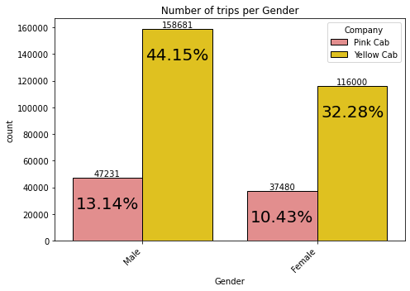
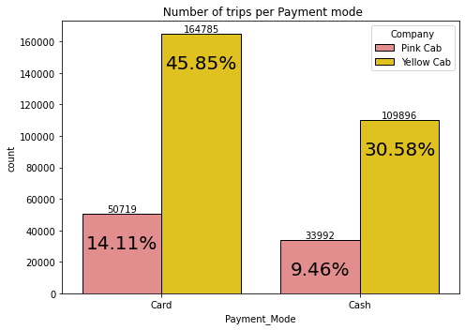
Profit Analysis
EDA - Cab trips vs Payment mode / Gender
Almost 60% of all payments were made by card with a higher demand for Yellow Cab
Male are the majority who take cabs, being 57.3% of the total against 42.7% of female with a higher demand for Yellow Cabs.

Slide 22
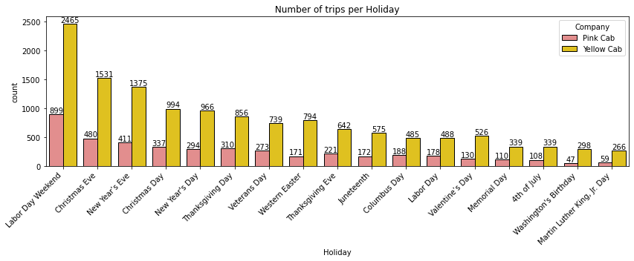
Profit Analysis
EDA - Cab trips vs Holidays
The holidays with most people taking cabs are Labor Day Weekend, Christmas Eve/Day` and New Year's Eve/Day with higher demand for Yellow Cabs.

Slide 23
Profit Analysis
EDA - Annotation
Descriptive analysis provides the basic statistics of each attribute of the dataset, and based on this, some of the problematic attribute can be identified. Based on the analysis we can affirm`
There are NO `missing values`
There are NO `low variance of numerical attributes` There are NO `low entropy of categorical attributes.
There is ONE `skew distribution`: The `Price Charged` has extreme values that cannot be treated as outliers and was applied a log transformation to generate a more balanced distribution.
There are NO high cardinality of categorical attributes`

Slide 24
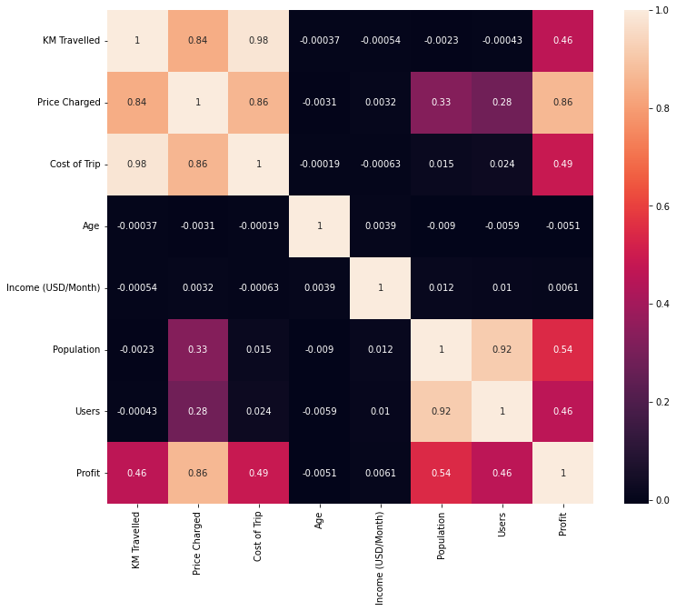
Profit Analysis
EDA - Correlation
Km Travelled, Price Charged and Cost of Trip are highly correlated. This make sense since the price charged and cost of trip are defined based on the Km travelled.
Population and number of Cab Users of a city are also highly correlated. As we have high population in a city we also have more possible cab users.
There's also a significant correlation between the population and number of cab users of a city with the `price charged`. Apparently in cities with high population and number of cab users, the price charged are higher. The higher the demand, the higher the price.

Slide 25
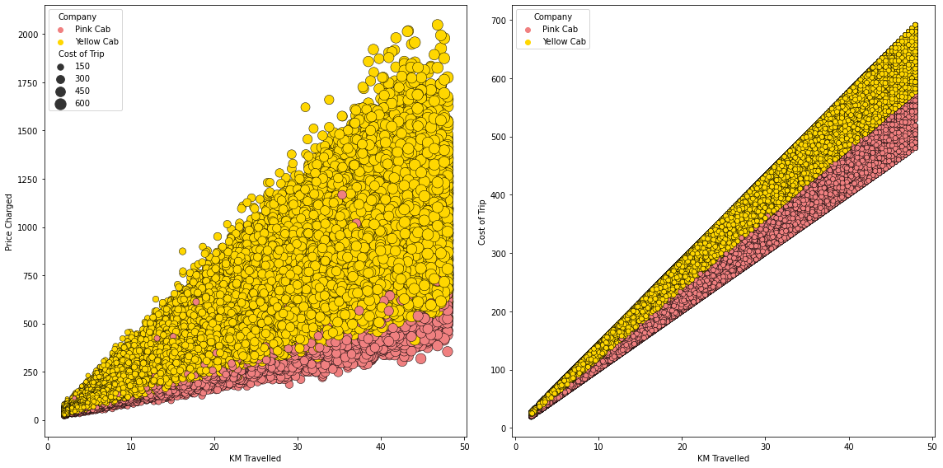
EDA - Price charged vs Km travelled

Slide 26
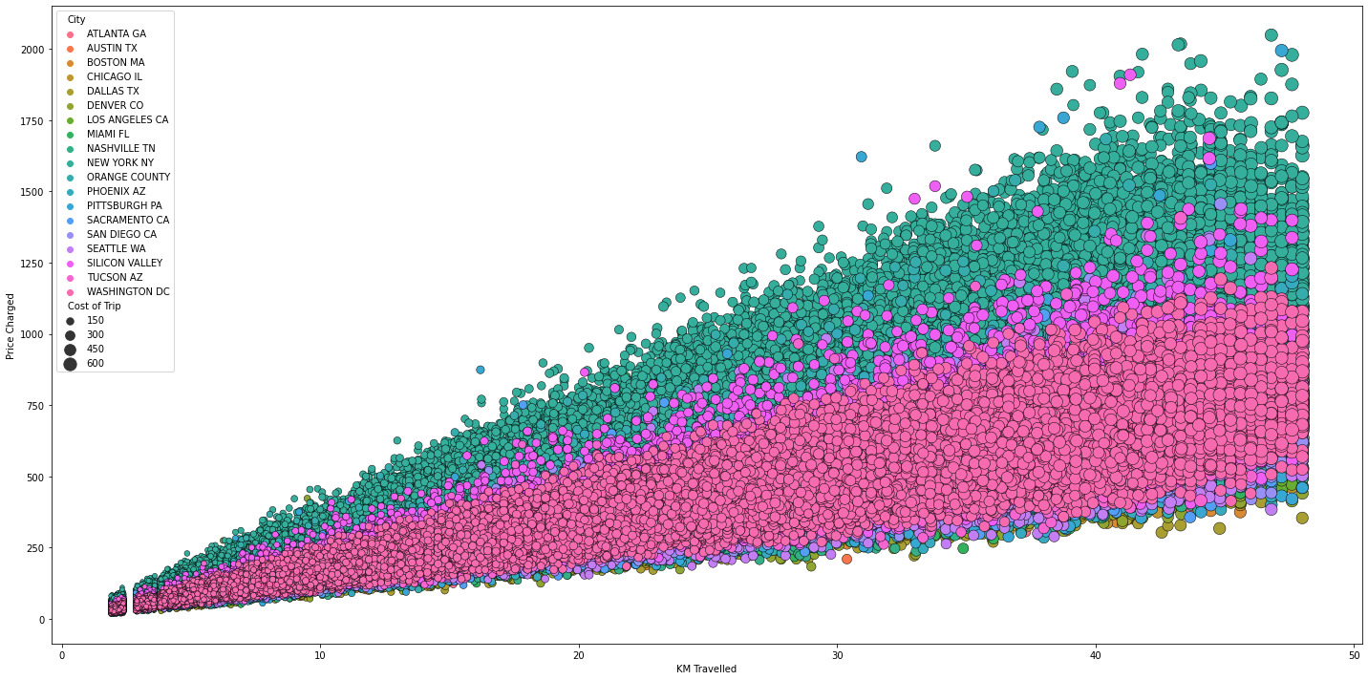
EDA - Price charged vs Km travelled

Slide 27
EDA - Price charged vs Km travelled
The Yellow cab, in addition to charging more per kilometer traveled, also has higher associated costs. The variability of prices and costs for both companies are according to each city. The little gab on the last two scatter plot seems to be a range of Km travelled that is missing on the dataset.

Slide 28
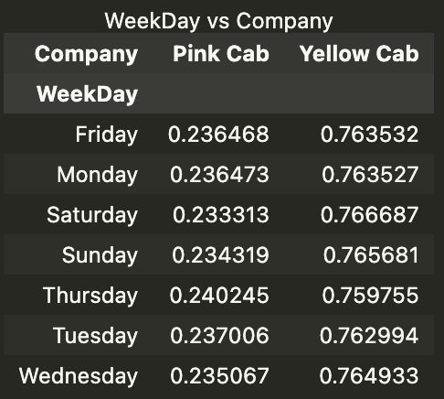
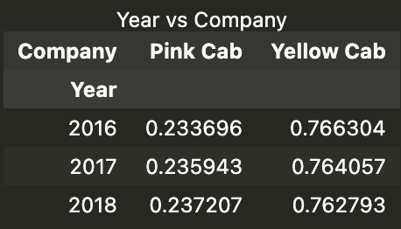
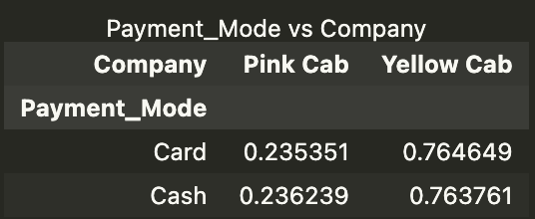
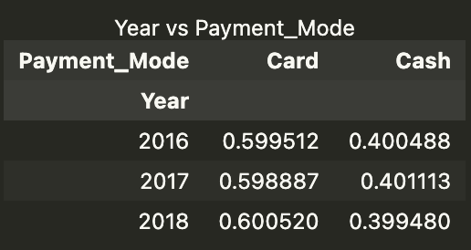
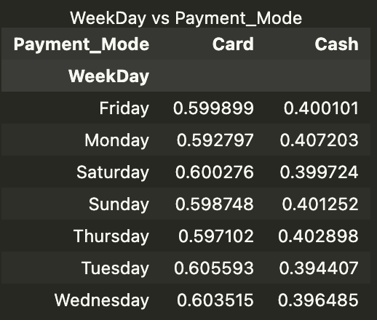
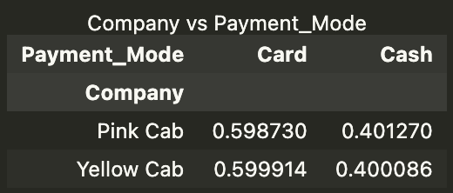
EDA - Contingency Tables

Slide 29
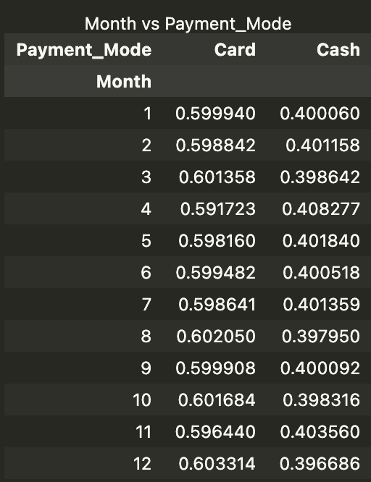
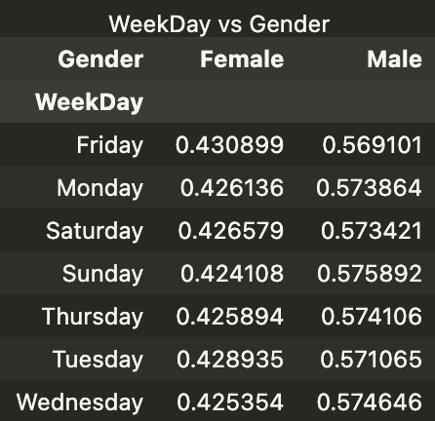
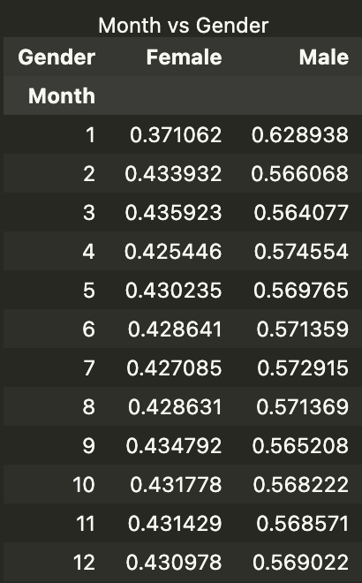
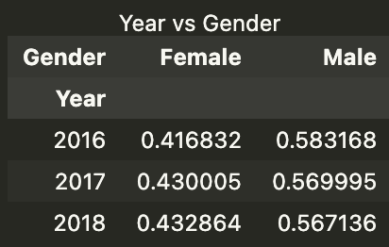
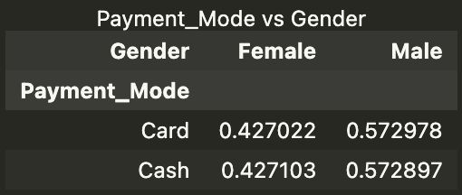
EDA - Contingency Tables

Slide 30
EDA - Contingency Tables
Check below for some of the main contingency table results:
Weekday vs Company, Year vs Company and Payment Mode vs Company: On each weekday, ~23.5% of users use pink cabs and ~76.5% yellow cabs. The quantities change, but the proportion remains even when analyzed on yearly basis and only changes when looking at over the months. This proportion is also confirmed when we look at the payment mode where ~23.5% of users who pay by card or cash use pink cabs and ~76.5% use yellow cabs. This may indicate that the yellow cab company has ~76.5% of the all available cabs (when we compare yellow cab vs pink cab).
Company vs Payment Mode, Weekday vs Payment Mode, Month vs Payment Mode and Year vs Payment Mode: For both companies, the payment mode is divided into 60% card and 40% cash. It doesn't matter if the analysis is done for each weekday, each month or year, the proportion of users for each payment mode is always ~60% for cards and ~40% for cash.
Weekday vs Gender, Month vs Gender, Year vs Gender and Payment Mode vs Gender: On each weekday the proportion of users for each gender is ~43% female and ~57% male. Excluding January, this proportion is also consistent across each month and with a slight difference from 2016 it is also consistent across years. When we check payment mode versus gender, we also see this proportion consistent with ~43% of card users being female and ~57% male.

Slide 31
Profit Margin
Exploratory Data Analysis (EDA)
Pink Cab vs Yellow Cab
Notes:
As a Go-To-Market (G2M) strategy on the Cab industry, the XYZ company needs an understanding of the cab market before taking a decision.

Slide 32
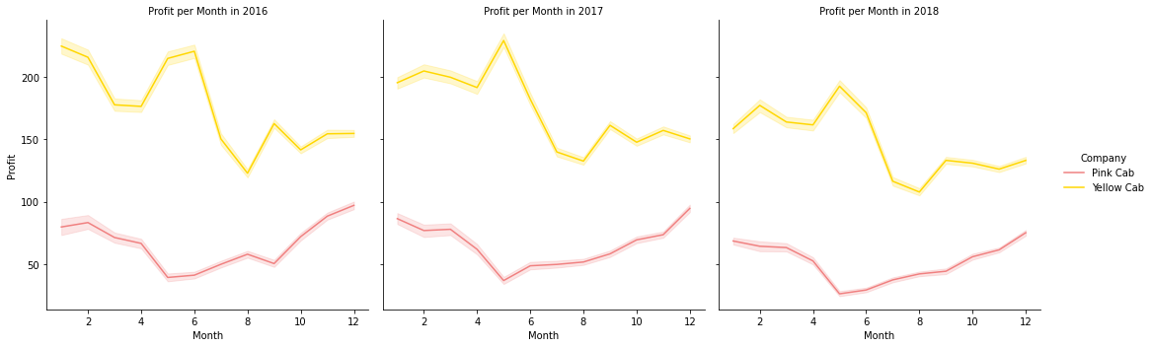
EDA - Profit Margin vs Month (Yearly)
The profit in each month analyzing each year separately shows that the Yellow Cab always performs better than the Pink Cab. However when analysing individually, we see Yellow Cab being worse in December than January while Pink Cab is being better.

Slide 33
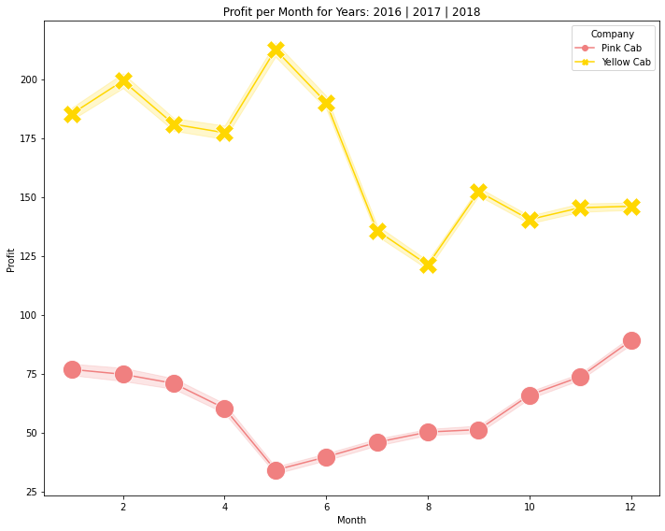
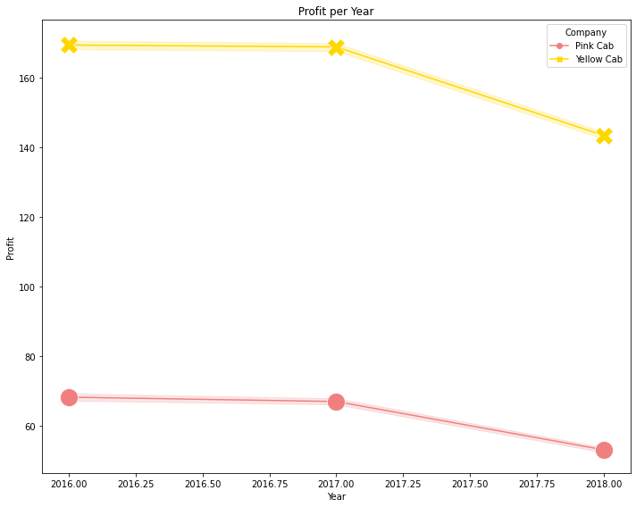
EDA - Profit Margin vs Month (average)/Year
The profit in each month in average or each year shows that the Yellow Cab always performs better than the Pink Cab.

Slide 34
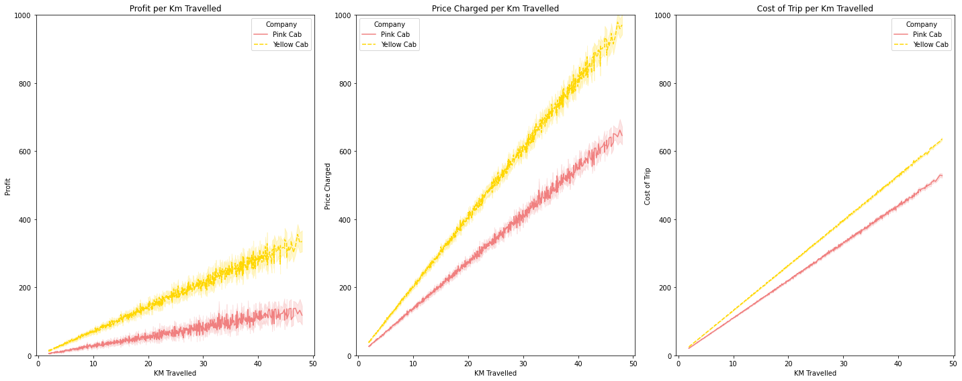
EDA - Profit Margin/Price Charged/Cost vs Km Travelled
Analyzing the line plots we can infer that there is variability in the prices charged that are reflected in profit. This is probably due to the different amounts charged in each city for both companies. The costs however do not vary much from city to city and so performs almost as a line, with higher costs per Km by Yellow Cab.

Slide 35
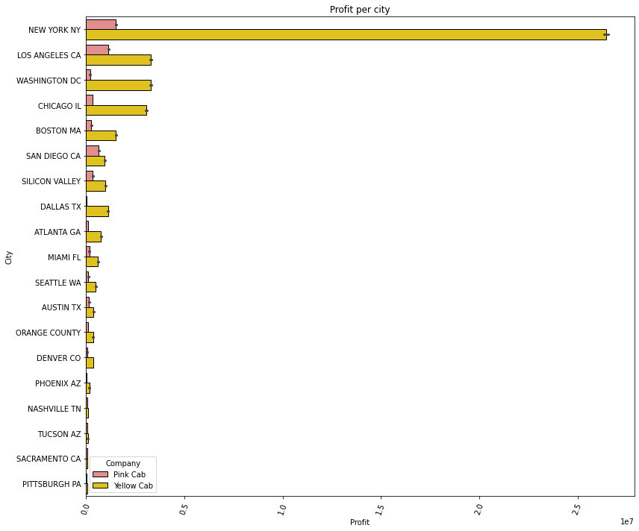
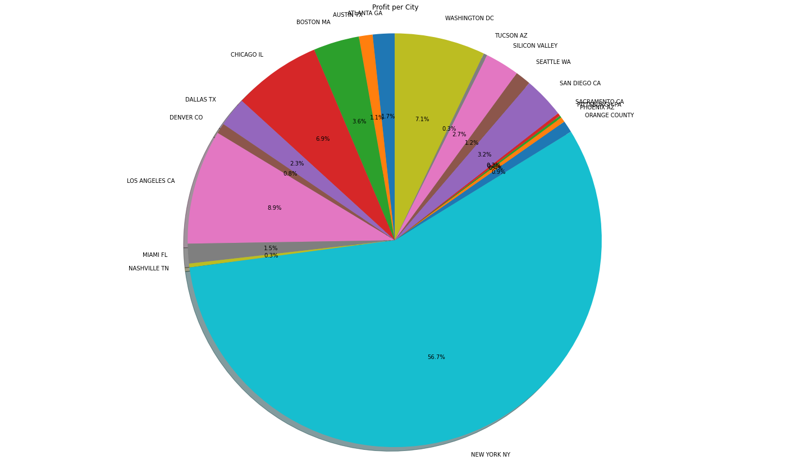
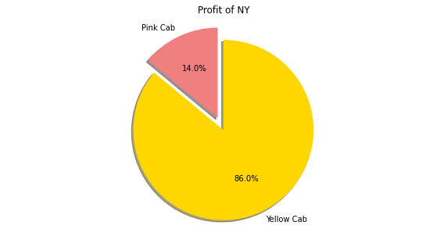
EDA - Profit Margin vs City
NY represents about 57% of the total profit of the two cab companies combined. 86% of all cabs in NY are Yellow Cab.

Slide 36
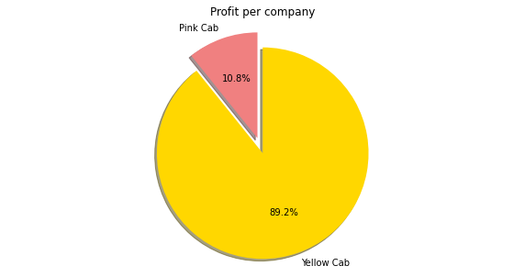
EDA - Profit Margin vs Company
Yellow cab owns 89% of the total profit made by both cab companies

Slide 37
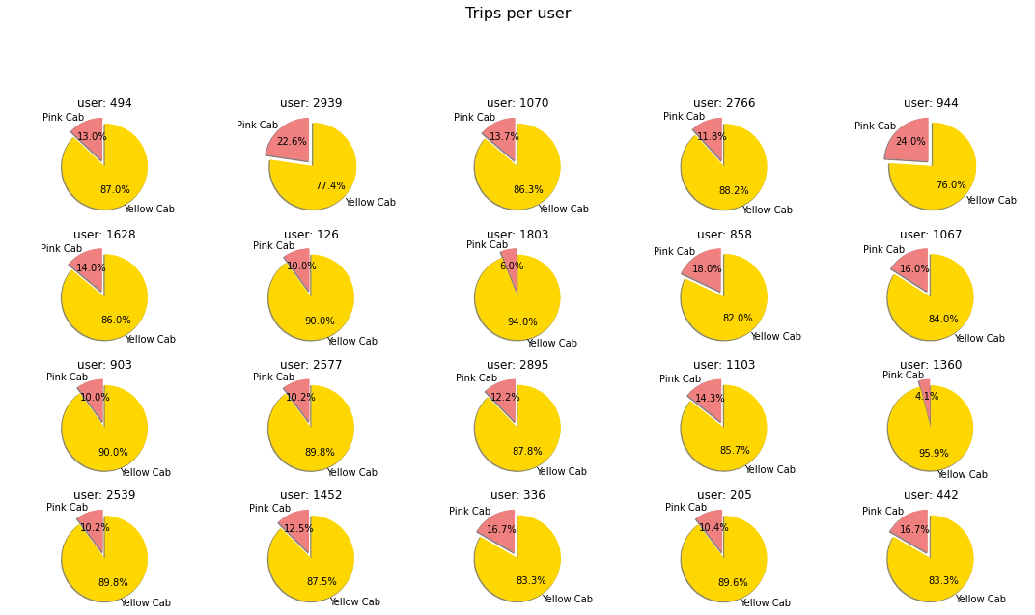
EDA - Profit Margin vs 20 most frequent users
Analyzing the 20 most frequent cab users, we can observe a preference for Yellow cab.

Slide 38
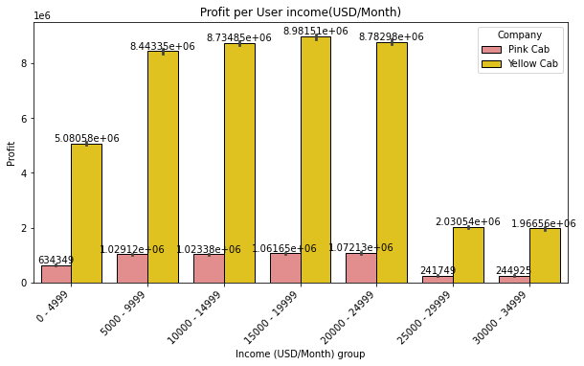
Profit Analysisz
EDA - Profit Margin vs User income
The profit margins of the Yellow Cab and Pink Cab come from users with incomes/month ranging from $5,000 to $25,000. Most use a Yellow cab.

Slide 39
Recommendations
Conclusions from the Analysis
Evaluating all time period scenarios (Day, Weekday, Month and Year) in average, Yellow Cab always presents more cab users and so a better profit margin.
The profit margin increases with the increase in the number of customers. However, this increase is not proportional, as it varies according to each city and the cities charges differently.
NY represents about 57% of the total profit of the two cab companies combined. 86% of all cabs in NY are Yellow Cab.
Yellow cab owns 89% of the total profit margin made by both cab companies
Analyzing the 20 most frequent cab users, we observe a preference for Yellow cab.
Based on the contingency tables we can infer that Yellow Cab company has ~76.5% of the all available cabs (when compared with Pink Cab).
The Yellow cab is an older company on the market, with a higher profit margin, probably more cars on the streets and has also a greater user fidelity. For that reason we recommend Yellow Cab as the company to invest in.

Slide 40
Thank You

