Slide 1
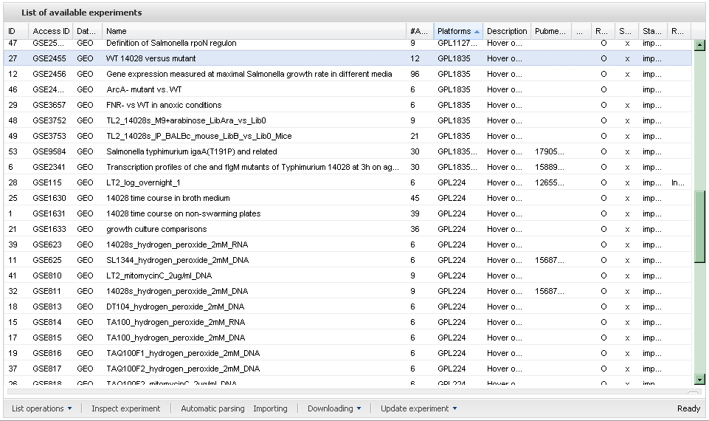
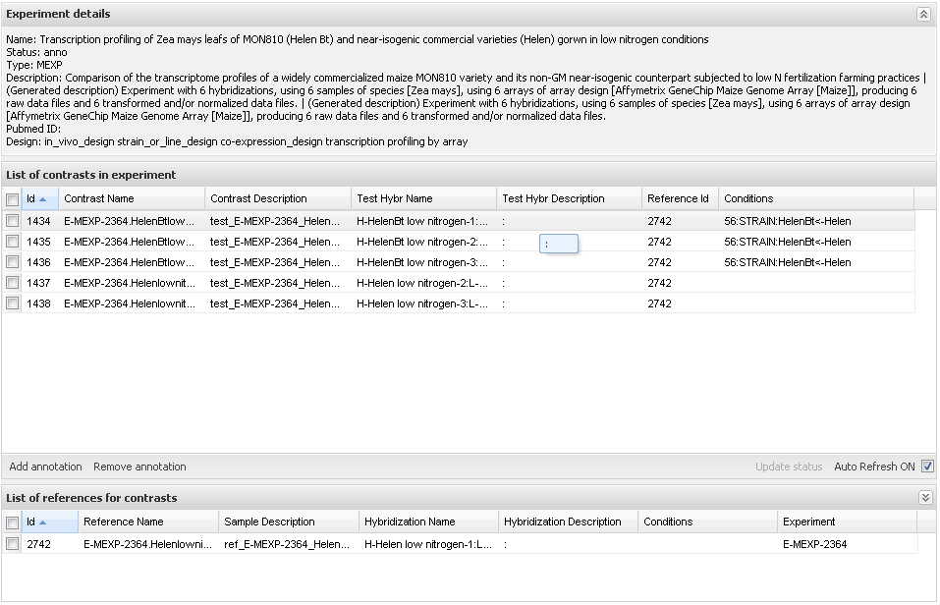
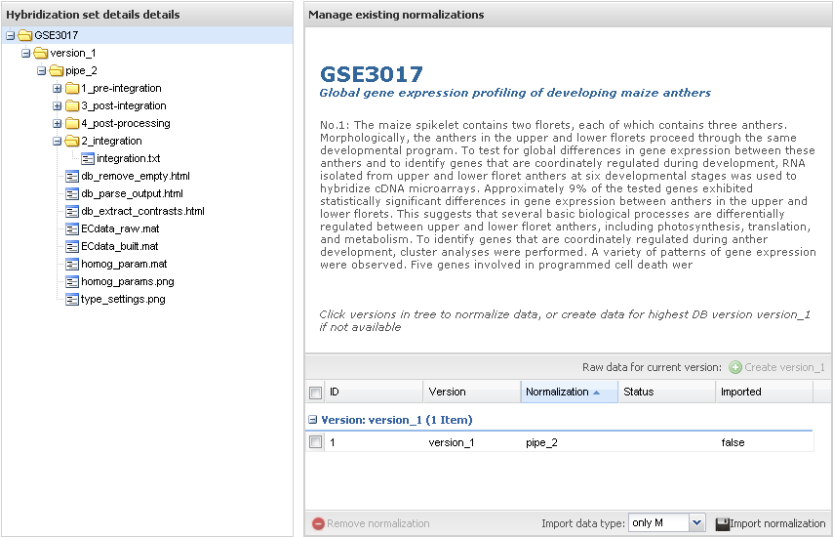
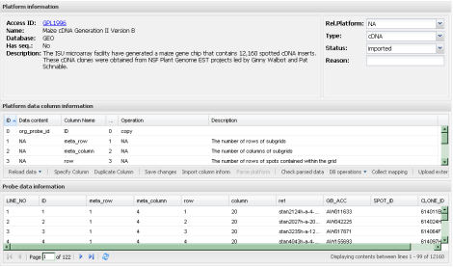
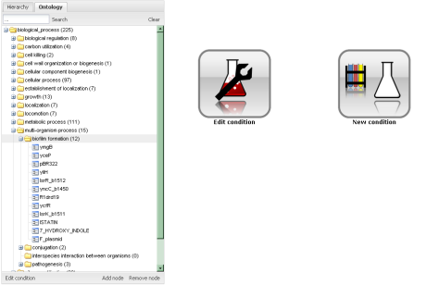
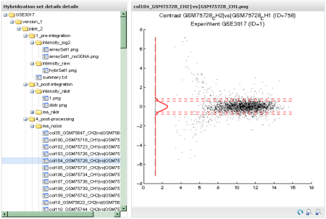
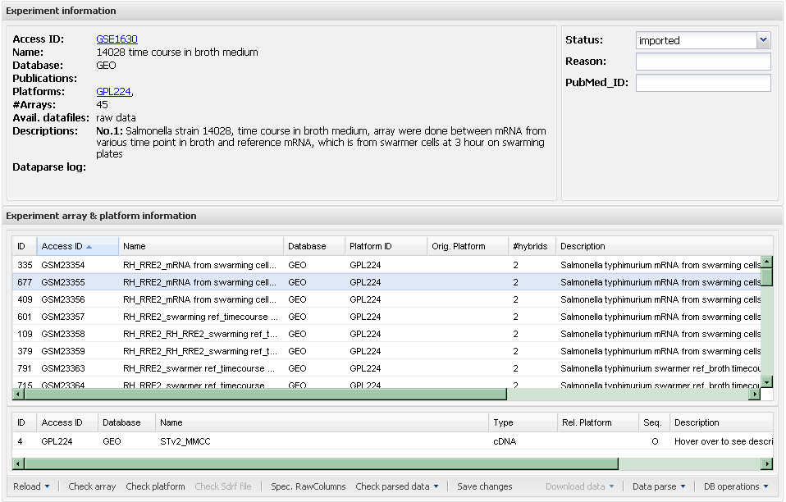
Collection
Annotaion
Homogenization
Sample annotation
Platform
parse and import
Contrast specification
Experiment
parse and import
Normalization

Slide 2
1.Data Collection
2.Annotation
3.Homogenization
sample
annotations
experiment
data
contrast specifications
data
normalization
platform
layout

Slide 3
1.Data Collection
2.Annotation
3.Homogenization
sample
annotations
experiment
data
contrast specifications
data
normalization
platform
layout

Slide 4
1.Data Collection
2.Annotation
3.Homogenization
sample
annotation
experiment
data extraction
contrast designation
data
normalization
platform
specs extraction

