Slide 1
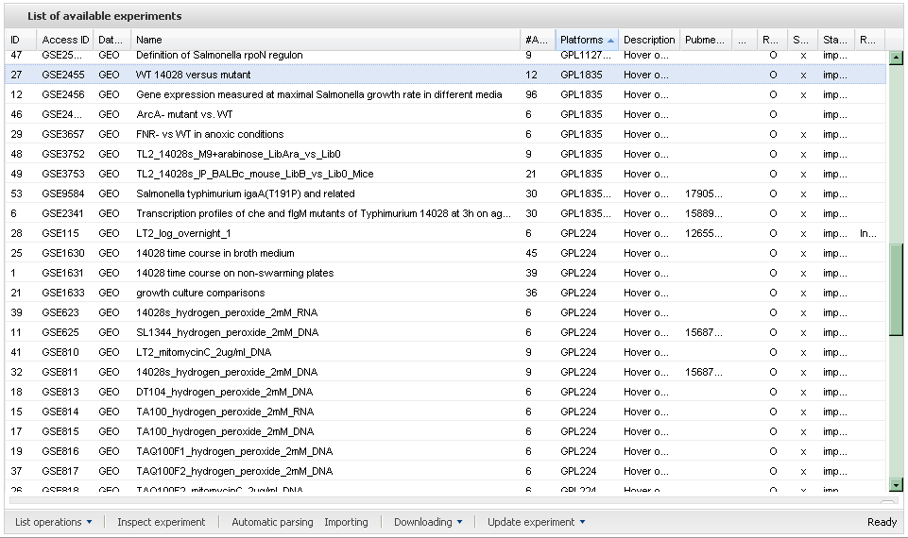
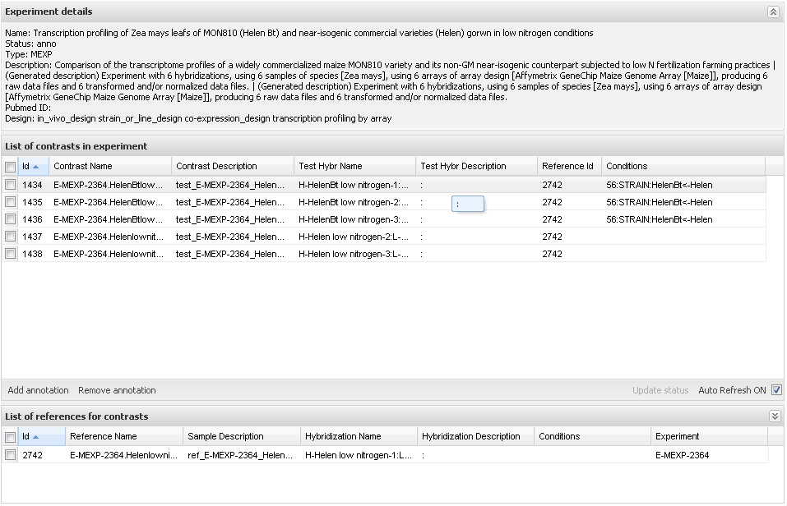
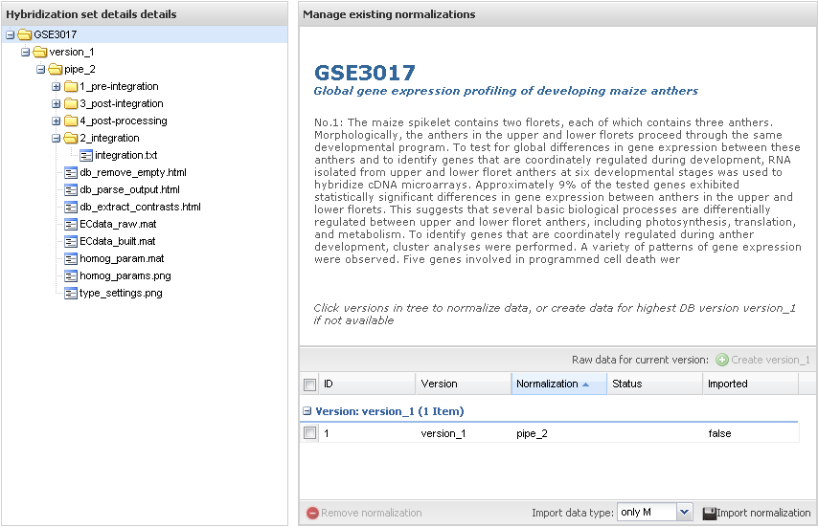
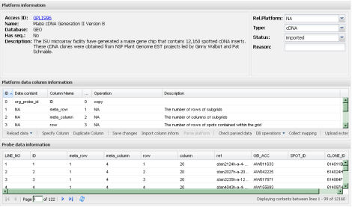
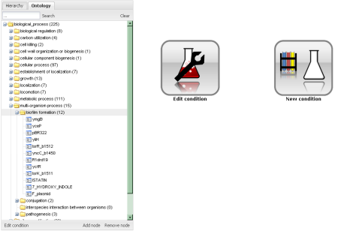
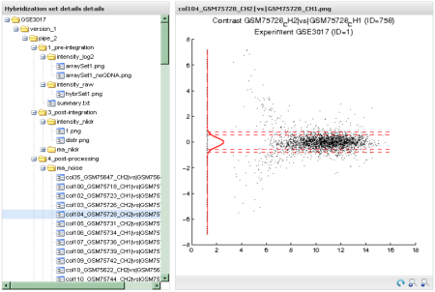
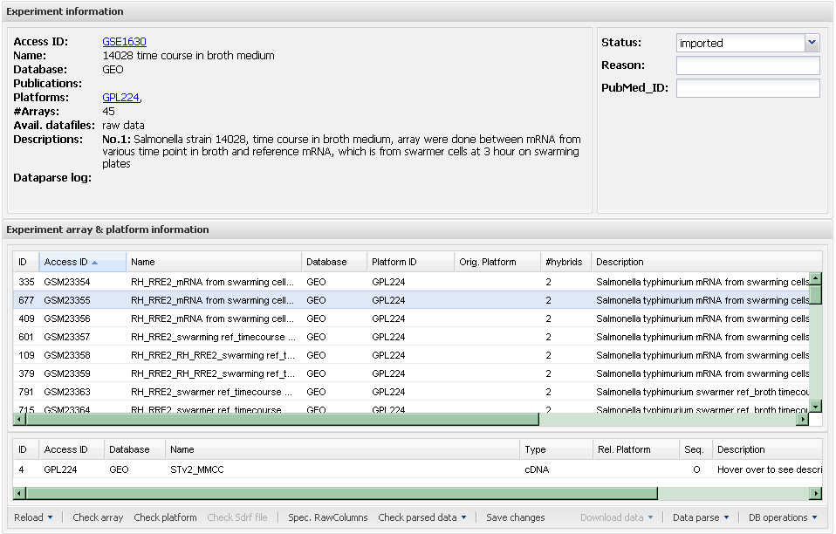
1.Data Collection
2.Annotation
3.Homogenization
sample
annotations
experiment
data
contrast specifications
data
normalization
platform
layout

Slide 3
Publically accessible data
contrast
annotation
sample
contrast
norm data
gene annotation
articles
experiment
gene
array
hybridization
raw data
platform
Internal only data

Slide 4
Publically accessible data
contrast
annotation
sample
contrast
norm data
gene annotation
articles
experiment
gene
array
hybridization
raw data
platform
Internal only data

