Slide 1
DGTN: Dual-channel Graph Transition Network for Session-based Recommendation
工海碩一 R09525066 李政翰
工海碩二 R08525066 黃富榆
工海碩二 R08525091 賴昱榮
農經碩一 R09627023 吳柏叡
DGTN: Dual-channel Graph Transition Network for Session-based Recommendation https://arxiv.org/pdf/2009.10002v1.pdf

Slide 2
Agenda
01
Motivation
problem,solution and pretreat
02
Graph Embedding
How to do Graph Embedding
03
Result
The performance and model size

Slide 3
Motivation
problem,solution and pretreat

Slide 4
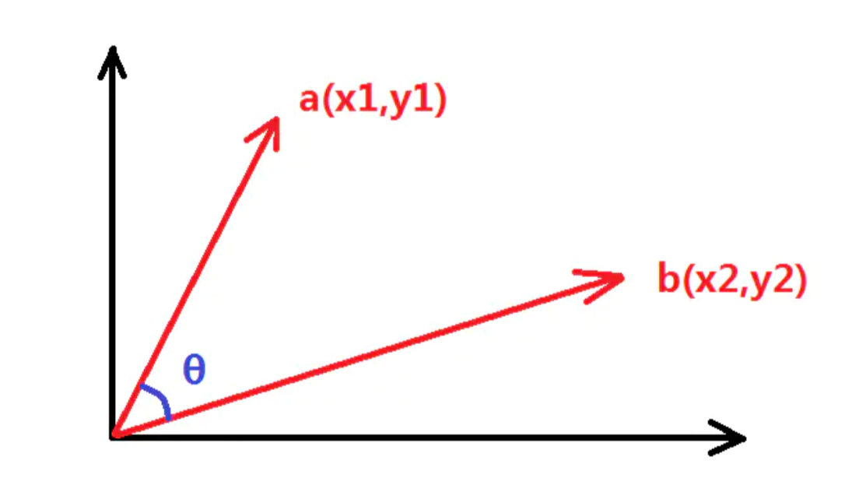
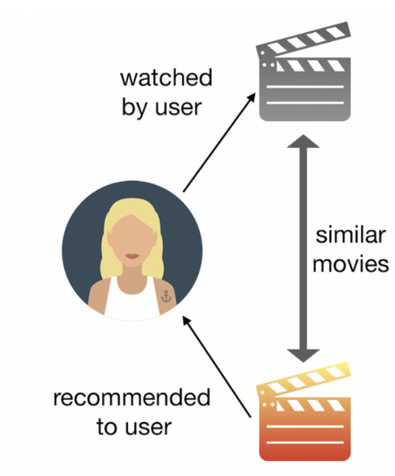
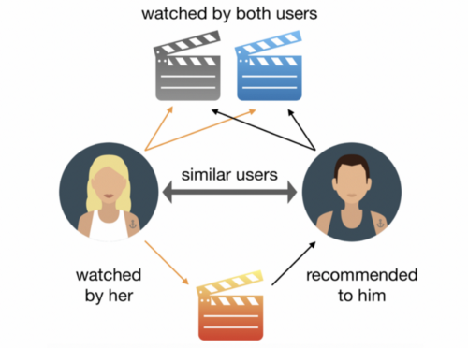
Collaberative Filtering (CF)
itemCF
Problem of
Recommendation
System
userCF
Cosine similarity
Cold Start: What if we don’t have customer profile?

Slide 5
Session based method
(即使沒有過去資料的新產品，仍能根據行為預測)
relies on anonymous user action clicks in an ongoing session to predict the user’s next action
Method of
Recommendation
System
RNN
(問題:無法考慮到節點的上下文關聯性)
have strong abilities to consider the relevance between node
SR-GNN
(問題:無法考慮到會話間的鄰近關係)
model complex transitions among item nodes on the graph
If we consider the neighborhood relations between session,
can we do much better?

Slide 6

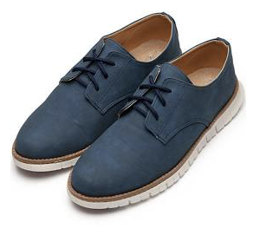


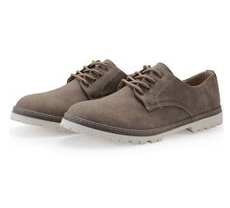

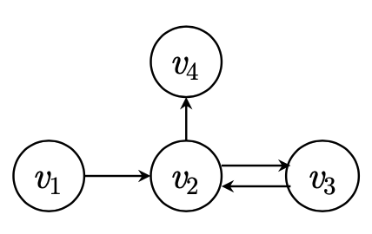
About
Session
Based
GNN
Buy
user web session
The sequence can be handled by Neural Network

Slide 7
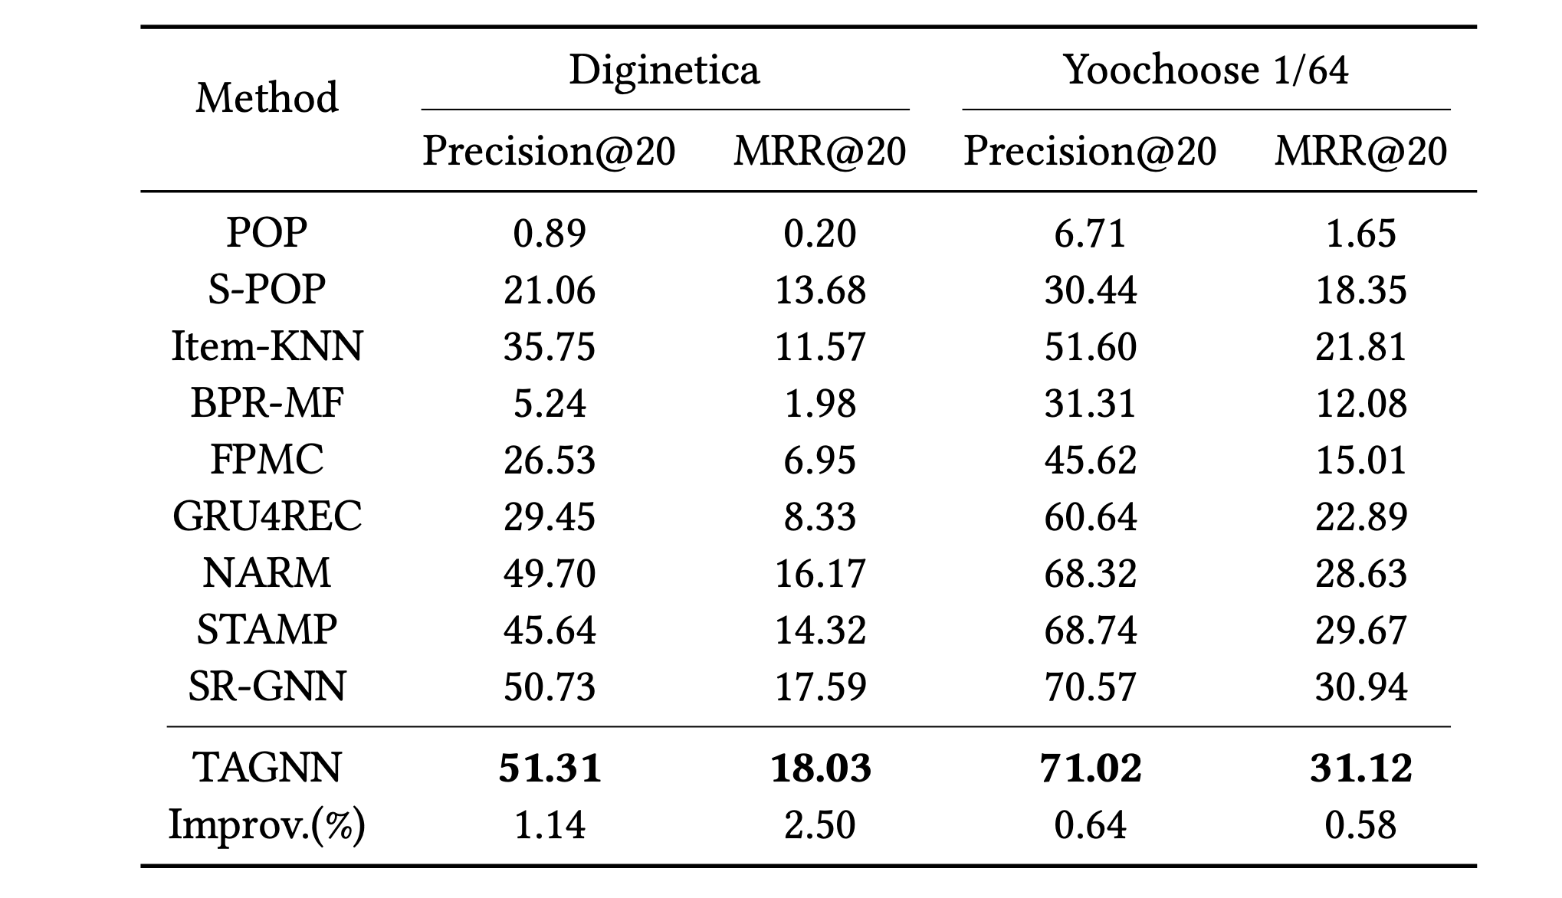
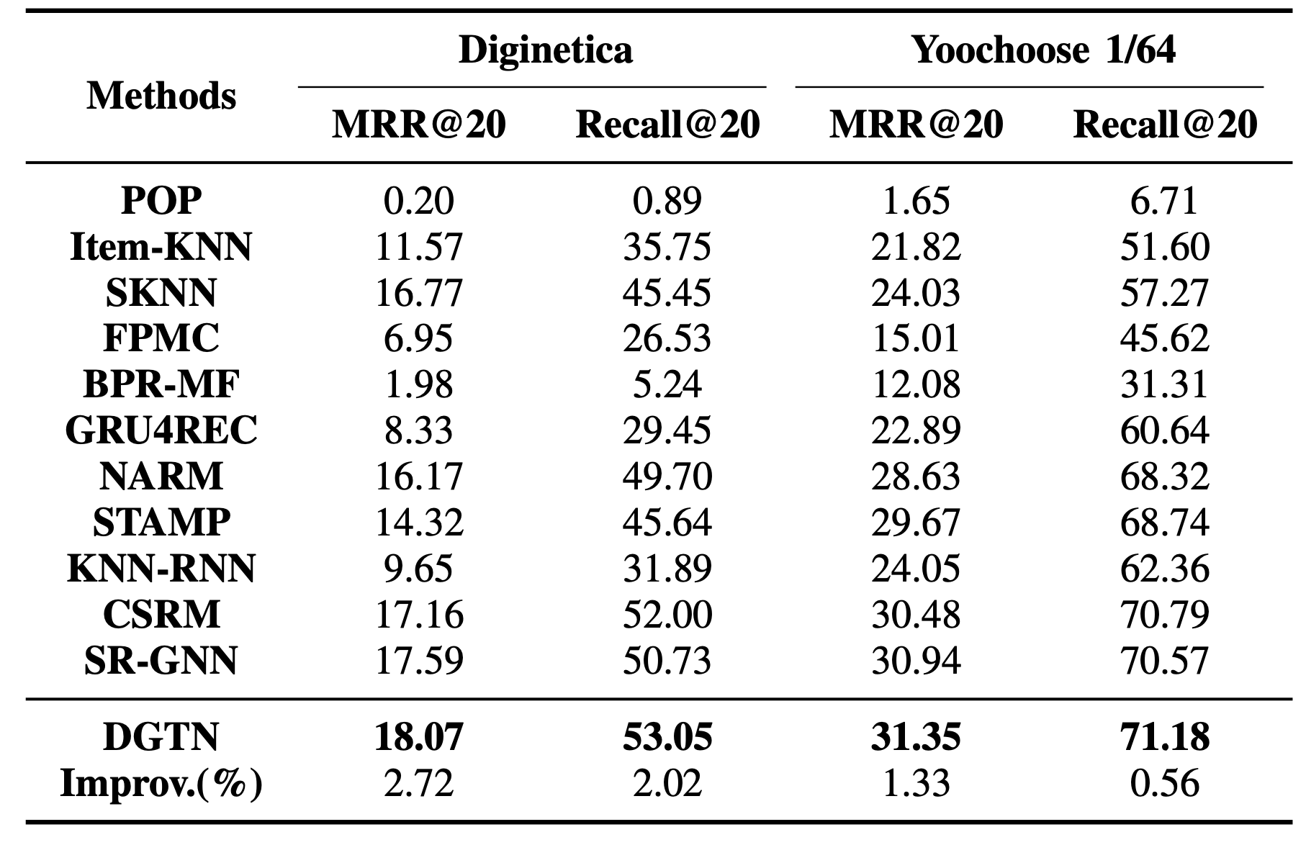
Graph
Neural
Network
Comparison
How about DGTN?
state of art
Table from TAGNN paper
Table from DGTN paper

Slide 8
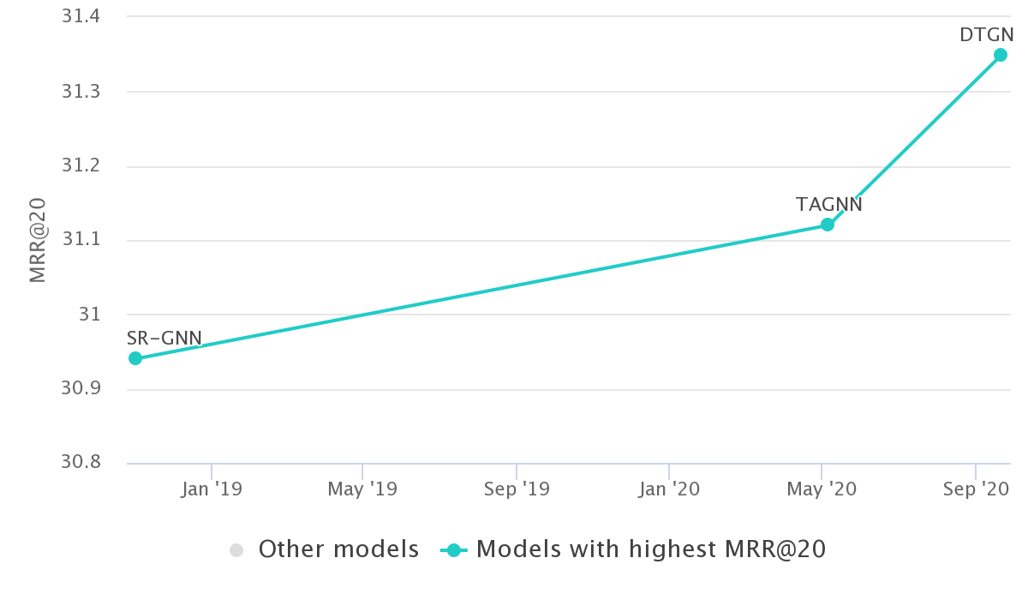
Graph
Neural
Network
Comparison
sources https://paperswithcode.com/task/session-based-recommendations

Slide 9
Graph Embedding
How to do Graph Embedding

Slide 10
Graph Embedding
影響performance的最大關鍵：

Slide 11
Graph Embedding
影響performance的最大關鍵：
如何做Graph Embedding

Slide 12
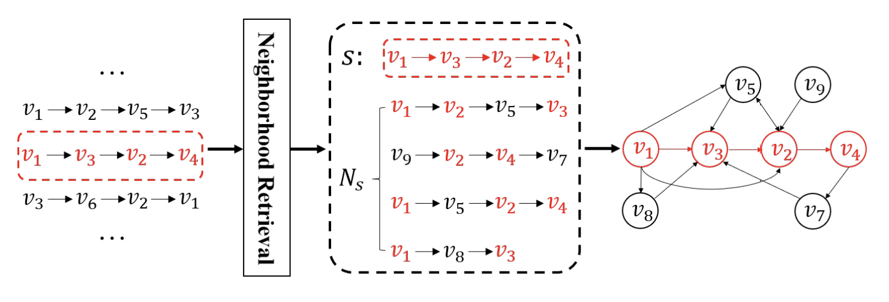
Graph Embedding
影響performance的最大關鍵：
如何做Graph Embedding

Slide 13
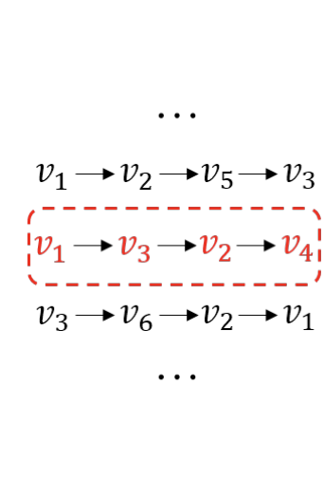
Graph Construction
列出所有的sessions

Slide 14
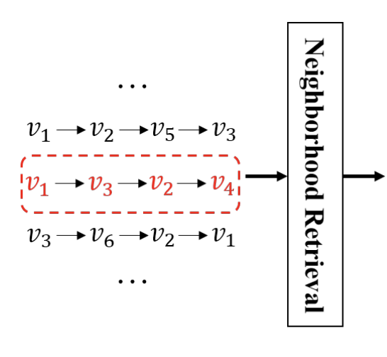
Graph Construction
列出所有的sessions
尋找target session的neighbors

Slide 15
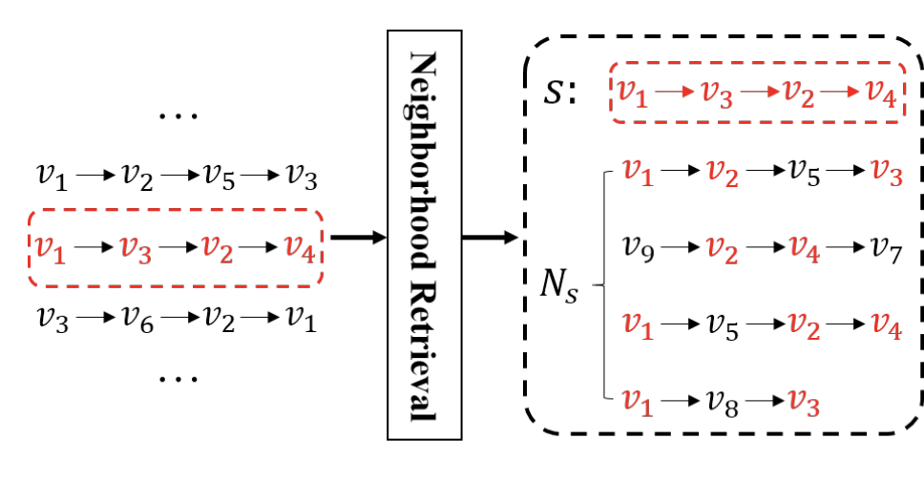
Graph Construction
列出所有的sessions
尋找target session的neighbors
建立neighborhood

Slide 16
Graph Construction
列出所有的sessions
尋找target session的neighbors
建立neighborhood（如何決定哪些sessions可以存在neighborhood?）

Slide 17
Graph Construction
列出所有的sessions
尋找target session的neighbors
建立neighborhood
將neighborhood中的每個點(node)按照sessions建立關係(edge)，成為Graph

Slide 18
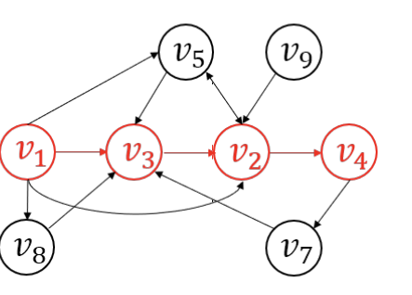
Graph Construction

Slide 19
Graph Construction
圖中有user當前session的行為（紅點）
也有global的collaborative Information（黑點）

Slide 20
Graph Construction
圖中有user當前session的行為（紅點）
也有global的collaborative Information（黑點）
不能直接混為一談！！！

Slide 21
Graph Construction
圖中有user當前session的行為（紅點）
也有global的collaborative Information（黑點）
不能直接混為一談！！！
＝> Dual Channel

Slide 22
Implementation detail
&
performances
Action speaks louder than words

Slide 23
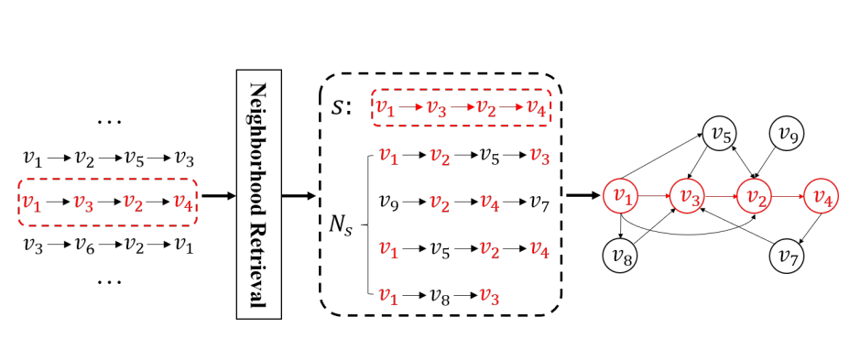
Implementation
details
How it retrieve neighbor sessions?

Slide 24
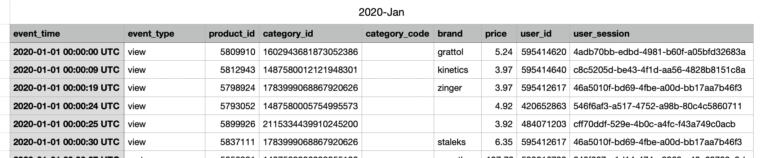
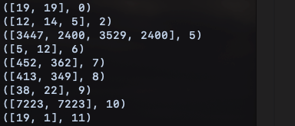
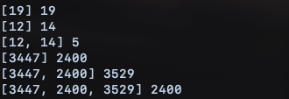
Data Preprocessing
Raw Data
( [ product_ID ] ,sess_id )
Group By
sess_ID
Trainable data
f([ so far path ]) = next_click probability
Notes:
raw data: each record is a session
each session property , we only care the two column: session ID and item ID
Connect each item by the same session : session path

Slide 25
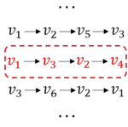

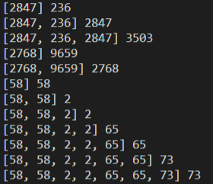
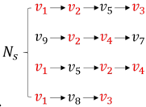

Implementation
details
Target session
Dataset
find first k-th similar sessions

Slide 26
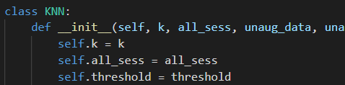
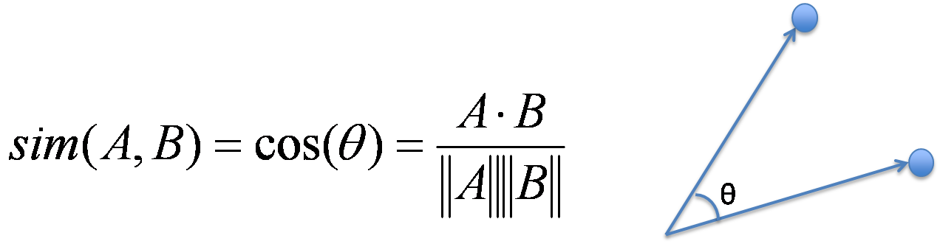
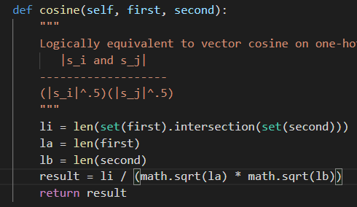
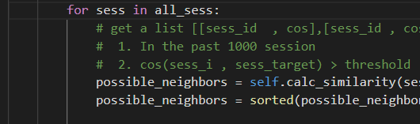

Implementation
details
= KNN (K-nearest neighbors)
Sorted by cosine similarity
Can reduce computing time for one-hot space

Slide 27
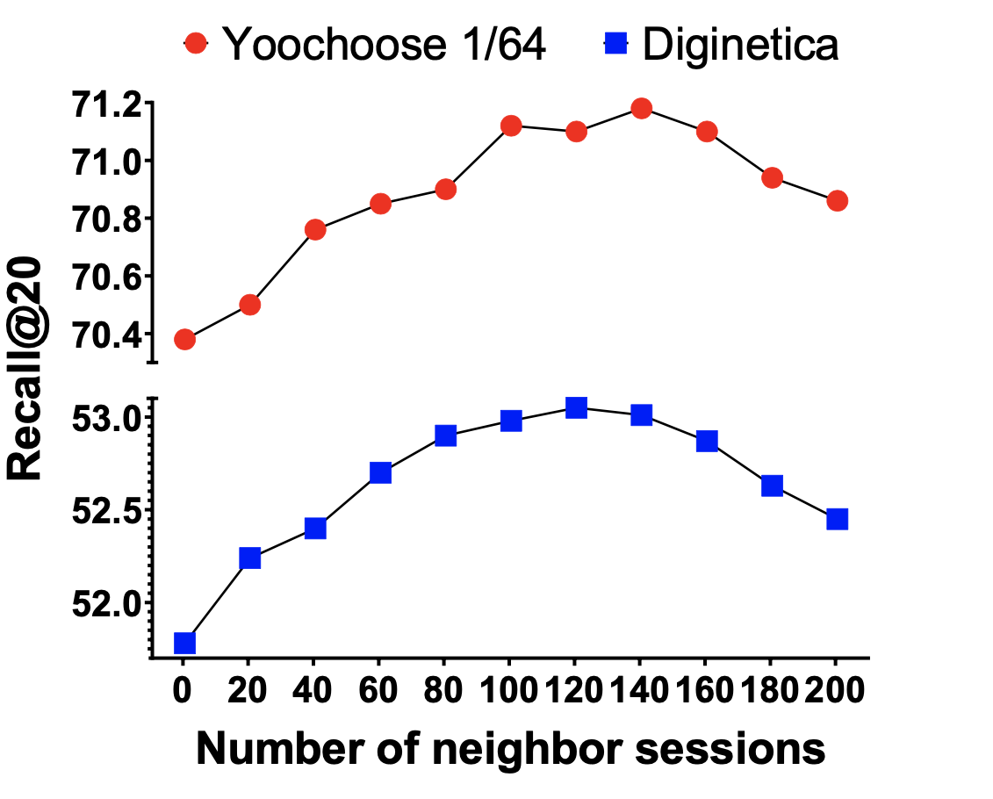
Implementation
details
Graph
Neural
Network
Optimal number of neighbor session
k↑ better
k ↓ noise increase

Slide 28
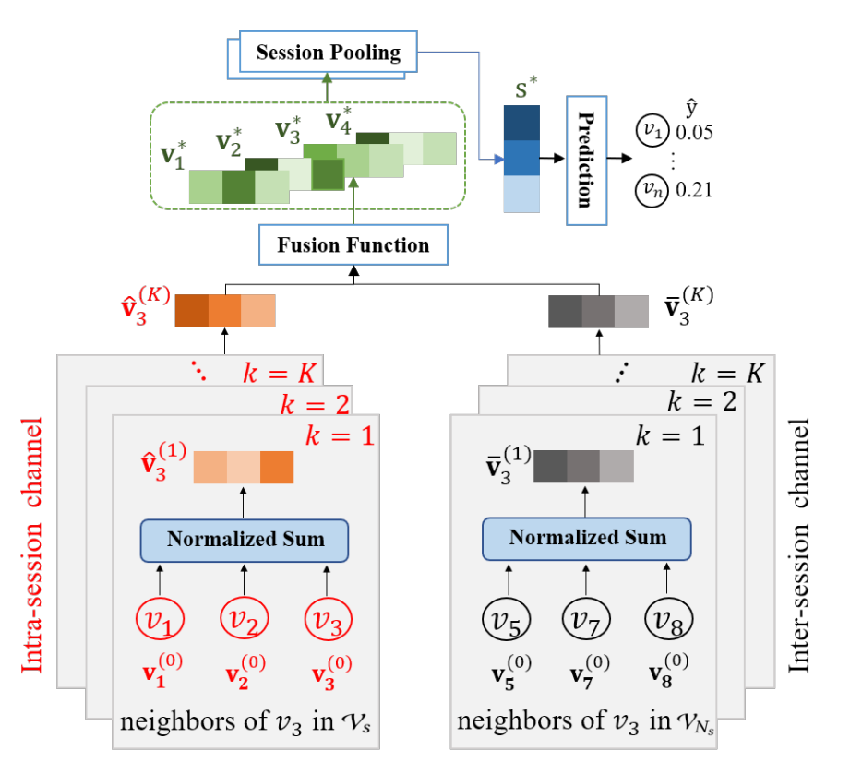
Implementation
details

Slide 29

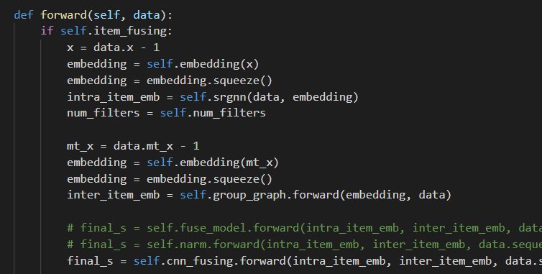
Implementation
details
Intra_embedding
Inter_embedding

Slide 30
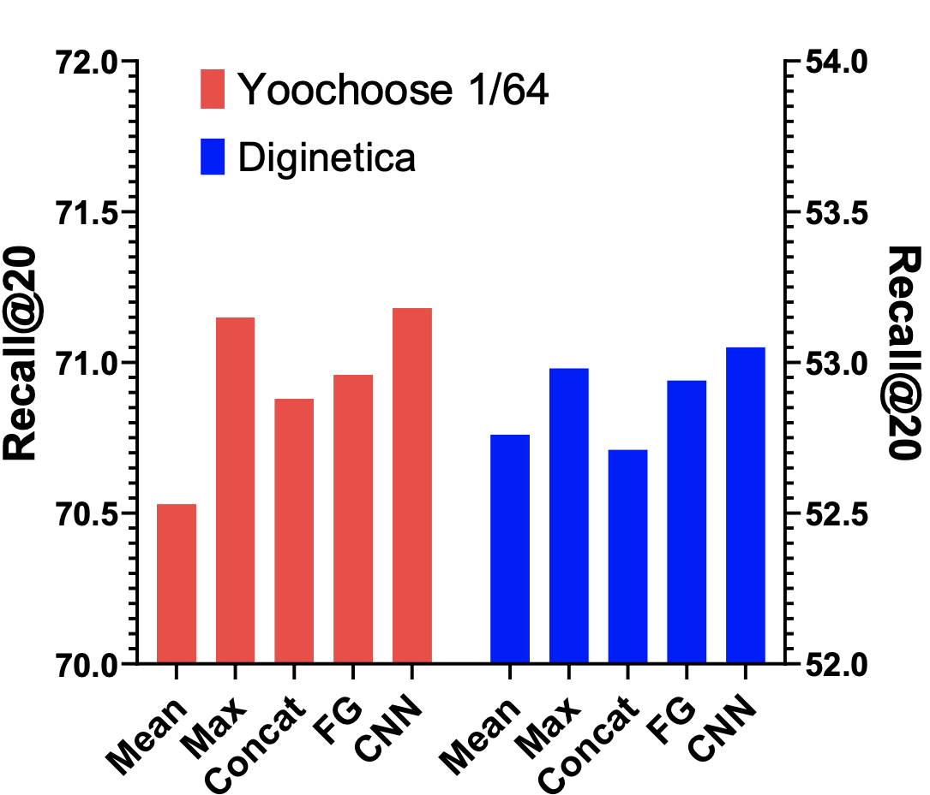

Implementation
details
Mean-Pooling
Concatenation
Max-Pooling
Fusion Gating
CNN
Mean( , ) =
T
concat( , ) =
Max ( , ) =
=
Proj ( ) =

Slide 31
Implementation
details

Slide 32
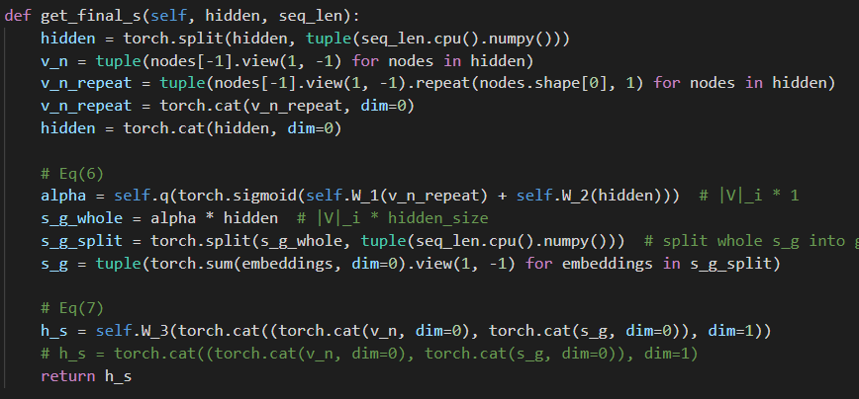
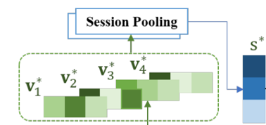






Implementation
details
Attention
Proj ( ) =
=

Slide 33
Conclusion
A good Session-bases recommendation system
Predict customer behaviors
Recommend without membership (But if you have, it’ll be better )
Consider the similar session is necessary

Slide 34
Q & A
Thanks for listening

