Slide 1
1) MOBILE FIRST

Slide 2

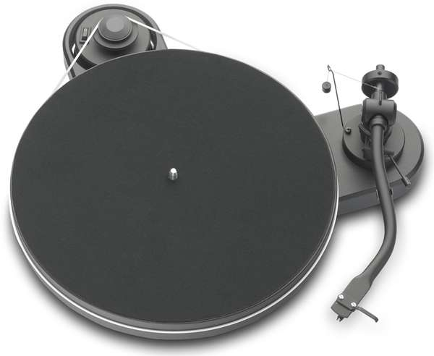
?
PLAY
DIFF
Test your memory and 90’s MUSICHOODNESNESSS!!!!!

Slide 3
?
?
PLAY
DIFF
Test your memory and 90’s MUSICHOODNESNESSS!!!!!
[1] SELECT DIFICULTY (DIFF):
  NORMAL : Hear 15 seconds of a chorus
  GROOPIE: Hear first 15 seconds of the song.
[2] PLAY: Press PLAY to start the game
[3] LISTEN: A record will play for 15 seconds
[4] GUESS: Select the ARTIST/SONG combination you think is playing.

Slide 4
Now playing?????
By The Way : Red hot Chilli Peppers
Nookie : Limp Bizkit
Got the Life : KoRN
Crawling : Linkin Park

Slide 5

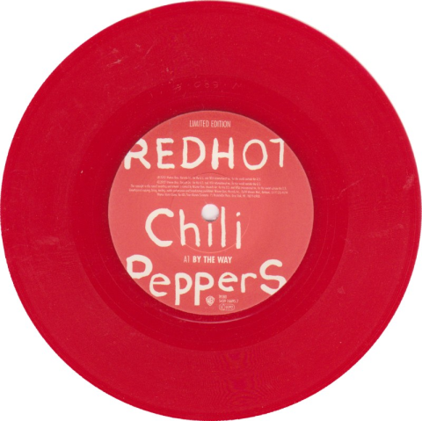
GOT IT!!!!!!!!!!!!
SONG: By The Way
BAND: Red Hot Chilli Peppers

Slide 6
Playing : 1 of 5
Which is the right one?
By The Way : Red hot Chilli Peppers
Nookie : Limp Bizkit
Got the Life : KoRN
Crawling : Linkin Park
COLLECTION
SONG: By The Way
BAND: Red Hot Chilli Peppers

Slide 7
2) RESPONSIVE TO WIDER SCREENS

Slide 8
?
DIFF
Test your memory and 90’s MUSICHOODNESNESSS!!!!!
PLAY

Slide 9
?
?
DIFF
1
Test your memory and 90’s MUSICHOODNESNESSS!!!!!
PLAY
2
[1] SELECT DIFICULTY (DIFF):
  NORMAL : Hear 15 seconds of a chorus
  GROOPIE: Hear first 15 seconds of the song.
[2] PLAY: Press PLAY to start the game
[3] LISTEN: A record will play for 15 seconds
[4] GUESS: Select the ARTIST/SONG combination you think is playing.
4
3

Slide 10
SONG: By The Way
BAND: Red Hot Chilli Peppers

Slide 11
OTHER THOUGHTS

Slide 12

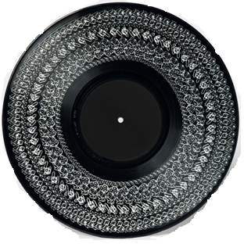

Slide 13

Test your memory and 90’s MUSICHOODNESNESSS!!!!!
PLAY

Slide 15
0
?
?
DIFF
Select difficulty:
NORMAL : Hear 15 seconds of a chorus
GROOPIE: Hear first 15 seconds of the song.
Test your memory and 90’s MUSICHOODNESNESSS!!!!!
PLAY
3
2
Select the ARTIST/SONG you think is playing
A RECORD will play for 15 Seconds

