Slide 1

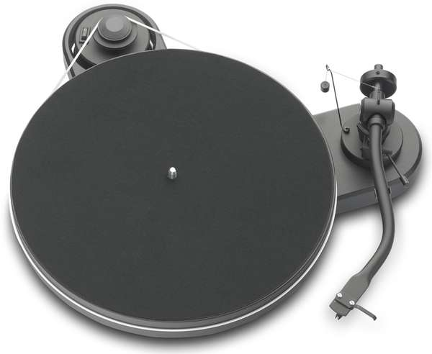
?
PLAY
DIFF
Test your memory and 90’s MUSICHOODNESNESSS!!!!!

Slide 2
1) ADD RANDOMNESS, SCALLABILITY, SCOPE AND FUN !!!: Revamping the STATIC memoryJukeBox (http://leoreq.github.io/memoryJukebox/) Trivia with Spotify API integration.
+ Twiter bootstrap framework for eventual responsiveness, and easen usability.

Slide 3
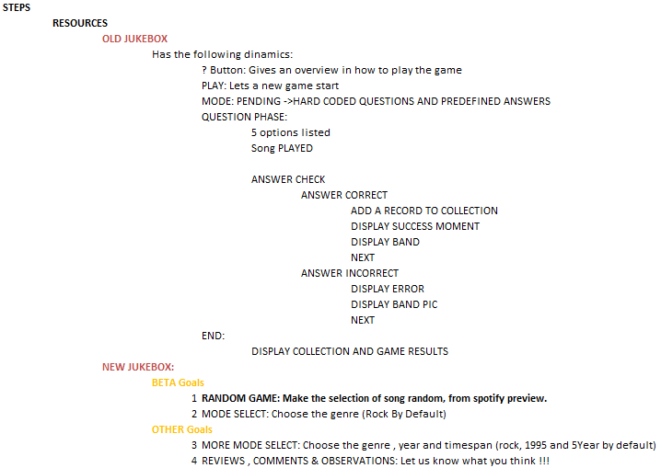

Slide 4
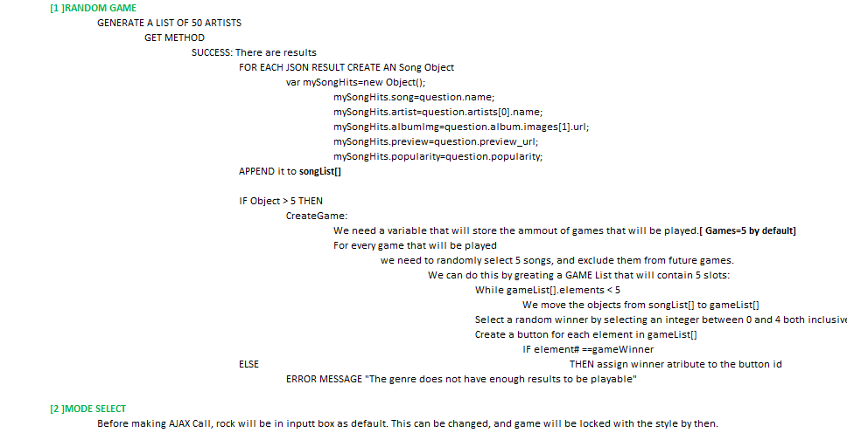

Slide 5
1) MOBILE FIRST

Slide 6
?
PLAY
DIFF
Test your memory and 90’s MUSICHOODNESNESSS!!!!!

Slide 7
?
?
PLAY
DIFF
Test your memory and 90’s MUSICHOODNESNESSS!!!!!
[1] SELECT DIFICULTY (DIFF):
  NORMAL : Hear 15 seconds of a chorus
  GROOPIE: Hear first 15 seconds of the song.
[2] PLAY: Press PLAY to start the game
[3] LISTEN: A record will play for 15 seconds
[4] GUESS: Select the ARTIST/SONG combination you think is playing.

Slide 8
Now playing?????
By The Way : Red hot Chilli Peppers
Nookie : Limp Bizkit
Got the Life : KoRN
Crawling : Linkin Park

Slide 9

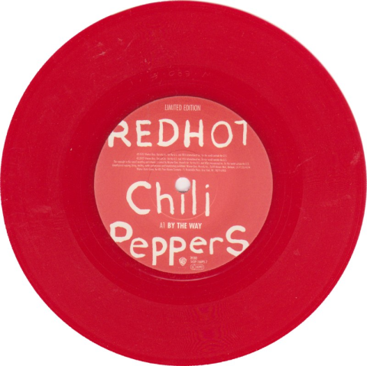
GOT IT!!!!!!!!!!!!
SONG: By The Way
BAND: Red Hot Chilli Peppers

Slide 10
Playing : 1 of 5
Which is the right one?
By The Way : Red hot Chilli Peppers
Nookie : Limp Bizkit
Got the Life : KoRN
Crawling : Linkin Park
COLLECTION
SONG: By The Way
BAND: Red Hot Chilli Peppers

Slide 11
OTHER THOUGHTS

