Slide 1
https://color.adobe.com/create/color-wheel/?base=2&rule=Monochromatic&selected=0&name=My%20Color%20Theme&mode=rgb&rgbvalues=0.34705882352941175,0.39607843137260074,0.5,0.39411764705882346,0.588310708899149,1,0.6941176470588235,0.792156862745098,1,0.19705882352941173,0.2941553544495745,0.5,0.5552941176470588,0.6337254901961612,0.8&swatchOrder=0,1,2,3,4
On Hover: Service Level Agreement APP
SLAPP
Carrousel: What we do Section
CLIENTES
COMPAÑIA
LOG-IN: Company main info. Offer sign in/log in
CLIENTS Evaluate Function
EVALUAR
SERVICIO
ADMINISTRAR
SERVICIOS
View of all clients (can be enhanced with a search function)
EXPLORAR COMPAÑIAS/SERVICIOS
FEEDBACK & SOCIAL SECTION: links for feedback
Tell us what you Think:
Notes:
Home.html

Slide 2
77378273

Slide 3
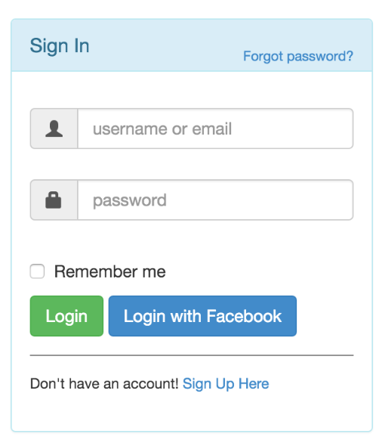
SLAPP
Tell us what you Think:
Notes:
Login.html

Slide 4
SLAPP
Create your Account
Enter Company Name
Enter Company Email
Enter Password
Confirm Password
SIGN UP
Tell us what you Think:

Slide 5
SLAPP
Enhance your Profile
Enter Phone Number
Enter Address
Enter Company Description
Upload Profile Pic
SUBMIT & CONTINUE
Tell us what you Think:

Slide 6
SLAPP
Company Name Ambientes Proyectados
email: proyectos@italinea.com.bo
Phone: +591 71322410
Address: San Martin 1300
1) ADD a Service Contract
2) ADD a Provider/Employee
3) ISSUE a SLA
4) PANEL
Tell us what you Think:

Slide 7
SLAPP
Tell us what you Think:

