Slide 1

Mo Patel
Director, Artificial Intelligence
Think Big Analytics
Recommendation Systems
Wide & Deep – part 3
Beyond Search

Slide 2
Agenda
Introduction to recommendation systems
Traditional recommendation approaches
Introduction to Wide & Deep
Wide Learning in context of Wide & Deep
Deep Learning Fundamentals
Deep Learning for Recommendations
Preparing Data for Wide & Deep
Training Wide & Deep models
Serving Wide & Deep models
Champion-Challenger Approach to deployment
Tuning Wide & Deep models
Wrap-up and Summary
Notes:
Now we have covered some of the fundamentals for Deep Learning, let’s focus on Deep Learning specifically for Recommendation Engines.

Slide 3
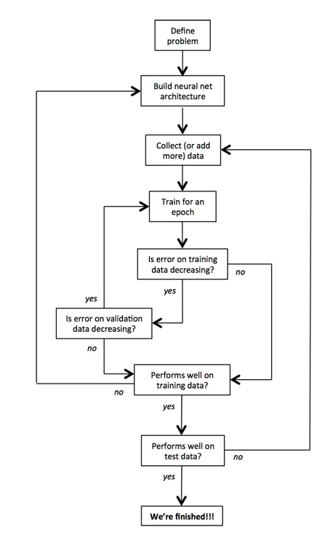
Notes:
In general, a workflow for training and evaluating a deep learning model would look something like this.
First we need to rigorously define our problem. This involves determining our inputs, the potential outputs, and the vectorized representations of both. If we were training a model to identify cancer, for example, we would provide RBG images as input which can be represented as a vector of pixel values. Our output would be a probability distribution over three mutually exclusive probabilities: 1) normal, 2) benign tumor, or 3) malignant tumor.
After we define our problem, we need to build a neural network architecture to solve it. Our input layer would have to be of appropriate size to accept the raw data from the image, and our output layer would have to be a softmax of size 3. We will also have to define the internal architecture of the network (number of hidden layers, the connectivities, et.). There will be more to say on that later.
At this point we also want to collect a significant amount of data for training or modeling. This data would probably be in the form of uniformly size pathological images that have been labeled by a medical expert. We shuffle and divide this data into separate training, validation, and test sets.
Finally we are ready to begin gradient descent. We train the model on our training set for an epoch of time. At the end of each epoch, we ensure that our error on the training set and validation set is decreasing. When one of these stops to improve, we terminate and make sure we are happy with the model’s performance on the test data. If we are unsatisfied, we may need to rethink our architecture or reconsider whether the data we collect has the information required to make the prediction we want. If our training set error stopped improving, we probably need to do a better job of capturing the important features in our data. If our validation set error stopped improving, we probably need to take measures to prevent overfitting.

Slide 4
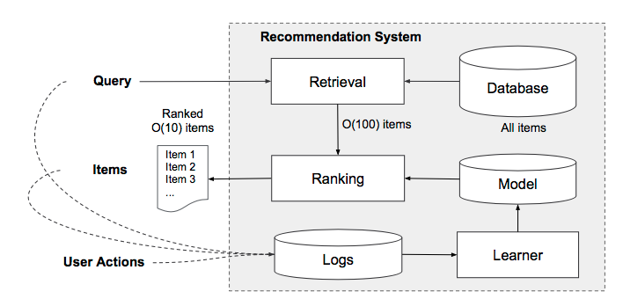
Notes:
An overview of the app recommender system is shown here. A query, which can include various user and contextual features, is generated when a user visits the store. The recommender system returns a list of items (also referred to as impressions) on which users can perform certain actions such as clicks or purchases. These user actions, along with the queries and impressions, are recorded in the logs as the training data for the learner.
Since there can be millions of items in the database, it is intractable to exhaustively score every item for every query within the serving latency requirements (often O(10) mil- liseconds). Therefore, the first step upon receiving a query is retrieval. The retrieval system returns a short list of items that best match the query using various signals, usually a combination of machine-learned models and human-defined rules. After reducing the candidate pool, the ranking system ranks all items by their scores. The scores are usually P(y|x), the probability of a user action label y given the features x, including user features (e.g., country, language, demographics), contextual features (e.g., device, hour of the day, day of the week), and impression features (e.g., item age, historical statistics of an item).

Slide 5
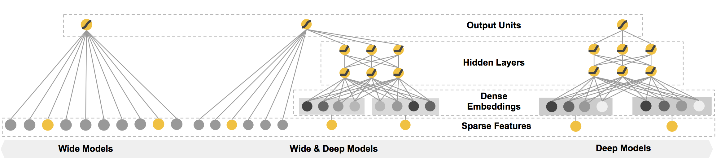
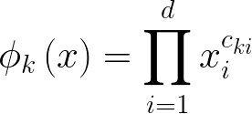

Wide & Deep
Notes:
Recall that the wide component is a generalized linear model of the form y = w^T x + b, as illustrated above (left).
One of the most important transformations is the cross-product transformation, which we saw earlier.It it defined here, where c-ki is a boolean variable that is 1 if the ith feature is part of the k-th transformation k, and 0 otherwise.For binary features, a cross-product transformation (e.g., “AND(gender=female, language=en)”) is 1 if and only if the constituent features (“gender=female” and “language=en”) are all 1, and 0 otherwise. This captures the interactions between the binary features, and adds nonlinearity to the generalized linear model.

Slide 6

Wide & Deep
Notes:
The deep component is a feed-forward neural network, (right). For categorical features, the original inputs are feature strings (e.g., “language=en”). Each of these sparse, high-dimensional categorical features are first converted into a low-dimensional and dense real-valued vector, often referred to as an embedding vector. The dimensionality of the embeddings are usually on the order of O(10) to O(100). The embedding vectors are initialized ran- domly and then the values are trained to minimize the final loss function during model training. These low-dimensional dense embedding vectors are then fed into the hidden layers of a neural network in the forward pass. Specifically, each hidden layer performs the computation above where l is the layer number and f is the activation function, often rectified linear units (ReLUs). a(l) , b(l) , and W (l) are the activations, bias, and model weights at l-th layer.

Slide 7
Wide & Deep
Notes:
The wide component and deep component are combined using a weighted sum of their output log odds as the prediction, which is then fed to one common logistic loss function for joint training. Note that there is a distinction between joint training and ensemble approaches. In an ensemble, individual models are trained separately without knowing each other, and their predictions are combined only at inference time but not at training time. In contrast, joint training optimizes all parameters simultaneously by taking both the wide and deep part as well as the weights of their sum into account at training time. There are implications on model size too: For an ensemble, since the training is disjoint, each individual model size usually needs to be larger (e.g., with more features and transformations) to achieve reasonable accuracy for an ensemble to work. In comparison, for joint training the wide part only needs to complement the weaknesses of the deep part with a small number of cross-product feature transformations, rather than a full-size wide model. Joint training of a Wide & Deep Model is done by back propagating the gradients from the output to both the wide and deep part of the model simultaneously using mini-batch stochastic optimization.
For a logistic regression problem, the model’s prediction is, as above where Y is the binary class label, sigma(·) is the sigmoid function, phi(x) are the cross product transformations of the original features x, and b is the bias term. Wwide is the vector of all wide model weights, and Wdeep are the weights applied on the final activations a(lf ).

Slide 8
Agenda
Introduction to recommendation systems
Traditional recommendation approaches
Introduction to Wide & Deep
Wide Learning in context of Wide & Deep
Deep Learning Fundamentals
Deep Learning for Recommendations
Preparing Data for Wide & Deep
Training Wide & Deep models
Serving Wide & Deep models
Champion-Challenger Approach to deployment
Tuning Wide & Deep models
Wrap-up and Summary
Notes:
Now let’s look at steps we take to prepare data for Wide and Deep.

Slide 9
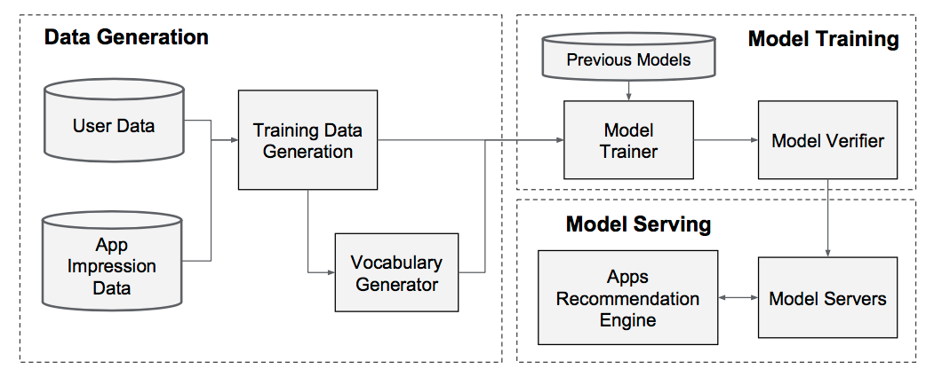
Notes:
The implementation of the our recommendation pipeline consists of three stages: data generation, model training, and model serving as shown.

Slide 10
Notes:
In the Data Generation stage, user and item impression data within a period of time are used to generate training data. Each example corresponds to one impression. The label is item acquisition: 1 if the impressed item was selected, and 0 otherwise. Vocabularies, which are tables mapping categorical feature strings to integer IDs, are also generated in this stage. The system computes the ID space for all the string features that occurred more than a minimum number of times. Continuous real-valued features are normalized to [0, 1] by mapping a feature value x to its cumulative distribution function P (X <= x), divided into n_q quantiles. The normalized value is i - 1/n_q -1 for values in the i-th quantiles. Quantile boundaries are computed during data generation.

Slide 11
Notes:
During Model Training, our input layer takes in training data and vocabularies and generate sparse and dense features together with a label. The wide component consists of the cross-product transformation of user selected items and impression data. For the deep part of the model, A 32-dimensional embedding vector is learned for each categorical feature. During Wide and Deep experiments at Google, they concatenated all the embeddings together with the dense features, resulting in a dense vector of approximately 1200 dimensions. The concatenated vector is then fed into 3 ReLU layers, and finally the logistic output unit.
The Google Wide & Deep models were trained on over 500 billion examples. Every time a new set of training data arrives, the model needs to be re-trained. However, retraining from scratch every time is computationally prohibitive and delays the time from data arrival to serving an updated model.To tackle this challenge, they implemented a warm-starting system which initializes a new model with the embeddings and the linear model weights from the previous model.Before loading the models into the model servers, a dry run of the model is done to make sure that it does not cause problems in serving live traffic. They empirically validated the model quality against the previous model as a sanity check.

Slide 12
Notes:
Once the model is trained and verified, we load it into the model servers. For each request, the servers receive a set of item candidates from the item retrieval system and user features to score each item. Then, the items are ranked from the highest scores to the lowest, and we show the items to the users in this order. The scores are calculated by running a forward inference pass over the Wide & Deep model. In order to serve each request on the order of 10 ms, they optimized the performance using multithreading parallelism by running smaller batches in parallel, instead of scoring all candidate items in a single batch inference step.

