Slide 1

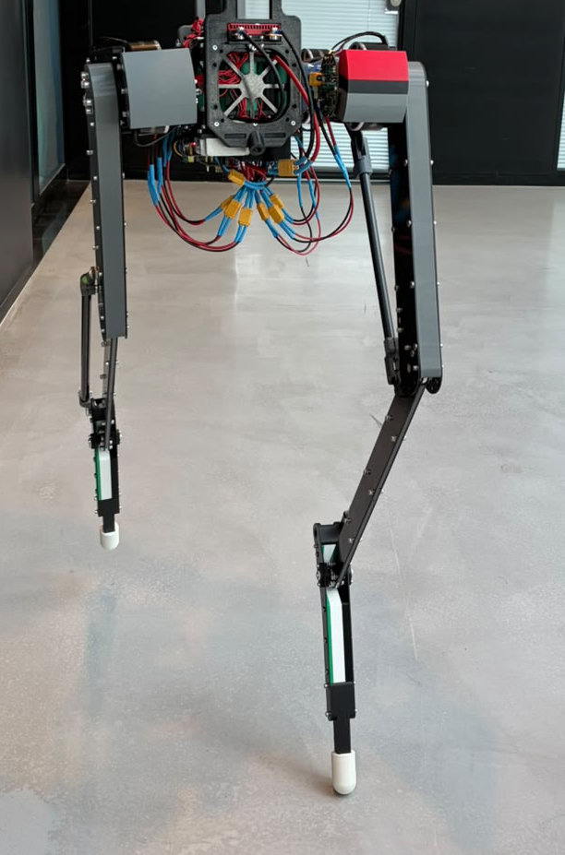
DASH-01
Midterm Presentation · Controller
Léo-Paul Rizkallah
REHAssist Lab
Professor: Mohamed Bouri · Supervisor: Sara Messara
October 29, 2026
Results reviewed 26 October 2026
Previous robot iteration - photo from Tim
Notes:
Suggested time: 20 seconds.
My project continues Nathann’s controller work on DASH-01, alongside Tim’s mechanical redesign. The first part of the semester has been about adapting the simulator and recovering useful locomotion on the new robot. I will show the architecture we inherited, what the experiments taught us, and how we move from promising simulation videos to treadmill tests and a short demonstration.
Evidence / provenance:
Reference style, lab/supervision and photograph: Tim Kobler, DASH01_midterm.pptx, supplied by user.
Data cutoff: 26 October 2026; presentation date follows Tim’s deck.

Slide 2
Outline
1
Context
Existing controller · Semester goal · Starting point
2
What was done
Controller · Learning · Gait · Results
3
Objectives and timeline
Demo sequence · Early treadmill tests
4
Challenges
Sim-to-real gap · Unknown unknowns
Notes:
Suggested time: 10 seconds.
I will follow the same four parts as Tim: context, what was done, objectives and timeline, and challenges. My focus is the controller and its validation.
Evidence / provenance:
Outline cloned from Tim Kobler’s supplied presentation; controller-specific subtitles.

Slide 3
PART 1
Context
Existing controller · Semester goal · Starting point
1. Context
2. What was done
3. Objectives and timeline
4. Challenges
Notes:
Suggested time: 5 seconds.
Part 1: Context.
Evidence / provenance:
Section divider cloned from the corresponding part of Tim’s supplied deck, including navigation, layout and typography.

Slide 4
Semester goal
INHERITED
WHAT CHANGED
SEMESTER OBJECTIVE
Working baseline
A new model
A short robot demo
Nathann’s RL pipeline
Gait generator + feedback
Deployment code and UI
New geometry and flat feet
Corrected mass and inertia
New homing configuration
Start upright
Walk at commanded speeds
Stop and remain standing
My focus: adapt and validate the learned controller. Tim’s focus: the mechanics.
4
Notes:
Suggested time: 35 seconds.
The starting point was not an empty software project: Nathann already had a working learning pipeline and a structured walking controller. But new geometry, feet and mass distribution change the dynamics. My part is to adapt the model, train useful behavior, diagnose what the policy actually does and validate it on the real robot. Tim and I therefore share the sim-to-real objective. The final goal remains startup, commanded walking and a controlled stop, rather than just a fast simulation clip.
Evidence / provenance:
README.md: original three-phase demonstration plan.
report/cad-v2-import.md: 14.594154 kg corrected simulation model.
report/architecture.md; RLframework/networks.py.

Slide 5
Starting point: Nathann’s controller
Commanded speed
Sensors
State estimate
RL policy
Gait generator
PD + limits
IMU + joints
180 ms history
Learned velocity
From sensor history
384 obs + 3 est.
47 outputs · 100 Hz
41 gait parameters
6 joint corrections
Targets + gains
Torque/speed caps
Training only: PPO + privileged critic in MuJoCo / MJX
Six motors
+ robot
Ground-truth velocity and contacts help learning, not the deployed actor.
Feedback: joint measurements and IMU → next policy update. Simulation advances in 1 ms substeps.
The policy generates motion targets; motor feedback turns those targets into torque.
5
Notes:
Suggested time: 55 seconds.
This is a hybrid controller. A neural network uses a short history of joint measurements and the IMU, plus a learned velocity estimate. At one hundred hertz it outputs forty-seven values: forty-one parameters describing periodic joint motion and gains, and six immediate corrective joint offsets. Gait parameters are committed on the gait clock; corrections remain active every tick. PD control and motor limits then generate torque. During PPO training, a separate critic can see simulator ground truth, including contact. The actor cannot. That separation matters for transfer: simulation contact rewards are not additional hardware sensors.
Evidence / provenance:
RLframework/networks.py; RLframework/env.py; RLframework/gait.py; RLframework/drive.py.
report/architecture.md: 384 actor observations, 47 actions, estimator 128/64, actor 256/256, privileged critic 413.
Current CAD-v2 policies disable STOP; START/STOP integration remains planned.

Slide 6
PART 2
What was done
Model · Learning · Gait · Results
1. Context
2. What was done
3. Objectives and timeline
4. Challenges
Notes:
Suggested time: 5 seconds.
Part 2: What was done.
Evidence / provenance:
Section divider cloned from the corresponding part of Tim’s supplied deck, including navigation, layout and typography.

Slide 7
What we explored and what we learned
1
Stopping on the previous robot
Older model
Abrupt braking exposed a missing standing skill. Imitation improved quiet holding.
2
New CAD and gait discovery
Model + diagnosis
Correct inertials and closed loops; investigate dragging, asymmetry and micro-steps.
3
Reproduce the walking recipe
WALK-01
Recover sustained commanded locomotion on CAD-v2 from the supplied homing pose.
4
Measure real heel/toe support
Flat-feet baseline
Add contact-based slip, completed-cycle symmetry and mid-stance flat support.
5
Shape the swing trajectory
CLEARANCE-01 / 02
Measure clearance; teach higher lift, then target a smaller height band.
Survival, speed tracking and gait quality are different objectives.
7
Notes:
Suggested time: 55 seconds.
There were several phases, and the early failures were useful. On the previous robot, simply asking a walking policy to stop did not teach balance. Standing demonstrations improved near-standing holding, but that was not a robust stop from motion. With the new CAD we then saw dragging, unilateral activity and micro-steps, so reward and diagnostic definitions became central. After reproducing sustained walking, we moved to actual heel and toe contact measurements. The latest experiments focus on foot lift. This progression is why I now separate staying upright, following a speed and having an acceptable gait.
Evidence / provenance:
docs/stop03-experiment-report.md; docs/stop05-experiment-report.md.
report/cad-v2-import.md; docs/gait11-experiment-report.md; docs/walk01-experiment-report.md.
docs/flatfeet-symmetry-v1.md; docs/clearance01-experiment-report.md; docs/clearance02-experiment-report.md.
STOP-03: 0/32 to 21/32 strict 5 s holds after imitation; near-standing, previous model, not a moving-stop result.

Slide 8
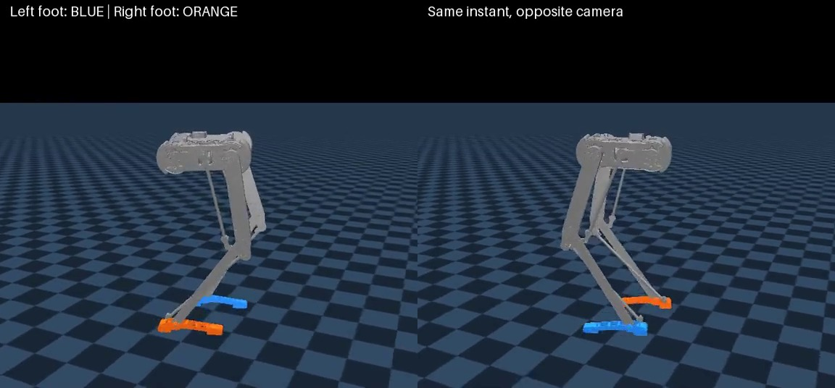
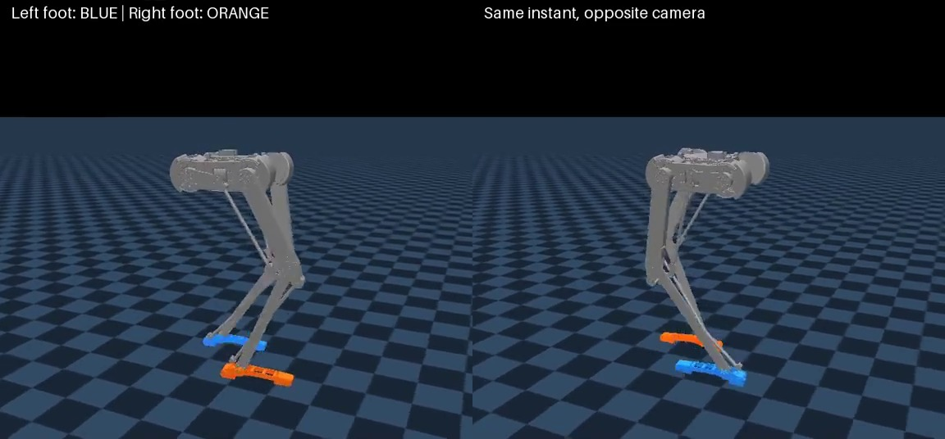
Walking policies: visual evolution
Walking reproduction
Flat-feet baseline
WALK-01 best · checkpoint 169.57M
Best checkpoint 184.32M · later used for fine-tuning
Simulation · nominal MJX replays · 12 s excerpts (t = 6–18 s) · 1× playback
Same 1.50 m/s command; different trained policies. Click each clip to play.
8
Notes:
Suggested time: 55 seconds.
These clips have the same target speed and show two stages of the work. The first is the reproduced walking recipe; the second is the flat-feet baseline. Please look at the feet, rather than only the body moving forward. Even when the policy survives, support can be rolled onto one pad and a foot can slide instead of taking a clean swing. The clips are normal-speed simulation recordings, not hardware experiments. They illustrate the evolution, but they are not a controlled single-reward ablation, and one good clip cannot establish robustness.
Evidence / provenance:
report/videos/walk01_best_1.50mps.mp4; report/videos/flatfeet_best_1.50mps.mp4.
docs/experiments/walk01_20261019_v1/; docs/experiments/dash01_flatfeet_symmetry_v1/.
Both source clips: nominal MJX, target 1.50 m/s, seed 1000, first episode retained. Excerpts 6–18 s; header/footer cropped for readability, motion not modified.

Slide 9
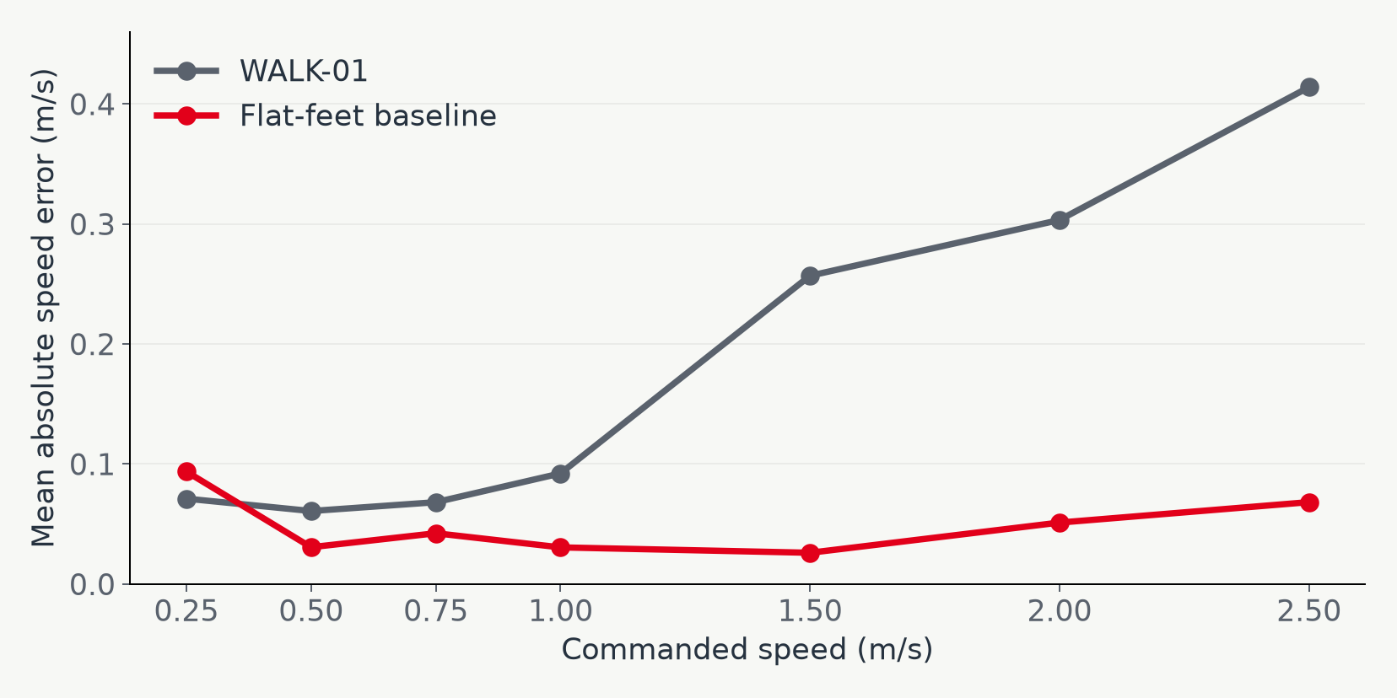
Speed tracking
Mean speed error
0.181 → 0.049
m/s across the speed ladder
28 / 28
full 30 s trials
both best policies
A better tracking score does not automatically mean a clean or transferable gait.
9
Notes:
Suggested time: 40 seconds.
The numerical comparison is encouraging. On the same nominal seven-speed evaluation ladder, the saved best flat-feet policy reduces average absolute speed error from about zero-point-eighteen to zero-point-zero-five metres per second. Both saved best policies complete all twenty-eight trials, so survival alone would not show this improvement. We must still inspect support, slip and individual leg behavior. Several things changed together in the flat-feet experiment, and these are single-seed training results, so the graph supports progress rather than a causal claim for one isolated reward term.
Evidence / provenance:
docs/experiments/walk01_20261019_v1/best_eval.json.
docs/experiments/dash01_flatfeet_symmetry_v1/best_eval.json.
28 nominal trials, 30 s, 5 s excluded from tracking, command ladder .25/.5/.75/1/1.5/2/2.5 m/s. Not a controlled reward ablation.

Slide 10
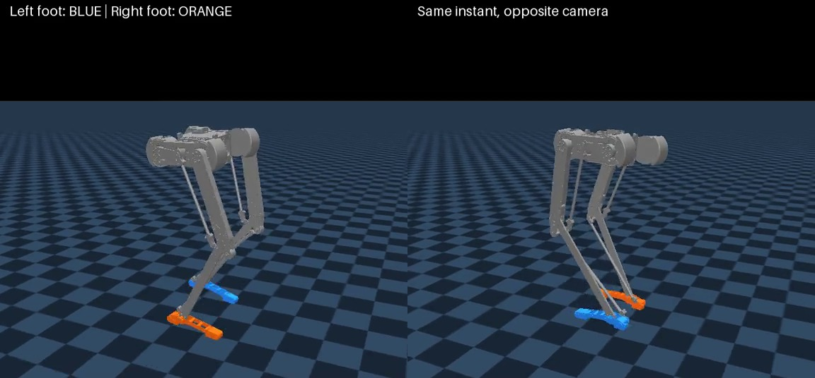
Foot clearance: first results
Mean airborne lift
23.6 mm
left (baseline: 2.46 mm)
20.9 mm
right (baseline: 2.25 mm)
+50M training steps
Target: 1.50 m/s
Evaluation-protocol replay · trial 0 / 12 · t = 6–18 s · 1×
Promising swing motion in simulation; startup reliability still needs investigation.
10
Notes:
Suggested time: 45 seconds.
The flat-feet baseline had only two to three millimetres of average airborne clearance. A dense penalty below the target gave a learning signal even when feet were still dragging, and fifty million additional steps increased mean lift to roughly twenty-four and twenty-one millimetres. This clip is the first trial from the retained batch, not a selected best-looking trial. There is an important caveat: a separate standalone replay fell after three-point-seven seconds. We keep that failure in the backup slides. The result demonstrates learnable foot lift, not a validated standalone startup or hardware-ready controller.
Evidence / provenance:
docs/experiments/clearance01_20261025_v1/clearance_baseline.json; latest_clearance_eval.json.
report/videos/clearance01_final_1.50mps.mp4; original evaluation-protocol replay all 12 trials survive 25 s.
Mean numbers: matched 12-trial 30 s nominal evaluation, 5 s warmup. Video is a single 25 s replay, whose mean is 23.55/20.91 mm.
report/clearance01-videos.html: standalone pinned-command replay falls at 3.67 s; cause not isolated.

Slide 11
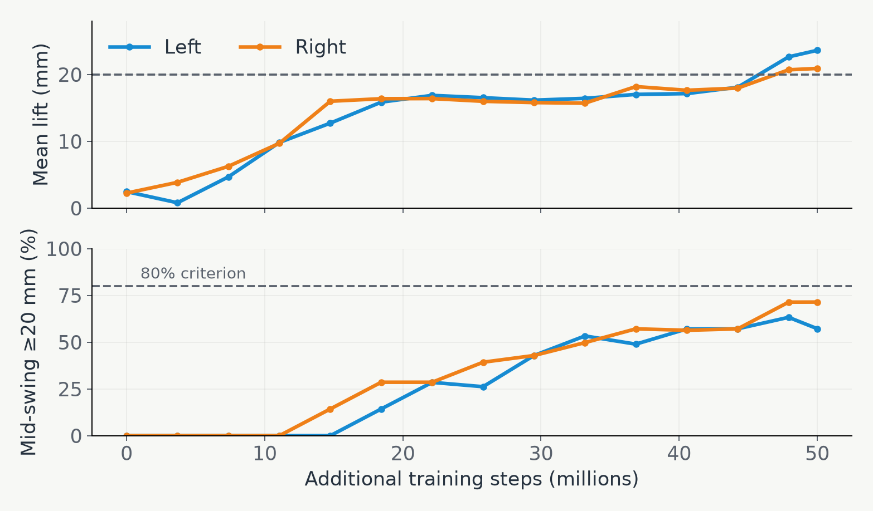
Next training objective
NEXT TRAINING
10–25 mm
Minimum swing target
Capped bonus
Penalty above 25 mm
200M steps
Submitted 26 October
Results not reviewed yet
CLEARANCE-02 starts again from the flat-feet baseline, not the high-lift policy.
11
Notes:
Suggested time: 50 seconds.
This plot shows why the latest policy is progress but not the end point. Mean height rises, yet the fraction of scheduled mid-swing samples above twenty millimetres remains below our eighty-percent criterion. Peaks also reach roughly forty to fifty millimetres. A bonus that merely saturates does not cap the actual motion. The next run therefore returns to the flat-feet baseline and targets a lower band: ten millimetres minimum, bonus saturation at twenty-five, plus an explicit penalty above that upper target. We submitted two hundred million additional steps. There are no reviewed results for that run in this deck.
Evidence / provenance:
docs/experiments/clearance01_20261025_v1/clearance_evaluations.jsonl.
Final scheduled mid-swing >=20 mm: left 57.18%, right 71.43%; 0/12 fully qualified.
report/data/clearance01/replay-summary.json: median complete-bout peaks 46.55/40.80 mm.
docs/clearance02-experiment-report.md; job 3231747 submitted, no subsequent monitoring. Upper target is a soft cost, not a hard clamp.

Slide 12
PART 3
Objectives and timeline
Demo sequence · Early treadmill tests
1. Context
2. What was done
3. Objectives and timeline
4. Challenges
Notes:
Suggested time: 5 seconds.
Part 3: Objectives and timeline.
Evidence / provenance:
Section divider cloned from the corresponding part of Tim’s supplied deck, including navigation, layout and typography.

Slide 13
Objectives for Robotics Day
1 / INITIALIZE
2 / START
3 / STOP
Start upright
Walk on command
Brake and stand
Known initial pose
Automatic upright startup
Recover from small disturbances
START command
Joystick-style speed changes
Stay within walking regime
Smooth deceleration
Stop without assistance
Remain still for ≥5 seconds
These are integration targets — not capabilities already validated on CAD-v2 hardware.
13
Notes:
Suggested time: 45 seconds.
The demonstration plan has not changed. First, the robot starts from a defined position, reaches an upright stance and tolerates small disturbances. Then a START command enables walking, with joystick-style speed changes within a walking regime. Finally, STOP should decelerate the robot and lead to stable standing for at least five seconds. A simulation homing reset is not an automatic hardware startup controller, and current locomotion training has STOP disabled. The policy’s stop behavior is also separate from the emergency kill. These remain integration tasks that must be checked one transition at a time.
Evidence / provenance:
README.md: three-phase demo objective.
docs/stop02-training-plan.md: braking and >=5 s hold; historical model.
report/architecture.md: homing reset versus startup; policy STOP versus safety kill.

Slide 14
Timeline
NOW / NEXT TEST SLOT
BEFORE ROBOTICS DAY
ROBOTICS DAY
AFTER THE DEMO
SIMULATION
Compare clearance runs
Freeze baseline
Fit measured mismatches
Train demo transitions
Freeze tested checkpoint
No last-minute retraining
Quantify robustness
Write final report
HARDWARE
Treadmill tests ASAP
Calibrate; short trials
Repeat low-speed trials
Log and fix failures
Rehearse demo
Keep tested fallback
Wider speed envelope
Repeatability tests
Repeat throughout: measure → reproduce in simulation → update → retest
First tests: next available slot after assembly, calibration, support and kill checks.
14
Notes:
Suggested time: 55 seconds.
I do not want to postpone hardware testing until the simulator appears perfect. The immediate priority is the first short treadmill session, as soon as assembly, calibration and test support are ready with Tim. In parallel, simulation work continues on the clearance comparison and transition skills. Each hardware trial should produce a useful log: what command was sent, what motion and current were measured, and how the failure developed. We then reproduce the mismatch in simulation and retest. Before the event, we freeze and rehearse a tested sequence, keeping a fallback demonstration if a full autonomous stop is not reliable. The timeline is deliberately relative.
Evidence / provenance:
User direction: 8–10 minute talk and relative timeline; treadmill tests ASAP.
README.md: original demo plan.
Tim’s supplied slides: assembly/calibration/initial pose and test-support dependencies. Dates intentionally not copied to this relative plan.
Proposed roadmap, not completed milestones or guaranteed dates.

Slide 15
PART 4
Challenges
Sim-to-real gap · Unknown unknowns
1. Context
2. What was done
3. Objectives and timeline
4. Challenges
Notes:
Suggested time: 5 seconds.
Part 4: Challenges.
Evidence / provenance:
Section divider cloned from the corresponding part of Tim’s supplied deck, including navigation, layout and typography.

Slide 16
Where we are stuck
KNOWN SUSPECTS
CONTROL AND OBSERVABILITY
The physical model
Timing and sensing
Friction, compliance, inertia and actuator response
Delay, velocity estimation and phase timing
REWARD AND VALIDATION
UNKNOWN UNKNOWNS
A high score can hide a bad gait
Unmodeled effects
Dragging, contact chatter and fragile startup
Short trials and logs before adding complexity
We do not know what we do not know until we test the real robot.
16
Notes:
Suggested time: 55 seconds.
The main difficulty is not just more training time. We know some likely sources of mismatch: contact friction and compliance, inertia, motor response, delay and state estimation. There is also an observability difference: the simulator can use contact for the gait clock, while the robot does not have that same contact signal. And we have already seen evaluation protocols produce different startup outcomes. Beyond these known suspects are the unknown unknowns that only the first real tests reveal. That is why early, short and instrumented treadmill trials are more useful now than trying to perfect every detail in simulation before touching hardware.
Evidence / provenance:
report/architecture.md: contact-based phase resynchronization versus free-running deployment.
report/policy-transfer01.md: original-policy direct swap falls in 0.71–0.75 s.
docs/flatfeet-symmetry-v1.md: contact-chatter symmetry blind spot and slip.
docs/clearance01-experiment-report.md: replay discrepancy. Hardware mismatch items are hypotheses, not measured findings.

Slide 17
What we need
WHAT WE HAVE
WHAT COMES NEXT
WHAT WILL HELP
A working RL pipeline
Better speed tracking
Higher foot clearance
Treadmill tests ASAP
Measure the mismatch
Integrate start → walk → stop
Test access with Tim
Repeatable test setup
Agree demo priorities
Priority: test the real robot while refining simulation.
17
Notes:
Suggested time: 30 seconds.
We now have a substantially better simulation baseline, and the foot-clearance experiments show that the robot can learn the missing swing motion. The next useful step is to test the real robot early, measure the gap and connect the individual skills into the original demonstration sequence. The most useful support is coordinated treadmill access with Tim, a repeatable setup and agreement on which demo behaviors to prioritize if time is tight. I have backup slides with the reward definitions, the standalone failure and exact evidence sources.
Evidence / provenance:
Evidence and limitations are documented in the preceding slides and report/README.md.
Support requests and timeline are proposed next steps, not claims of completed deployment.

Slide 18
Questions?
Thank you
Next: treadmill tests and sim-to-real
DASH-01 · Midterm update · REHAssist Lab
18
Notes:
Suggested time: 5 seconds.
Thank you. I am happy to discuss the controller, the experimental results and the first treadmill tests.
Evidence / provenance:
Closing slide cloned from Tim’s supplied presentation; controller-specific subtitle.

Slide 19
Backup: reward definitions
Support
Heel OR toe contact defines stance; both define flat support.
Use force-qualified MuJoCo contact (≥2 N).
Slip
Actual motion at the foot–ground contact, in all horizontal directions.
Forward, backward and sideways sliding remain penalized.
Symmetry
Compare several completed stance / swing cycles from both feet.
Temporary pad contact loss does not itself terminate.
Flat support
Modest missing-flat-support cost in mid-stance only.
First / last 20% of stance are exempt; no planted-foot bonus.
Clearance
Lowest oriented heel/toe pad surface, not a toe point alone.
CLEARANCE-02: 10 mm minimum with edge ramps; soft 25 mm upper target.
19
Notes:
Suggested time: 0 seconds.
Use if asked about reward design. The actor does not receive direct contact flags. Mid-stance flat support has a deliberately modest missing-support cost rather than a large bonus for remaining planted. Clearance penalties apply to scheduled swing even if the foot never leaves the ground, so dragging cannot avoid them. An upper-height penalty is a soft training objective, not a guaranteed kinematic bound. Known brief-contact history blind spots remain documented.
Evidence / provenance:
RLframework/flatfeet.py; RLframework/swing_clearance.py; RLframework/env.py.
docs/clearance02-experiment-report.md; docs/flatfeet-symmetry-v1.md.

Slide 20
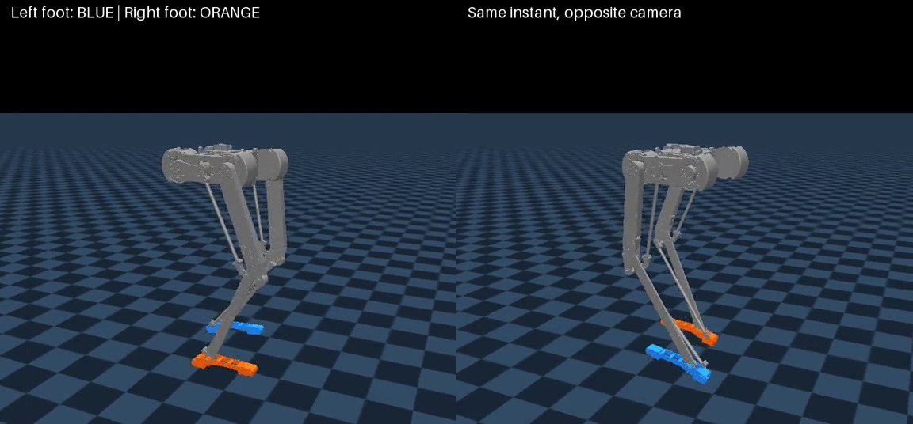
Backup: the failed replay
Same trained checkpoint
12-environment protocol
12 / 12 survive 25 s
Standalone pinned command
Fall at 3.67 s
Both batch size and command handling changed; the cause is not isolated.
20
Notes:
Suggested time: 0 seconds.
This video is retained explicitly to prevent overclaiming. The same checkpoint survives all twelve trials in an evaluation-style recording but fails in a separate one-environment pinned-command recording. Two protocol factors changed together, and small numerical differences can also matter; we have not isolated the cause. Do not state that the batch size caused the fall or that the successful evaluation proves robust startup. No auto-reset trajectory is spliced into this failure clip.
Evidence / provenance:
docs/experiments/clearance01_20261025_v1/clearance01_trace_standalone.json: 3.67 s, fall.
docs/experiments/clearance01_20261025_v1/clearance01_trace_eval12.json: all 12 first episodes 25 s, 80 cycles per foot after warmup.
report/videos/clearance01_standalone_1.50mps.mp4.

Slide 21
Backup: evidence and comparison limits
Experiment
Training / checkpoint
What is established
STOP-03 · previous model
Imitation + PPO; near-standing resets
21/32 strict 5 s holds after imitation; not a moving stop.
WALK-01 · CAD-v2
200M; best 169.57M
28/28 nominal 30 s trials; 0.181 m/s speed error.
Flat-feet · CAD-v2
200M; best 184.32M
28/28 nominal 30 s trials; 0.049 m/s speed error.
CLEARANCE-01
+50.01M from flat-feet best
23.62 / 20.91 mm mean airborne lift; no full qualification.
CLEARANCE-02
200M additional requested; job 3231747
Submitted 26 October; results not reviewed.
All displayed motion is simulation. Different training changes are not isolated ablations.
Exact source paths, protocols and caveats are in the speaker notes and sources.md.
21
Notes:
Suggested time: 0 seconds.
Numbers are from locally archived results, not live training status. Speed statistics use saved best policies and the same nominal ladder. Clearance means use matched parent/final twelve-trial evaluation at 1.50 m/s; do not confuse airborne time means with mean peaks. Earlier standing results concern the previous robot. All training/evaluation results here remain simulation results.
Evidence / provenance:
docs/stop03-experiment-report.md; docs/walk01-experiment-report.md; docs/flatfeet-symmetry-v1.md.
docs/clearance01-experiment-report.md; docs/clearance02-experiment-report.md.
Full data/source references in speaker notes and sources.md.

