Slide 1
Faith Over Fear
A message from Joshua 1
Pastor Dana Reyes
Notes:
Welcome everyone. Today we are starting our series Strong and Courageous.

Slide 2
The Situation
Moses has died
Israel stands at the edge of the promised land
Joshua 1:1-5
Notes:
Joshua had every reason to be afraid. His mentor was gone and the task ahead was enormous. Maybe you are standing at the edge of something big right now.

Slide 3
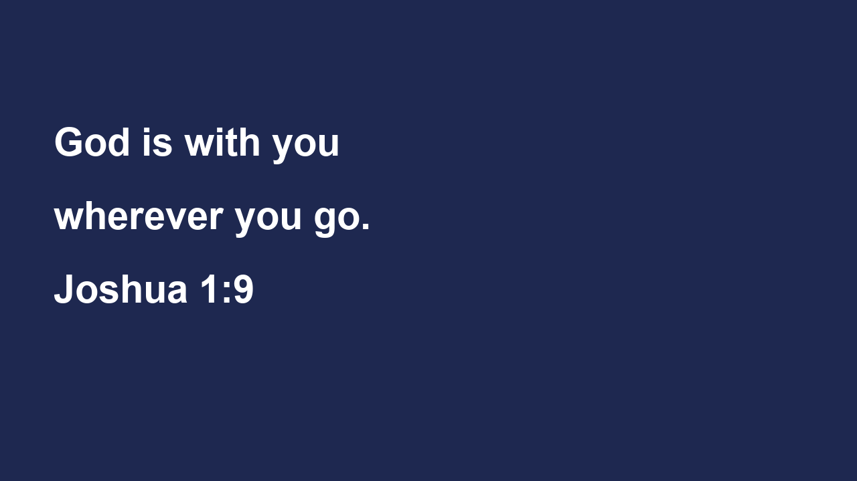
God's Command
Be strong and courageous
Do not be afraid or discouraged
Joshua 1:6-9
Notes:
Notice that courage here is a command, not a feeling. God does not say feel brave. He says be strong. We need to choose courage because God is with us.

Slide 4
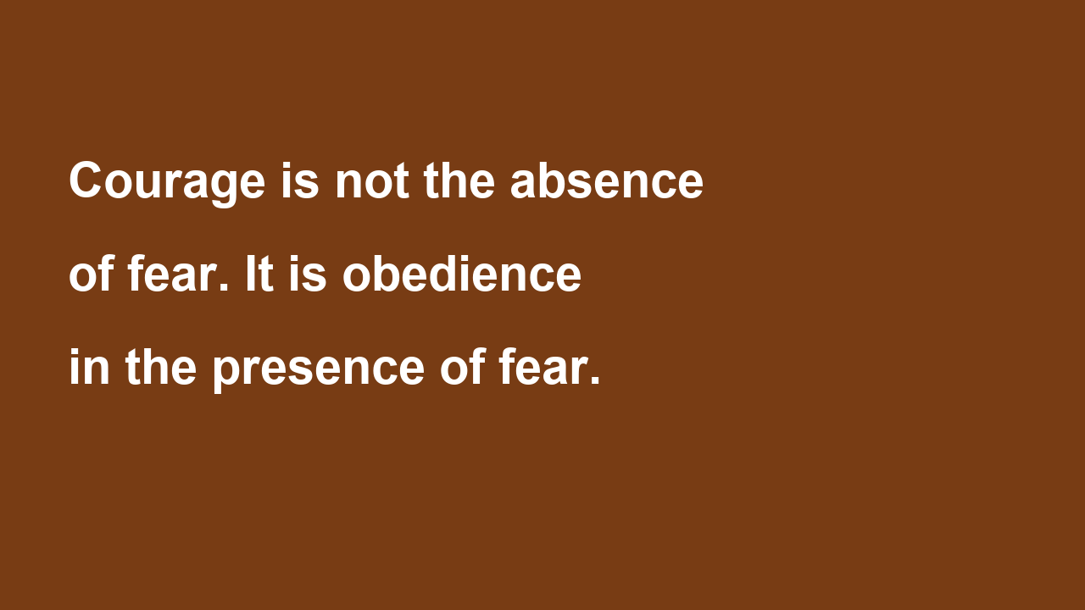
Courage Defined
Notes:
Here's the thing: courage grows when we remember who goes with us. Fear shrinks when we meditate on God's word day and night.

Slide 5
Living It Out
Name your fear
Read Joshua 1:9 every morning
Take one obedient step this week
Notes:
So this week, I want to challenge you. Write down the one fear that is holding you back. Then trust God and take one step of obedience anyway.

Slide 6
Announcements
Small groups start Wednesday

