Slide 1
Effects of a Forward Propagation Algorithm in Continuous Processes
Department of Chemical and Biological Engineering
Princeton University
Leonardo Assis
February 4th, 2025

Slide 2



Background and Motivation
$β_{j}^{MIN}, β_{j}^{MAX}$ = [2, 3] kg/h
$τ_{ⅈj}^{MIN},τ_{ⅈj}^{MAX}$ = [4, 5] h
T1-U1
$β_{j}^{MIN}, β_{j}^{MAX}$ = [3, 5] kg/h
$τ_{ⅈj}^{MIN}, τ_{ⅈj}^{MAX}$ = [3, 5] h
Basic Constraints
Mass balance
Task-Unit assignment
Decisions
What are the task-unit assignments?
Solutions Strategies
Reformulations
Production Rate
Production Length
Tightening Constraints
Decomposition
When should each task start?
What should be the length and production rate for each task?
Goal Chemical Process
Transform raw materials into products
Resources are usually limited
Objective
Minimize cost
Maximize production/profits
Minimize makespan
RM
IA1
T2-U3
P1
T1-U2
$β_{j}^{MIN}, β_{j}^{MAX}$ = [2, 3] kg/h
$τ_{ⅈj}^{MIN},τ_{ⅈj}^{MAX}$ = [1, 4] h

Slide 3
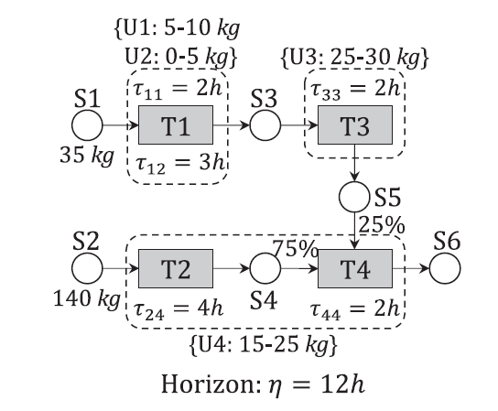



Batch vs. Continuous Processes and Degrees of Freedom
T1-U1
10
10
T1-U2
5
batch size
T3-U3
25
0
1
2
3
4
5
6
$β_{j}^{MIN}, β_{j}^{MAX}$ = [2, 3] kg/h
$τ_{ⅈj}^{MIN},τ_{ⅈj}^{MAX}$ = [4, 5] h
T1-U1
T1-U1
$β_{j}^{MIN}, β_{j}^{MAX}$ = [3, 5] kg/h
$τ_{ⅈj}^{MIN}, τ_{ⅈj}^{MAX}$ = [3, 5] h
3
3
3
3
3
T1-U2
processing rate
task duration
RM
IA1
T2-U3
P1
2
2
2
2
T2-U3
5
5
5
5
3
T1-U2
$β_{j}^{MIN}, β_{j}^{MAX}$ = [2, 3] kg/h
$τ_{ⅈj}^{MIN},τ_{ⅈj}^{MAX}$ = [1, 4] h
0
1
2
3
4
5
6
Notes:
Forward Propagation for Batch Processes
Forward Propagation for Continuous Processes

Slide 4





Batch vs. Continuous and Degrees of Freedom
$β_{j}^{MIN}, β_{j}^{MAX}$ = [2, 3] kg/h
$τ_{ⅈj}^{MIN},τ_{ⅈj}^{MAX}$ = [4, 5] h
T1-U1
T1-U1
$β_{j}^{MIN}, β_{j}^{MAX}$ = [20, 25] kg/h
$τ_{ⅈj}^{MIN}, τ_{ⅈj}^{MAX}$ = [3, 5] h
3
3
3
3
3
3
3
3
3
T1-U2
2
2
2
2
2
2
2
2
RM
IA1
T2-U3
P1
T2-U3
25
25
25
T1-U2
$β_{j}^{MIN}, β_{j}^{MAX}$ = [2, 3] kg/h
$τ_{ⅈj}^{MIN},τ_{ⅈj}^{MAX}$ = [1, 4] h
0
1
2
3
4
5
…
$β_{j}^{MIN}, β_{j}^{MAX}$ = [20, 30] kg/h
$τ_{ⅈj}^{MIN},τ_{ⅈj}^{MAX}$ = [4, 5] h
T1-U1
T1-U1
$β_{j}^{MIN}, β_{j}^{MAX}$ = [3, 5] kg/h
$τ_{ⅈj}^{MIN}, τ_{ⅈj}^{MAX}$ = [3, 5] h
20
20
20
20
20
T1-U2
15
15
15
15
RM
IA1
T2-U3
P1
T2-U3
5
5
5
5
5
5
5
5
5
T1-U2
$β_{j}^{MIN}, β_{j}^{MAX}$ = [15, 25] kg/h
$τ_{ⅈj}^{MIN},τ_{ⅈj}^{MAX}$ = [1, 4] h
0
1
2
3
4
5
6
Notes:
Forward Propagation for Batch Processes
Forward Propagation for Continuous Processes in cases of slow
slow upstream and fast downstream
fast upstream and slow downstream
Beverage production: large volumes of concentrated syrup are created prior to downstream dilution, carbonation, bottling, and packaging
Sugar processing: large quantities of sugarcane or sugar beets are processed into raw sugar, which is refined into white sugar, powdered sugar, or syrups, typically in smaller quantities

Slide 5
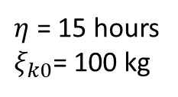

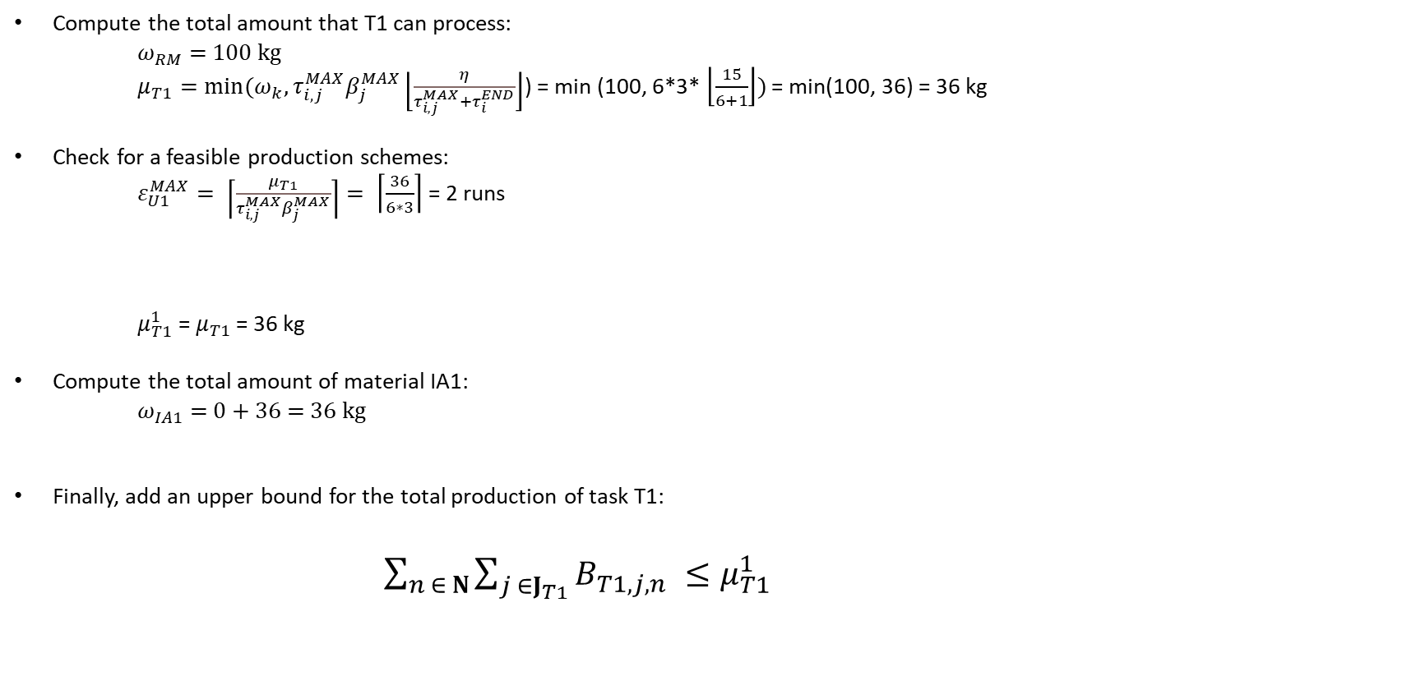
Toy Problem: Maximization of P1
T1-U1
T2-U2
$β_{j}^{MIN}, β_{j}^{MAX}$ = [2, 3] kg/h
$τ_{ⅈj}^{MIN}=τ_{ⅈj}^{MAX}$ = 6 h
$β_{j}^{MIN}, β_{j}^{MAX}$ = [2, 3] kg/h
$τ_{ⅈj}^{MIN}=τ_{ⅈj}^{MAX}$ = 6 h
$η$ = 15 hours
$ξ_{k0}$= 100 kg
RM
IA1
P1
Compute the total amount that T1 can process:
$ω_{RM}$ = 100 kg
$μ_{T1}=min(ω_{k}, τ_{i,j}^{MAX}β_{j}^{MAX}\left\lfloor \frac{η}{τ_{i,j}^{MAX}+τ_{i}^{END}}\right\rfloor$) = min (100, 6*3* $\left\lfloor \frac{15}{6+1}\right\rfloor )$ = min(100, 36) = 36 kg
Check for a feasible production schemes:
$ε_{U1}^{MAX}= \left\lceil \frac{μ_{T1}}{τ_{i,j}^{MAX}β_{j}^{MAX}}\right\rceil = \left\lceil \frac{36}{6∗3}\right\rceil$ = 2 runs
$μ_{T1}^{1}$ = $μ_{T1}$ = 36 kg
Compute the total amount of material IA1:
$ω_{IA1}$ = 0 + 36 = 36 kg
Finally, add an upper bound for the total production of task T1:
$\sum_{n ∈ N}{\sum_{j ∈J_{T1}}{B_{T1,j,n}}} ≤μ_{T1}^{1}$
Notes:
Let us understand how can we generate upper bounds on task production.

Slide 6



Assumptions and Considerations
The planning horizon $η=$H
${\text{τ}}_{i,j}^{MIN}$ = ${\text{τ}}_{i,j}^{MAX}$ to better predict maximum production
Tasks can only consume/produce one material
Bottlenecks are created by defining low $β_{i,j}^{MIN}$and $β_{i,j}^{MAX}$in certain tasks
$${\text{τ}}_{i,j}^{MAX}$$
$${\text{τ}}_{i,j}^{MIN}$$
0
1
2
3
4
5
6
7
8
9
10
11
50
TA1-1
100
RM
IA1
TC1-5
P1
TA1-2
Notes:
In some cases, tasks can run with ${\text{τ}}_{i,j}^{MAX}$ for most of the planning horizon but run with ${\text{τ}}_{i,j}^{MIN}$ for the last periods since it would not be possible to do it with ${\text{τ}}_{i,j}^{MAX}$. That is why we say ${\text{τ}}_{i,j}^{MIN}$ = ${\text{τ}}_{i,j}^{MAX}$.

Slide 7
Network 6
TC1-7
P1
TB1-3
IB1
Network material
IA1
TC2-7
P2
Unlimited storage capacity
TB2-3
IB2
$$χ$$
TC5-5
P3
Finite storage capacity
TA1-1
TC6-5
P4
Continuous task
RM
TB3-4
IB3
Startup
TA2-2
IA2
2
1
P5
TC3-6
Shutdown
TB4-4
IB4
2
TC4-6
1
P6
Startup and shutdown time (h)
Direct transitions
Task-unit compatibility:
UA1
UA2
UB3
UB4
UC5
UC6
UC7

Slide 8
Results for no changes in the production rate of tasks
There are small improvements in the LP relaxation, and in some cases the LP relaxation is the same.

Slide 9
Results for changes in the production rate of tasks TB2 and TB3
60 s vs. 230 s
62 s vs. 170 s
There are small improvements in the LP relaxation, and in some cases the LP relaxation is the same
For the bigger instances, even though it has a better LP relaxation, it took more time to solve the problem.
Notes:
Check if it is taking a lot of time to find the first feasible solution.

Slide 10
Results for changes in the production rate of tasks TB1 and TB4
280 s vs. 870 s
120 s vs. 470 s
There are small improvements in the LP relaxation, and in some cases the LP relaxation is the same
For the bigger instances, even though it has a better LP relaxation, it took more time to solve the problem.

Slide 11
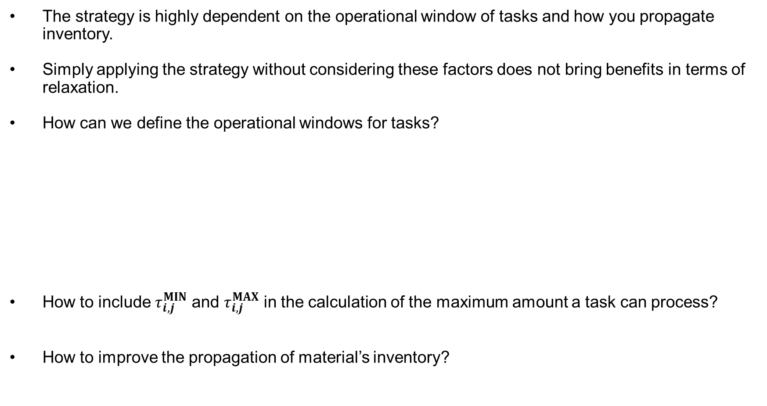
Conclusions and Future Work
The strategy is highly dependent on the operational window of tasks and how you propagate inventory.
Simply applying the strategy without considering these factors does not bring benefits in terms of relaxation.
How can we define the operational windows for tasks?
How to include ${\text{τ}}_{i,j}^{MIN}$ and ${\text{τ}}_{i,j}^{MAX}$ in the calculation of the maximum amount a task can process?
How to improve the propagation of material’s inventory?
T1-U1
20
20
20
20
20
T1-U2
15
15
15
15
T2-U3
5
5
5
5
5
5
5
5
5
0
1
2
3
4
5
6
50
TA1-1
100
RM
IA1
TC1-5
P1
TA1-2

Slide 12
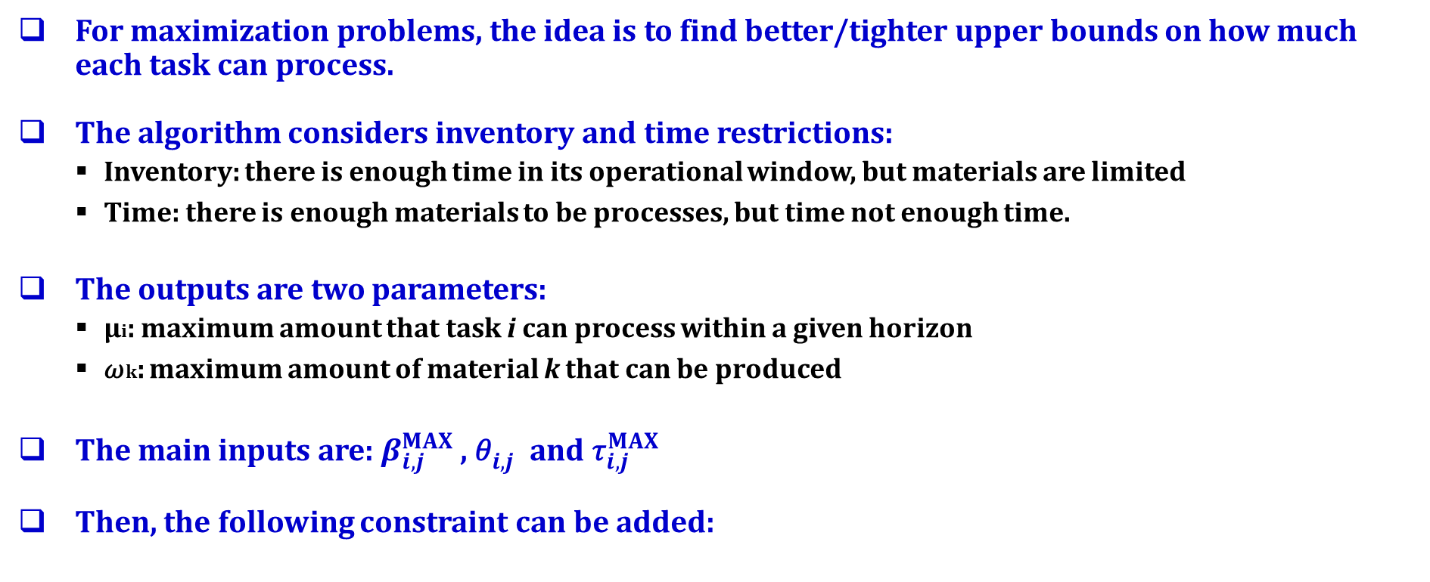

FP Algorithm
For maximization problems, the idea is to find better/tighter upper bounds on how much each task can process.
The algorithm considers inventory and time restrictions:
Inventory: there is enough time in its operational window, but materials are limited
Time: there is enough materials to be processes, but time not enough time.
The outputs are two parameters:
µi: maximum amount that task i can process within a given horizon
𝜔k: maximum amount of material k that can be produced
The main inputs are:$β_{i,j}^{MAX}$, ${\text{θ}}_{i,j}^{}$and ${\text{τ}}_{i,j}^{MAX}$
Then, the following constraint can be added:
$$\sum_{n ∈ N}{\sum_{j ∈ J_{i}^{}}{B_{i,j,n}}} ≤{\text{µ}}_{i}^{1}, ∀ i∈I^{P}$$

Slide 13

Future Work
The planning horizon H is for ${\text{θ}}_{i,j}^{}$
${\text{τ}}_{i,j}^{MIN}$ = ${\text{τ}}_{i,j}^{MAX}$ to better predict maximum production
Tasks can only consume/produce one material
$${\text{τ}}_{i,j}^{MAX}$$
$${\text{τ}}_{i,j}^{MIN}$$
0
1
2
3
4
5
6
7
8
9
10
11
TA1-1
RM
IA1
TC1-5
P1
TA1-2

Slide 14
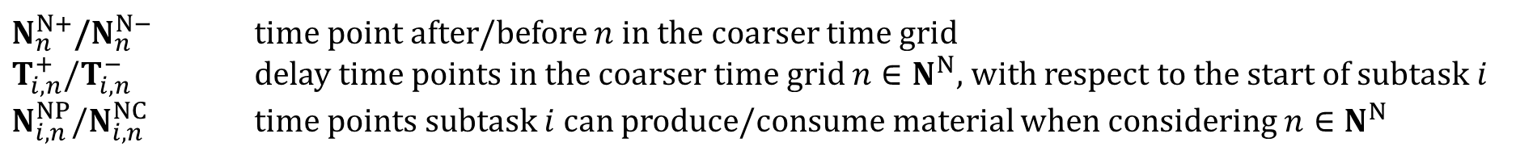
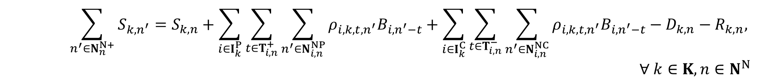
Model
Task-Unit Assignment Constraint
$$\sum_{i∈I_{j}}{\sum_{t=0}^{τ_{i}−1}{X_{i,n−t}}}+\sum_{n^{′}∈N_{n}^{N+}}{{\hat{X}}_{j,n^{′}}^{I}}=1, ∀ j∈J, n∈N^{N}$$
Unit Capacity Constraint
$$β_{i,n}^{MIN}X_{i,n}≤B_{i,n}≤β_{i,n}^{MAX}X_{i,n}, ∀ i∈I, n∈N^{N}$$
Material Balance Constraint
$$\sum_{n^{′}∈N_{n}^{N+}}{S_{k,n^{′}}}=S_{k,n}+\sum_{i∈I_{k}^{P}}{\sum_{t∈T_{i,n}^{+}}{\sum_{n^{′}∈N_{i,n}^{NP}}{ρ_{i,k,t,n^{′}}B_{i,n^{′}−t}}}}+\sum_{i∈I_{k}^{C}}{\sum_{t∈T_{i,n}^{−}}{\sum_{n^{′}∈N_{i,n}^{NC}}{ρ_{i,k,t,n^{′}}B_{i,n^{′}−t}}}}−D_{k,n}−R_{k,n},$$
$$∀ k∈K,n∈N^{N}$$
$N_{n}^{N+}$/$N_{n}^{N−}$ time point after/before $n$ in the coarser time grid
$T_{i,n}^{+}$/$T_{i,n}^{−}$ delay time points in the coarser time grid $n∈N^{N}$, with respect to the start of subtask $i$
$N_{i,n}^{NP}$/$N_{i,n}^{NC}$ time points subtask $i$ can produce/consume material when considering $n∈N^{N}$
Notes:
$T_{i,n}^{+}$: TB1,n26,t0-t1 and ITB1,n26,t0-t2
$T_{i,n}^{−}$: TB1,n26,t0-t2 and ITB1,n26,t0-t3
$N_{i,n}^{NP}$: TB1,n26,n24-n25 and ITB1,n26,n24-n25

Slide 15
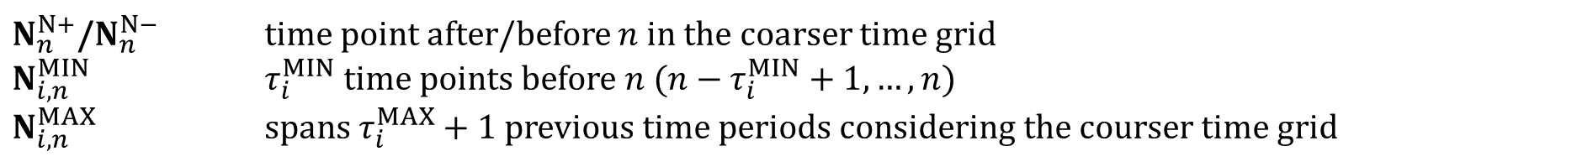
Model
Run-Starting and Run-Ending Constraints
$$Y_{i,n}^{S}=X_{i,n}−\sum_{n^{′}∈N_{n}^{N−}}{X_{i,n^{′}}}+Y_{i,n}^{E}, ∀ i∈I^{P}, n∈N^{N}$$
$$Y_{i,n}^{S}+Y_{i,n}^{E}≤1, ∀ i∈I^{P}, n∈N^{N}$$
Run Length Constraints
$$X_{i,n}≥ \sum_{n^{′}∈N_{i,n}^{MIN}}{Y_{i,n^{′}}^{S}}, ∀ i∈I^{P},n∈N^{N}$$
$$τ_{i}^{MAX}≥ \sum_{n^{′}∈N_{i,n}^{MAX}}{ψ_{n^{′}}X_{i,n^{′}}}, ∀ i∈I^{P}, n∈N^{N}$$
$N_{n}^{N+}$/$N_{n}^{N−}$ time point after/before $n$ in the coarser time grid
$N_{i,n}^{MIN}$ $τ_{i}^{MIN}$ time points before $n$ (${n−τ}_{i}^{MIN}+1,…,n$)
$N_{i,n}^{MAX}$ spans $τ_{i}^{MAX}+1$ previous time periods considering the courser time grid
Notes:
N^{MAX} starts counting backward starting from the next time point in N^{D}

Slide 16
Model
Objective Functions
$$min Cost=\sum_{k∈K}{\sum_{n∈N^{N}}{γ_{k,n}^{S}S_{k,n}}}+\sum_{i∈I}{\sum_{n∈N^{N}}{(γ_{i,n}^{X}X_{i,n}+γ_{i}^{B}B_{i,n})}}+\sum_{i∈I^{P}}{\sum_{n∈N^{N}}{(γ_{i}^{Y}Y_{i,n}^{S})}}$$
$$max Profit=\sum_{k∈K^{F}}{\sum_{n∈N^{N} }{π_{k}R_{k,n}}}−Cost$$
Notes:
$π_{k}$~70-100
Check computationally if XI helps
Unit based discretization (downstream is finer). Will need to handle material balance for intermediates since RM will only need 2 hour time grid, products will need 1 hour time grid (material balance constraint), but intermediates may need to be handled differently.

Slide 17
We consider 3 types of continuous tasks
run
run
0
1
2
3
4
5
6
7
8
9
10
11
12
13
14
run
run
startup
direct transition
shutdown
0
1
2
3
4
5
6
7
8
9
10
11
12
13
14
run
run
startup
shutdown
startup
shutdown
0
1
2
3
4
5
6
7
8
9
10
11
12
13
14

Slide 18
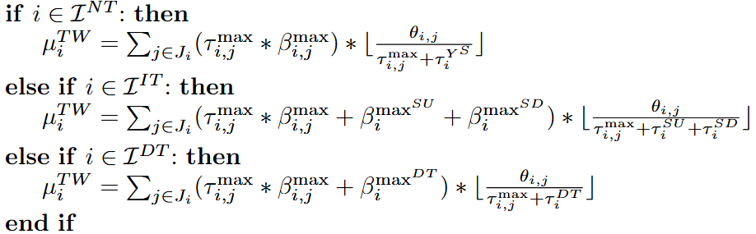


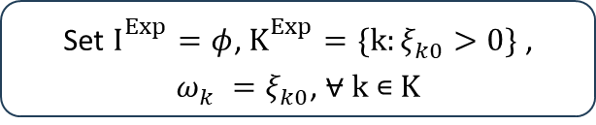




Basic Idea of the FP Algorithm
Set $I_{}^{Exp}=φ$, $K_{}^{Exp}=\{k:ξ_{k0}^{}>0\}$ , $ω_{k}^{}=ξ_{k0}^{}$, ⩝ k ∊ K
Calculate ${\text{µ}}_{i}^{}$and ${\text{µ}}_{i}^{1},\text{⩝ }\text{i}\text{ ∊}I_{k}^{−},{\text{k}\text{ ∊} K}_{}^{Exp}$
$I_{}^{Exp}=I_{}^{Exp}$⋃ {i}
Calculate $ω_{k}^{},\text{⩝ }\text{k}\text{ ∊}K_{i}^{+},{\text{i}\text{ ∊}I}_{}^{Exp}$
$K_{}^{Exp}=K_{}^{Exp}$⋃ {k}
$$K_{}^{Exp}=K$$
$I_{}^{Exp}=$ I
No
Yes
Stop

Slide 19
LR
Paper | Environments | Method | Partial Results
2006-A decomposition framework for the scheduling of single- and multi-stage processes https://doi.org/10.1016/j.compchemeng.2005.09.011 | Single and multi-stage batch plants. | Assignment-Sequencing decomposition. Also, an algorithm identifies infeasible assignments and generates tightening constraints for the assignment subproblem.
Mixed-Integer Programming Model and Tightening Methods for Scheduling in General Chemical Production Environments, Velez 2013 https://pubs.acs.org/doi/10.1021/ie302741b |  | DPA. Lower bounds based on: the number of batches of each task the cumulative amount processed by each task
Reformulations and Branching Methods for Mixed-Integer Programming Chemical Production Scheduling Models, Velez 2013 (https://pubs.acs.org/doi/10.1021/ie303421h) |  | RKV
Advances in Mixed-Integer Programming Methods for Chemical Production Scheduling, Velez 2014 (https://doi.org/10.1146/annurev-chembioeng-060713-035859) |  | Review
On the solution of large-scale mixed integer programming scheduling models (https://doi.org/10.1016/j.ces.2015.05.021) |  | Multiple grids DPA FP RKV
Preprocessing and tightening methods for time-indexed MIP chemical production scheduling models (https://doi.org/10.1016/j.compchemeng.2015.10.003) |  | Methods based on operating widows (due to natural delay) and inventory for maximization problems. They are sequential and depend on parameters first found in the EST-LT method: Time Window EST-LT FP Group Identification Feasible Algorithm | For FP, 3 models: SP&S: Shah discrete-time STN S&K GH&M
Discrete-time mixed-integer programming models and solution methods for production scheduling in multistage facilities (https://doi.org/10.1016/j.compchemeng.2016.04.034) |  | Time Window EST-LT RKV Priority Branching on busiest stage
Strengthening Discrete-Time Scheduling Formulations by Introducing the Concept of Campaigns |  | For dealing with problems that consider changeover, they propose a formulation based on the concept of campaigns (an uninterrupted sequence of n jobs belonging to the same class in a machine). In STN models, does it make trying to minimize alternating runs of different tasks in the same unit? | Larger number of variables and same number of constraints Changeovers are only accounted for by campaigns and not checked in every period. Time reduction by 3 orders.

Slide 20
LR
Paper | Environments | Method | Partial Results
Valid Inequalities Based on Demand Propagation for Chemical Production Scheduling MIP Models, Velez 2013 (https://aiche.onlinelibrary.wiley.com/doi/10.1002/aic.14021) |  | DPA. Lower bounds based on: the number of batches of each task the cumulative amount processed by each task
Mixed-Integer Programming Model and Tightening Methods for Scheduling in General Chemical Production Environments, Velez 2013 (https://pubs.acs.org/doi/10.1021/ie302741b) |  | DPA. Lower bounds based on: the number of batches of each task the cumulative amount processed by each task
Reformulations and Branching Methods for Mixed-Integer Programming Chemical Production Scheduling Models, Velez 2013 (https://pubs.acs.org/doi/10.1021/ie303421h) |  | RKV
Advances in Mixed-Integer Programming Methods for Chemical Production Scheduling, Velez 2014 (https://doi.org/10.1146/annurev-chembioeng-060713-035859) |  | Review
On the solution of large-scale mixed integer programming scheduling models (https://doi.org/10.1016/j.ces.2015.05.021) |  | Multiple grids DPA FP RKV
Preprocessing and tightening methods for time-indexed MIP chemical production scheduling models (https://doi.org/10.1016/j.compchemeng.2015.10.003) |  | Methods based on operating widows (due to natural delay) and inventory for maximization problems. They are sequential and depend on parameters first found in the EST-LT method: Time Window EST-LT FP Group Identification Feasible Algorithm | For FP, 3 models: SP&S: Shah discrete-time STN S&K GH&M
Discrete-time mixed-integer programming models and solution methods for production scheduling in multistage facilities (https://doi.org/10.1016/j.compchemeng.2016.04.034) |  | Time Window EST-LT RKV Priority Branching on busiest stage
Strengthening Discrete-Time Scheduling Formulations by Introducing the Concept of Campaigns |  | For dealing with problems that consider changeover, they propose a formulation based on the concept of campaigns (an uninterrupted sequence of n jobs belonging to the same class in a machine). In STN models, does it make trying to minimize alternating runs of different tasks in the same unit? | Larger number of variables and same number of constraints Changeovers are only accounted for by campaigns and not checked in every period. Time reduction by 3 orders.

Slide 21
For most cases, the LP relaxation of both formulations are less or equal to the predicted amount.
For materials IA1 and IA2 the LP relaxation of the original formulation is higher than the predicted amount.
Does it mean that the mass balance constraint is already doing the job?

