Slide 1
Introduction
Warning during vLLM startup
vllm serve Qwen/Qwen3.8-27B-FP8
...
WARNING [fp8_utils.py:851] Using default W8A8 Block FP8 kernel config. Performance might be sub-optimal!
Config file not found at .../configs/N=17408,K=5120,device_name=NVIDIA_L40S,dtype=fp8_w8a8,block_shape=[128,128].json
...

Slide 2
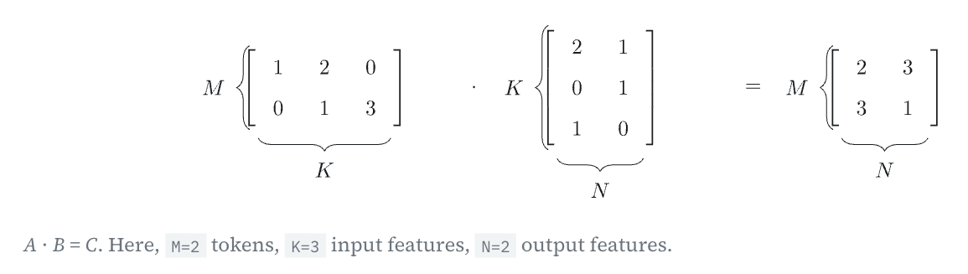
Introduction
Matrix multiplication

Slide 3
Introduction
Matrix multiplication shape

Slide 4
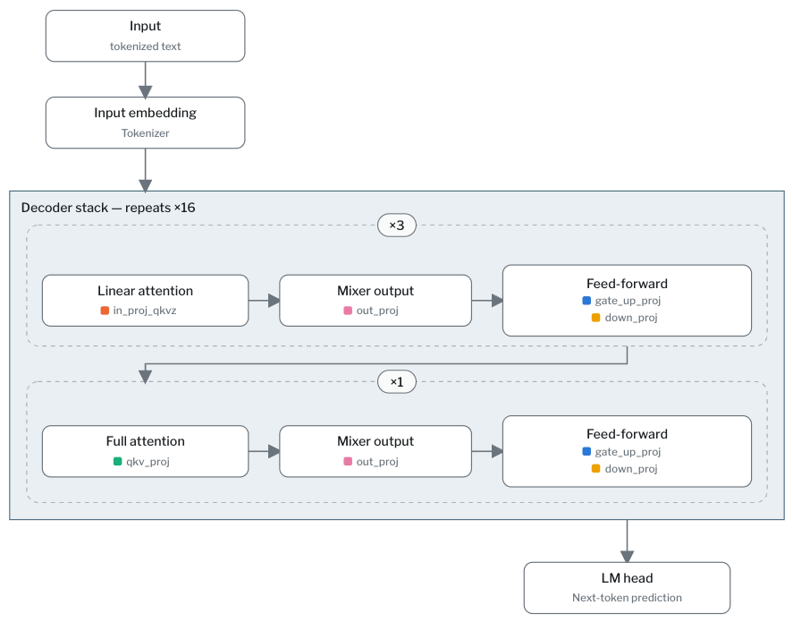
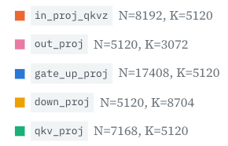
Introduction
Qwen3.8-27B architecture

Slide 5
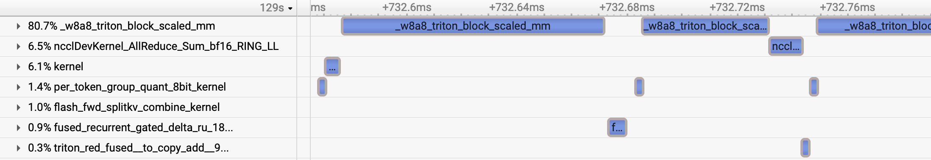
Introduction
Use NVIDIA Nsight Systems to check kernel launches

Slide 6
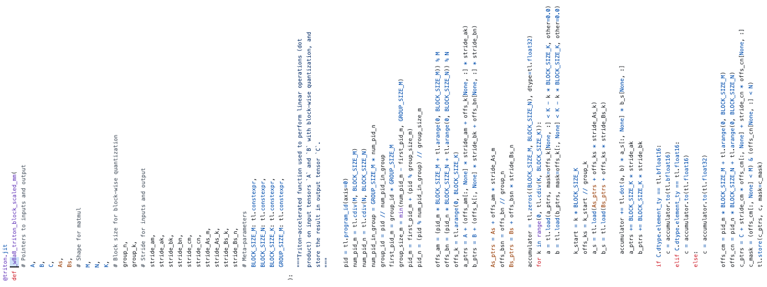
Introduction
How is the matrix multiplication implemented?
Using Triton in vllm/model_executor/layers/quantization/utils/fp8_utils.py:

Slide 7
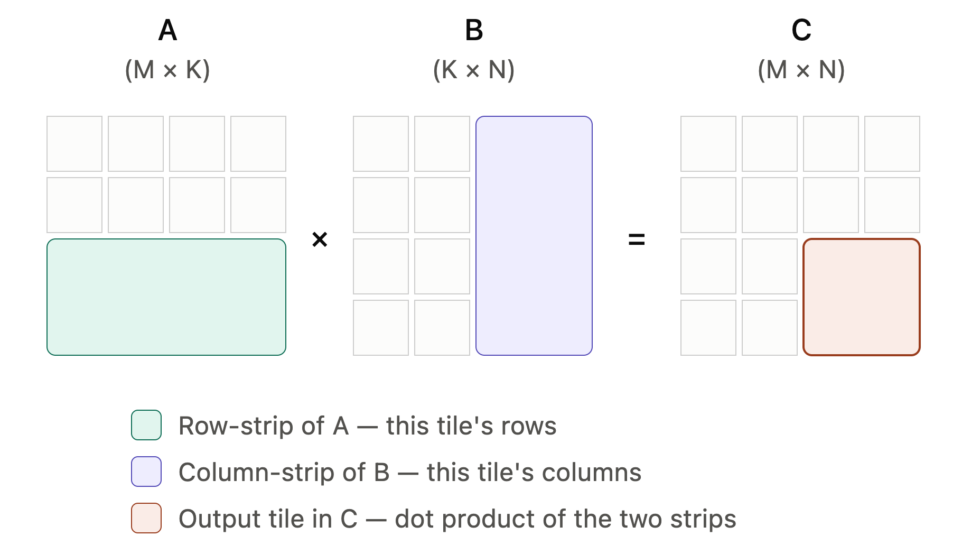
Introduction
The kernel params
By default:
What are blocks/tiles?
{
"BLOCK_SIZE_M": 64,
"BLOCK_SIZE_N": 128,
"BLOCK_SIZE_K": 128,
"GROUP_SIZE_M": 32,
"num_warps": 4,
"num_stages": 2
}

Slide 8
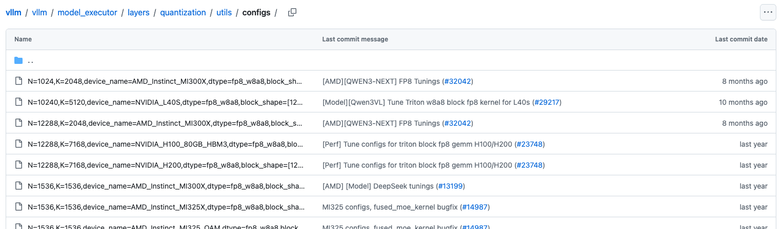
Introduction
Tuned configs for certain GEMM shape + GPU model combinations
But missing for our model’s shapes on L40S:
vllm serve Qwen/Qwen3.8-27B-FP8
...
WARNING [fp8_utils.py:851] Using default W8A8 Block FP8 kernel config. Performance might be sub-optimal!
Config file not found at .../configs/N=17408,K=5120,device_name=NVIDIA_L40S,dtype=fp8_w8a8,block_shape=[128,128].json
...

Slide 9
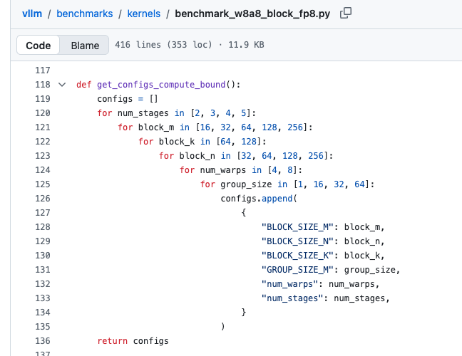
Autotuning
Let’s use vLLM’s autotuning script to get custom configs!
#N=17408,K=5120,device_name=NVIDIA_L40S,dtype=fp8_w8a8,block_shape=[128,128].json
{
"1": {
"BLOCK_SIZE_M": 16,
"BLOCK_SIZE_N": 64,
"BLOCK_SIZE_K": 128,
"GROUP_SIZE_M": 32,
"num_warps": 8,
"num_stages": 4
},
"2": {
"BLOCK_SIZE_M": 16,
"BLOCK_SIZE_N": 64,
"BLOCK_SIZE_K": 128,
"GROUP_SIZE_M": 64,
"num_warps": 8,
"num_stages": 3
},
"4": {
"BLOCK_SIZE_M": 16,
"BLOCK_SIZE_N": 64,
"BLOCK_SIZE_K": 128,
"GROUP_SIZE_M": 32,
"num_warps": 8,
"num_stages": 5
},
...
}

Slide 10
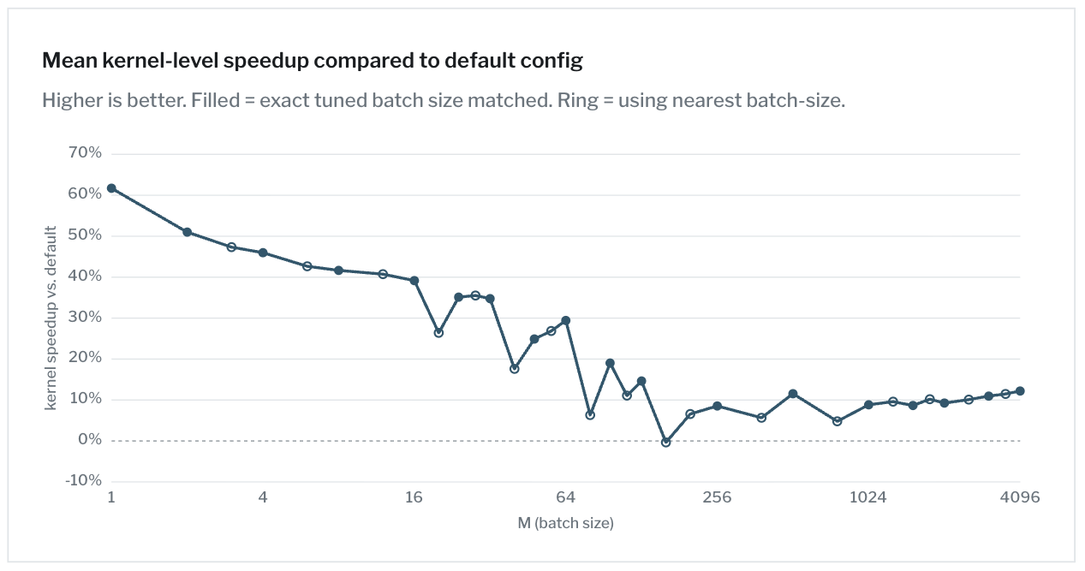
Use autotuning script
How much does the performance improve?

Slide 11
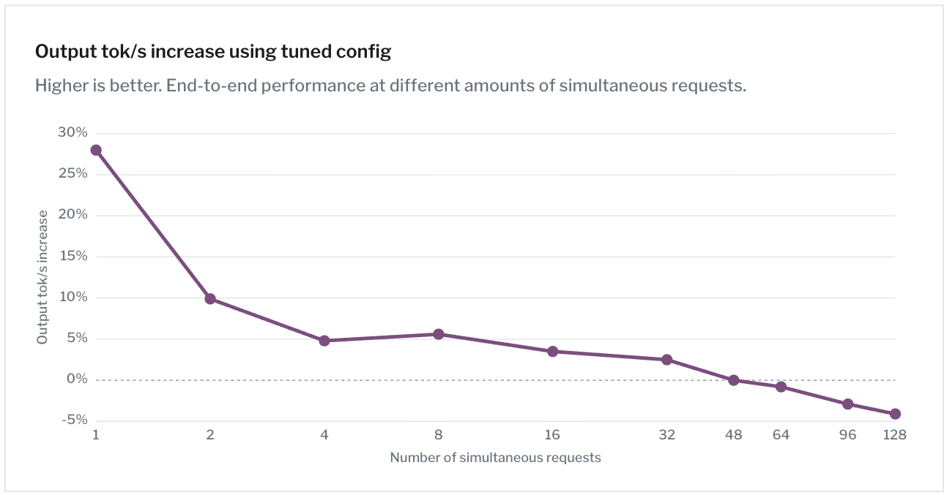
Use autotuning script
How much does the performance improve?

Slide 12
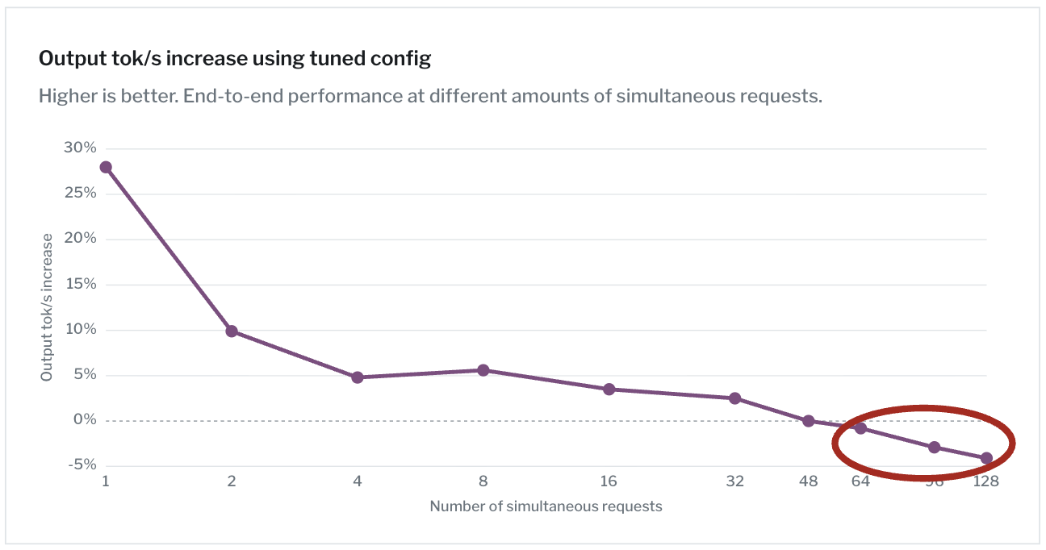
Use autotuning script
How much does the performance improve?

Slide 13
How can a kernel config that's faster across the whole batch-size range
make the e2e system slower under high-concurrency load?

Slide 14
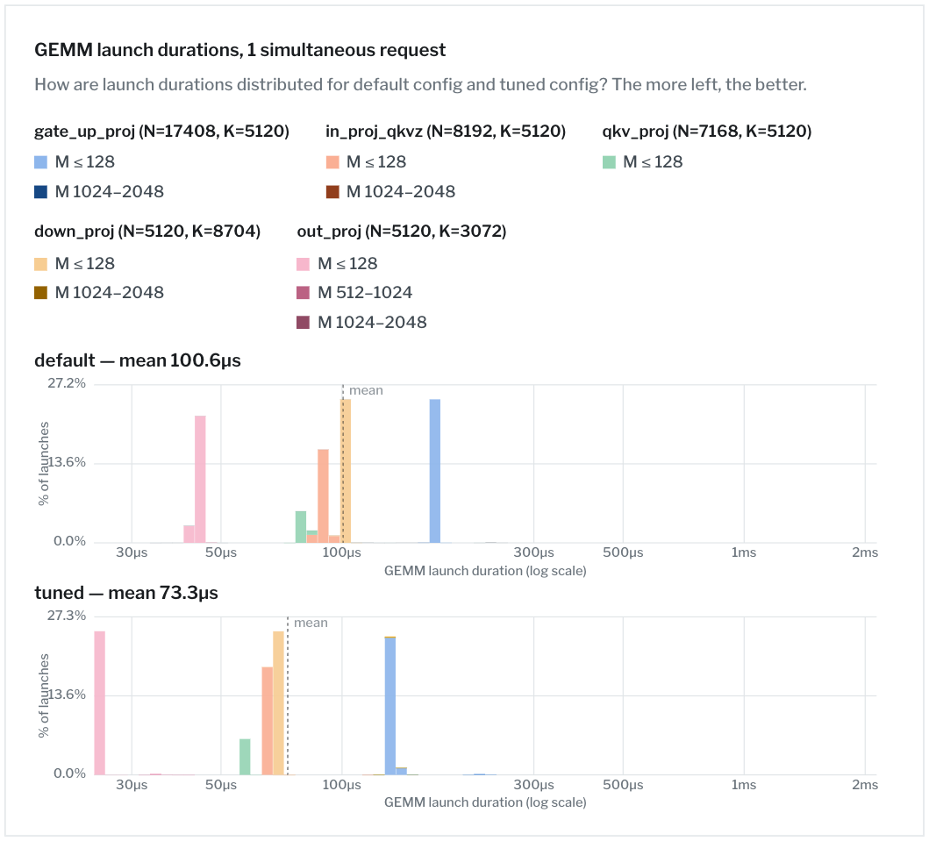
Reason for high-concurrency performance worsening
How does it look like for 1 simultaneous request?

Slide 15
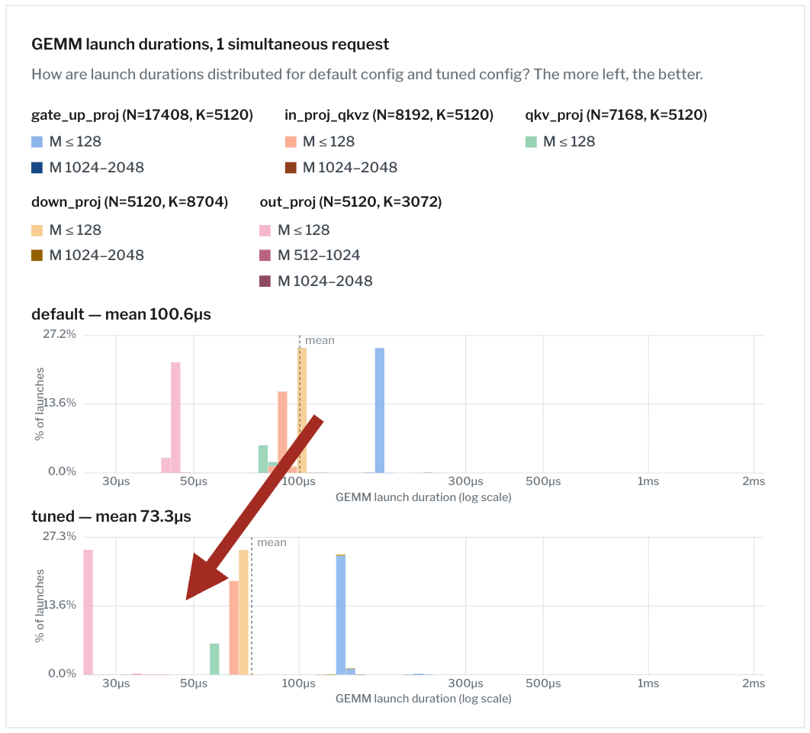
Reason for high-concurrency performance worsening
How does it look like for 1 simultaneous request?
=> Looks good.

Slide 16
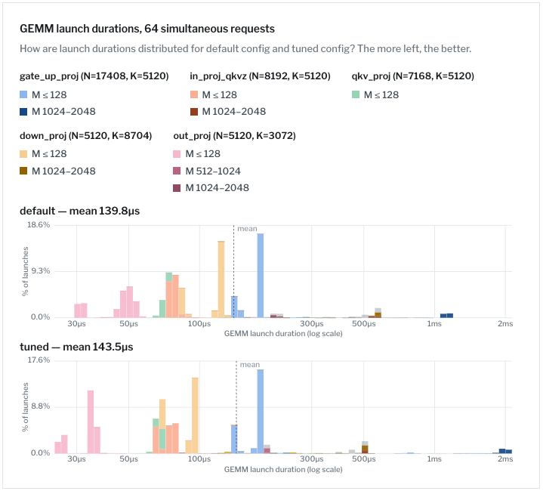
Reason for high-concurrency performance worsening
How does it look like for 64 simultaneous request?

Slide 17
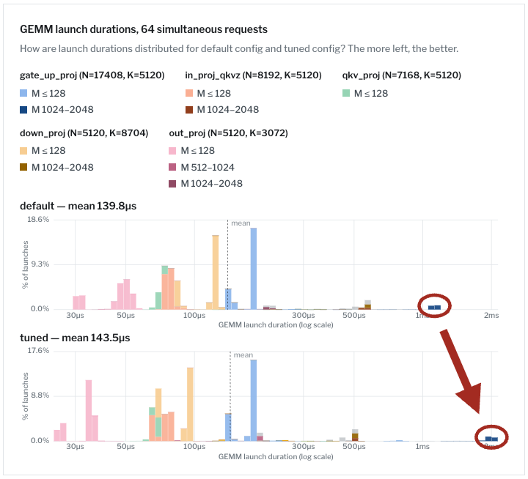
Reason for high-concurrency performance worsening
How does it look like for 64 simultaneous request?
=> Bad. Why is the cluster with shape M≈2000, N=17408, K=5120 taking almost double the time?

Slide 18
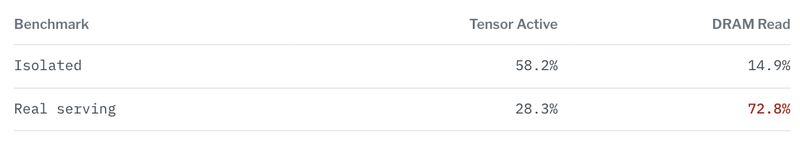
Reason for high-concurrency performance worsening
Could it be related to DRAM access?
=> Yes. But why is more data pulled from DRAM under real serving than in isolation?

Slide 19
Reason for high-concurrency performance worsening
The autotuning script get’s the matrices from L2 cache
A, As = make_A(M, K)
B, Bs = make_B(N, K) # allocated ONCE
for config in search_space:
t = benchmark_config(A, B, As, Bs, config) # every launch reuses the SAME B
BUT: During real inferencing, there are many other things which go through the cache before the same layer gets called again using the same weight matrix B.
=> B will have been evicted from L2 cache.

Slide 20
The autotuner measures a GEMM whose operands are cached.
Real serving never lets the operands stay in cache.

Slide 21
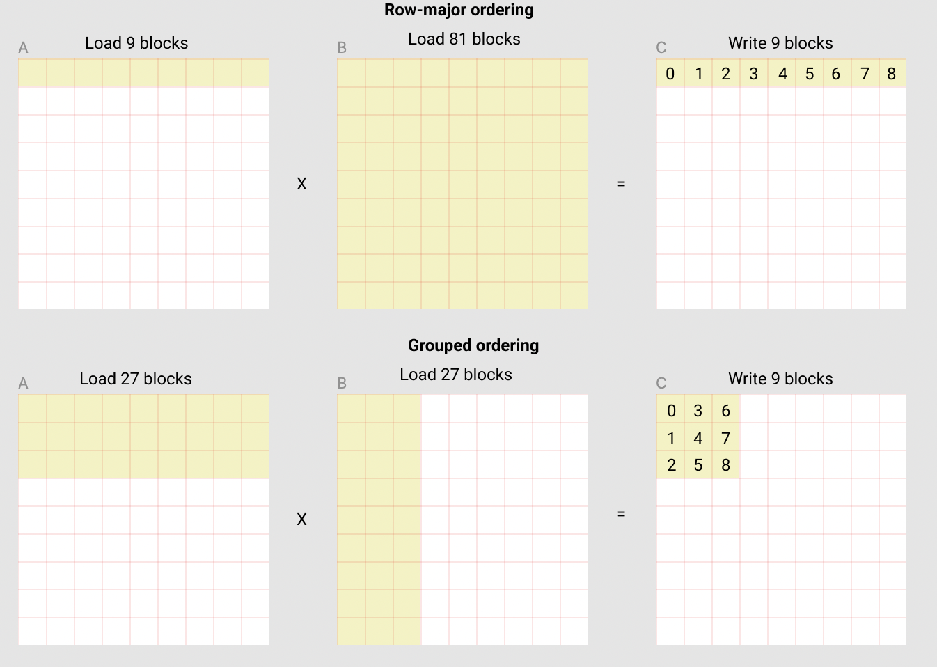
Narrowing down the effect
Which param gets the most bad influence from the wrong cache assumption?
"2048": {
"BLOCK_SIZE_M": 128,
"BLOCK_SIZE_N": 128,
"BLOCK_SIZE_K": 128,
"GROUP_SIZE_M": 1,
"num_warps": 8,
"num_stages": 3
},
“BLOCK_SIZE_M (…) affects the L2 cache hit rate”
- Triton Matrix Multiplication Tutorial

Slide 22
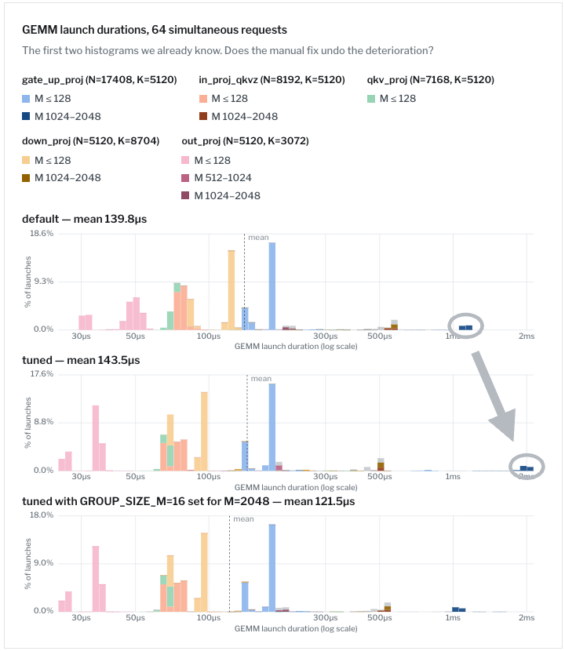
Narrowing down the effect
Does changing GROUP_SIZE_M from 1 to 16 fix it?

Slide 23
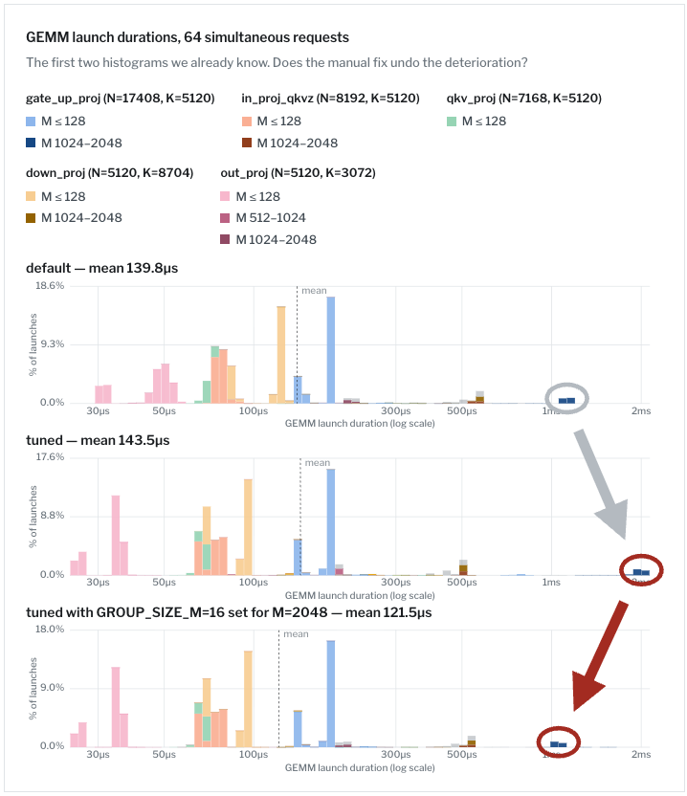
Narrowing down the effect
Does changing GROUP_SIZE_M from 1 to 16 fix it?
=> Yes!

Slide 24
Fixing the autotune script
Solution: Evict cache before every run
def benchmark_config(...):
for _ in range(num_iters):
flush_buf.zero_() # the fix: evict L2 before every launch
start_event.record()
run()
end_event.record()

Slide 25
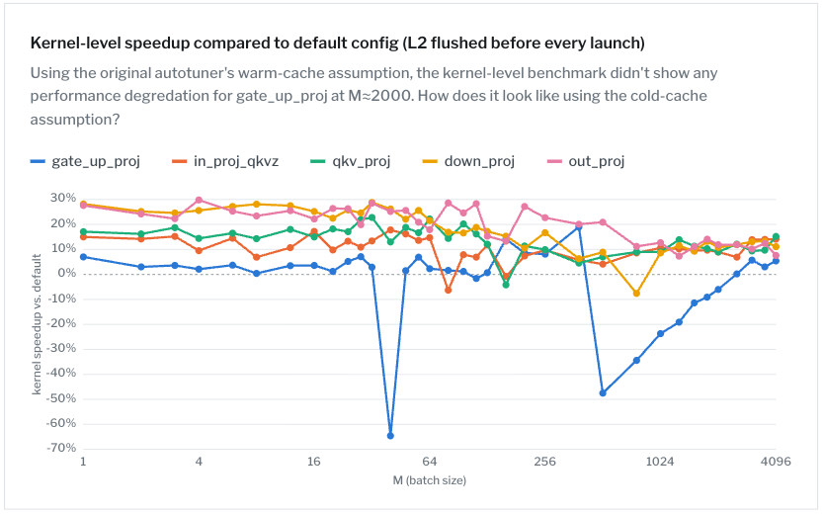
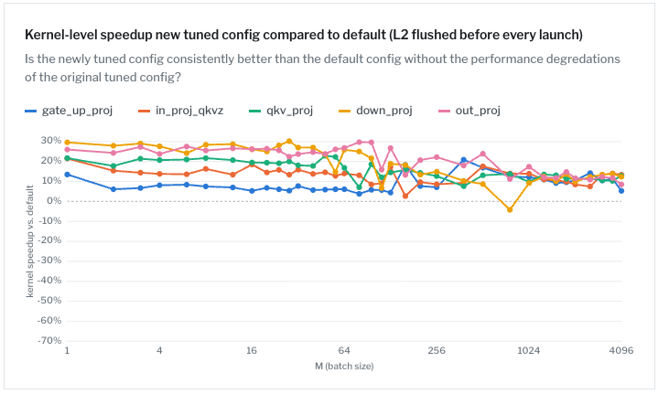
Fixing the autotune script
Before vs. after fix (both measured with L2 flushed before every iteration)

Slide 26
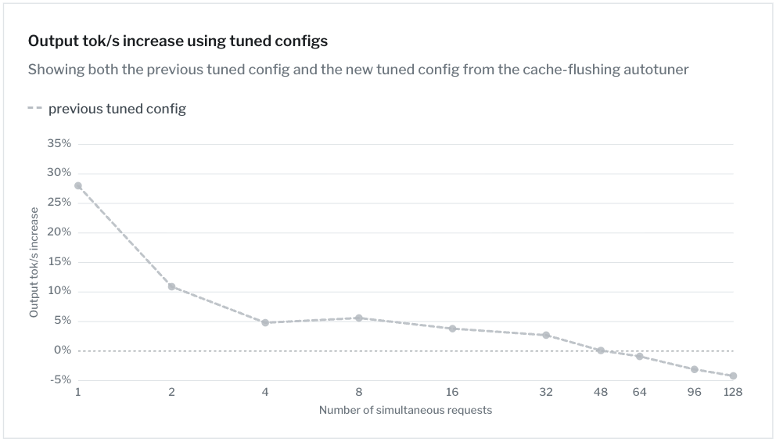
Fixing the autotune script
Real serving performance improvement

Slide 27
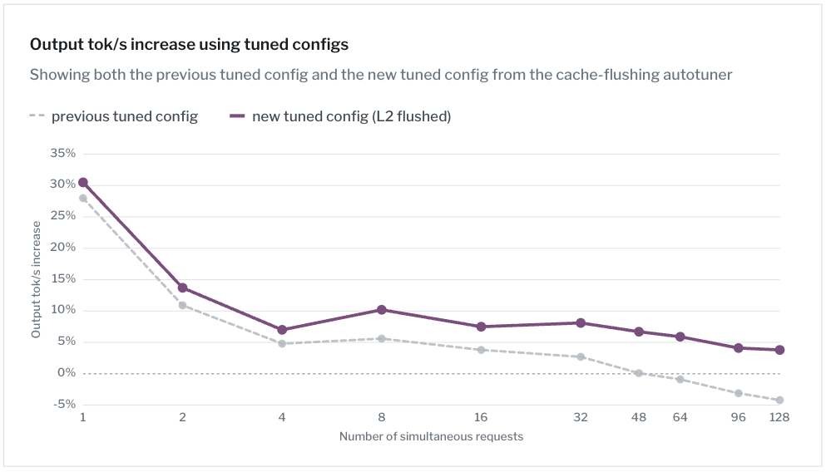
Fixing the autotune script
Real serving performance improvement
=> Better across all concurrencies!

