Slide 1

Observer 模式
Copyright © 2017 Senao Inc. All rights reserved

Slide 2
從一個簡單的程式開始

Slide 3
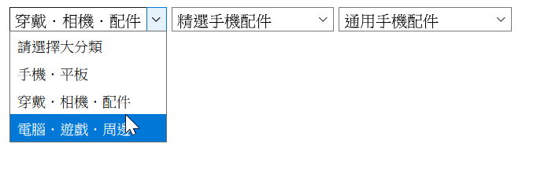
需求
三層連動的下拉選單，且可設定預設值

Slide 4
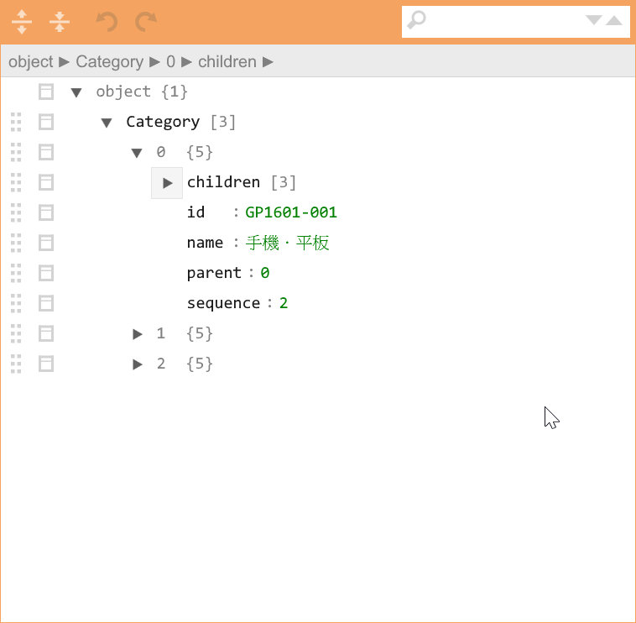
資料格式：第一層

Slide 5
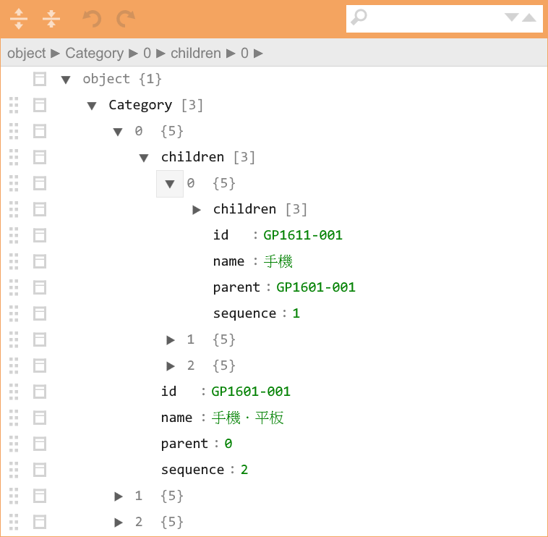
資料格式：第二層

Slide 6
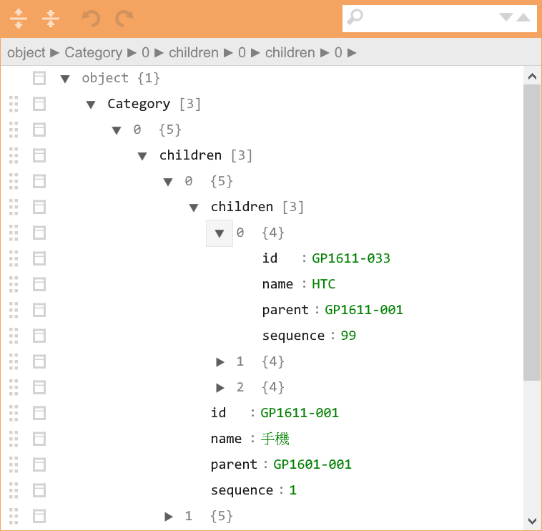
資料格式：第三層

Slide 7
資料層級關係

Slide 8
擴充點一
建立選項時
{ "children": [], "id": "GP1601-001", "name": "手機．平板", "parent": "0", "sequence": "2" }
{ "id": "GP1601-001", "name": "手機．平板" }

Slide 9
擴充點二
要將資料傳遞給下層選單時
callback

Slide 10
擴充點三
要能任意指定下層選單

Slide 11
使用情境 - HTML
<select name="optone" id="category1"> <option value="" selected="selected">請選擇大分類</option> </select> <select name="optone" id="category2"> <option value="" selected="selected">請選擇中分類</option> </select> <select name="optone" id="category3"> <option value="" selected="selected">請選擇小分類</option> </select>

Slide 12
使用情境 - JavaScript
import {CascadingComboBox} from "../v1/CascadingComboBox"; let comboBox3 = new CascadingComboBox('category3'); let comboBox2 = new CascadingComboBox('category2', comboBox3); let comboBox1 = new CascadingComboBox('category1', comboBox2); comboBox3.onCreateOption = onCreateOption; comboBox3.onItemSelected = onItemSelected; comboBox2.onCreateOption = onCreateOption; comboBox2.onCreateChildData = onCreateChildData; comboBox2.onItemSelected = onItemSelected; comboBox1.onCreateOption = onCreateOption; comboBox1.onCreateChildData = onCreateChildData; comboBox1.onItemSelected = onItemSelected; comboBox1.setData( sampleData["Category"], ['GP1601-005', 'GP1611-003', 'GP1611-137']);

Slide 13
Callback - 將資料轉換成選項
/** * @param {CascadingComboBox} sender * @param {int} index * @param {object} element * @returns {{key, value}} */ function onCreateOption(sender, index, element) { return { key: element.id, value: element.name } }
{ "children": [], "id": "GP1601-001", "name": "手機．平板", "parent": "0", "sequence": "2" }
{ "id": "GP1601-001", "name": "手機．平板" }

Slide 14
Callback – 建立傳給下層選單的資料
/** * @param {CascadingComboBox} sender * @param {object} data * @returns {Array|*|children|HTMLCollection} */ function onCreateChildData(sender, data) { return data.children; }
{ "children": …., "id": "GP1601-001", "name": "手機．平板", "parent": "0", "sequence": "2" }

Slide 15
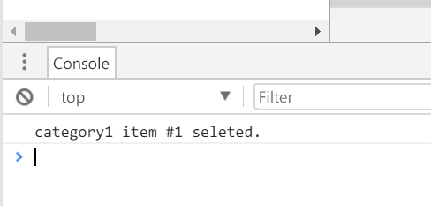
Callback – 目前選取的項目編號
/** * @param {CascadingComboBox} sender * @param {int} index */ function onItemSelected(sender, index) { console.log(`${sender.id} item #${index} seleted.`); }

Slide 16
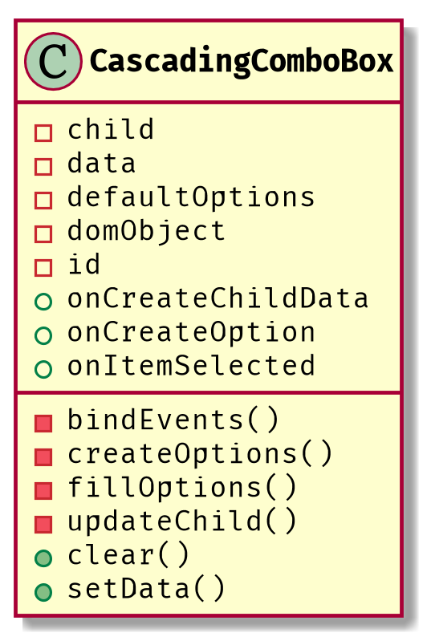
類別圖 v1

Slide 17
constructor
export class CascadingComboBox { /** * Constructor * @param {string} id * @param {?CascadingComboBox} child - 子選單，可以不指定 */ constructor(id, child = null) { this.id = id; this.domObject = document.getElementById(id); Assert.true(SystemUtils.isNotNull(this.domObject), `HTML 元素 ${id} 不存在!`); this.child = child; this.data = []; this.defaultOptions = []; this.onCreateOption = null; this.onCreateChildData = null; this.onItemSelected = null; this.bindEvents(); }

Slide 18
bindEvents
bindEvents() { // 當使用者選擇某個項目時會呼叫此函式 this.domObject.onchange = () => { if (SystemUtils.isNotNull(this.onItemSelected)) { this.onItemSelected(this, this.domObject.selectedIndex); } if (SystemUtils.isNull(this.child)) { return; } // 如果是選到第一個選項(預設值) if (this.domObject.selectedIndex === 0) { this.child.clear(); return; } // 子選單連動 this.updateChild(); } }

Slide 19
setData
/** * 設定資料。 * @param {Object[]} data - 陣列型態的資料 * @param {string[]} defaultOptions - 預設選項 * 如果串接三層， defaultOptions 就要將三層的 key 組成陣列傳入。 * ex: ['GP1601-005', 'GP1611-003', 'GP1611-137'] */ setData(data, defaultOptions) { this.data = data || []; this.defaultOptions = defaultOptions || []; this.fillOptions(); }

Slide 20
fillOptions
/** * 填滿選項 */ fillOptions() { // 清除目前的選項 this.clear(); // 根據傳入的資料建立選項 this.data.forEach(this.createOptions.bind(this)); // 如果有子選單而且有預設值 if (SystemUtils.isNotNull(this.child) && this.domObject.selectedIndex > 0) { this.updateChild(); } }
this.data.forEach(()=> { .... })

Slide 21
createOptions
/** * 建立選項 * @param {object} element * @param {int} index - element 的編號 */ createOptions(element, index) { if (SystemUtils.isNull(this.onCreateOption)) { return; } // 呼叫使用者指定的 callback 將陣列元素轉換成 option let option = this.onCreateOption(this, index, element); // 新增一個選項 let newOption = new Option(option.value, option.key); this.domObject.options[this.domObject.options.length] = newOption; // 有預設選項嗎? if (SystemUtils.isEmpty(this.defaultOptions)) { return; } // 此選項是否為預設被選取? newOption.defaultOptions = newOption.value === this.defaultOptions[0];

Slide 22
updateChild
/** * 更新下層選單 */ updateChild() { if (SystemUtils.isNull(this.onCreateChildData)) { return; } // 取得選到的資料 let selectedData = this.data[this.domObject.selectedIndex - 1]; // 呼叫 callback 將選到的資料傳換成給下層選單的資料 let dataForChild = this.onCreateChildData(this, selectedData); let selectedKeysForChild = []; if (SystemUtils.isNotEmpty(this.defaultOptions)) { selectedKeysForChild = this.defaultOptions.slice(1); } // 將資料設定到下層選單 this.child.setData(dataForChild, selectedKeysForChild); }

Slide 23
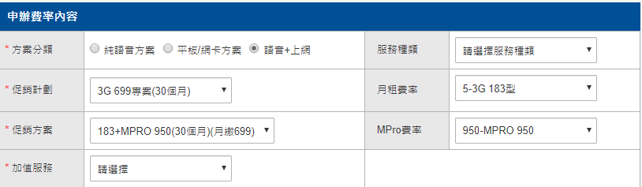
新需求
下層選單不只一個!!!

Slide 24
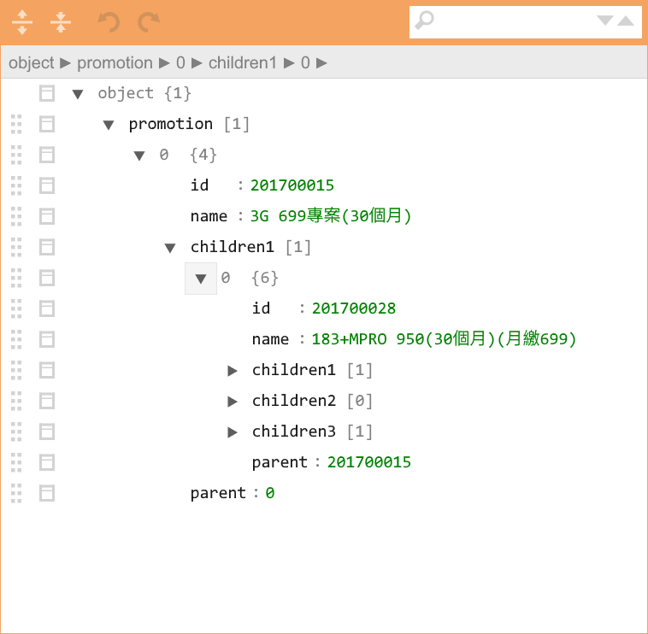

Slide 25
每個下層選單的資料都不一樣
如何在選擇項目之後，將不同資料傳送給每個下層選單

Slide 26
解決方法
新增一個 method 可加入子選單
將下層選單用陣列儲存，要更新下層選單時，遍歷整個陣列

Slide 27
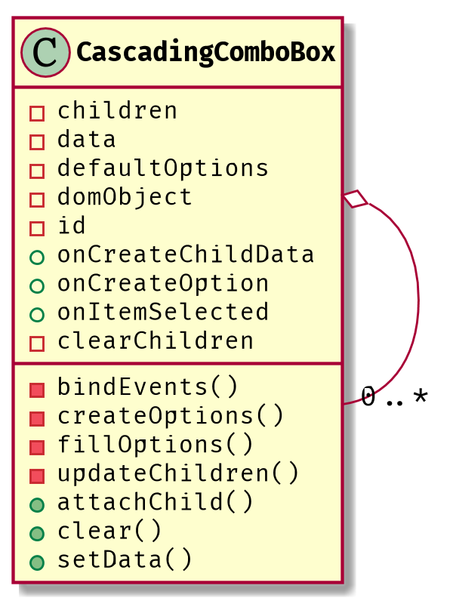
類別圖 v2

Slide 28
使用情境 - JavaScript
舊版
let comboBox3 = new CascadingComboBox('category3'); let comboBox2 = new CascadingComboBox('category2', comboBox3); let comboBox1 = new CascadingComboBox('category1', comboBox2);
新版
let comboBox3 = new CascadingComboBox('category3'); let comboBox2 = new CascadingComboBox('category2'); let comboBox1 = new CascadingComboBox('category1'); comboBox1.attachChild(comboBox2); comboBox1.attachChild(comboBox3);

Slide 29
constructor
constructor(id) { this.id = id; this.domObject = document.getElementById(id); Assert.true(SystemUtils.isNotNull(this.domObject), `HTML 元素 ${id} 不存在!`); this.children = []; this.data = []; this.defaultOptions = []; this.onCreateOption = null; this.onCreateChildData = null; this.onItemSelected = null; this.bindEvents(); }

Slide 30
attachChild
/** * 加入子選單 * @param {CascadingComboBox} child */ attachChild(child) { this.children.push(child); }

Slide 31
bindEvents
bindEvents() { // 當使用者選擇某個項目時會呼叫此函式 this.domObject.onchange = () => { if (SystemUtils.isNull(this.onItemSelected)) { return; } // 將選取的項目編號傳給使用者指定的 callback this.onItemSelected(this, this.domObject.selectedIndex); // 如果沒設定下層選單，不用處理 if (SystemUtils.isEmpty(this.children)) { return; } // 如果是選到第一個選項(預設值) if (this.domObject.selectedIndex === 0) { this.clearChildren(); return; } this.updateChildren(); } }

Slide 32
updateChildren
updateChildren() { if (SystemUtils.isNull(this.onCreateChildData)) { return; } // 取得選到的資料 let selectedData = this.data[this.domObject.selectedIndex - 1]; // 呼叫 callback 將選到的資料傳換成給下層選單的資料 let dataForChild = this.onCreateChildData(this, selectedData); let selectedKeysForChild = []; if (SystemUtils.isNotEmpty(this.defaultOptions)) { selectedKeysForChild = this.defaultOptions.slice(1); } // 將資料設定到下層選單 this.children.forEach((child) => { child.setData(dataForChild, selectedKeysForChild); } ) }

Slide 33
有忘記什麼嗎?

Slide 34
新需求
下層選單不只一個!!!

Slide 35
每個下層選單的資料都不一樣
如何在選擇項目之後，將不同資料傳送給每個下層選單

Slide 36
將下拉選單和Callback綁在一起
attachChild
onCreateChildData

Slide 37
使用情境 - JavaScript
let mainCombobox = new CascadingComboBox({ id: 'categoryMain', onCreateOption: onCreateOptionCallback, onSelected: onItemSelectedCallback }); mainCombobox.setData(MPro.promotion);

Slide 38
使用情境 - JavaScript
let combobox1 = new CascadingComboBox({ id: 'category1', onCreateOption: onCreateOptionCallback, onSelected: onItemSelectedCallback }); mainCombobox.attachChild({ child: combobox1, onCreateChildData: /** * @callback onCreateChildDataCallback * @param {Object} data * @param {CascadingComboBox} target * @returns {Object} */ function (data, target) { return data.children1[0].children1; } });

Slide 39
Constructor
/** * @param {Object} options * @property {string} id * @property {onCreateOptionCallback} onCreateOption * @property {onSelectedCallback} onSelected * @constructor */ constructor(options) { this.id = options.id; this.domObject = document.getElementById(id); Assert.true(SystemUtils.isNotNull(this.domObject), `HTML 元素 ${id} 不存在!`); this.children = []; this.data = []; this.defaultOptions = []; this.onCreateOption = options.onCreateOption; this.onItemSelected = options.onSelected; this.bindEvents(); }

Slide 40
attachChild
/** * 加入子選單 * @param {Attachment} attachment */ attachChild(attachment) { this.children.push(attachment); }

Slide 41
clearChildren
/** * 清除子選單 */ clearChildren() { this.children.forEach( /** * 呼叫子選單的清除功能 * @param {Attachment} attachment */ (attachment) => { attachment.child.clear(); }); }

Slide 42
updateChildren
/** * 更新下層選單 */ updateChildren() { // 將資料設定到下層選單 this.children.forEach( (attachment) => { if (SystemUtils.isNull(attachment.onCreateChildData)) { return; } let selectedData = this.data[this.domObject.selectedIndex - 1]; let dataForChild = attachment.onCreateChildData(selectedData, attachment.child); let selectedKeysForChild = []; if (SystemUtils.isNotEmpty(this.defaultOptions)) { selectedKeysForChild = this.defaultOptions.slice(1); } attachment.child.setData(dataForChild, selectedKeysForChild, attachment.child); } ) }
comboBox1.setData( sampleData["Category"], ['GP1601-005', 'GP1611-003', 'GP1611-137']);

Slide 43
新需求
選單變更時，按鈕也要跟著改變

Slide 44
解決方法
建立一個 interface 讓按鈕與其他元件都具備接收資訊的能力
…..
xxx
interface
OK

Slide 45
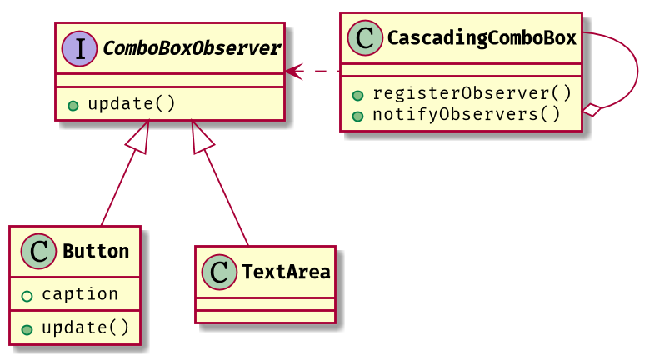
類別圖 v4

Slide 46
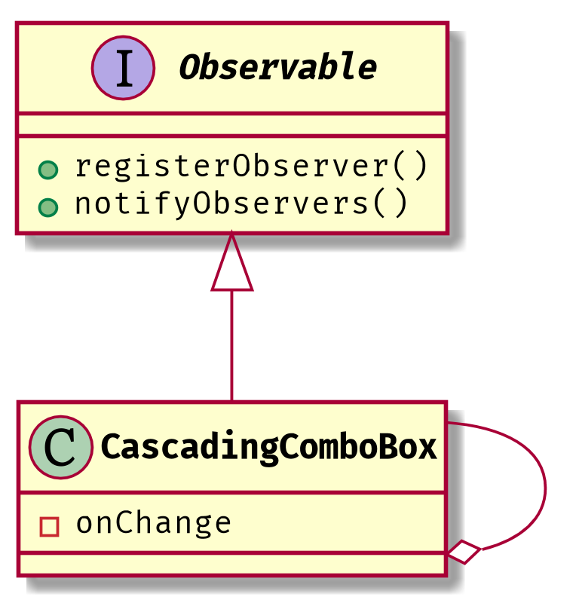
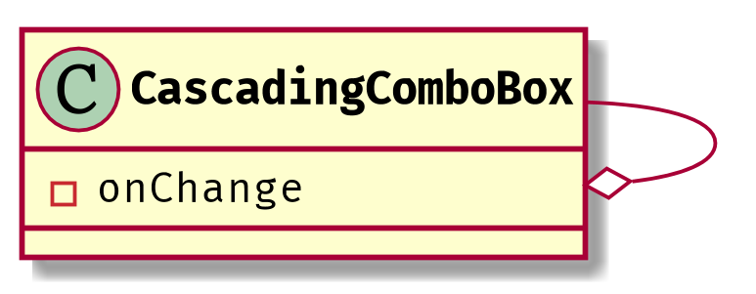
問題
如果將來有其他元件也可以發出訊息

Slide 47
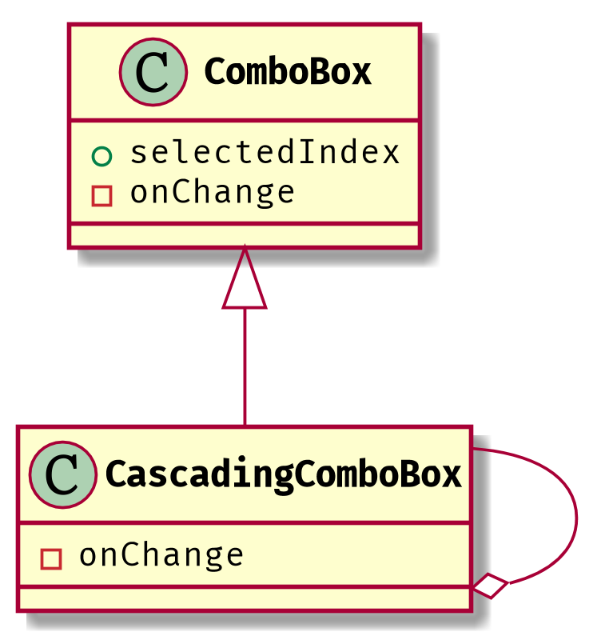
問題
CascadingComboBox 做太多事情

Slide 48
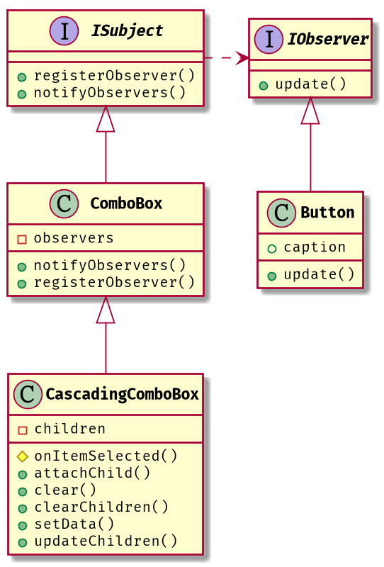
類別圖 v5

Slide 49
問題
JavaScript 沒有 Interface!!!

Slide 50

何謂 Interface?
人 + 蜘蛛服 = 蜘蛛人

Slide 51
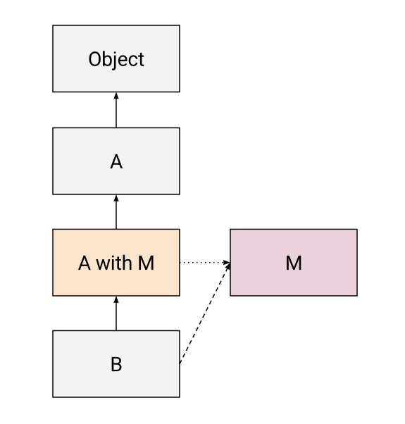
MixIn

Slide 52
IObserver.js
import {ISubject} from "./ISubject"; export const IObserver = (superclass) => class extends superclass { /** * * @param {ISubject} subject */ update(subject) { throw new TypeError('update must be implemented'); } };

Slide 53
IObserver.js
import {IObserver} from "./IObserver"; export const ISubject = (superclass) => class extends superclass { /** * 註冊觀察者 * @param {IObserver} observer */ registerObserver(observer) { throw new TypeError('registerObserver must be implemented!') } /** * 通知觀察者 */ notifyObservers() { throw new TypeError('notifyObservers must be implemented!') } };

Slide 54
Button.js
import {IObserver} from "./IObserver"; export class Button extends IObserver(Object) { constructor(id) { super(); this.domObject = document.getElementById(id); } update(subject) { this.caption = subject.selectedIndex; } get caption() { return this.domObject.innerHTML; } set caption(value) { this.domObject.innerHTML = value; } }

Slide 55
ComboBox.js
import * as SystemUtils from "./SystemUtils"; import {ISubject} from "./ISubject"; import Assert from "assert-js"; export class ComboBox extends ISubject(Object){ constructor(options) { super(); this.domObject = document.getElementById(options.id); Assert.true( SystemUtils.isNotNull(this.domObject), `HTML 元素 ${options.id} 不存在!`); this.itemSelectedCallback = options.onItemSelected; this.createOptionCallback = options.onCreateOption; this.observers = []; this.data = []; this.defaultOptions = []; this.bindEvents(); }

Slide 56
ComboBox.js
/** * 註冊觀察者 * @param {ComboBoxObserver} observer */ registerObserver(observer) { this.observers.push(observer); } /** * 通知觀察者 */ notifyObservers() { /** * @param observer Observer */ this.observers.forEach((observer) => { observer.update(this); }) }

Slide 57
CascadingComboBox.js
import * as SystemUtils from './SystemUtils'; import {ComboBox} from "./ComboBox"; /** * 連動下拉選單 */ export class CascadingComboBox extends ComboBox { /** * @param {Object} options * @property {string} id * @property {createOptionCallback} onCreateOption * @property {itemSelectedCallback} onItemSelected * @constructor */ constructor(options) { super(options); this.children = []; this.data = []; this.defaultOptions = []; }

Slide 58
CascadingComboBox.js
/** * 繫結事件 */ onItemSelected() { super.onItemSelected(); if (this.domObject.selectedIndex === 0) { this.clearChildren(); return; } this.updateChildren(); } /** * 加入子選單 * @param {Attachment} attachment */ attachChild(attachment) { this.children.push(attachment); }

Slide 59
CascadingComboBox.js
/** * 設定資料。 * @param {Object[]} data - 陣列型態的資料 * @param {string[]} defaultOptions - 預設選項 * 如果串接三層， defaultOptions 就要將三層的 key 組成陣列傳入。 * ex: ['GP1601-005', 'GP1611-003', 'GP1611-137'] */ setData(data, defaultOptions) { super.setData(data, defaultOptions); if (this.selectedIndex > 0) { this.updateChildren(); } } /** * 清除選項內容，子選單也會一併清除 */ clear() { super.clear(); this.clearChildren(); }

Slide 60
CascadingComboBox.js
/** * 清除子選單 */ clearChildren() { this.children.forEach( /** * 呼叫子選單的清除功能 * @param {Attachment} attachment */ (attachment) => { attachment.child.clear(); }); }

Slide 61
CascadingComboBox.js
updateChildren() { // 將資料設定到下層選單 this.children.forEach( /** * 呼叫子選單的清除功能 * @param {Attachment} attachment */ (attachment) => { if (SystemUtils.isNull(attachment.onCreateChildData)) { return; } let selectedData = this.data[this.domObject.selectedIndex - 1]; let dataForChild = attachment.onCreateChildData(
selectedData, attachment.child); let selectedKeysForChild = []; if (SystemUtils.isNotEmpty(this.defaultOptions)) { selectedKeysForChild = this.defaultOptions.slice(1); } attachment.child.setData(
dataForChild, selectedKeysForChild, attachment.child); } ) }

Slide 62
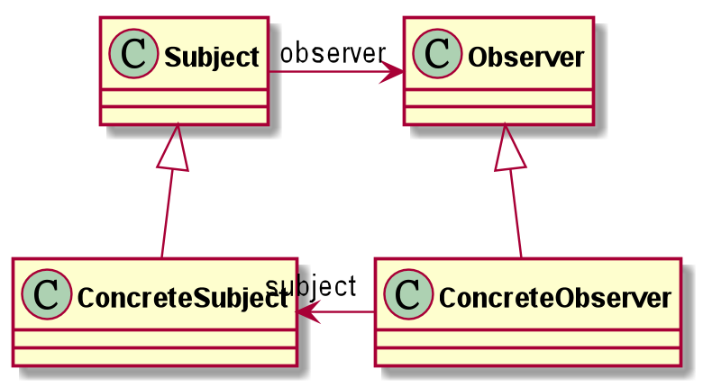
觀察者模式
觀察者模式定義了一種一對多的依賴關係，讓多個觀察者物件同時監聽某一個主題物件，這個主題物件在狀態變化時，會通知所有觀察者物件，使它們能夠自動更新自己。

Slide 63
參考資料
Real MixIns with Javascript classes
http://justinfagnani.com/2015/12/21/real-mixins-with-javascript-classes/

Slide 64
作業 #1
假設你有一個類別 Clock，每一秒鐘會執行 onTick 一次
另外有一個類別 DigitalClock，他接收 Clock 所傳過來的時分秒，並顯示在螢幕上

Slide 65
作業 #1
class Clock {
void onTick(){
}
}
class DigitalClock{
void update(int hours, int minutes, int seconds}
}
}

Slide 66
作業 #1
請用自己熟悉的語言套用 Observer Pattern 讓 DigitalClock 可以顯示 Clock 的內容

Slide 67
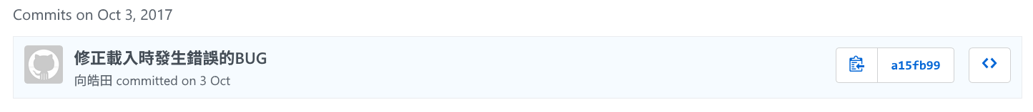
作業繳交方式
繳交內容：程式碼與 Class Diagram，檔案請放在 Github
以 email 寄出，信件標題 DP01-016050
信件內容：master 的 commit 網址
https://github.com/leoshiang/LSMoney/tree/a15fb999930c12fe0bbf3783d5cd37ae0df8d1d6

