Slide 1
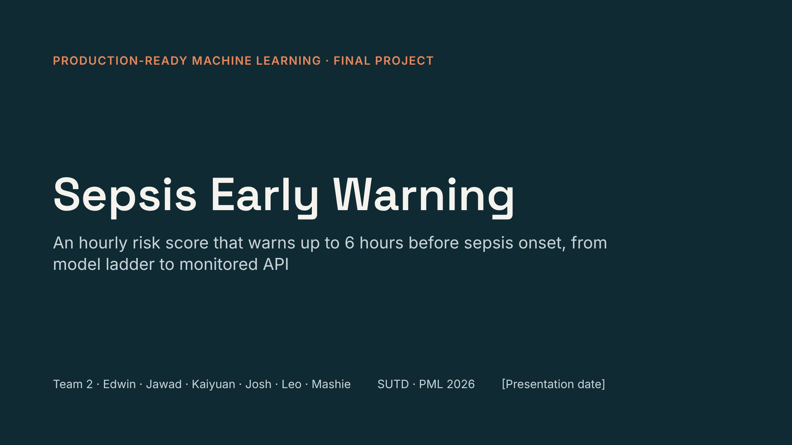
Notes:
Open with the one-line goal: an hourly risk score that warns before onset, built with course techniques and shipped as a monitored service. Each owner presents their own slides.

Slide 2
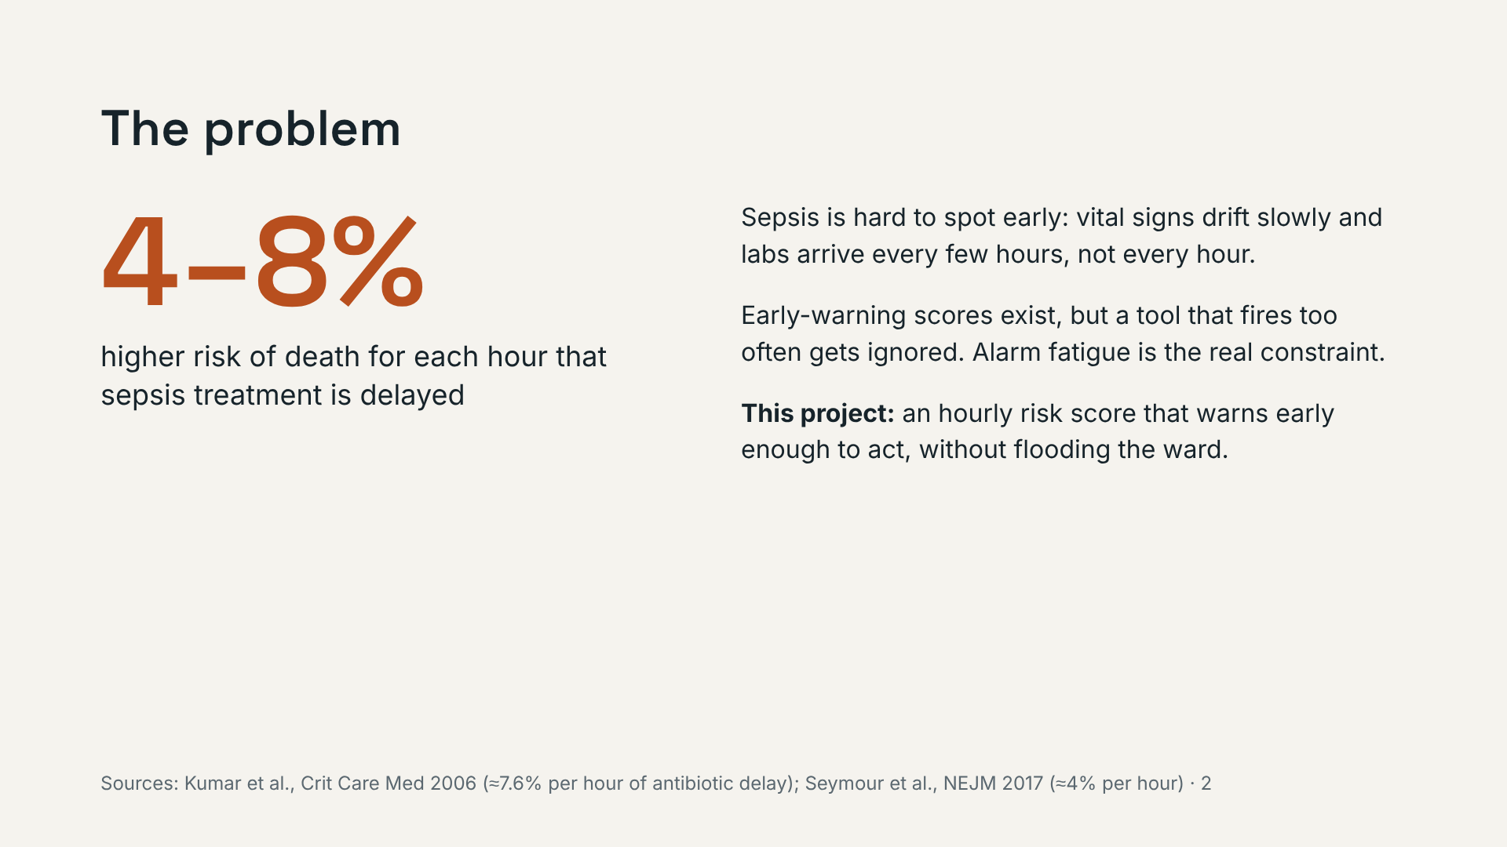
Notes:
Frame it as a timing problem plus an alarm-fatigue problem. Both shape the metric on the next slide.

Slide 3
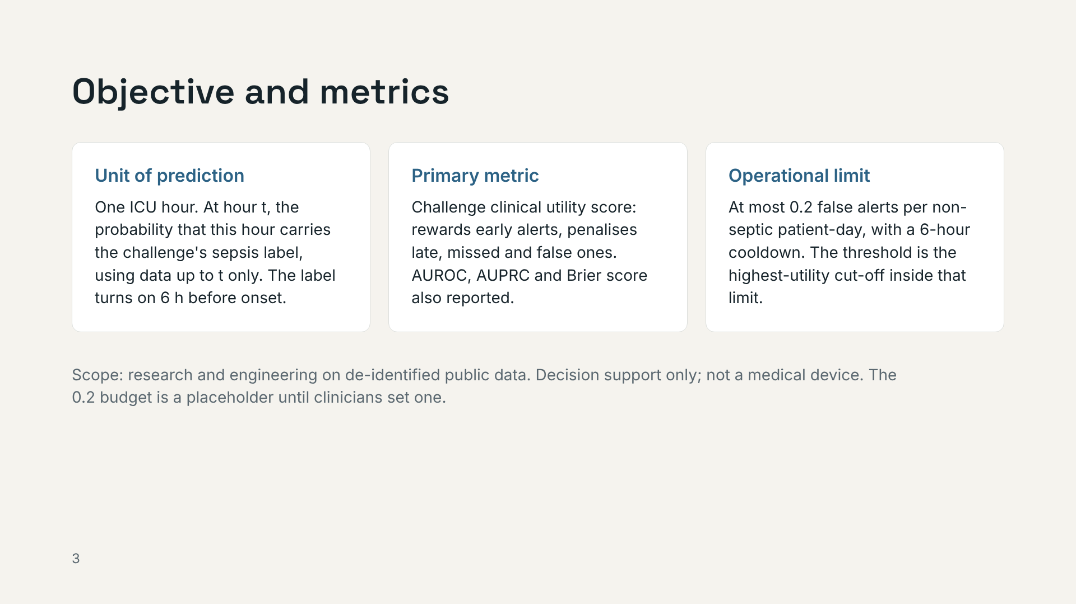
Notes:
The score is not "probability of onset in the next 6 hours": the label stays on after onset, so say "the challenge label". The alert budget, not AUROC, decides whether this would be usable. Without a cooldown, a patient above threshold for five hours would count as five alarms; clinically it is one.

Slide 4
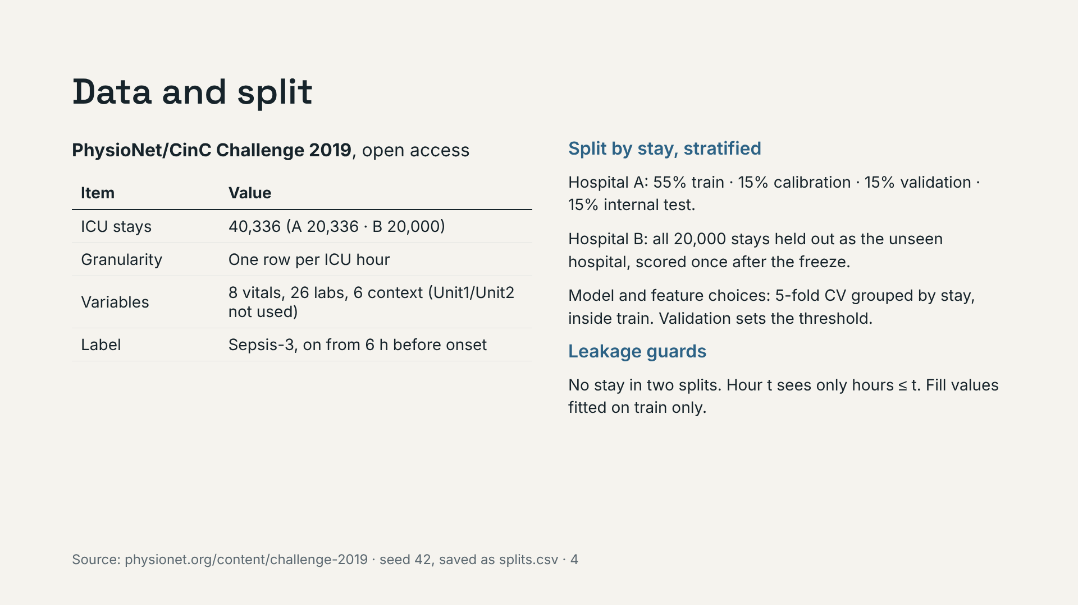
Notes:
A record is an ICU stay, not a person; the dataset has no person ID. Grouped CV inside train is being added under K01–K03; if it is not finished by the presentation, say choices were made on the validation split. Hospital B doubles as the drift scenario later.

Slide 5
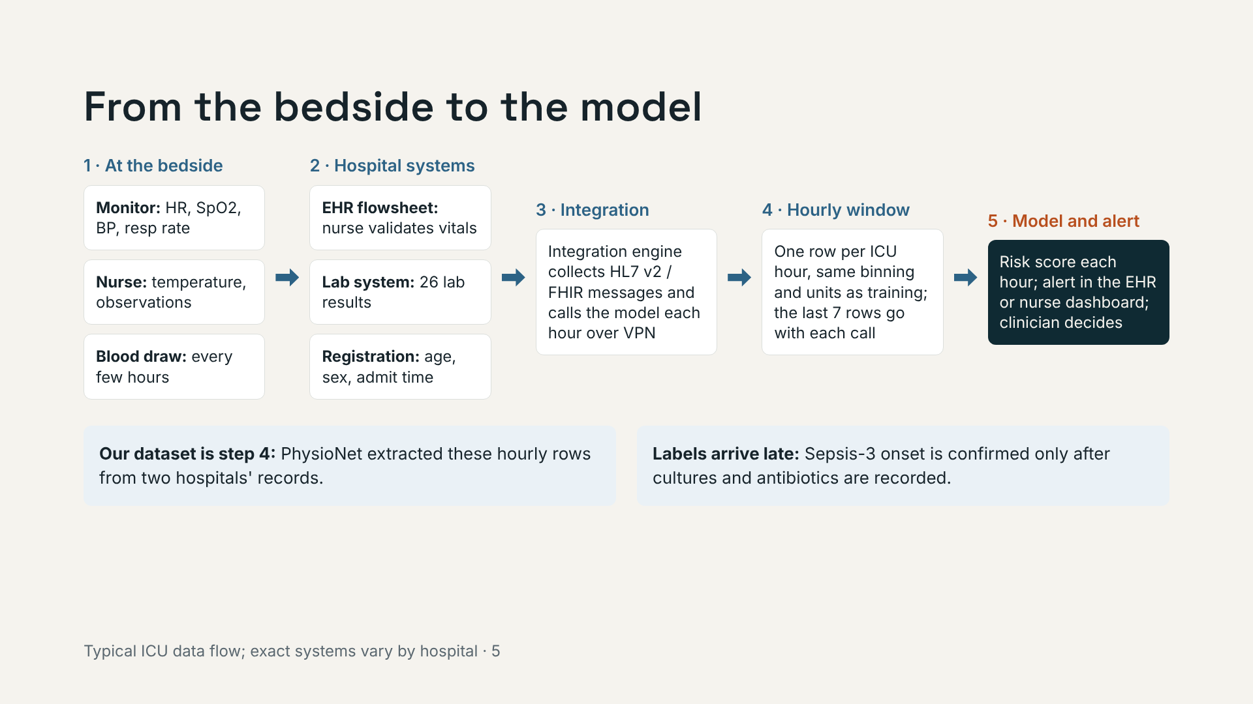
Notes:
Walk left to right. Two points matter for the model: labs are sparse because blood is drawn every few hours, and the true label is only known later, which is why monitoring has two speeds.

Slide 6
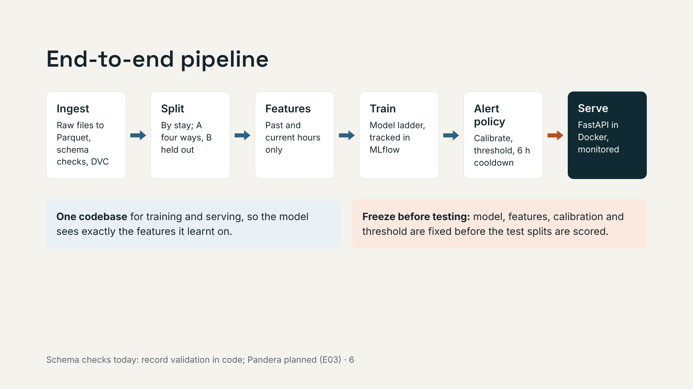
Notes:
Point out the shared feature code: the most common production ML bug is training/serving skew. The orange arrow is the freeze: everything to its left is decided on train, calibration and validation only.

Slide 7
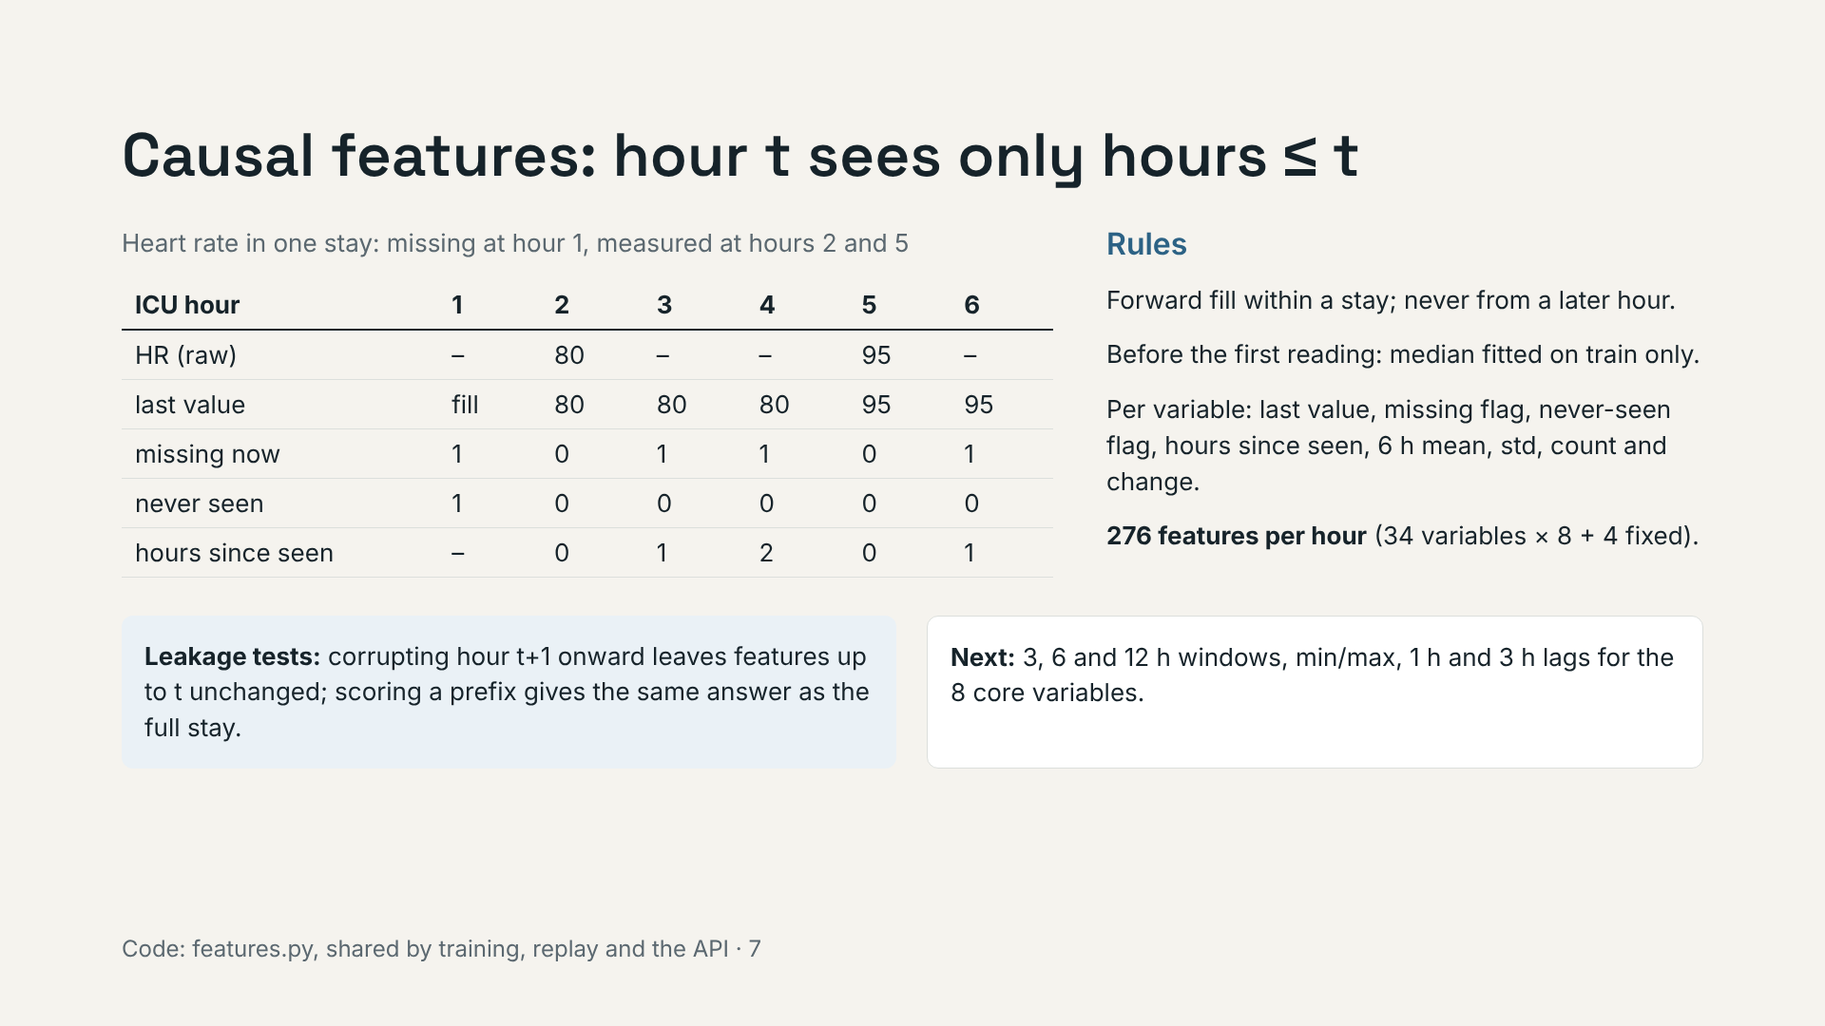
Notes:
Missingness is information: labs are ordered when a clinician is worried, so "measured now" and "hours since measured" carry signal. But measurement habits differ between hospitals, which matters at hospital B. Label the multi-window features as planned unless they are merged by the presentation.

Slide 8
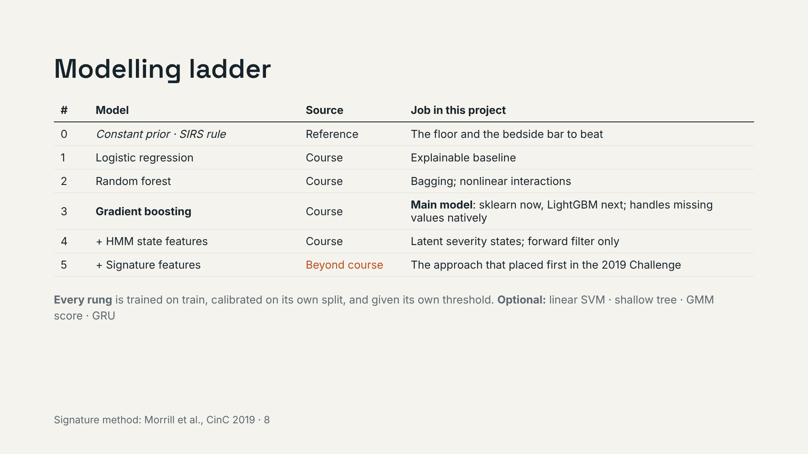
Notes:
Each rung must beat the one below in grouped CV inside train to earn its place. Rungs 4 and 5 are add-on feature sets for the gradient-boosting model, each tested with and without.

Slide 9
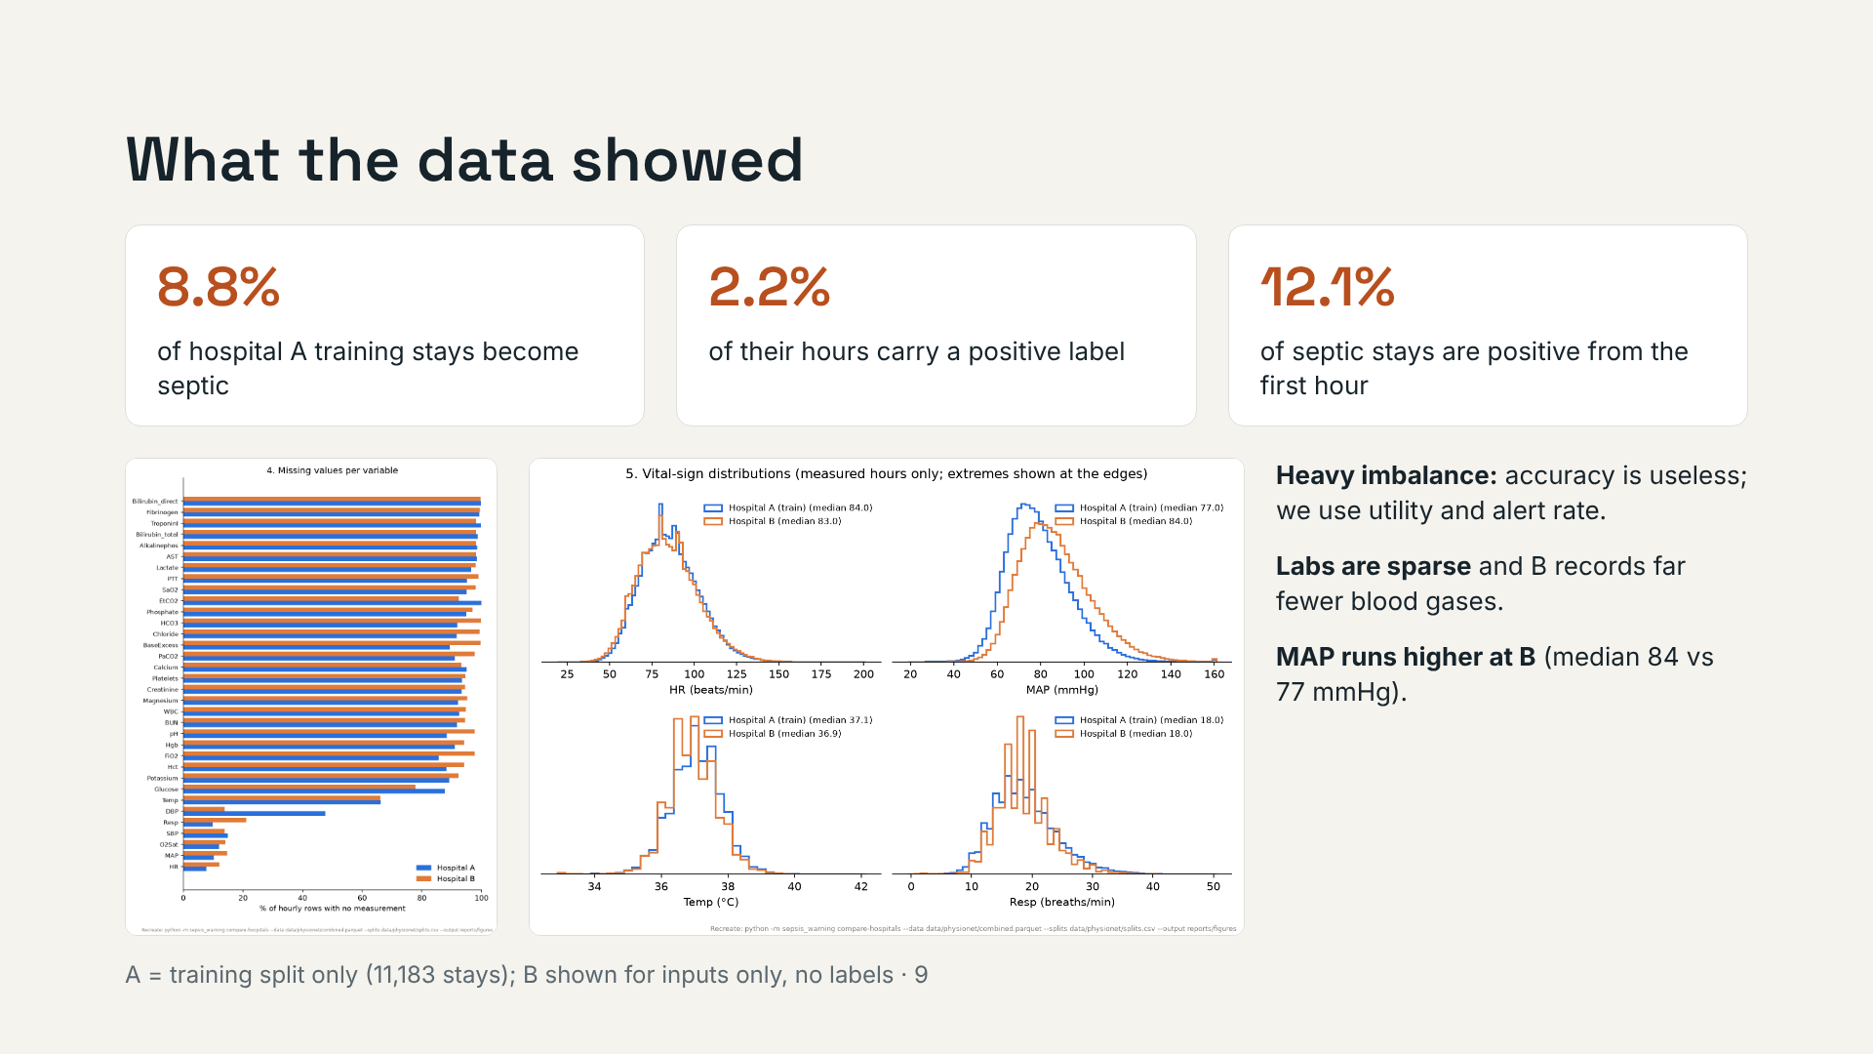
Notes:
Only hospital A's training split is explored, so nothing here peeks at A's test stays. Hospital B appears only through its inputs (missingness and vitals), which a deployed system would see anyway; B's labels stay untouched until the final test.

Slide 10
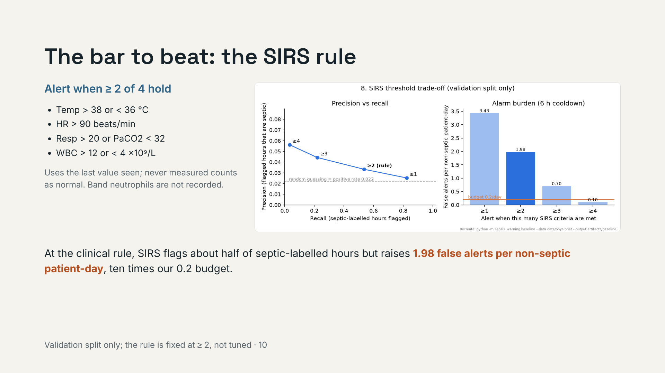
Notes:
SIRS is never trained, so it uses no data to fit. It goes through the same threshold, cooldown and metric code as the models. The sweep over 1 to 4 criteria is descriptive: the rule stays at 2.

Slide 11
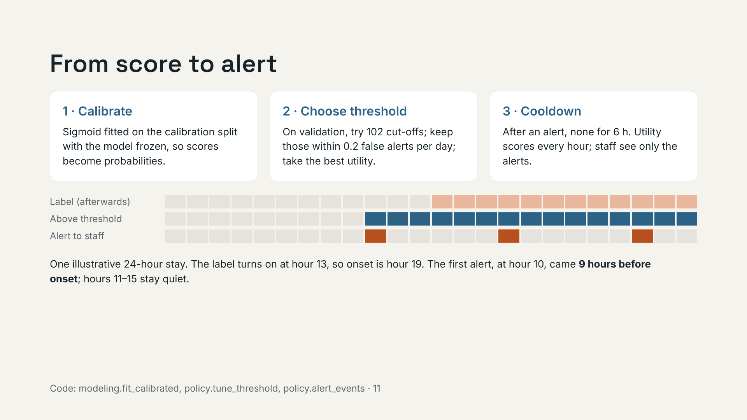
Notes:
Two different counts: hourly decisions are what the PhysioNet utility scores; alerts with the cooldown are what a nurse would see, and what the alert budget limits. The label is never shifted again: onset is inferred as first label hour plus 6.

Slide 12
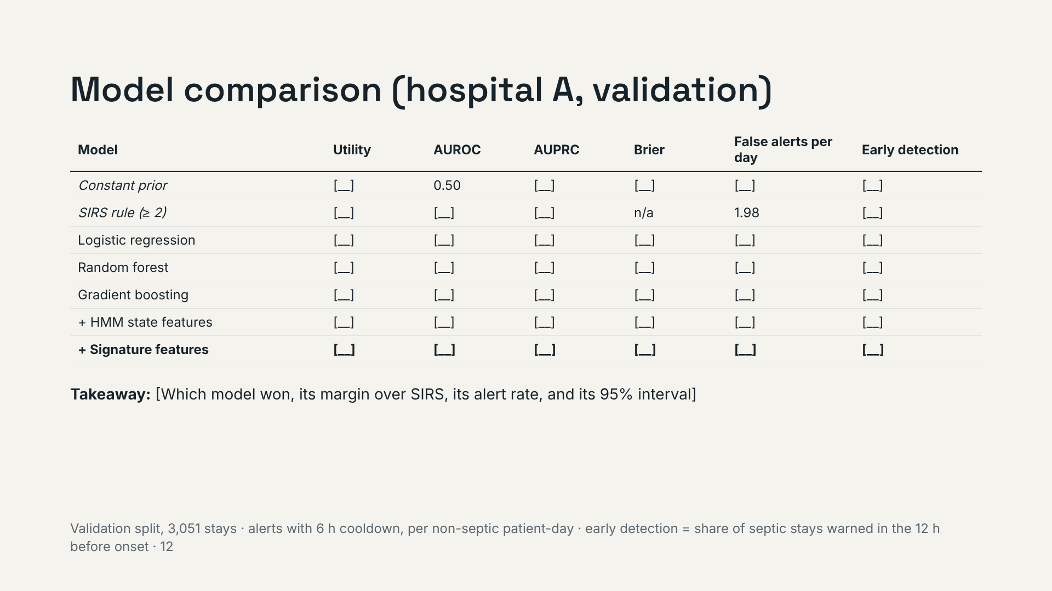
Notes:
Read the winner and its alert rate, not every cell. The winner is the highest utility within the 0.2 alert budget, then fewest false alerts, then AUPRC. Add bootstrap intervals by stay: with about 270 septic stays, small differences are noise. SIRS has no Brier score because its score is not a probability.

Slide 13
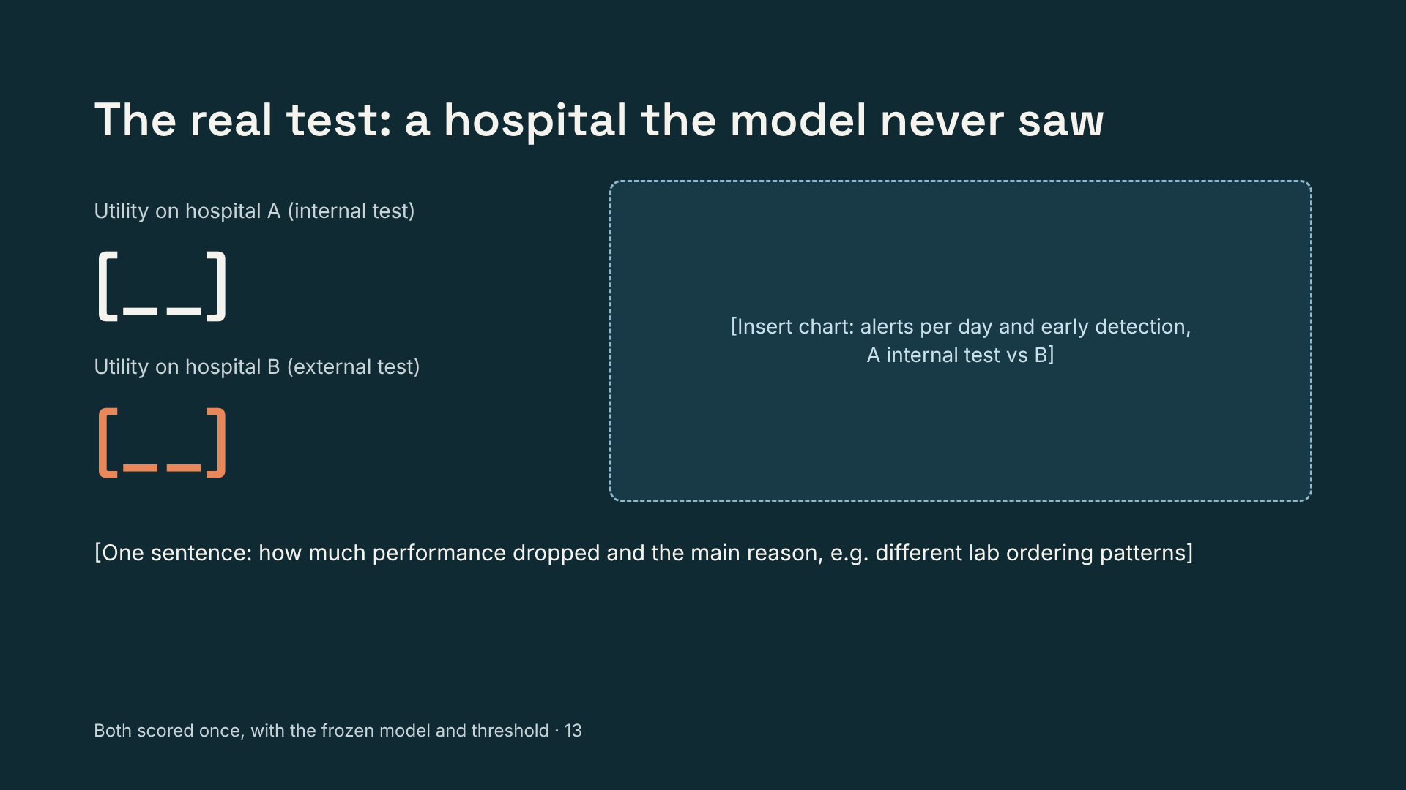
Notes:
This is the slide most sepsis projects skip. Cross-hospital generalisation was the hardest part of the original Challenge too. Expect calibration to run high at B: the model was calibrated where 8.8% of stays are septic, and B has 5.7%. Report the drop; do not retune on B.

Slide 14
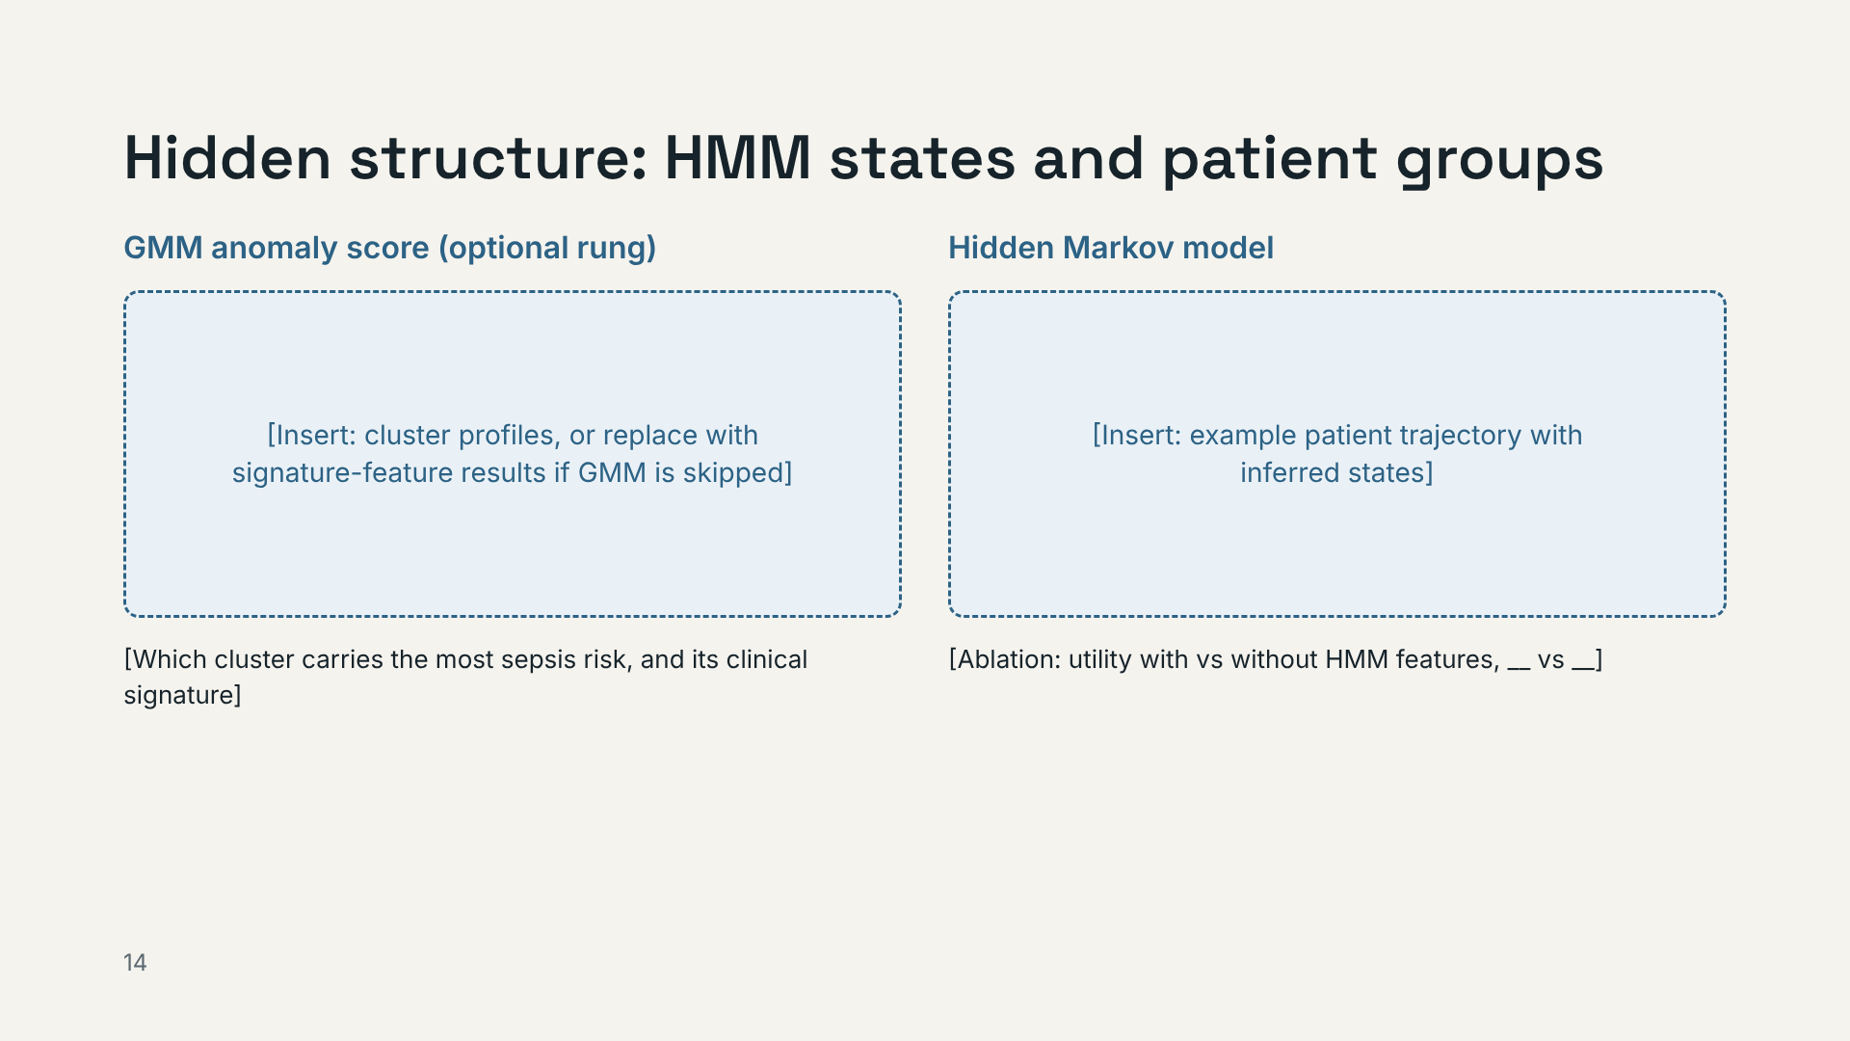
Notes:
Be honest if the HMM adds little: published work found high variation between patients limits HMMs used alone. Its value may be the interpretable trajectory view.

Slide 15
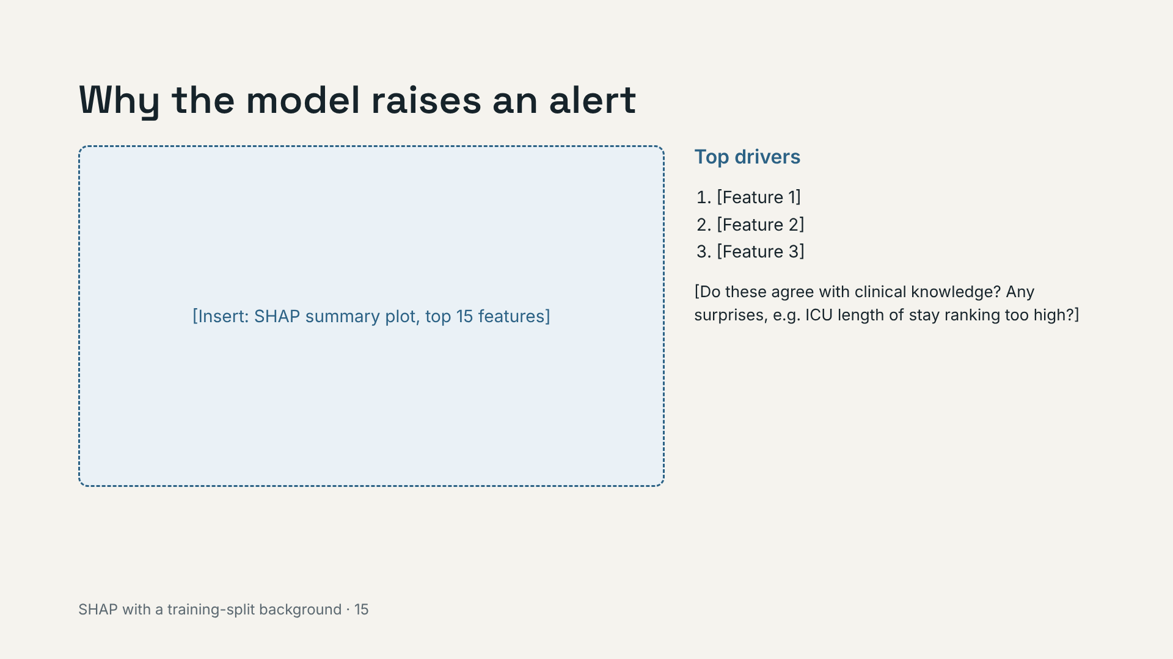
Notes:
Every API response returns its top three contributing features (top_features), so a clinician can see why an alert fired. These are associations the model uses, not causes.

Slide 16
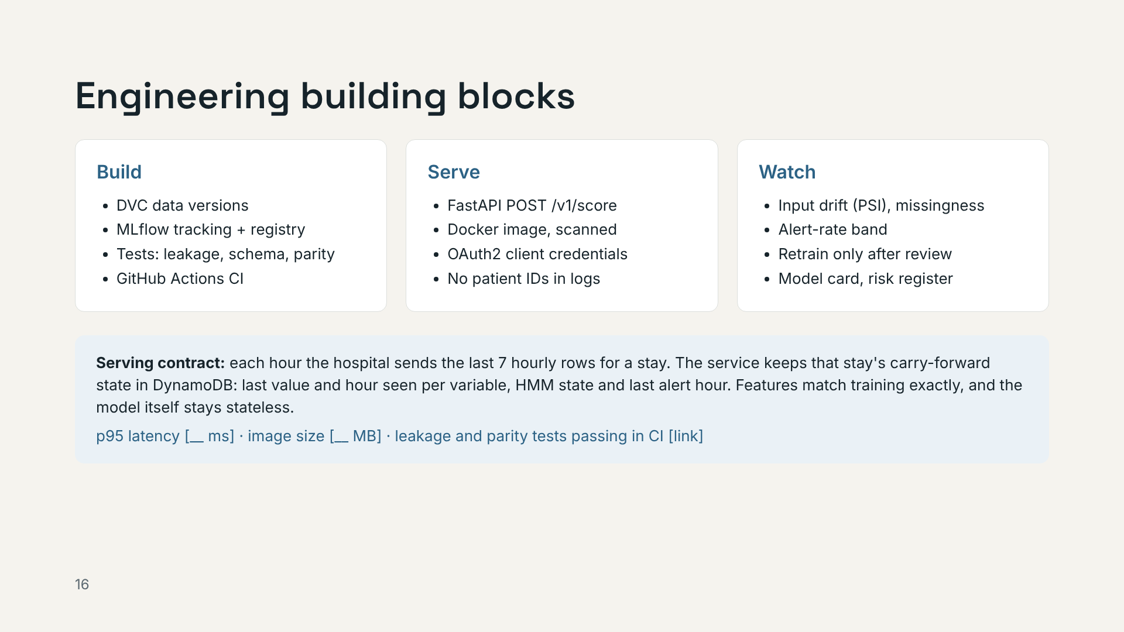
Notes:
Why 7 rows plus state, not "the last 24 hours": a lab measured 30 hours ago is still the last lactate, and the HMM state depends on the whole stay. Sending a window alone would give different features from training. Demo point: one command reproduces the model, the container and the monitoring report.

Slide 17
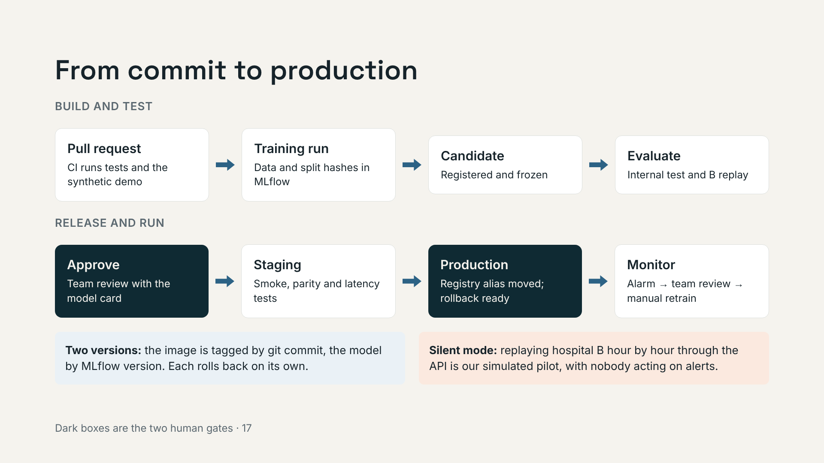
Notes:
Nothing retrains or redeploys automatically. Parity means the API gives exactly the same scores as the batch replay for the same stay. Staging uses synthetic stays only.

Slide 18
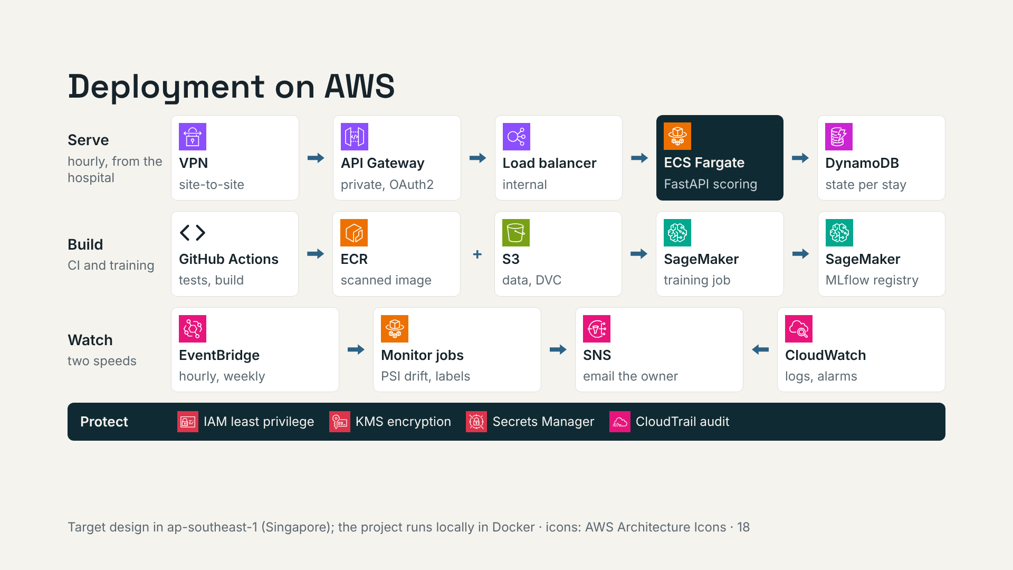
Notes:
Read the top row left to right: the hospital's integration engine sends the last 7 hourly rows over the VPN to a private API Gateway, which checks the OAuth2 token and forwards to the scoring service on Fargate. The service reads and writes each stay's carry-forward state in DynamoDB. The same Docker image from ECR runs SageMaker training and the API. Monitoring alarms email the owner; retraining needs team approval. Before any real use, check data-residency and health-data rules in the hospital's country.

Slide 19
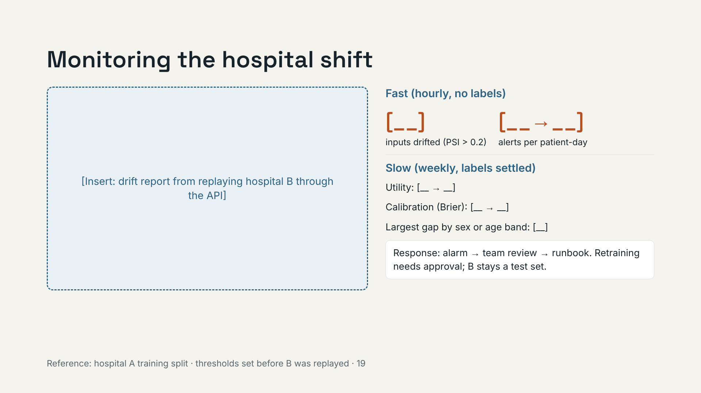
Notes:
Sepsis labels settle hours or days later, so input drift and alert rate are the early signals; utility and calibration confirm weekly. Drift in inputs does not prove performance dropped; the slow checks decide that. We show detection and the runbook, not retraining on B: retraining on B would make B no longer a fair test.

Slide 20
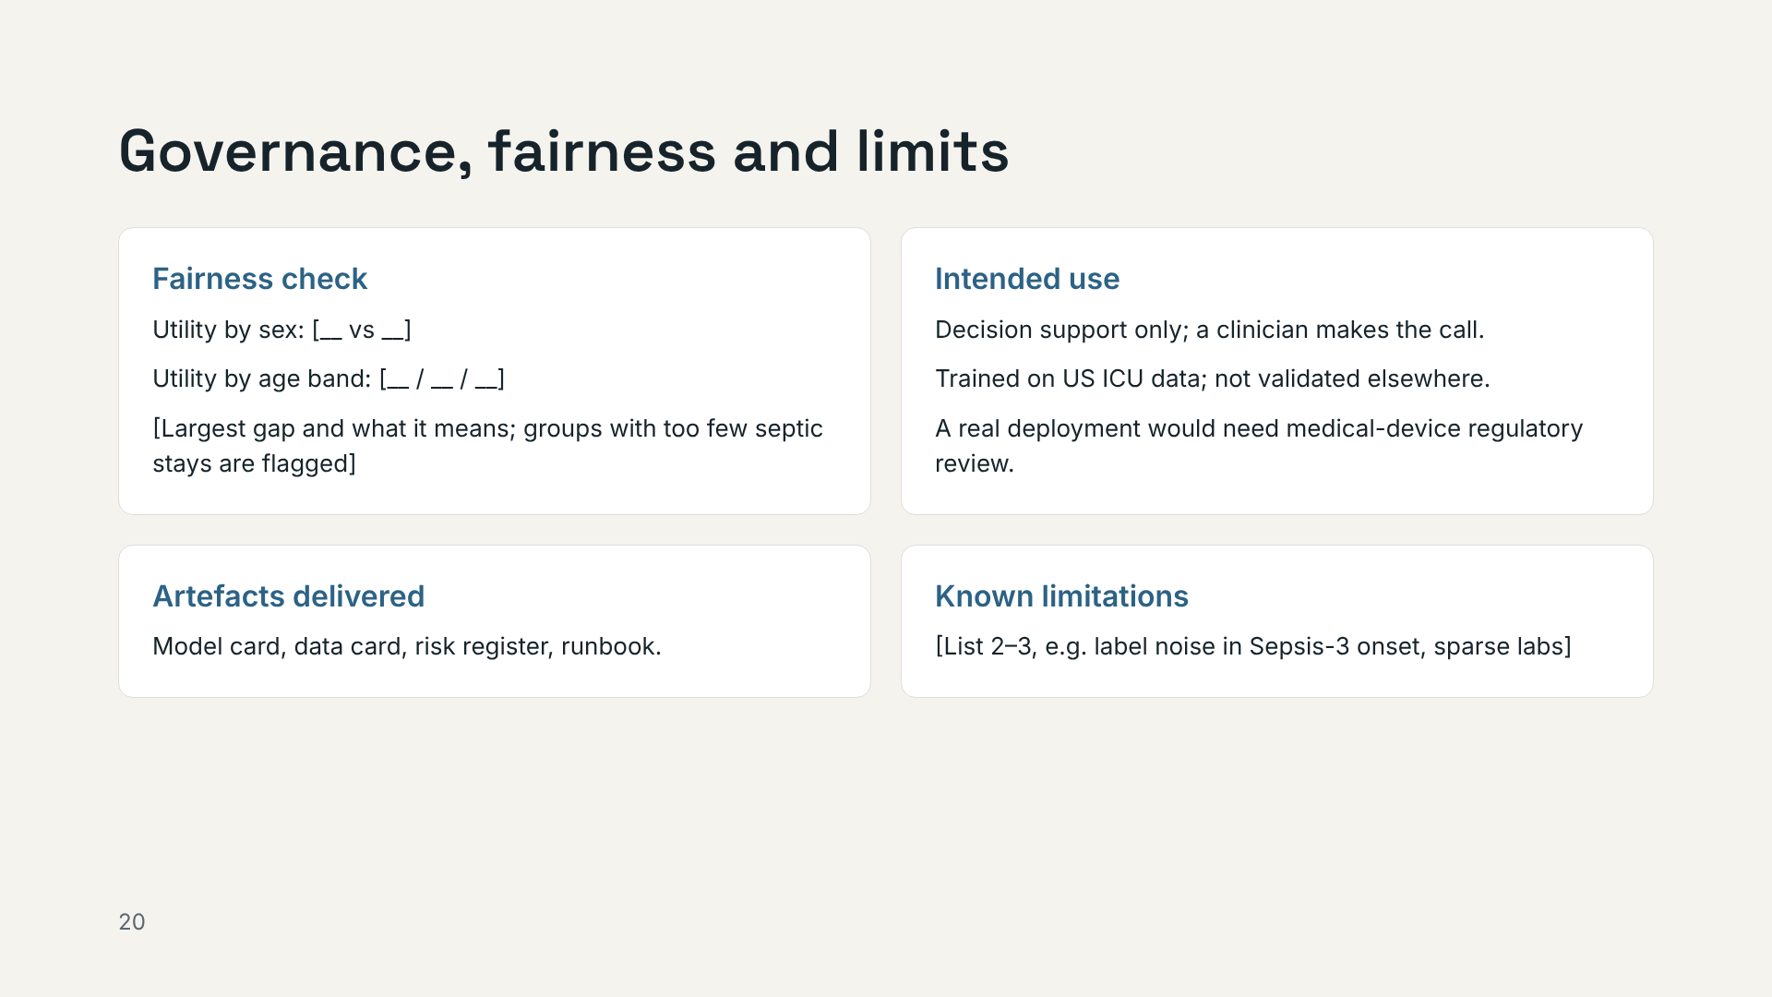
Notes:
Framed the way an architecture review board would ask: who uses it, what can go wrong, how we would know.

Slide 21
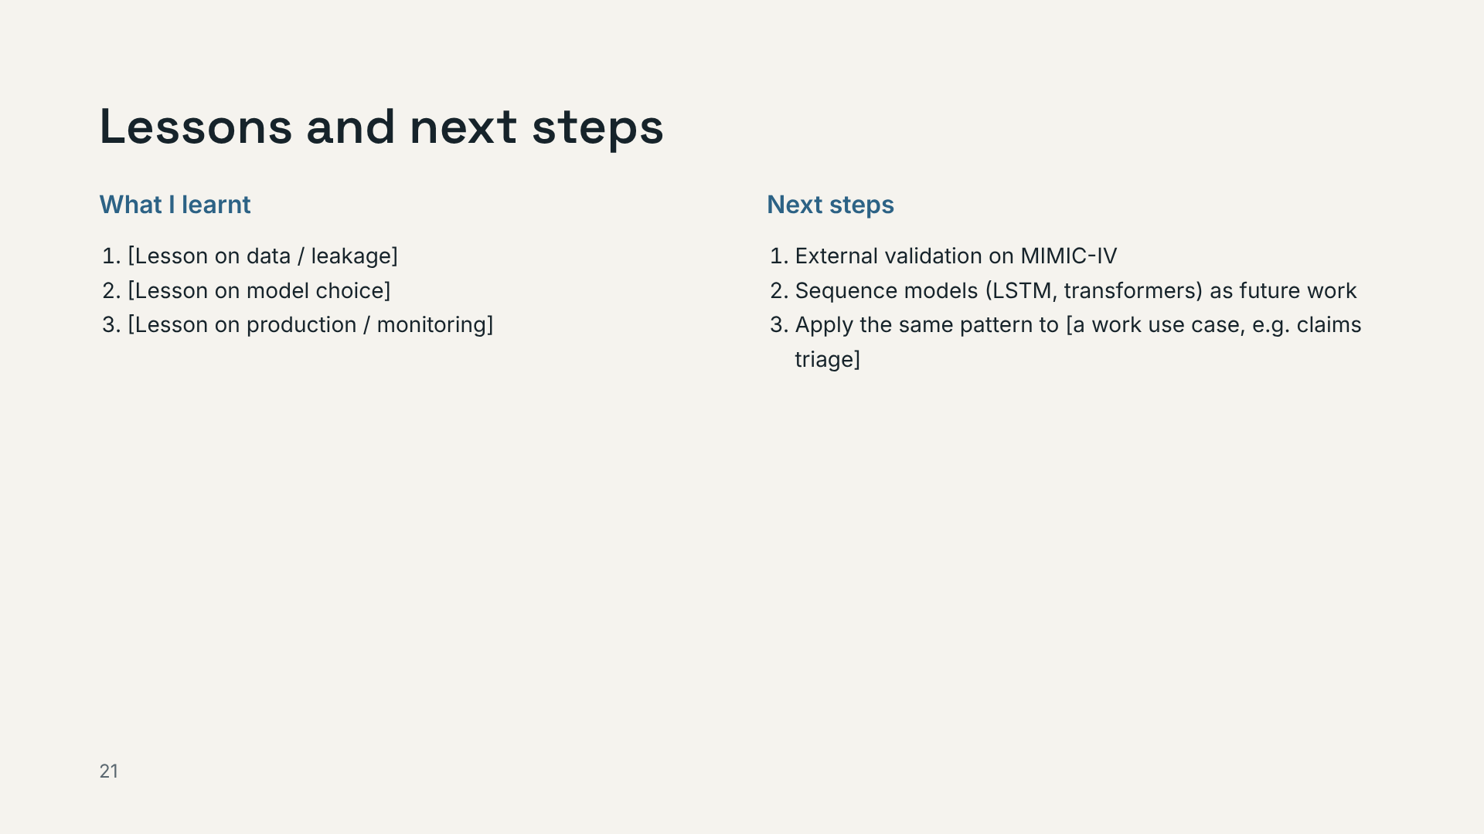
Notes:
Close the loop to work: hourly risk scoring, drift monitoring and explainability for a regulator transfer directly to insurance.

Slide 22
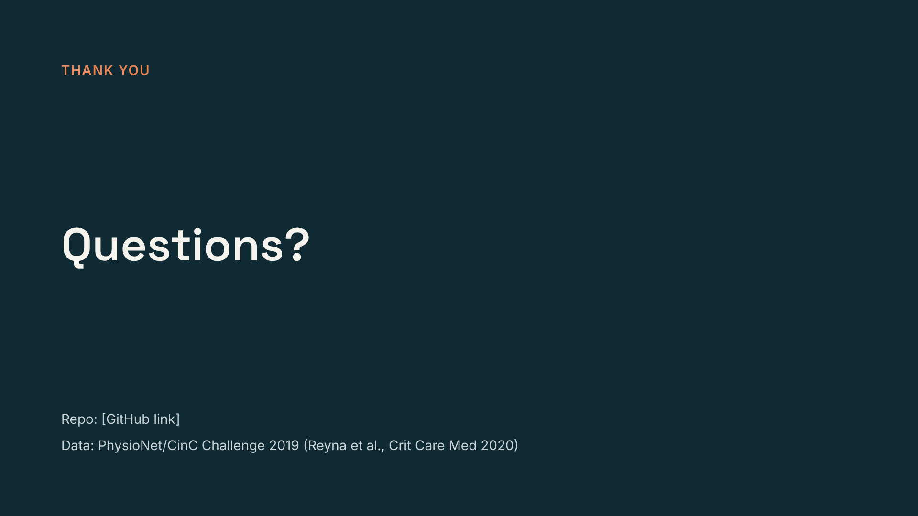
Notes:
Have the Docker demo ready in a terminal in case someone asks to see it run.

