Slide 1





Creative Nonfiction
The
Main Literary Genres

Slide 2




Introduction

Slide 3
To begin with, let’s say you want to read something. You go to a bookstore or go to a library.
You stop at the edge of the bookstore and stare for while. Apart from books, what do you notice on the shelves?
Yes, Labels

Slide 4

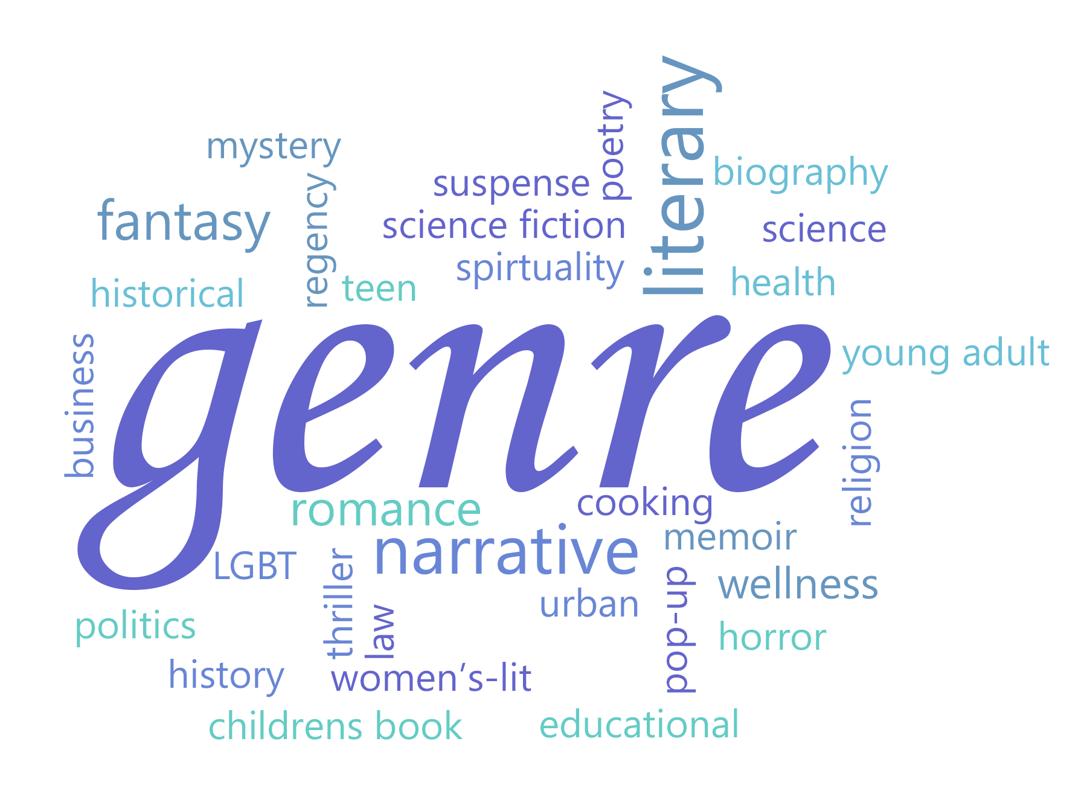

What is a Genre?
a category of artistic, musical, or literary composition characterized by a particular style, form, or content.

Slide 5
What are Literary Genres?
Are categories, types, or collections of literature. They often share characteristics such as subject matters or topic, style, form, purpose, and audience.

Slide 6
By understanding genre, you cannot only find more things to read, you can better understand what the writer is trying to accomplish.

Slide 7
Writers can choose from a wide range of genres in literature to suit their personal interests and writing styles. A genre of literature is a classification that describes the content, tone, and style of a writer's work. Understanding the different genres of literature can help you decide what type to pursue as a writer.

Slide 8




The 5 Main Literary Genres
Fiction
Drama
Non
fiction
Prose
Mystery
Historical Fiction
Realism
Magical Realism
Fantasy
Romance
Science Fiction
Dystopian
Horror
Fable
Mythology
Poetry
Tragedy
Comedy
Musical
Melodrama
Autobiography
Biography
Essay
Epic
Narrative
Lyric
Dramatic

Slide 9







01
poetry
01

Slide 10




poetry
01
A poem's meter, rhythm, and its focus on the sounds of syllables, words, and phrases distinguish it from other types of literature.
A poem is a piece of literature that makes use of rhythmic qualities of language, such as phonesthetics, sound symbolism, and meter to convey meaning.

Slide 11
01
Subgenres of Poetry
01

Slide 12
epic
Epic: Epics are long-verse narratives retelling the heroic journey of an individual or a group of individuals. An epic typically features superhuman feats, extraordinary adventures, highly stylized language, and a combination of lyrical and dramatic elements.

Slide 13
examples
Beowulf
Lam-ang
The Odessey
Gilgamesh Epic
The Iliad

Slide 14
narrative
A narrative poem tells a story through poetic techniques, such as rhyme, rhythm, similes, and metaphors. Narrative poems are longer than other forms of poetry and contain a complete story similar to a novel.

Slide 15
examples
The Raven By Edgar Allan Poe
On Dinosaur Island by Kenn Nesbitt

Slide 16
lyric
Lyric poems are short, highly musical verses that express powerful emotions. A lyric poem is a personal expression of emotion written by a single individual.

Slide 17
examples
I felt a Funeral in my Brain my Emily Dickinson
Whose list to Hunt by sir Thomas Wyatt
The Road Not Taken By Robert Frost

Slide 18
dramatic
Dramatic poetry is poetry that's written in verse for public recitation or performance. The purpose of dramatic poetry is often to express one's thoughts aloud to another actor, oneself, or an audience.

Slide 19
examples
Paradise Lost by John Milton.
”The Seven Ages of Man” by William Shakespeare.
”Poetics” by Aristotle.
”Ulysses” by Alfred Tennyson.

Slide 20
02
fiction
01

Slide 21
fiction
01
There are several purposes for fiction, including entertaining, inspiring, informing, and persuading the audience. Fiction writers create stories using their imagination.
use figurative language to create stories of completely untrue events, characters, and settings to stimulate the imaginations of their readers.

Slide 22
02
Subgenres of Fiction
01

Slide 23
mystery
Mystery novels provide readers with plots that explore mysteries from beginning to end. One of the main characters in a mystery is typically a detective or a private investigator who solves the mystery with the reader.

Slide 24
examples
The Girl with the Dragon Tattoo
Perfume
Murders in the Rue Morgue

Slide 25
Historical fiction
Historical fiction uses real-life events to support its plots and key details. A work of historical fiction engages readers by retelling a historical event in creative ways that alter minor details, such as characters' names or the setting.

Slide 26
examples
Tomb Raider
National Treasure
The Pillars of the Earth

Slide 27
realism
Literary realism depicts familiar objects, people, and places without dramatizing or romanticizing the story. Literary realism emphasizes realistic characters and settings, detailed descriptions of everyday occurrences, and depictions of social classes.

Slide 28
examples
The Adventures of Huckleberry Finn By
Mark Twain

Slide 29
magical realism
Magical realism is a genre of literature that depicts reality with a sense of fantasy or magic. A magic realism story is a variation of realism fiction.

Slide 30
examples
Edward Scissorhands
Amelie

Slide 31
fantasy
Fantasy novels usually depict imaginary settings, beings, and universes that are nonexistent in the real world.

Slide 32
examples
The Lord of the Rings
The Wizard of Oz
The Chronicles of Narnia
Harry Potter Series

Slide 33
romance
Love stories are the dominant theme of romance novels. Although romance is also a prominent element of other forms of fiction, romance novels emphasize the development of a romantic relationship.

Slide 34
examples
The Notebook
A Walk to Remember
Titanic
Brokeback Mountain

Slide 35
Science fiction
There are several themes that are characteristic of science fiction, including space exploration, futuristic species, and time travel. Most of the stories revolve around scientific concepts, such as physics, astronomy, anthropology, chemistry, and astrophysics.

Slide 36
examples
Back to the Future
ET
Madmax
Splice
Jurrasic Park

Slide 37
dystopian
A dystopian story envisions a world that's in a state of cataclysmic decline. A dystopian fiction can depict societies with perpetual wars, social and economic class divisions, mass poverty, environmental destruction, anarchy, and loss of individuality.

Slide 38
examples
The Hunger Games
Divergent
The Blade Runner

Slide 39
horror
The primary goal of horror fiction is to shock and frighten readers. A horror story involves characters, settings, and plots that create suspense and tension for the reader.

Slide 40
examples
The Exorcist
Ginger Snaps
The Conjuring
The Nun

Slide 41
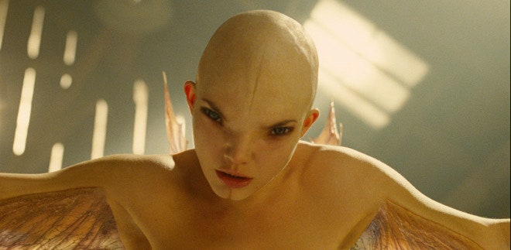
examples

Slide 42
fable
Fables typically teach a moral lesson to the reader or illustrate a moral dilemma that the protagonist overcomes. An author may use inanimate objects or animals as protagonists who act like humans to resolve conflict in a manner that demonstrates character development.

Slide 43
examples
The Tortoise and the Hare
The Lion and the Mouse
The Fox and the Crow

Slide 44
mythology
The mythological genre reveals elements of human behaviour through the use of symbols. Mythology includes themes such as gods, goddesses, and cultural phenomena.

Slide 45
examples
Greek Mythology
Philippine Mythology
Norse Mythology

Slide 46





03
nonfiction
01

Slide 47
nonfiction
01
Students can gain a deeper understanding of fiction texts through nonfiction texts, such as textbooks and essays. Before writing a nonfiction piece, nonfiction authors typically conduct extensive research.
Nonfiction writing aims to inform or inspire the audience by using actual events, people, places, or facts.

Slide 48
02
Subgenres of Nonfiction
01

Slide 49
autobiography
An autobiography is a personal narrative of one's life. Autobiographies may serve a variety of purposes, such as helping the author overcome a difficult situation, assisting people in overcoming similar challenges, or simply conveying stories.

Slide 50
biography
A biography is an account of a person's life, written by someone else. Many biographies feature notable individuals, such as celebrities, athletes, business leaders, and politicians.

Slide 51
essay
An essay is a short piece of writing in which the author elaborates on an idea or topic after conducting thorough research. An essay may aim to engage its readers, influence their thinking, get them involved in its ideas, or persuade them to adopt the same point of view.

Slide 52
04
drama
01

Slide 53
drama
A drama contains dialogue, and the actors portray the characters through their impersonations. A dramatic piece of literature contains acts or scenes that rely on props or imaginative dialogue to create a visual experience.
01
The performance of a dramatic piece of literature may occur on stage in front of a live audience or through radio, film, and television.

Slide 54
04
Subgenres of Drama
01

Slide 55
tragedy
Tragedies focus on hardships that can cause emotional distress to the protagonists of the story. Tragedies contain details that illustrate the challenges that the protagonist experiences.

Slide 56
comedy
A comedy is a type of drama with a humorous tone that depicts amusing events in which the characters ultimately prevail. A comedy features a lighthearted tone, clever wordplay, turns of phrase, and humorous discussions of serious topics.

Slide 57
musical
A musical can be an original work or an adaptation of a longer literary work. Musical dramas tell a story through music and include direct expressions of themes through song.

Slide 58
melodrama
Melodramas are pieces of dramatic literature that depict serious stories. A melodrama may contain heroes, heroines, villains, and mentors with flaws who overcome their limitations to achieve success.

Slide 59
05
prose
01

Slide 60
prose
Instead of relying on rhythmic structure, as in traditional poetry, it relies on a natural flow of speech and ordinary grammatical structure.
It involves clear, concise paragraphs that may be fiction or nonfiction. When writing prose, writers divide the text into paragraphs and use regular grammar that can be serious or humorous.
01
The prose is a literary genre with no formal metrical structure.

Slide 61
Thank you for listening
01

