Slide 1

Joint interpolation of 3-component GPS velocities constrained by elasticity
Leonardo Uieda, David Sandwell, and Paul Wessel
Department of Geology and Geophysics, SOEST, University of Hawaii at Manoa
Feel free to photograph and share this presentation. doi:10.6084/m9.figshare.6387467
SE21-A023 - AOGS - 2018/06/05

Slide 2
GPS
Interpolation

Slide 3
Single component:
Splines (Sandwell, 1987, Wessel & Bercovici, 1998, etc)
GPS Imaging (Hammond et al, 2016) and many others...
Multi-component:
Finite-element elastic Green's functions
(Haines et al., 2015)
Analytical elastic Green's functions
(Sandwell & Wessel, 2016)

Slide 4
Single component:
Splines (Sandwell, 1987, Wessel & Bercovici, 1998, etc)
GPS Imaging (Hammond et al, 2016) and many others...
Multi-component:
Finite-element elastic Green's functions
(Haines et al., 2015)
Analytical elastic Green's functions
(Sandwell & Wessel, 2016)

Slide 5
Single component:
Splines (Sandwell, 1987, Wessel & Bercovici, 1998, etc)
GPS Imaging (Hammond et al, 2016) and many others...
Multi-component:
Finite-element elastic Green's functions
(Haines et al., 2015)
Analytical elastic Green's functions
(Sandwell & Wessel, 2016)

Slide 6
3D elastic Green's functions

Slide 7
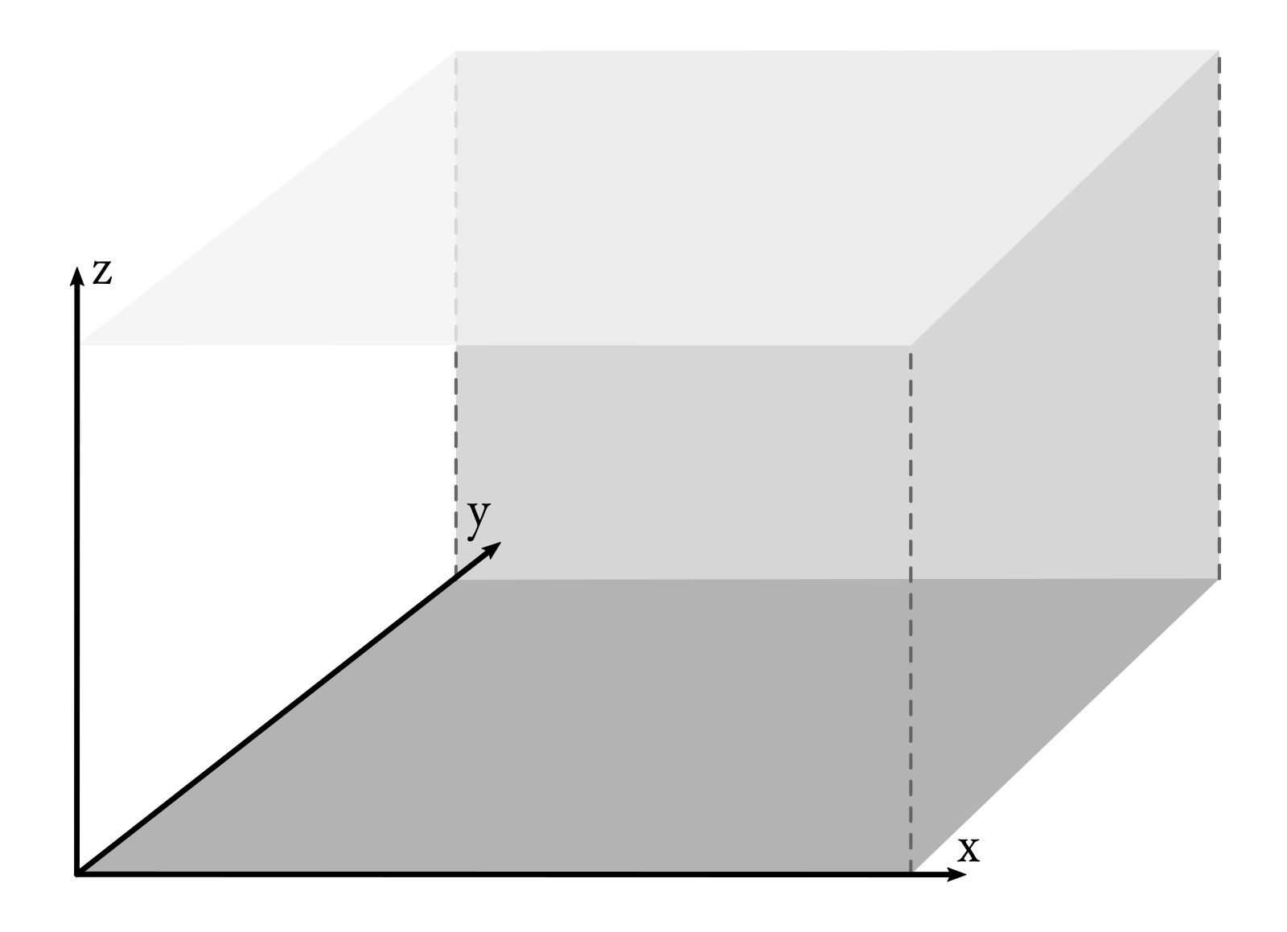

Slide 8
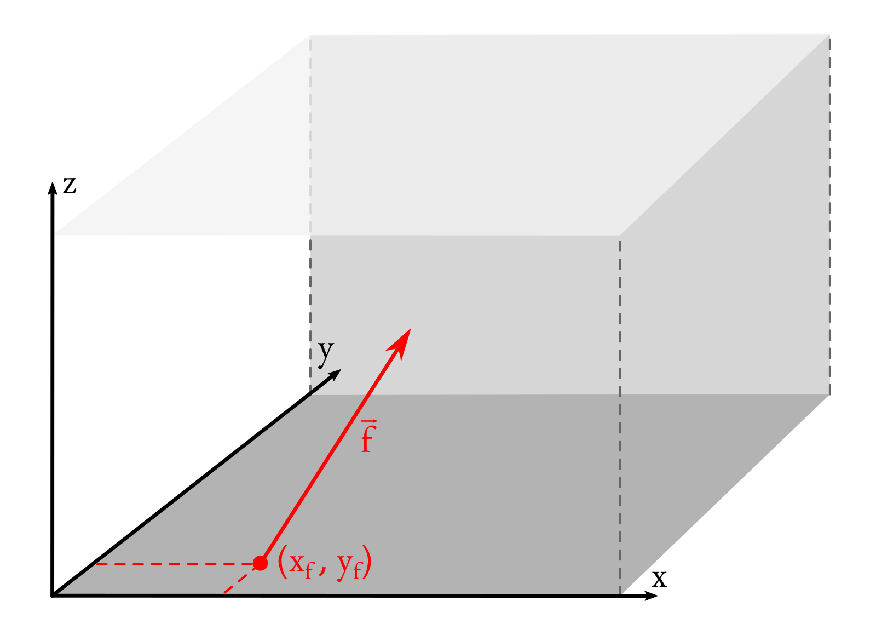

Slide 9
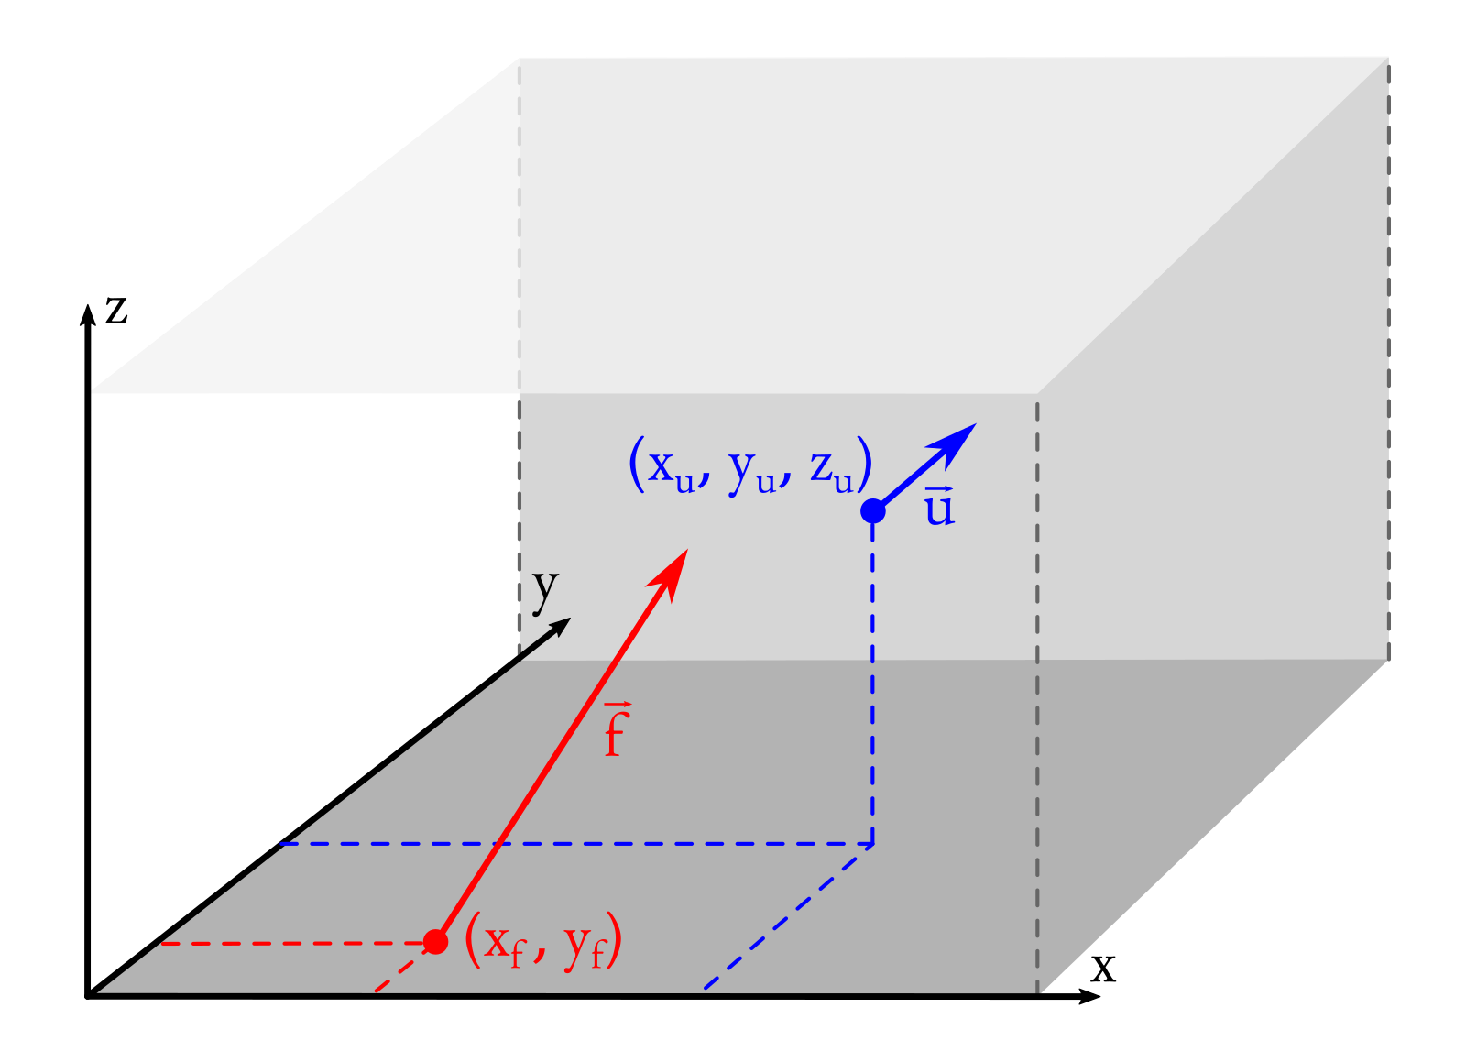

Slide 10
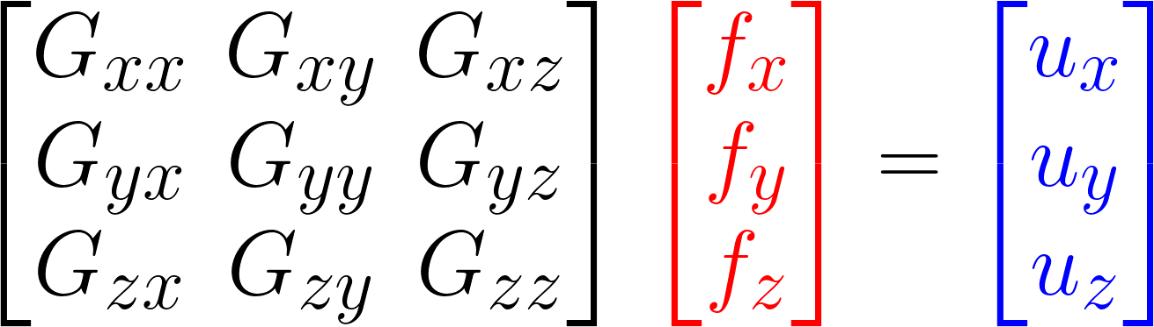

Slide 11
Green's functions
(Okumura, 1995)

Slide 12
Green's functions
force
displacement
(Okumura, 1995)

Slide 13
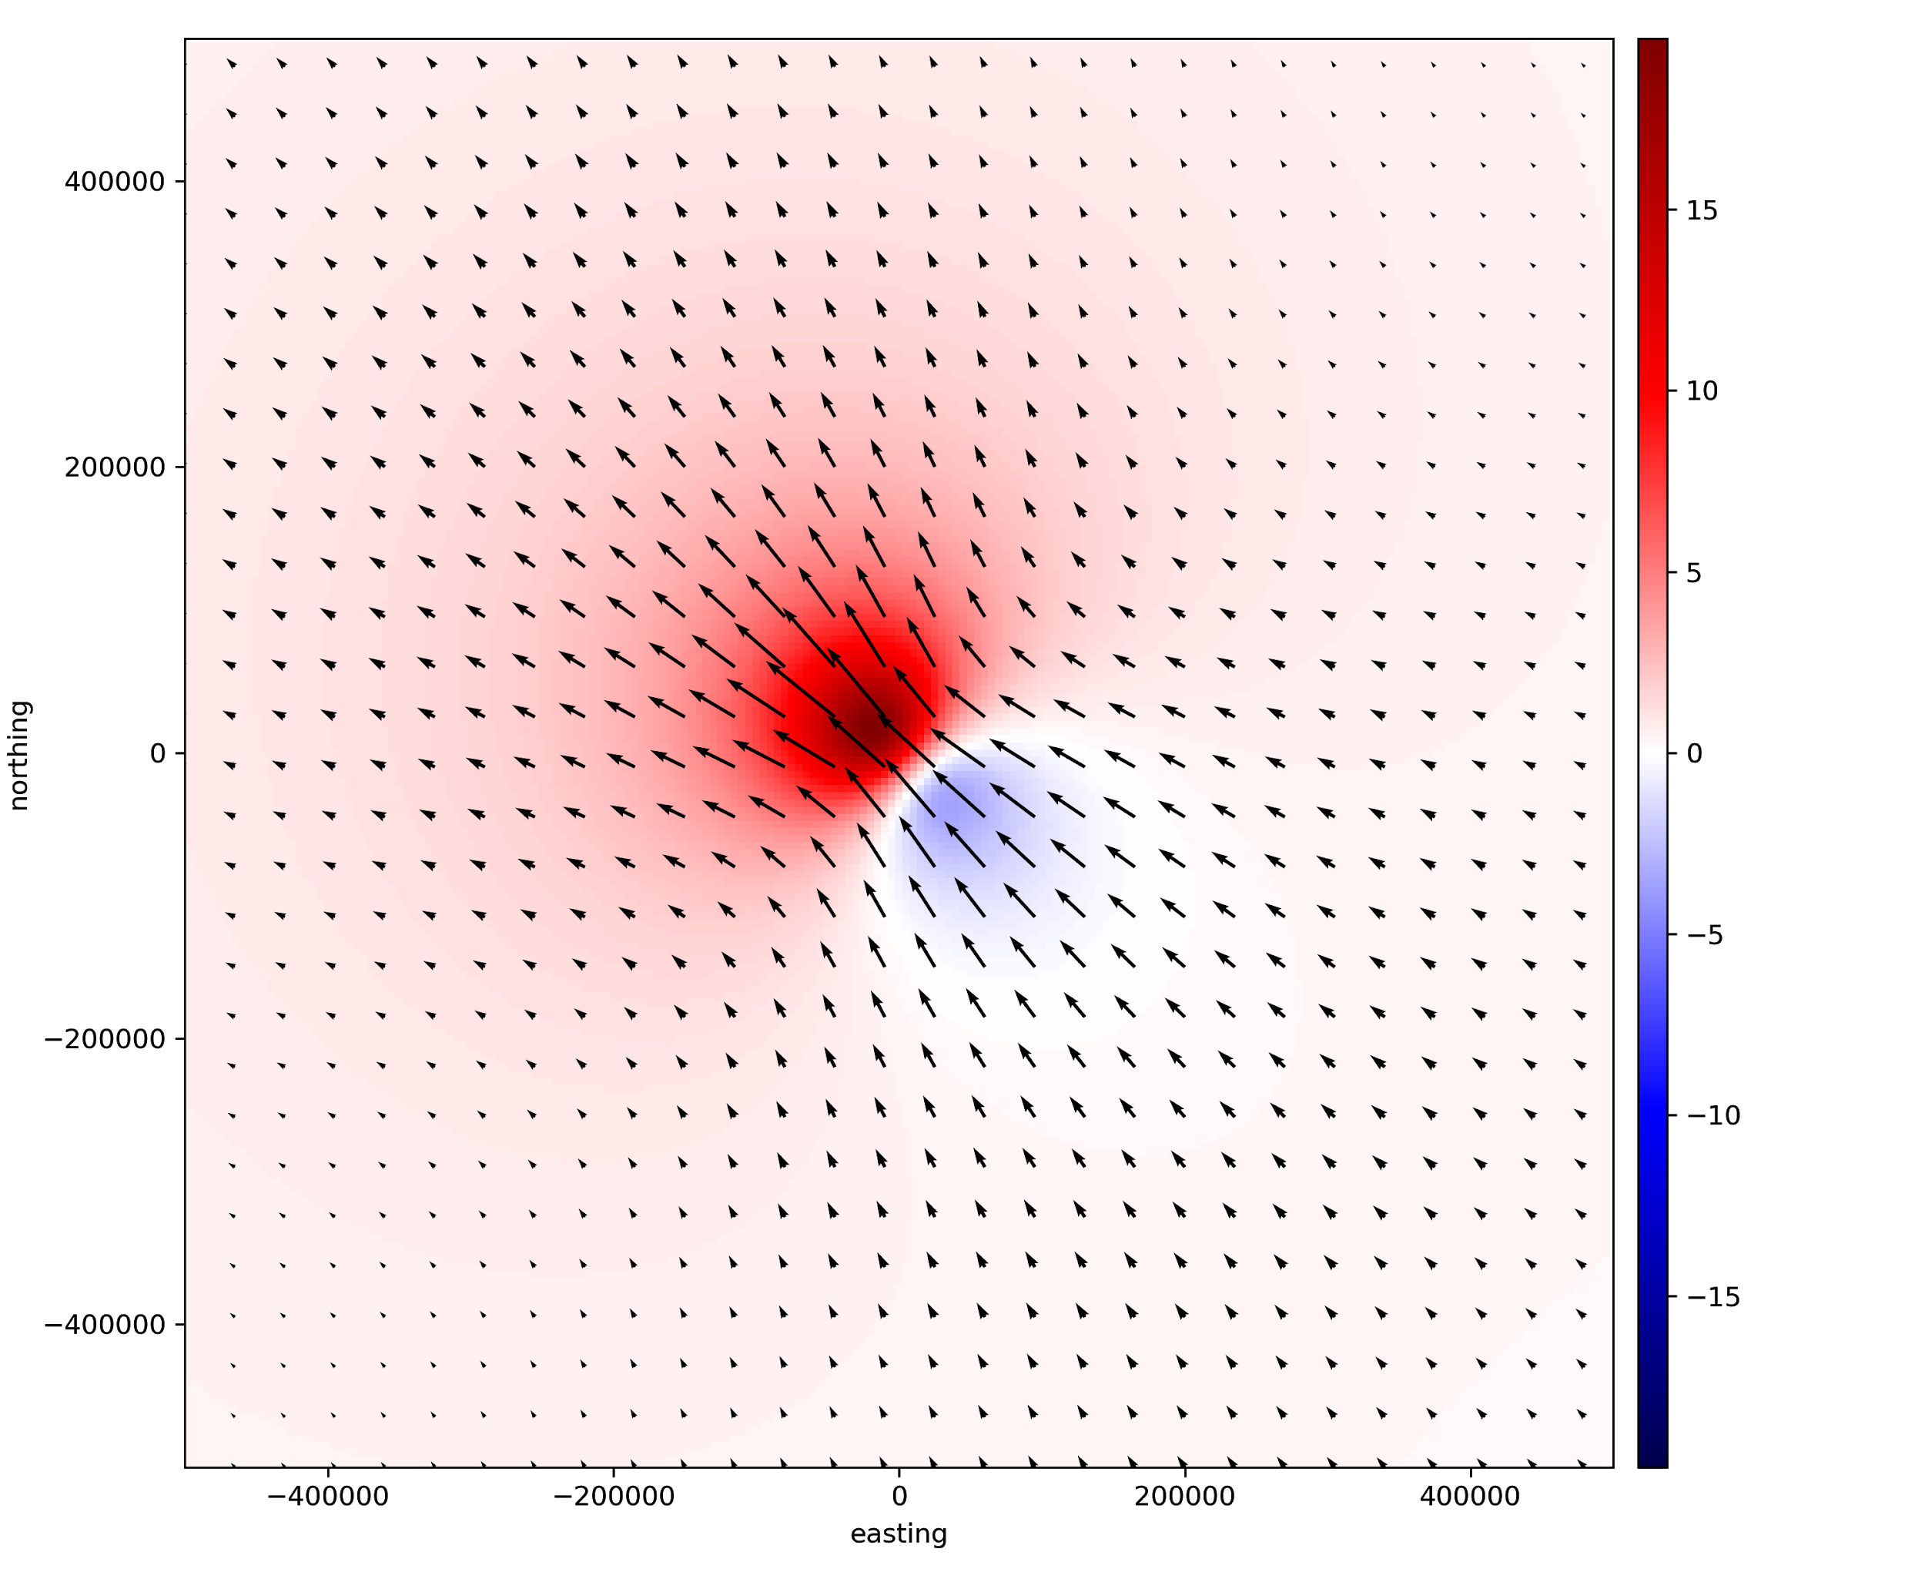
zu = 50km

Slide 16
zu = 50km

Slide 17
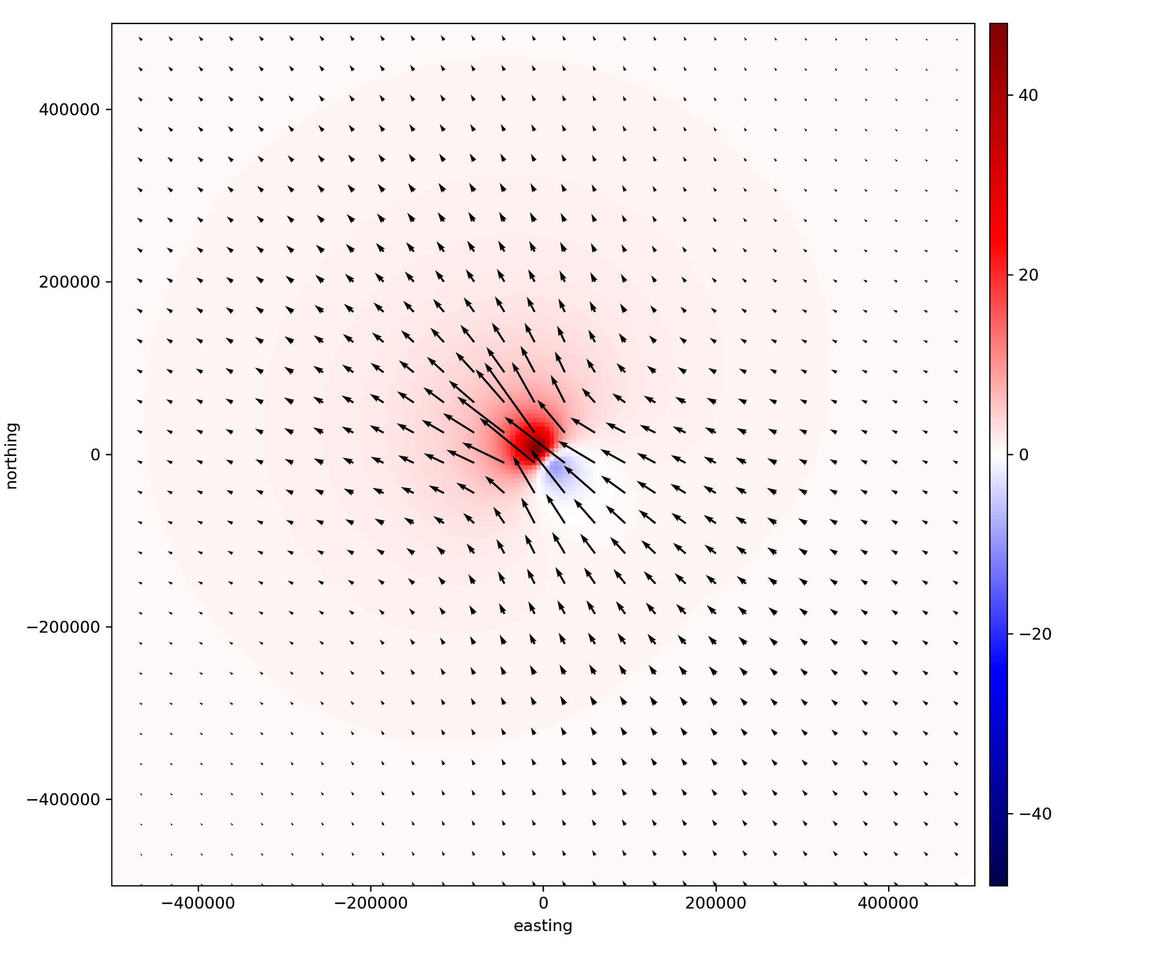
zu = 20km

Slide 18
Inverse problem

Slide 19
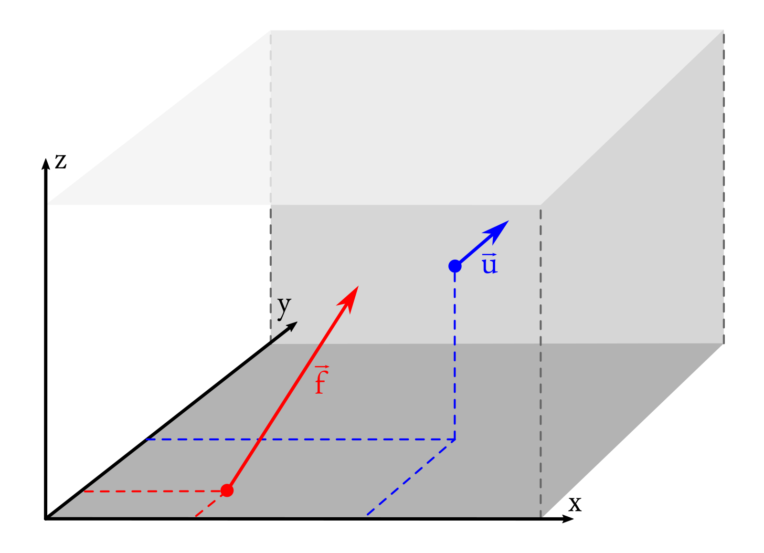
forward problem

Slide 20
inverse problem

Slide 21
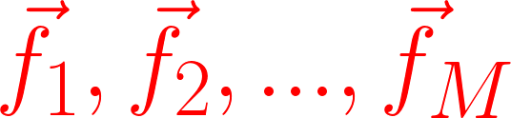

M forces
N displacements

Slide 22
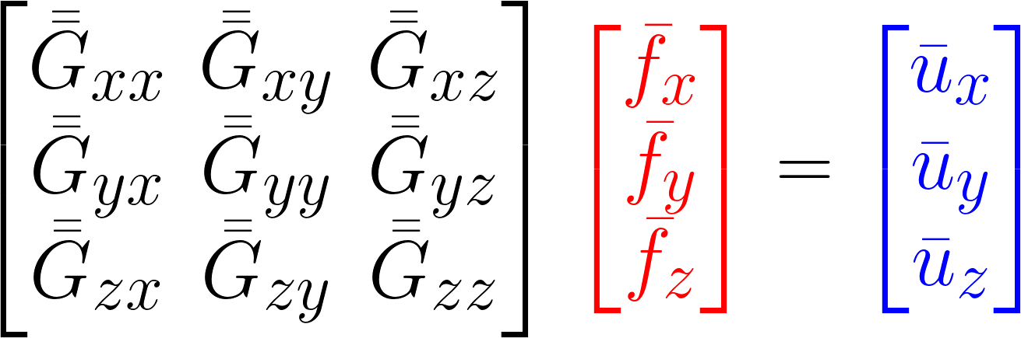
forward problem

Slide 23
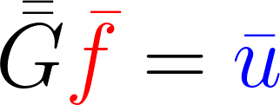
forward problem

Slide 24
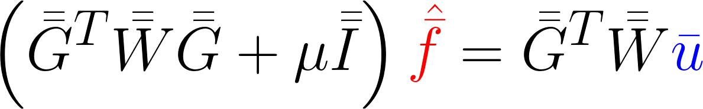
weighted least-squares solution

Slide 25
weighted least-squares solution
regularization

Slide 26
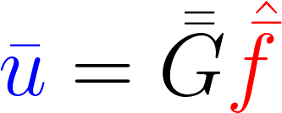
interpolation = forward modeling

Slide 27



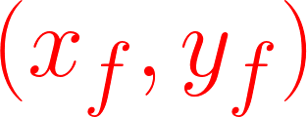
Controlling parameters:
regularization parameter
height of displacements
Poisson's ratio
force locations

Slide 28
Synthetic data

Slide 29
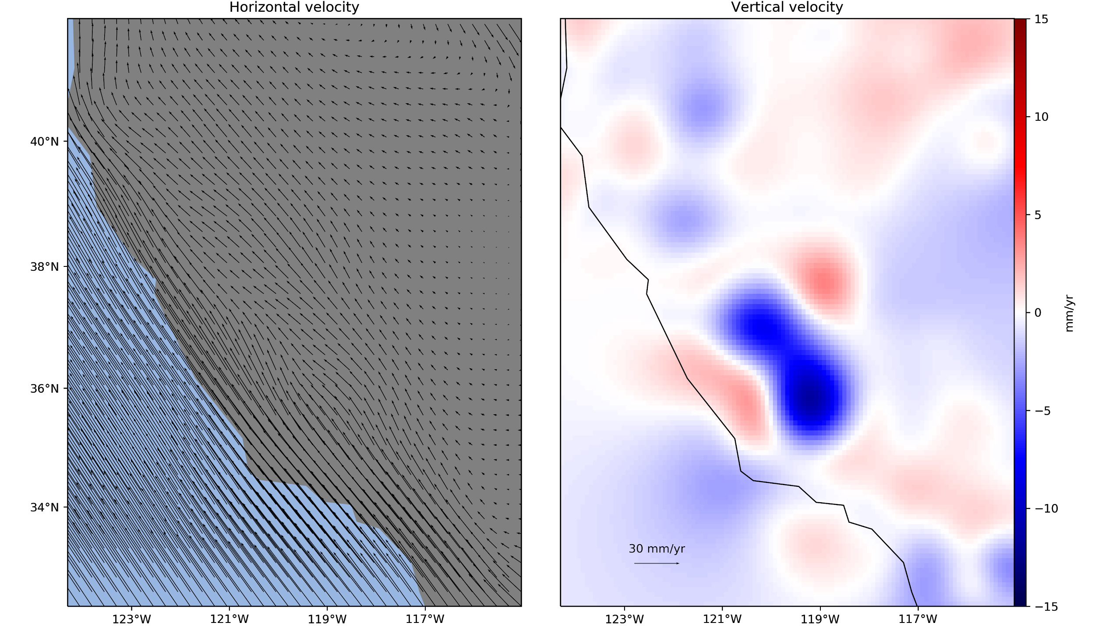

Slide 30
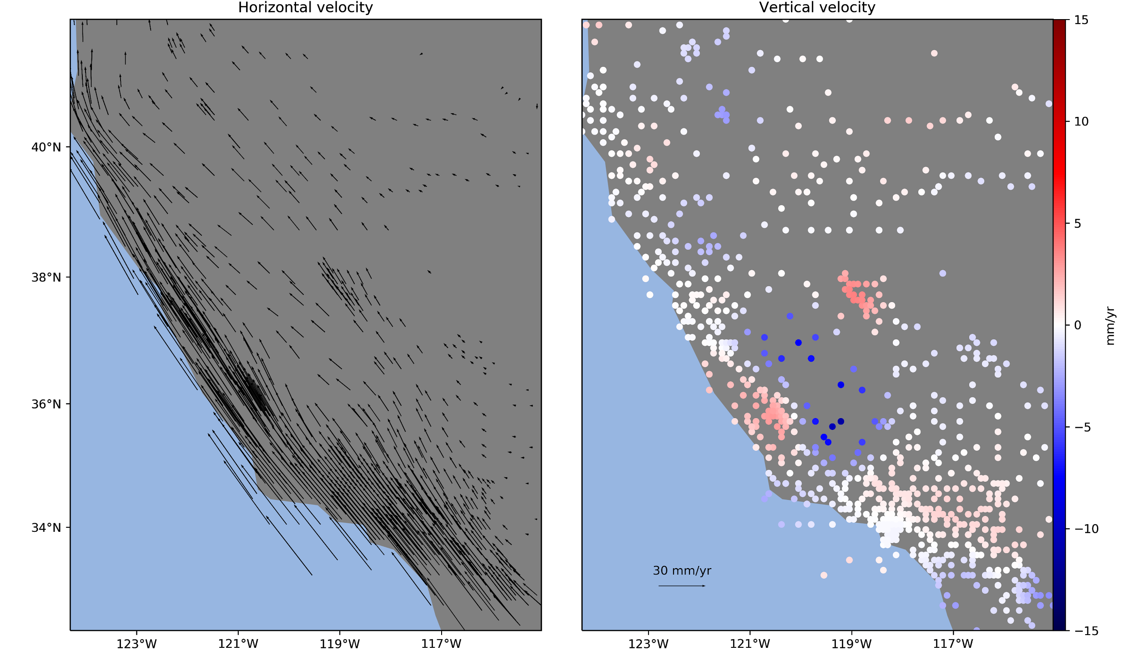
random sample

Slide 31
Controlling parameters:
regularization parameter
height of displacements
Poisson's ratio
force locations
10
100 km
0.5
same as data

Slide 32

gridded solution

Slide 33
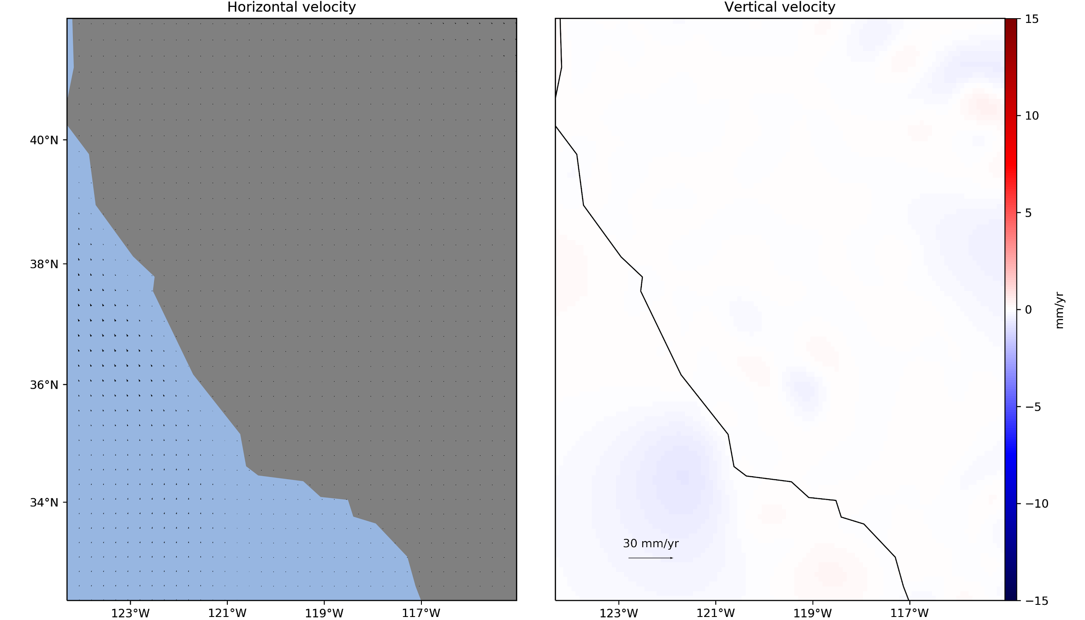
residuals

Slide 34
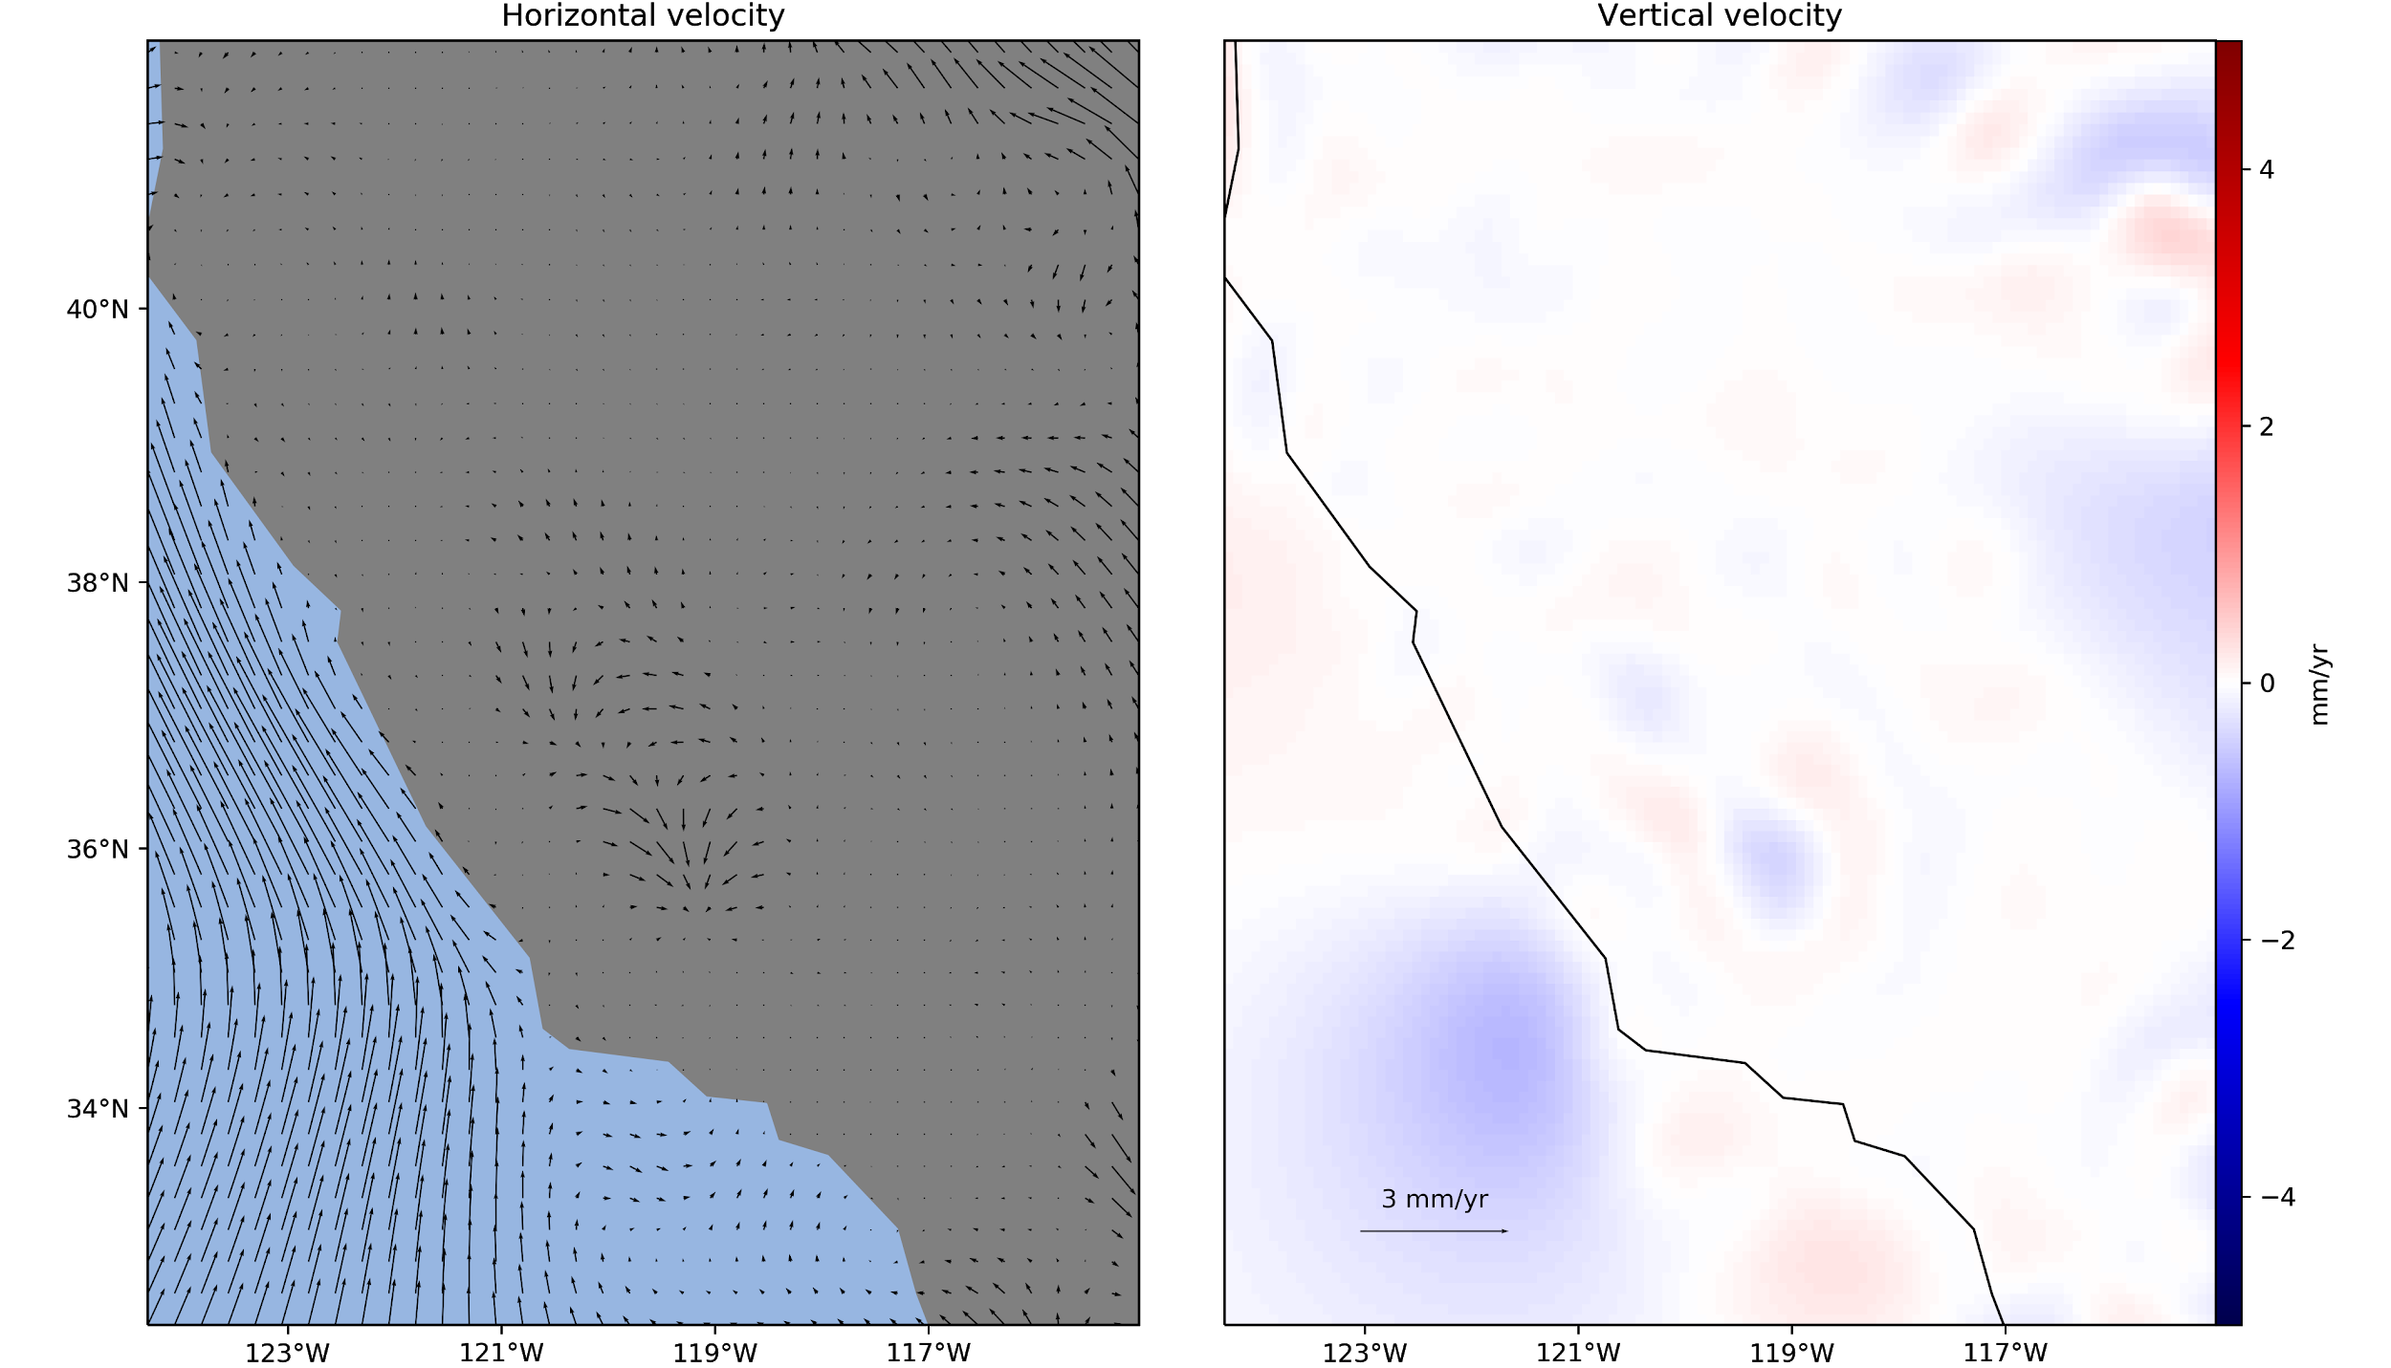
residuals (exaggerated)

Slide 35
Automatic tuning

Slide 36
Controlling parameters:
regularization parameter
height of displacements
Poisson's ratio
force locations

Slide 37
dataset

Slide 38
dataset
70% / 30%
train
test

Slide 39
dataset
70% / 30%
train
test
forces

Slide 40
dataset
70% / 30%
train
test
forces
predict test

Slide 41
dataset
70% / 30%
train
test
R² score
forces
predict test

Slide 42
dataset
70% / 30%
repeat
for parameter combinations
train
test
R² score
forces
predict test

Slide 43
best score
dataset
70% / 30%
repeat
for parameter combinations
train
test
R² score
forces
predict test

Slide 44
best score
dataset
70% / 30%
repeat
for parameter combinations
forces
train
test
R² score
forces
predict test

Slide 45
US West Coast

Slide 46
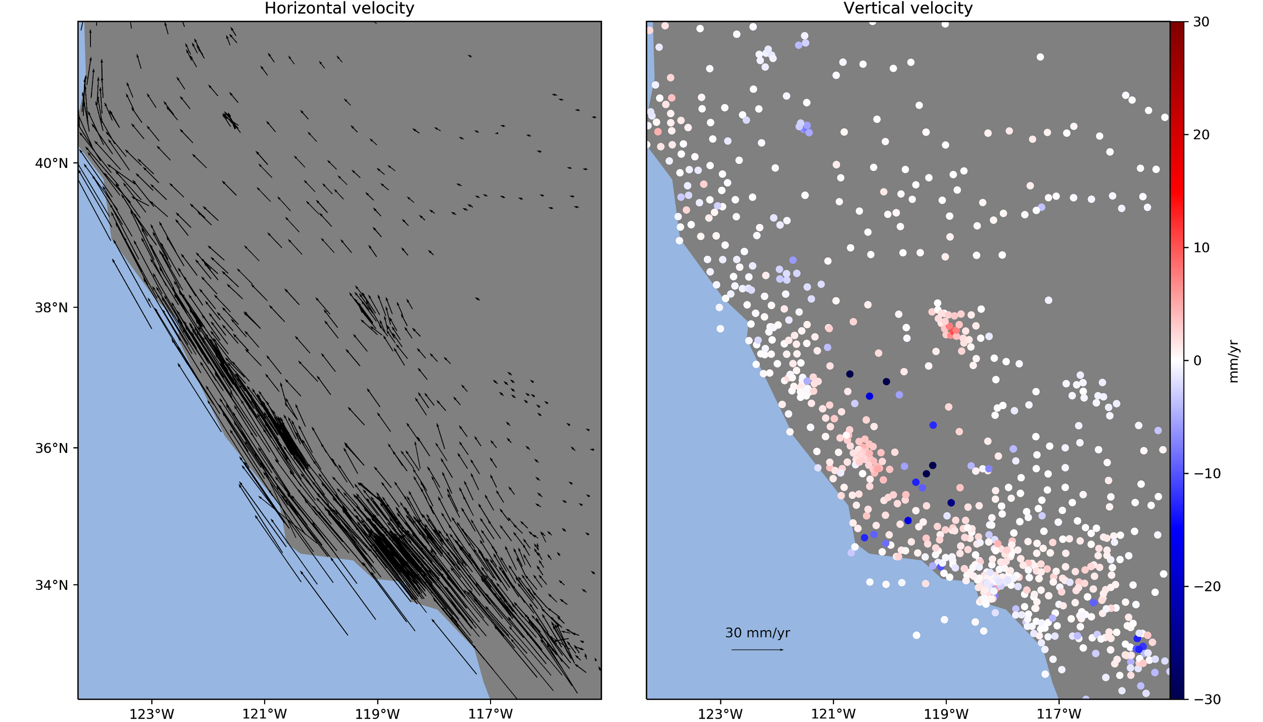
Plate Boundary Observatory 2017 data

Slide 47
Plate Boundary Observatory 2017 data

Slide 48
Plate Boundary Observatory 2017 data

Slide 49
Plate Boundary Observatory 2017 data

Slide 50
Auto-tuned parameters:
configurations tested
regularization parameter
height of displacements
Poisson's ratio
force locations (fixed)
120
50
10 km
0.5
same as data

Slide 51
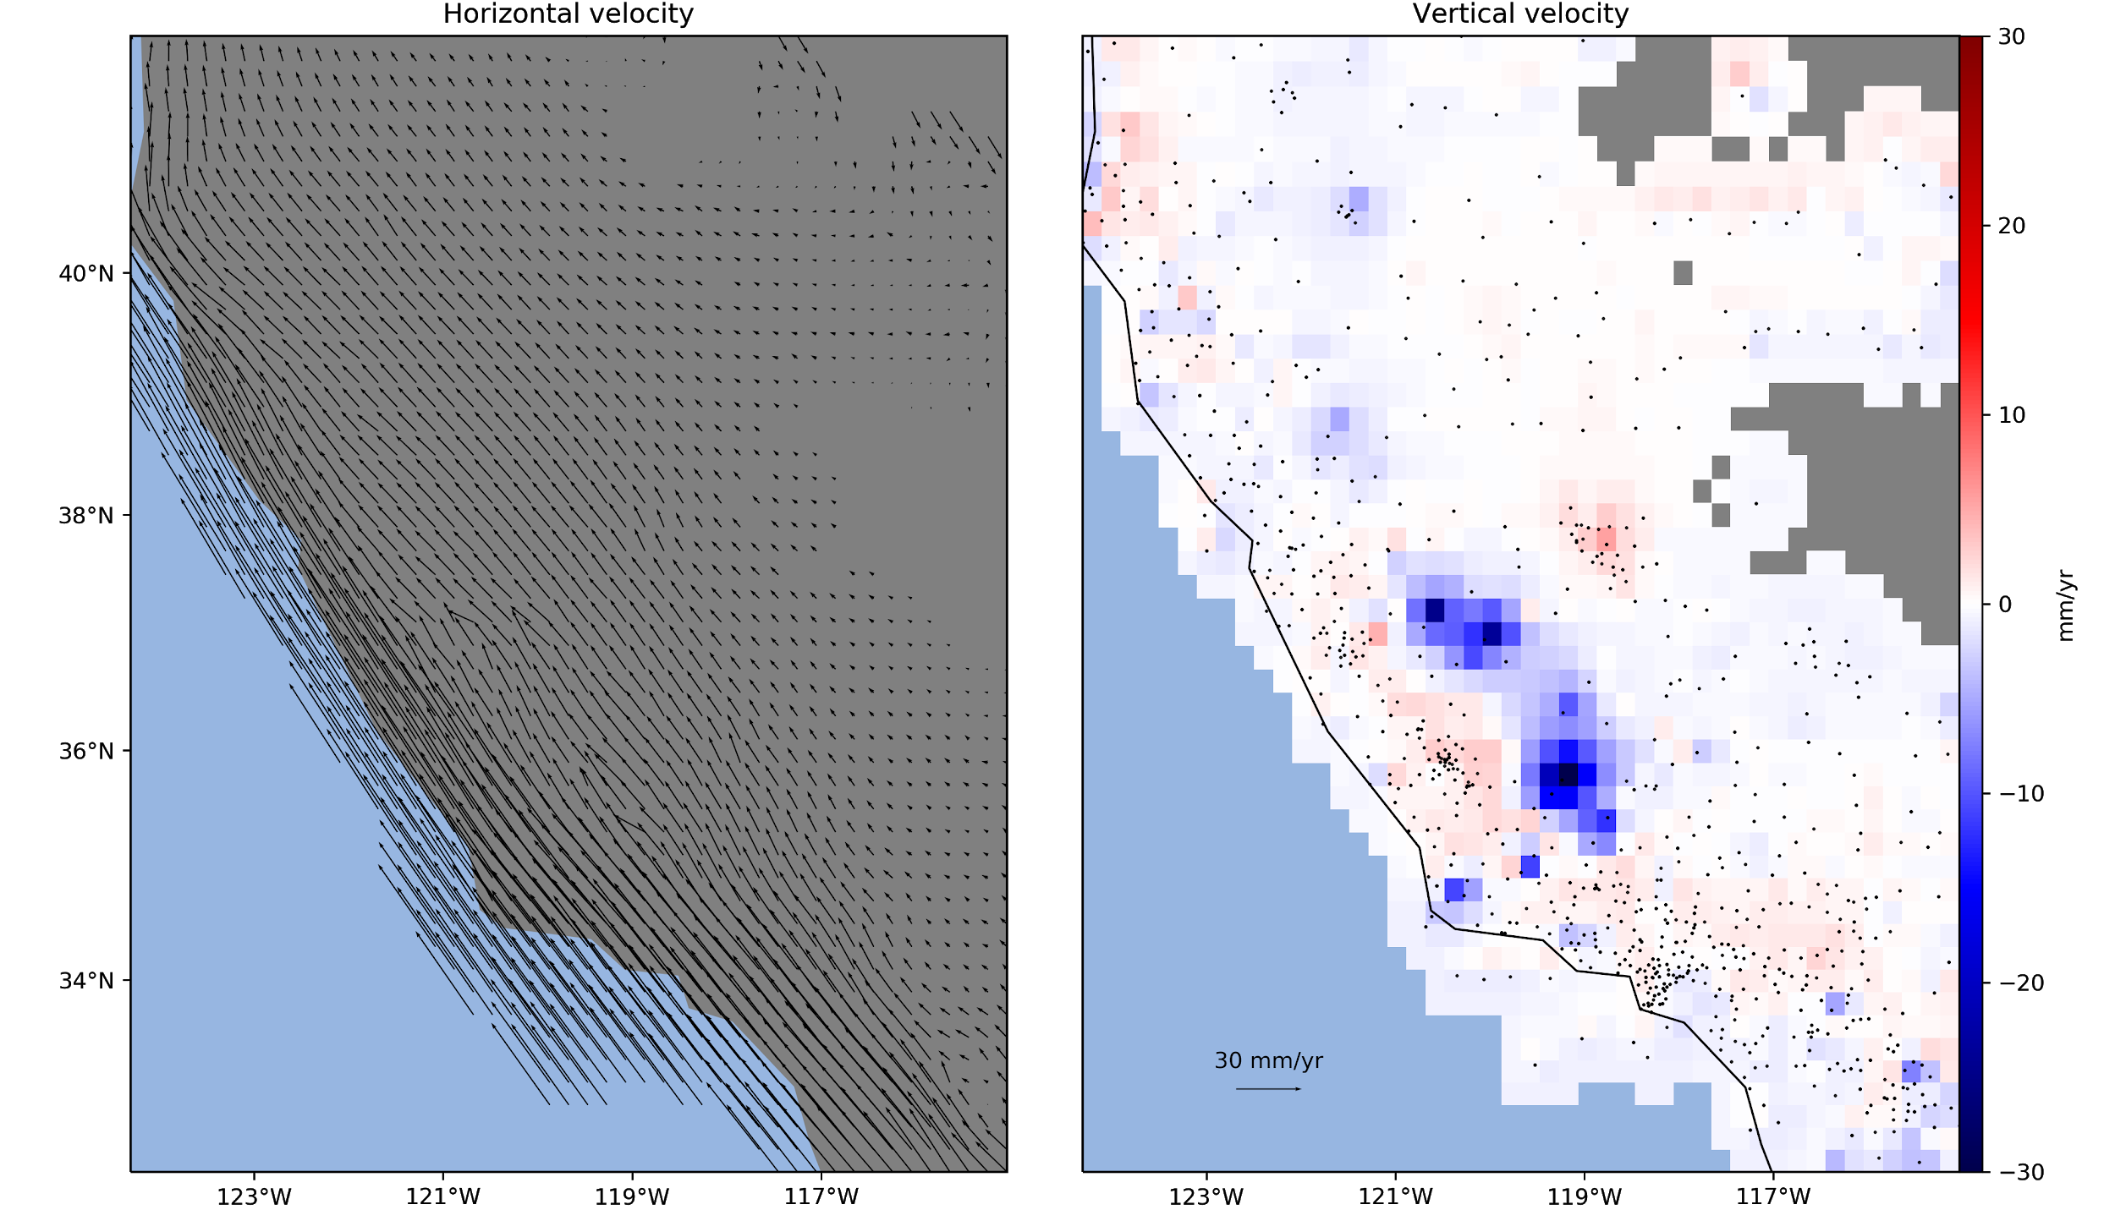

Slide 56
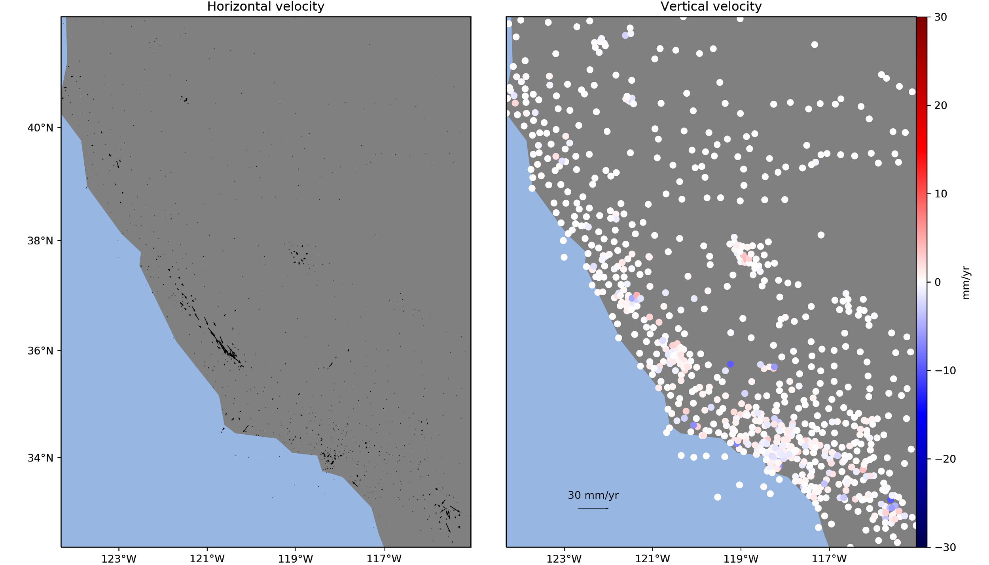
residuals

Slide 57
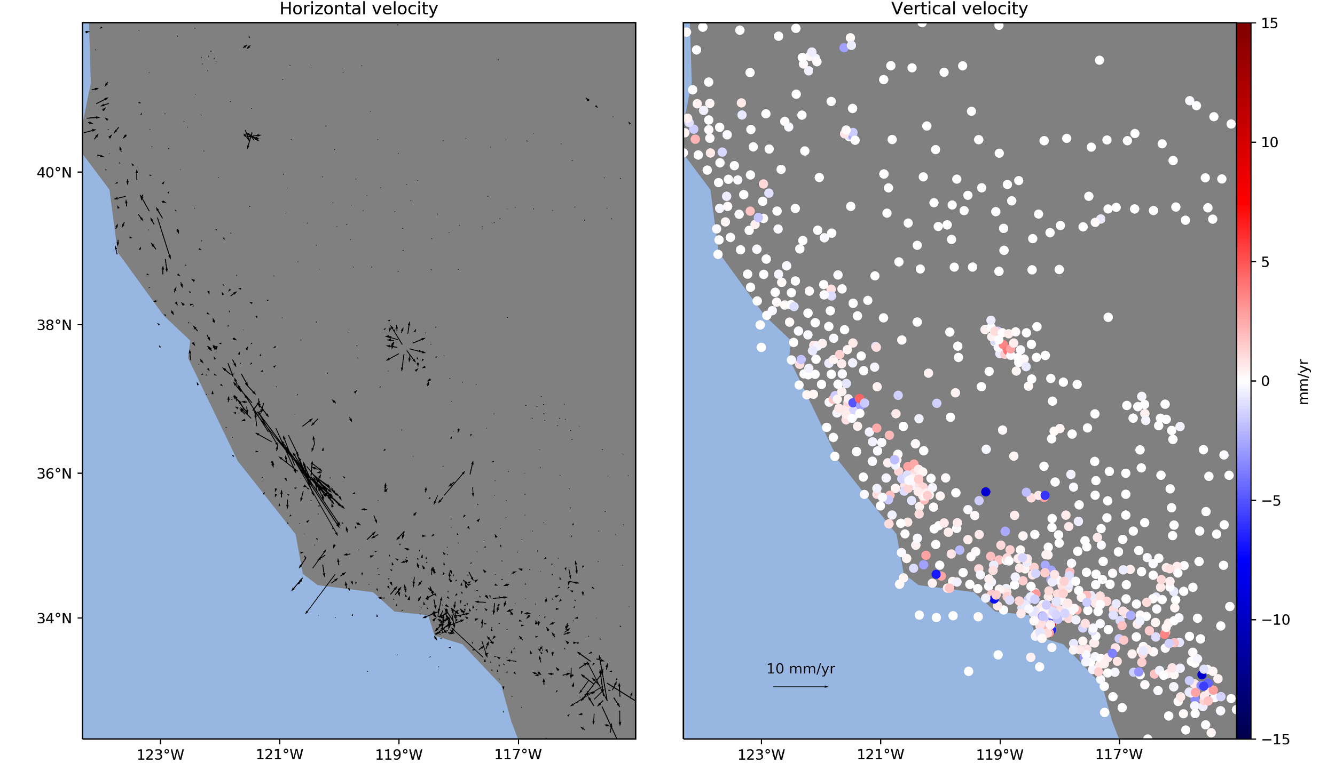
residuals (exaggerated)

Slide 58
residuals (exaggerated)

Slide 59
residuals (exaggerated)

Slide 60
residuals (exaggerated)

Slide 61
Conclusion

Slide 62
Main points:
Joint 3-component interpolation
Slower than other methods
Weighted solution + automatic tuning
Future work:
Placement of forces
Comparison with other methods
Applications to other areas
Faster execution + larger datasets

Slide 63
Main points:
Joint 3-component interpolation
Slower than other methods
Weighted solution + automatic tuning
Future work:
Weights + location of forces
Comparison with other methods
Applications to other areas
Faster execution + larger datasets

Slide 64
Acknowledgements
EarthScope PBO data provided by UNAVCO through the GAGE Facility with support from the National Science Foundation (NSF) and National Aeronautics and Space Administration (NASA) under NSF Cooperative Agreement No. EAR-1261833.
Download slides + source code: www.leouieda.com
Built on the Verde open-source Python library: github.com/fatiando/verde
Feel free to photograph and share this presentation. doi:10.6084/m9.figshare.6387467
SE21-A023 - AOGS - 2018/06/05

