Slide 1


Gravity inversion in spherical coordinates using tesseroids
Leonardo Uieda
Valéria C. F. Barbosa

Slide 2
Cartesian
Spherical
vs

Slide 3
Existing inversion with tesseroids
(Chaves and Ussami, 2013)
Geoid height anomalies
Space domain
Regularization:
  Depth-weighted Minimum Volume
  Similarity to seismic tomography

Slide 4
Adapt
Planting anomalous densities
(Uieda and Barbosa, 2012)

Slide 5
Planting anomalous densities
Space domain
Multicomponent: gravity + gradients
Non-conventional inversion
  Growth algorithm
  No linear systems
  Efficient sensitivity computations

Slide 7
Seed

Slide 19
Synthetics
Possible applications
Advantages
Shortcomings

Slide 20
(Hypothetical) Mantle Plume
Inspired by synthetics in Chaves and Ussami (2013)

Slide 21
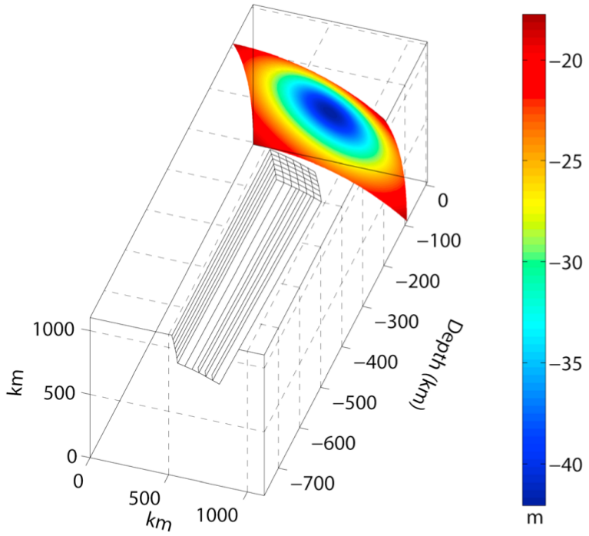
After Chaves and Ussami (2013)

Slide 22
top=100 km
2º
200 km
-50 kg.m⁻³
700 km

Slide 23
gzz at 250 km

Slide 24
Seed

Slide 26
Joint gz + gzz?

Slide 27
Same seed

Slide 28
gzz
gz

Slide 29
gzz
Joint

Slide 30
gzz
Joint

Slide 31
Lineament with dense rocks (magmatic)
Inspired by Chad lineament model
(Braitenberg et al, 2011)

Slide 32
After Braitenberg et al (2011)

Slide 33
After Braitenberg et al (2011)

Slide 34
top=1 km
8km
10º
N
300 kg.m⁻³
2º

Slide 35
gzz
At 20 km

Slide 36
Seeds

Slide 37
observed
predicted

Slide 39
What if height=120 km?

Slide 40
at 20 km
at 120 km

Slide 41
observed
predicted

Slide 42
at 20 km
at 120 km

Slide 43
Even higher height=270 km

Slide 44
at 120 km
at 270 km

Slide 45
observed
predicted

Slide 46
at 120 km
at 270 km

Slide 47
Magmatic underplating
Inspired by model of the Paraná basin by Mariani et al (2013)

Slide 48
After Mariani et al (2013)

Slide 49
After Mariani et al (2013)

Slide 50
top=30 km
10º
10º
5º
15
km
N
200 kg.m⁻³

Slide 51
gzz at 250 km

Slide 52
Seed

Slide 54
What if I use wrong density?

Slide 55
250 kg.m⁻³
150 kg.m⁻³

Slide 56
In conclusion

Slide 58
for tesseroids

Slide 59
single
vs
joint

Slide 60
height matters

Slide 61
correct
correct
dense
dense

Slide 62
Future
Combinations of tensor components
Dipping models (subducting plate)
Real data (open for collaboration)

Slide 63

OPEN SOURCE
fatiando.org
github.com/leouieda/egu2014

