Slide 1


3D gravity inversion by planting anomalous densities
Leonardo Uieda and Valéria C. F. Barbosa
Observatório Nacional
August, 2011

Slide 2
Outline

Slide 3
Outline
Forward Problem

Slide 4
Outline
Forward Problem
Inverse Problem

Slide 5
Outline
Forward Problem
Inverse Problem
Planting Algorithm
Inspired by René (1986)

Slide 6
Outline
Forward Problem
Inverse Problem
Planting Algorithm
Inspired by René (1986)
Synthetic Data

Slide 7
Outline
Forward Problem
Inverse Problem
Planting Algorithm
Inspired by René (1986)
Synthetic Data
Real Data

Slide 8
Forward problem

Slide 9
Surface of the Earth

Slide 10
Surface of the Earth
Observations
of

Slide 11
Surface of the Earth
Observations
of
Group in a vector:
= observed data

Slide 12
= observed data

Slide 13
= observed data
Assume caused by
anomalous sources

Slide 14
= observed data
Assume caused by
anomalous sources
Density contrast =

Slide 15
Parametrize the gravitational effect

Slide 16
Parametrize the gravitational effect
Linearize

Slide 17
Parametrize the gravitational effect
Linearize
Discretize into
M elements
Interpretative model

Slide 18
Parametrize the gravitational effect
Linearize
Discretize into
M elements
Interpretative model
jth element
Right rectangular prisms
Homogeneous density contrast
(Nagy et al., 2000)

Slide 19
Parametrize the gravitational effect
Linearize
Discretize into
M elements
Interpretative model
Arrange M density contrasts in a vector:
Parameter vector

Slide 20
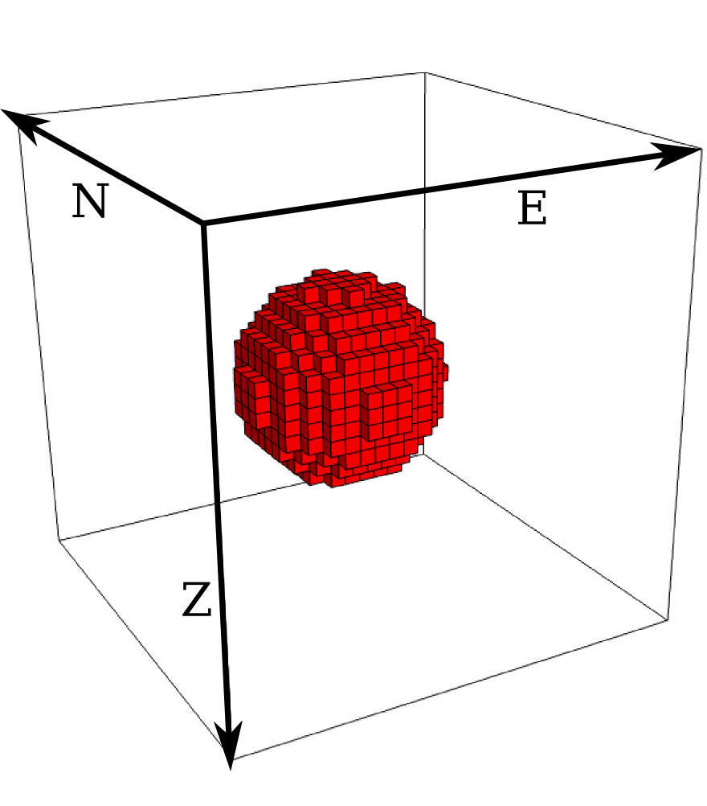
Parametrize the gravitational effect
Discretize into
M elements
Prisms with
not shown

Slide 21
Parametrize the gravitational effect
Discretize into
M elements
Prisms with
not shown

Slide 22
Parametrize the gravitational effect
Predicted data
Discretize into
M elements
Prisms with
not shown

Slide 23
Parametrize the gravitational effect
Predicted data
Discretize into
M elements
Gravitational effect is linear
Prisms with
not shown

Slide 24
Parametrize the gravitational effect
Predicted data
Discretize into
M elements
Gravitational effect is linear
Density contrast of jth prism
Prisms with
not shown

Slide 25
Parametrize the gravitational effect
Predicted data
Discretize into
M elements
Gravitational effect is linear
Effect of prism with unit density
Prisms with
not shown

Slide 26
Parametrize the gravitational effect
Predicted data
Discretize into
M elements
Gravitational effect is linear
Prisms with
not shown

Slide 27
Parametrize the gravitational effect
Predicted data
Discretize into
M elements
Gravitational effect is linear
Parameter vector
Prisms with
not shown

Slide 28
Parametrize the gravitational effect
Predicted data
Discretize into
M elements
Gravitational effect is linear
Jacobian (sensitivity) matrix
Prisms with
not shown

Slide 29
Parametrize the gravitational effect
Predicted data
Discretize into
M elements
Gravitational effect is linear
Column vector of A
Prisms with
not shown

Slide 30
Solved forward problem:

Slide 31
How to do the inverse?
?

Slide 32
Inverse problem

Slide 33
Minimize difference between

Slide 34
Observed data
Minimize difference between

Slide 35
Predicted data
Minimize difference between
and

Slide 36
Minimize difference between
and

Slide 37
Minimize difference between
and
Residual vector

Slide 38
Minimize difference between
and
Residual vector
Data-misfit function:

Slide 39
Minimize difference between
and
Residual vector
Data-misfit function:
ℓ₂-norm of r
Least-squares fit

Slide 40
ill-posed problem
non-existent
non-unique
non-stable

Slide 41
constraints
ill-posed problem
non-existent
non-unique
non-stable

Slide 42
constraints
ill-posed problem
well-posed problem
non-existent
exist
non-unique
unique
non-stable
stable

Slide 43
Constraints:
1. Compact

Slide 44
Constraints:
1. Compact
no holes inside

Slide 45
Constraints:
1. Compact
no holes inside
2. Concentrated around “seeds”

Slide 46
Constraints:
Similar to René (1986)
1. Compact
no holes inside
2. Concentrated around “seeds”

Slide 47
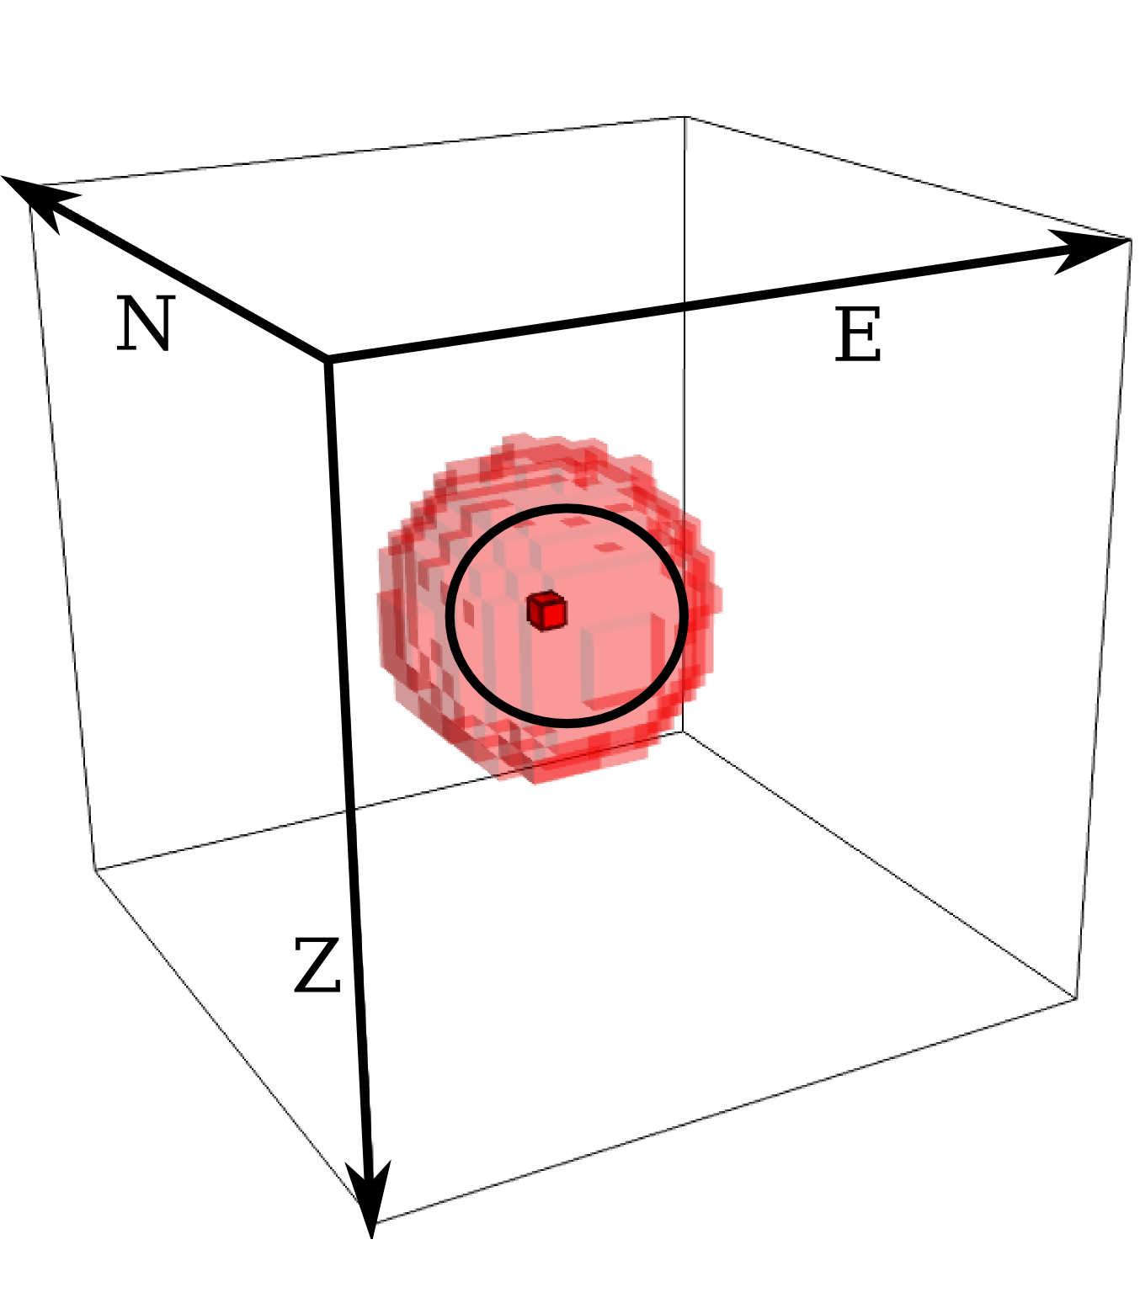
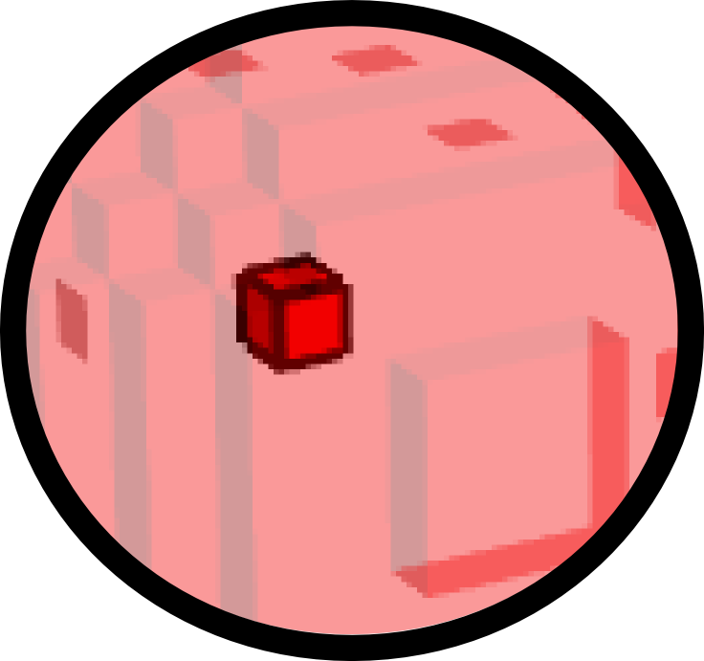
Constraints:
Similar to René (1986)
1. Compact
no holes inside
2. Concentrated around “seeds”
User-specified prisms

Slide 48
Constraints:
Similar to René (1986)
1. Compact
no holes inside
2. Concentrated around “seeds”
User-specified prisms
Given density contrasts

Slide 49
Constraints:
Similar to René (1986)
1. Compact
no holes inside
2. Concentrated around “seeds”
User-specified prisms
Given density contrasts
Any n° of ≠ density contrasts
Not like René (1986)

Slide 50
Constraints:
Similar to René (1986)
1. Compact
no holes inside
2. Concentrated around “seeds”
User-specified prisms
Given density contrasts
Any n° of ≠ density contrasts
3. Only
or
Not like René (1986)

Slide 51
Constraints:
Similar to René (1986)
1. Compact
no holes inside
2. Concentrated around “seeds”
User-specified prisms
Given density contrasts
Any n° of ≠ density contrasts
3. Only
or
Not like René (1986)
4.
of closest seed

Slide 52
constraints
ill-posed problem
well-posed problem
Minimize data misfit
Minimize goal function

Slide 53
constraints
ill-posed problem
well-posed problem
Minimize data misfit
Minimize goal function
Regularizing parameter

Slide 54
constraints
ill-posed problem
well-posed problem
Minimize data misfit
Minimize goal function
Regularizing function

Slide 55
constraints
ill-posed problem
well-posed problem
Minimize data misfit
Minimize goal function
Regularizing function
= tradeoff between fit and regularization

Slide 56
Regularization:

Slide 57
Regularization:
Similar to
Silva Dias et al. (2009)

Slide 58
Regularization:
Similar to
Silva Dias et al. (2009)
= avoid singularity
= distance between jth prism and seed
= how much compactness
(3 to 7)

Slide 59
Regularization:
For
:

Slide 60
Regularization:
For
:
distance from seeds

Slide 61
Regularization:
For
:
distance from seeds
regularizing function

Slide 62
Regularization:
For
:
distance from seeds
regularizing function
Imposes:
Compactness
Concentration around seeds

Slide 63
Constraints:
1. Compact
Regularization
2. Concentrated around “seeds”
3. Only
or
4.
of closest seed

Slide 64
Constraints:
1. Compact
Regularization
2. Concentrated around “seeds”
3. Only
or
Algorithm
4.
of closest seed

Slide 65
Planting Algorithm

Slide 66
Overview:
Based on René (1986)

Slide 67
Overview:
Based on René (1986)
Start with seeds

Slide 68
Overview:
Based on René (1986)
Start with seeds

Slide 69
Overview:
Based on René (1986)
Start with seeds
known density contrast & position

Slide 70
Overview:
Based on René (1986)
Start with seeds
known density contrast & position
All other parameters set to 0

Slide 71
Overview:
Based on René (1986)
Start with seeds
known density contrast & position
All other parameters set to 0
Iteratively grow

Slide 72
Overview:
Based on René (1986)
Start with seeds
known density contrast & position
All other parameters set to 0
Iteratively grow
add neighbor of seed

Slide 73
Overview:
Based on René (1986)
Start with seeds
known density contrast & position
All other parameters set to 0
Iteratively grow
add neighbor of seed
accretion

Slide 74
Overview:
Based on René (1986)
Start with seeds
known density contrast & position
All other parameters set to 0
Iteratively grow
add neighbor of seed
accretion
Controlled by goal function and data misfit function

Slide 75
Algorithm:

Slide 76
Algorithm:
Define interpretative model
Interpretative model

Slide 77
Algorithm:
= observed data
Define interpretative model
Interpretative model

Slide 78
Algorithm:
= observed data
Define interpretative model
All parameters zero
Interpretative model

Slide 79
Algorithm:
= observed data
Define interpretative model
All parameters zero
seeds
Interpretative model

Slide 80
Algorithm:
Define interpretative model
All parameters zero
seeds
Include seeds
Seeds
Prisms with
not shown

Slide 81
Algorithm:
Define interpretative model
All parameters zero
seeds
Include seeds
Compute initial residuals
Prisms with
not shown

Slide 82
Algorithm:
Define interpretative model
All parameters zero
seeds
Include seeds
Compute initial residuals
Residual vector
Prisms with
not shown

Slide 83
Algorithm:
= observed data
Define interpretative model
All parameters zero
seeds
Include seeds
Compute initial residuals
Observed data
Prisms with
not shown

Slide 84
Algorithm:
= observed data
Define interpretative model
All parameters zero
seeds
= predicted data
Include seeds
Compute initial residuals
Predicted by seeds
Prisms with
not shown

Slide 85
Algorithm:
= observed data
Define interpretative model
All parameters zero
seeds
= predicted data
Include seeds
Compute initial residuals
Prisms with
not shown

Slide 86
Algorithm:
= observed data
Define interpretative model
All parameters zero
seeds
= predicted data
Include seeds
Compute initial residuals
Many
Prisms with
not shown

Slide 87
Algorithm:
= observed data
Define interpretative model
All parameters zero
seeds
= predicted data
Include seeds
Compute initial residuals
Prisms with
not shown

Slide 88
Algorithm:
= observed data
Define interpretative model
All parameters zero
seeds
= predicted data
Include seeds
Compute initial residuals
Prisms with
not shown

Slide 89
Algorithm:
= observed data
Define interpretative model
All parameters zero
seeds
= predicted data
Include seeds
Compute initial residuals
Density contrast
of sth seed
Prisms with
not shown

Slide 90
Algorithm:
= observed data
Define interpretative model
All parameters zero
seeds
= predicted data
Include seeds
Compute initial residuals
Column vector
of A
Prisms with
not shown

Slide 91
Algorithm:
= observed data
Define interpretative model
All parameters zero
seeds
= predicted data
Include seeds
Compute initial residuals
Neighbors
Find neighbors of seeds
Prisms with
not shown

Slide 92
Growth:
Prisms with
not shown

Slide 93
Growth:
Try accretion to sth seed:
Prisms with
not shown

Slide 94
Growth:
Try accretion to sth seed:
Choose neighbor:
Prisms with
not shown

Slide 95
Growth:
Try accretion to sth seed:
Choose neighbor:
1. Reduce data misfit
Prisms with
not shown

Slide 96
Growth:
Try accretion to sth seed:
Choose neighbor:
1. Reduce data misfit
2. Smallest goal function
Prisms with
not shown

Slide 97
Growth:
Try accretion to sth seed:
Choose neighbor:
1. Reduce data misfit
2. Smallest goal function
j = chosen
j
Prisms with
not shown

Slide 98
Growth:
Try accretion to sth seed:
Choose neighbor:
1. Reduce data misfit
2. Smallest goal function
j = chosen
(New elements)
j
Prisms with
not shown

Slide 99
Growth:
Try accretion to sth seed:
Choose neighbor:
1. Reduce data misfit
2. Smallest goal function
new predicted data
j = chosen
(New elements)
j
Prisms with
not shown

Slide 100
Growth:
Try accretion to sth seed:
Choose neighbor:
1. Reduce data misfit
2. Smallest goal function
new predicted data
j = chosen
(New elements)
Update residuals
j
Prisms with
not shown

Slide 101
Growth:
Try accretion to sth seed:
Choose neighbor:
1. Reduce data misfit
2. Smallest goal function
new predicted data
j = chosen
(New elements)
Update residuals
j
Prisms with
not shown

Slide 102
Growth:
Try accretion to sth seed:
Choose neighbor:
1. Reduce data misfit
2. Smallest goal function
new predicted data
j = chosen
(New elements)
Update residuals
j
Prisms with
not shown

Slide 103
Growth:
Try accretion to sth seed:
Choose neighbor:
1. Reduce data misfit
2. Smallest goal function
new predicted data
j = chosen
(New elements)
Update residuals
j
Prisms with
not shown

Slide 104
Growth:
Try accretion to sth seed:
Choose neighbor:
1. Reduce data misfit
2. Smallest goal function
new predicted data
j = chosen
(New elements)
Update residuals
j
Prisms with
not shown

Slide 105
Growth:
Try accretion to sth seed:
Choose neighbor:
1. Reduce data misfit
2. Smallest goal function
new predicted data
j = chosen
(New elements)
Update residuals
{
j
Prisms with
not shown

Slide 106
Growth:
Try accretion to sth seed:
Choose neighbor:
1. Reduce data misfit
2. Smallest goal function
new predicted data
j = chosen
(New elements)
Update residuals
j
Prisms with
not shown

Slide 107
Growth:
Try accretion to sth seed:
Choose neighbor:
1. Reduce data misfit
2. Smallest goal function
j = chosen
Update residuals
None found = no accretion
Prisms with
not shown

Slide 108
Growth:
Try accretion to sth seed:
Choose neighbor:
1. Reduce data misfit
2. Smallest goal function
j = chosen
Update residuals
None found = no accretion
Variable sizes
Prisms with
not shown

Slide 109
Growth:
Try accretion to sth seed:
Choose neighbor:
1. Reduce data misfit
2. Smallest goal function
j = chosen
Update residuals
None found = no accretion
Prisms with
not shown

Slide 110
Growth:
Try accretion to sth seed:
Choose neighbor:
1. Reduce data misfit
2. Smallest goal function
j = chosen
(New elements)
Update residuals
None found = no accretion
j
Prisms with
not shown

Slide 111
Growth:
Try accretion to sth seed:
Choose neighbor:
1. Reduce data misfit
2. Smallest goal function
j = chosen
Update residuals
None found = no accretion
At least one seed grow?
Yes
No
Prisms with
not shown

Slide 112
Growth:
Try accretion to sth seed:
Choose neighbor:
1. Reduce data misfit
2. Smallest goal function
j = chosen
Update residuals
None found = no accretion
At least one seed grow?
Yes
No
Prisms with
not shown

Slide 113
Growth:
Try accretion to sth seed:
Choose neighbor:
1. Reduce data misfit
2. Smallest goal function
j = chosen
(New elements)
Update residuals
None found = no accretion
j
At least one seed grow?
Yes
No
Prisms with
not shown

Slide 114
Growth:
Try accretion to sth seed:
Choose neighbor:
1. Reduce data misfit
2. Smallest goal function
j = chosen
(New elements)
Update residuals
None found = no accretion
At least one seed grow?
j
Yes
No
Prisms with
not shown

Slide 115
Growth:
Try accretion to sth seed:
Choose neighbor:
1. Reduce data misfit
2. Smallest goal function
j = chosen
Update residuals
None found = no accretion
j
At least one seed grow?
Yes
No
Prisms with
not shown

Slide 116
Growth:
Try accretion to sth seed:
Choose neighbor:
1. Reduce data misfit
2. Smallest goal function
j = chosen
Update residuals
None found = no accretion
At least one seed grow?
Yes
No
j
Prisms with
not shown

Slide 117
Growth:
Try accretion to sth seed:
Choose neighbor:
1. Reduce data misfit
2. Smallest goal function
j = chosen
Update residuals
None found = no accretion
At least one seed grow?
Yes
No
j
Prisms with
not shown

Slide 118
Growth:
Try accretion to sth seed:
Choose neighbor:
1. Reduce data misfit
2. Smallest goal function
j = chosen
Update residuals
None found = no accretion
At least one seed grow?
Yes
No
j
Prisms with
not shown

Slide 119
Growth:
Try accretion to sth seed:
Choose neighbor:
1. Reduce data misfit
2. Smallest goal function
j = chosen
Update residuals
j
None found = no accretion
At least one seed grow?
Yes
No
Prisms with
not shown

Slide 120
Growth:
Try accretion to sth seed:
Choose neighbor:
1. Reduce data misfit
2. Smallest goal function
j = chosen
Update residuals
None found = no accretion
j
At least one seed grow?
Yes
No
Prisms with
not shown

Slide 121
Growth:
Try accretion to sth seed:
Choose neighbor:
1. Reduce data misfit
2. Smallest goal function
j = chosen
Update residuals
None found = no accretion
At least one seed grow?
Yes
No
Prisms with
not shown

Slide 122
Growth:
Try accretion to sth seed:
Choose neighbor:
1. Reduce data misfit
2. Smallest goal function
j = chosen
Update residuals
None found = no accretion
At least one seed grow?
Yes
No
Prisms with
not shown
Done!

Slide 123
Advantages:
Compact & non-smooth
Any number of sources
Any number of different density contrasts
No large equation system
Search limited to neighbors

Slide 124
Remember equations:
Initial residual
Update residual vector

Slide 125
Remember equations:
Initial residual
Update residual vector
No matrix multiplication (only vector +)

Slide 126
Remember equations:
Initial residual
Update residual vector
No matrix multiplication (only vector +)
Only need some columns of A

Slide 127
Remember equations:
Initial residual
Update residual vector
No matrix multiplication (only vector +)
Only need some columns of A
Calculate only when needed

Slide 128
Remember equations:
Initial residual
Update residual vector
No matrix multiplication (only vector +)
Only need some columns of A
Calculate only when needed
& delete after update

Slide 129
Remember equations:
Initial residual
Update residual vector
No matrix multiplication (only vector +)
Only need some columns of A
Calculate only when needed
& delete after update
Lazy evaluation

Slide 130
Advantages:
Compact & non-smooth
Any number of sources
Any number of different density contrasts
No large equation system
Search limited to neighbors

Slide 131
Advantages:
Compact & non-smooth
Any number of sources
Any number of different density contrasts
No large equation system
Search limited to neighbors
No matrix multiplication (only vector +)
Lazy evaluation of Jacobian

Slide 132
Advantages:
Compact & non-smooth
Any number of sources
Any number of different density contrasts
No large equation system
Search limited to neighbors
No matrix multiplication (only vector +)
Lazy evaluation of Jacobian
Fast inversion + low memory usage

Slide 133
Synthetic Data

Slide 135
Sources = 1 km X 1 km X 1 km

Slide 136
Sources = 1 km X 1 km X 1 km

Slide 137
Sources = 1 km X 1 km X 1 km

Slide 138
Sources = 1 km X 1 km X 1 km

Slide 139
Sources = 1 km X 1 km X 1 km

Slide 140
Sources = 1 km X 1 km X 1 km
Data set = 375 observations

Slide 141
Sources = 1 km X 1 km X 1 km
Data set = 375 observations
Area = 5 km X 3 km

Slide 142
Sources = 1 km X 1 km X 1 km
Data set = 375 observations
Area = 5 km X 3 km
0.05 mGal Gaussian noise

Slide 143
Interpretative model = 151,875 prisms
Prisms = 66.7 m X 66.7 m X 66.7 m

Slide 144
Used 2 seeds

Slide 145
Used 2 seeds
Placed in center of sources

Slide 146
Used 2 seeds
Placed in center of sources
With corresponding density contrasts

Slide 147
Used 2 seeds
Placed in center of sources
With corresponding density contrasts

Slide 148
Used 2 seeds
Placed in center of sources
With corresponding density contrasts

Slide 149
Inversion result

Slide 150
Inversion result

Slide 151
compact
Inversion result
concentrated around seeds
recover correct geometry of sources

Slide 152
Predicted data
compact
Inversion result
concentrated around seeds
recover correct geometry of sources

Slide 153
Observed data
Predicted data
compact
Inversion result
concentrated around seeds
recover correct geometry of sources

Slide 154
Observed data
Predicted data
compact
Inversion result
concentrated around seeds
recover correct geometry of sources
fits observations

Slide 155
Observed data
Predicted data
375 data
On laptop with 2.0 GHz
151,875 prisms
Total time

Slide 156
Real Data

Slide 157
After Carminatti et al. (2003)

Slide 158
Cana Brava complex (CBC)
After Carminatti et al. (2003)

Slide 159
Cana Brava complex (CBC) & Palmeirópolis sequence (PVSS)
After Carminatti et al. (2003)

Slide 160
Cana Brava complex (CBC) & Palmeirópolis sequence (PVSS)
Outcropping
North of Goiás
Tocantins Province
Amazonian & São Francisco cratons
After Carminatti et al. (2003)

Slide 161
Cana Brava complex (CBC) & Palmeirópolis sequence (PVSS)
Gravimetric data:
132 observations
Residual Bouguer
Max 45 mGal
After Carminatti et al. (2003)

Slide 162
Cana Brava complex (CBC) & Palmeirópolis sequence (PVSS)
Previous interpretation:
Carminatti et al. (2003)
PVSS
CVC
Max depth
After Carminatti et al. (2003)

Slide 163
Cana Brava complex (CBC) & Palmeirópolis sequence (PVSS)
Previous interpretation:
Carminatti et al. (2003)
PVSS
CVC
Max depth
Test this hypothesis
After Carminatti et al. (2003)

Slide 164
Assign seeds
Assign seeds
Green:
Blue:
Red:
Total = 269

Slide 165
Interpretative model
Size: 120 km X 50 km X 11 km
Prism size: 500 m X 500 m X 575 m
480,000 prisms

Slide 166
Inversion result

Slide 167
Inversion result

Slide 168
Inversion result
Observed data
Predicted data

Slide 169
Inversion result

Slide 170
Inversion result

Slide 171
Inversion result

Slide 172
Inversion result

Slide 173
Inversion result

Slide 174
Inversion result

Slide 175
Inversion result
Max depth
Compact
Agree with previous interpretation
Fits observations

Slide 176
Inversion result
132 data
On laptop with 2.0 GHz
480,00 prisms
Total time

Slide 177
Conclusions

Slide 178
Conclusions
New 3D gravity inversion
Multiple sources
Interfering gravitational effects
Abrupt density-contrast distribution
No matrix multiplication
No need to solve large linear systems
Ideal for: ore bodies, intrusions, salt domes, etc

Slide 179
Previous and future work
Developed for gravity gradients
Presented at EAGE 2011 preliminary results
To be presented at SEG 2011:
  Final results
  Robust method to handle non-targeted sources

Slide 180
Thank you

